Slide 1
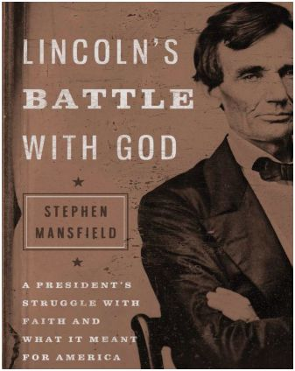
The Faith Journey of Abraham Lincoln
From atheist to (almost) Presbyterian

Slide 2
Lincoln’s Mother was a primary source of his intellectual character
Mother, Nancy Lincoln, was herself born poor and out of wedlock, but nurtured her children in a Christian home. She struggled with depression.
But, Nancy Lincoln nurtured Abraham’s intellect, and taught him to “worship God”
Nancy died of “milk sickness” when Abraham was only nine years old (1818).
Abraham suffered serious depression much of his life and the “thought of rain falling on graves.”

Slide 3
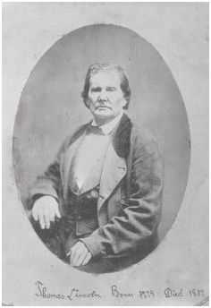
Stern Father Shaped Lincoln’s Hostility Toward God and Religion
Abraham’s father, Thomas, never appreciated his son’s intellect.
Was a “full throated Hard Shell Baptist”
When Abraham was 21 years old, he left home (at the earliest legal opportunity) and never returned.
“You are right, my father was a member of the Baptist church, but I am not.” President Lincoln, 1863.

Slide 4
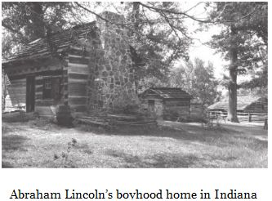
Early Childhood Shaped Lincoln’s Hostility Toward God and Religion
Lincoln’s childhood was filled with hard physical labor, even as he pursued his education and loved books.
Lincoln was influenced by religious skeptics in his readings:
  Ethan Allen, “Reason, the Only Oracle of Man
  Thomas Paine, “The Age of Reason”
“We perceive, with pain and fearful apprehension, a general dereliction of religious principle and practice…impiety and contempt of the laws and institutions of religion…abounding infidelity…Atheism.”
--1798 General Assembly of the Presbyterian Church

Slide 5
Lincoln as a young man in New Salem, Illinois attacked Christianity
“Christ is a bastard”
“The Bible is a book of contradictions”
Lincoln wrote a “book” or “extended essay” attacking the divinity of Christ and exposing Biblical contradictions.
His friend and employer, Samuel Hill, knew Lincoln had a bright future and protected him by burning all copies before he could have it published.
Lincoln publically attacked Peter Cartwright (Methodist minister who mixed politics and religion) accusing thus: “a most abandoned hypocrite…hoodwinking… and ridiculing a priest-ridden people”

Slide 6
Lincoln’s Depression
At 26, a friend, Ann Rutledge, died and Lincoln became depressed.
Friends removed knives and razors from his quarters because the feared he would kill himself.
Three years later, he wrote a poem: “The Suicide’s Soliloquy”: excerpt:
  “Yes! I’ve resolved the deed to do,
  And this place to do it:
  This heart I’ll rush a dagger through
  Thou I in hell should rue it!”
Lincoln would suffer repeatedly from depression, which he called his “hypo.”

Slide 7
Religious “Infidelity” hurt Lincoln’s early political career
Did not receive Whig party nomination for 7th District congressional race in 1843.
Lincoln wrote “…it was everywhere contended that no Christian ought to go for me, because I belonged to no church.”

Slide 8
Did Lincoln lie about his religious views to get votes?
In 1846, Lincoln ran against Peter Cartwright (the Methodist minister he earlier criticised) in the general election for the 7th House District of Illinois.
Cartwright quoted Lincoln’s criticisms of Christianity in the campaign.
Lincoln wrote a handbill in defense which said:
“That I am not a member of any Christian Church, is true, but I have never denied the truth of the Scripture; and I have never spoken with intentional disrespect of religion in general, or of any denomination of Christians in particular.”
So, Lincoln lied to voters in this instance for political purposes!
He defeated Cartwright in 1846.

Slide 9
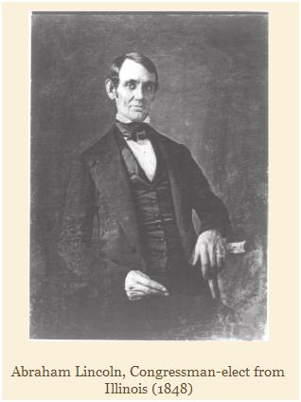
1849—Influence of Rev. James D. Smith
Lincoln was in Lexington, Kentucky in 1949 at Robert Todd’s house (his father-in-law)
Robert Todd had died and Lincoln was acting as executor of his estate.
Todd had extensive personal library, and Lincoln read many of these books, scribbling comments in them.
Lincoln was drawn to a book written by the pastor of First Presbyterian Church, of Springfield, Illinois.

Slide 10
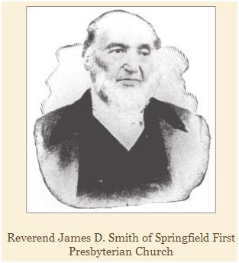
Rev. James D. Smith, Pastor of First Presbyterian Church, Springfield, Ill.
Smith founded Cumberland College in Lebanon, Tennessee
Famous for religious debates including one lasting 18 nights with skeptic C. G. Olmsted.
Rev. James D. Smith wrote a book defending Christianity against secular reason:
The Christian’s Defence,” by James D. Smith
Containing a Fair Statement, and Impartial Examination of the Leading Objections Urged by Infidels Against the Anitquity, Genuineness, Credibility and Inspiration of the Holy Scriptures; Enriched with Copious Extracts from Learned Authors.”

Slide 11
Lincoln and “The Christian’s Defence”
In 1849, Lincoln finished his term in Congress and returned to Springfield.
He immediately contacted Rev. James Smith, and held discussions about the arguments in his book.
Lincoln would cite the book (and recommend it) repeatedly to others throughout remaining life.
Lincoln attended First Presbyterian with his wife Mary Todd, paid for his pew, and donated regularly to the church’s ministries (and those of other churches too).
Mary joined First Presbyterian in 1852, but Abraham never formally joined a church during his lifetime.

Slide 12
Lincoln’s Faith in the 1850’s
Lincoln’s friends doubted that he accepted Christian Theology at this time.
Lincoln “tried to be a believer, but his reason could not grasp and solve the great problem of redemption as taught.” -- friend Joshua Speed.
“Probably it is to be my lot to go on in a twilight, feeling and reasoning my way through life, as questioning, doubting Thomas did. But in my poor maimed, withered way, I bear with me, as I go on, a seeking spirit of desire for a faith that was with him of olden time, who in his need, as I in mind, exclaimed: ‘Help thou my unbelief.’” – Lincoln, to a friend’s mother.
However, his attitudes had softened.
William Herndon, Lincoln’s law partner in Springfield: “in later life, Lincoln believed in God, would go to church as other men do, and was a deeply and thoroughly religious man.”
Others believed he was simply acquiescing to his wife’s Christianity and, more importantly, to political realities.

Slide 13
Lincoln’s Farewell Address in Springfield, 1861 – leaving for Washington
My friends— No one, not in my situation, can appreciate my feeling of sadness at this parting. To this place, and the kindness of these people, I owe every thing. Here I have lived a quarter of a century, and have passed from a young to an old man. Here my children have been born, and one is buried. I now leave, not knowing when, or whether ever, I may return, with a task before me greater than that which rested upon Washington. Without the assistance of that Divine Being, who ever attended him, I cannot succeed. With that assistance I cannot fail. Trusting in Him, who can go with me, and remain with you and be every where for good, let us confidently hope that all will yet be well. To His care commending you, as I hope in your prayers you will commend me, I bid you an affectionate farewell.

Slide 14
Lincoln’s Religious Language as President
Seems to acknowledge a Divine Being.
Avoids the word “Christ”
Frequency of invoking God in his speeches increased markedly during his trials as President.
Critics continued to accuse Lincoln of hypocrisy and political convenience in his references to religion.
Lincoln was repulsed from organized religion by pettiness over such issues as “dancing” and, especially, the defense of slavery by southern churches.

Slide 15
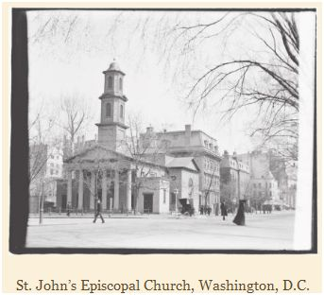
Lincoln and Church in Washington
Lincoln’s first full day in Washington, Feb. 24th, 1861, he attended church with William Henry Seward at St. John’s Episcopal near the White House. That day, Mary attended First Presbyterian nearby.

Slide 16
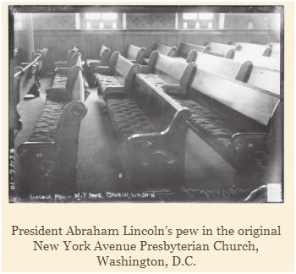
The Lincoln’s chose New York Avenue Presebyterian, three blocks from WH
Dr. Phineas Gurley, Pastor, was prominent former chaplain of the U.S. Senate
“The fact is, I don’t like to hear cut and dried sermons. No, when I hear a man preach, I like to see him act as if he were fighting bees!” --Lincoln
Pew B-14, same as that used by President Buchanan

Slide 17
Lincoln at N.Y Ave. Presb.
Lincoln donated money and attended nearly weekly, but never joined the church (as Mary did).
Was criticized as engaging in “crass political theater” by attending.
But, Lincoln also frequently attended Thursday evening prayer meetings there!
President told Rev. Gurley that “he had received great comfort from the meetings.”

Slide 18
Lincoln’s Support of Religion as President
Called for and funded military chaplains
Supported YMCA involvement with troops
Approved a bill that placed “In God We Trust” on a coin for the first time
Reversed and reprimanded Gen. Grant for expelling all the Jews from his department.
Eagerly supported bill establishing “a day of Public humiliation, prayer and fasting” a month after defeat at Battle of Bull Run 1861.

Slide 19
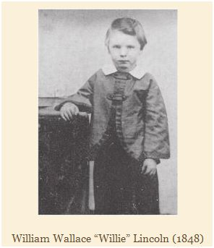
Death of Willie, 1862
Lincoln adored and spoiled his children, explicitly to give them fatherly love had missed himself as a child.
Son Willie died of smallpox, Feb. 20, 1862.
“My poor boy, he was too good for this Earth. God has called him home. I know that he is much better off in heaven, but then we loved him so. It is hard, hard to have him die!” --Lincoln’s words while viewing Willie’s body in private according to witness.
Lincoln, in deep grief, met with several clergy and discussed afterlife:
  Dr. Gurley, N.Y. Ave. Presb.
  Rev. James Smith, Springfield 1st Presb.
  Rev. Noyes Miner, Baptist pastor, Springfield
  Dr. Frances Vinton, Trinity Presb., N. Y. City

Slide 20
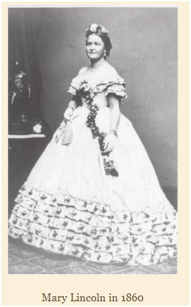
Mary Todd Lincoln engaged in the Occult after her son’s death
Occult and seances became popular in the U.S. in the 1840’s and following.
Abraham was concerned about Mary’s involvement with the occult, and tried to debunk the quacks calling on her.
Lincoln invited a reporter to participate with him in a séance with Charles Shockle (April 1863). Lincoln was unmoved, and his ridicule was reflected in the subsequent newspaper article.
Thus, President Lincoln publically supported mainline religions, but ridiculed unorthodox spiritulism.

Slide 21
Lincoln told his Cabinet, Sept. 22, 1862 that Emancipation Proclamation was a bargain with God
“When the rebel army was at Frederick, I determined, as soon as it should be driven out of Maryland, to issue a Proclamation of Emancipation such as I thought most likely to be useful. I said nothing to any one; but I made the promise to myself, and (hesitating a little)— to my Maker. The rebel army is now driven out, and I am going to fulfill that promise.” --Lincoln, according to the diary of Salmon Chase, Secretary of the Treasury.
“he remarked that he had made a vow, a covenant, that if God gave us the victory in the approaching battle [at Antietam] he would consider it an indication of Divine will, and that it was his duty to move forward in the cause of emancipation.”
– Gideon Welles diary (he was also at the meeting).

Slide 22
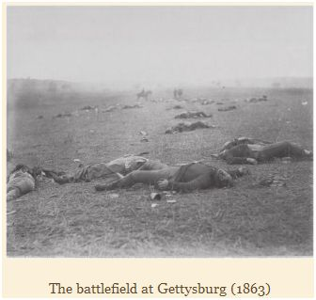
God, Lincoln, and Gettysburg
“…I went into my room one day and locked the door and got down on my knees before Almighty God and prayed to him mightily for victory at Gettysburg. I told him this was his war and our cause, his cause, but that we couldn’t stand another Fredericksburg or Chancellorsville. And I then and there made a solemn vow to Almighty God that if he would stand by our boys at Gettysburg, I would stand by him. And he did, and I will. And after that, I don’t know how it was and I can’t explain it, but soon a sweet comfort crept into my soul that things would go all right at Gettysburg…”
--Lincoln, speaking to Maj. General Daniel Edgar Sickles, commander of the 3rd Corps of the Union Army, following the battle of Gettysburg, as recorded by Lt. Col. James Rusling

Slide 23
Lincoln’s Second Inaugural Address: God punished Nation for Slavery
Only 703 words, 7 minutes, 4 paragraphs
Lincoln as prophet, pleading the case of God:
  The war was punishment for both North and South because of the sin of slavery
  Nation should pray this judgment to end quickly so “that this mighty scourge of war may speedily pass away.”
  “if God wills that it continue, until all the wealth piled up by the bond-man’s 250 years of unrequited toil shall be sunk and until every drop of blood drawn with the sword, as was said 3000 years ago, so still it must be said ‘the judgments of the Lord are true and righteous altogether’” (Ps. 19:9)

Slide 24
Dr. Phineas Gurley, after Lincoln’s Death
President Lincoln was “sound not only on the truth of the Christian religion but on all its fundamental doctrines and teaching. . . . After the death of his son Willie, and his visit to the battlefield of Gettysburg, he said . . . that he had lost confidence in everything but God, and that he now believed his heart was changed, and that he loved the Savior, and if he was not deceived in himself, it was his intention soon to make a profession of religion. “ --Dr. Gurley, Pastor of N.Y. Ave. Presb. Church
Was Lincoln about to be Baptized and join the Presbyterian Church?

Slide 25
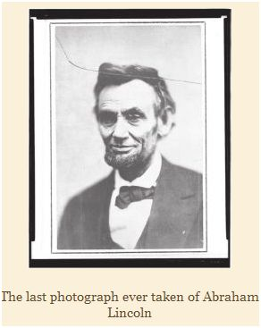
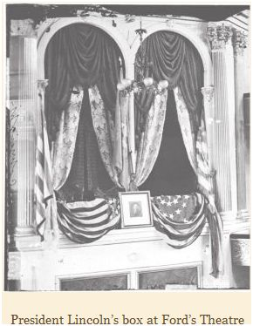

Slide 26
Mary Todd Lincoln: The President’s Last Words before he was shot:
“We will visit the Holy Land and see those places hallowed by the footsteps of the Savior. There is no place I so much desire to see as Jerusalem.”
--President Lincoln’s last words according to Mary Todd Lincoln
Is she a reliable witness? Only God knows what was in Abraham’s heart.

