Slide 1
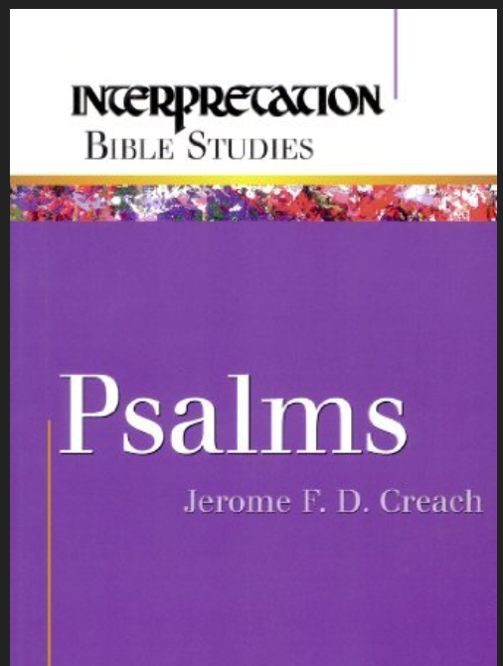
A Survey of the Book of Psalms
Tim Nolen
May 2015

Slide 2
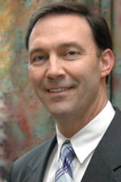
Survey of the Psalms
The lessons are based on “Psalms—Interpretation Series” by Jerome F. D. Creach
Jerome F. D. Creach
Ph.D. Union Presb. Seminary (Bible—OT), 1994
Professor of Old Test. at Pittsburgh Seminary
Ordained as Minister of Word and Sacrament in PC USA in 1987.
Author of seven books on the Old Testament
Married to Page L. D. Creach, also a minister in PC USA.

Slide 3
Introduction / Overview of Psalms

Slide 4
Author: The brief descriptions that introduce the psalms have David listed as author in 73 instances. David's personality and identity are clearly stamped on many of these psalms. While it is clear that David wrote many of the individual psalms, he is definitely not the author of the entire collection. Two of the psalms (72) and (127) are attributed to Solomon, David's son and successor. Psalm 90 is a prayer assigned to Moses. Another group of 12 psalms (50) and (73—83) is ascribed to the family of Asaph. The sons of Korah wrote 11 psalms (42, 44-49, 84-85,87-88). Psalm 88 is attributed to Heman, while (89) is assigned to Ethan the Ezrahite. With the exception of Solomon and Moses, all these additional authors were priests or Levites who were responsible for providing music for sanctuary worship during David's reign. Fifty of the psalms designate no specific person as author.
Date of Writing: A careful examination of the authorship question, as well as the subject matter covered by the psalms themselves, reveals that they span a period of many centuries. The oldest psalm in the collection is probably the prayer of Moses (90), a reflection on the frailty of man as compared to the eternity of God. The latest psalm is probably (137), a song of lament clearly written during the days when the Hebrews were being held captive by the Babylonians, from about 586 to 538 B.C.
It is clear that the 150 individual psalms were written by many different people across a period of a thousand years in Israel's history. They must have been compiled and put together in their present form by some unknown editor shortly after the captivity ended about 537 B.C.
Read more: http://www.gotquestions.org/Book-of-Psalms.html#ixzz3b6zNhaGh

Slide 5
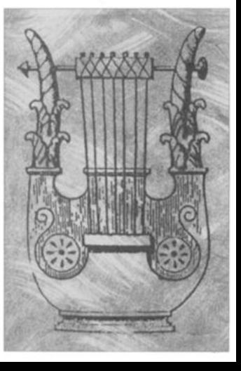
The Title of the Book
There are two well-known titles for the book of Psalms:
“Psalms” is the English title derived from a Greek word that means songs accompanied by stringed instruments
“Psalter” derives from another Greek term denoting the stringed instrument itself (probably the lyre).
The ancient writings show that music and corporate worship are central to a life devoted to God. 1 Samuel 16:14-23.
The actual Psalms are dominated by prayers that complain to God about human suffering. All the human reality reflected in the Psalms are considered to be instruments of praise.

Slide 6
“The wide range of expressions in the Psalter—the anger and pain of lament, the anguished self-probing of confession, the grateful fervor of thanksgiving, the ecstatic joy of praise—allows us to bring our whole lives before God.”
–Kathleen Norris, The Psalms, viii.

Slide 7
Nature of Prayer in the Psalms
“When one sits alone with a Psalm, one is sitting with and for the countless others who are praying them now, who have prayed them for thousands of years.” --Kathleen Norris, The Psalms, x.
Beyond liturgy and song, the Psalms provide model prayers for Christians. But, there are two important facts to remember:
The Psalms are prayers in a congregation or assembly
The Psalms speak from great suffering. American Christians may not be in this situation, but we should pray for those on behalf of others in the world who are suffering.
Important: The Psalms are about community, not the individualistic Christianity of many Americans.
TOY = Think Outside Yourself! (Bill Gaither’s Homecoming Radio)

Slide 8
The Structure of the Psalms
Psalms is 150 individual poems organized by association with David, Korah, or Asaph
Korah – Leader of a Levite clan (Ex. 6:21) of Temple gatekeepers (1 Chron. 9:19) and singers (2 Chron. 20:19)
Asaph – A music leader appointed by David (1 Chron. 6:39) and a Levite responsible for the bread offering.
Psalms 41; 72; 89; and 106 end with doxological formulas including “amen.” This divides the book into five sections, imitating the five books of the Torah (Genesis – Deuteronomy).
Psalms 1 and 2 introduce and model how the book should be read. They offer a portrait of the righteous person, and invite all to live in happiness in obedience to the Lord.

Slide 9
Theology of the Psalms
“The Psalms are the poetry of the reign of the LORD.“ – James L. Mays
“The Psalter is a little Bible.” – Martin Luther
The heart of theology of the Bible is contained in Psalms, and it provides the fertile soil for Christianity.
The Lord reigns from Mount Zion (46:4-7, 48:1-3, 76:1-3, 122:3-5)
From Zion, the King issues instructions (torah) Is. 2:3
God establishes the Davidic King on Zion 2:6
The primary duty of humanity is to submit to God’s rule (5:2)
Depend on divine protection (118:8-9)
Meditate on the torah (1:1-2)
Follow the leadership of the LORD’s anointed (2:1-2)
The righteous follow these, but the wicked do not. (37:39-40)
The Psalms complain that the wicked prosper, but affirm a faith that God will assure the fall of the wicked (73)

Slide 10
The Anatomy of a Psalm
“The God one encounters in the Psalms is God as human beings have experienced him as both awake and asleep, gloriously present and lamentably absent, and above all, various.”
-- Kathleen Norris, The Psalms, vii.

Slide 11
What is a Psalm?
There are many poems outside Psalms in the Bible (e.g. Ex. 15; 1Sam. 2:1-10, Luke 1:39-56).
The Psalms are unique in their placement together and some common elements distinguish them.
  Headings
  Poetry
  Body
  Context in the Psalter
Psalm 3 provides a good example for highlighting the features that define and help interpret the psalms.

Slide 12
The Heading of Psalm 3
Two-thirds of psalms have a heading.
It functions like a title separate from the body of the psalm.
Headings are later additions to the book to direct how the psalm is to be used.
Psalm 3 heading has three parts:
Psalm (Heb. mizmor) means “to praise God with music.”
“of David” indicates the song was written to commemorate King David
The biographical note explains that David spoke this psalm as he fled Absalom (2 Sam. 15). This might not be a literal, historical reference, but instead might indicate how David was remembered, in much the same way Americans idealize our remembrance of Washington or Lincoln. The best characteristics of our historical heroes inspired us toward being better citizens and be true to our nation’s values.

Slide 13
Other Heading Elements
Many psalms contain directions for its use in worship. Some are obscure to us today.
Psalm 7 is a shiggaion of David. No one is sure what this means.
Some psalm titles have liturgical and performance directions—Some are clear (e.g. Ps. 30 “at the dedication of the temple”) and others are not (e.g. Ps. 22 “According to the Deer of the Dawn”).
The term Selah appears frequently in the body of psalms. It might mark then end of a verse, or a lost musical note, or perhaps just means “hit it” as in start the music now.

Slide 14
Body of the psalm
Uncertain meanings of Hebrew words results in alternate words of translation. Ps 3:2 “deliverance” in the NIV is rendered as “help” in the NRSV. The Hebrew word is yeshu’ah and is the word from which the name of Jesus is derived!
Two characteristics of Hebrew poetry—rhythm and parallelism—do not translate well to English.
Rhythm: Ps 3:1-2 have a distinct metrical pattern in Hebrew, but in English this can only be simulated by arranging the words in lines of equivalent lengths.
Parallelism is the use of similar statements in multiple places as a way to complement, intensify, or advance an idea. Examples: Ps 3:1—increasingly intense portrayal of enemies. Ps 3:4 shows cause and effect.

Slide 15
Content of the psalm
The interpretation of the psalm rests primarily on the main content and its movement, coherence, and overall message.
Ps 3 is dominated by directly addressing God (1, 3, 7)
It can be characterized as a “prayer for the help of an individual.”
Verses | Function
1-2 | describe trouble that requires Yahweh’s action
3-6 | confess confidence in God’s delivery
7 | repeats the pattern of petition / confidence.
8 | praises the LORD and wishes for corporate blessing.

Slide 16
Interpretation of Psalm 3
The identity of the speaker cannot be determined. He refers to a multitude of foes may or may not be military in nature.
Whether real or figurative, every person can relate to a threat and oppression.
There is a temptation to believe what the enemy claims is true (v. 2 “there is no help for you in God”), but the psalmist defends against this in v. 8 “deliverance belong to the LORD.”

Slide 17
Context of placement in the Psalter
The placement in the book does not always help interpretation, but it does in Psalm 3.
Psalm 3 follows the first two introductory psalms.
Psalm 1 and 2 share the same vocabulary and end with “Happy are all who take refuge in Him.”
Psalm 3 follows this as an example of dependence on and faithfulness to God.
The association with David gives the model of faithfulness that we are to follow.

Slide 18
Types of Psalms
“Emotional immediacy, this ability to address people in all conditions of life, is what has made the Psalms the core of daily worship for both Jews and Christians for thousands of years”
-- Kathleen Norris, The Psalms, vii.
“Christians have said them as their own prayers, as guides to learning to pray, and as texts through which they came to know themselves and God more surely.”
--James L. Mays, Psalms, Interpretation, 2.
Without the Psalms and other liturgical expressions, worshipers will not know the words to use, and worship will not be relevant to God and His people.

Slide 19
Many Psalms fit into one of several themes
The Prayer for the Help of an Individual
The Thanksgiving Song of an Individual
The Corporate Prayer for Help
The Hymn
The Psalms of Instruction
Spontaneous worship can be meaningful, but it is also helpful to have a common language of worship and prayer to unit a community and to provide appropriate words when people face particular situations.

Slide 20
The Prayer for the Help of an Individual
This is the most common type, and are written in the first person, and are characterized by a petition to God for help. (Ps. 7:1)
The pleas for help are grounded in the trust and faith that God will answer. Ps. 12
Some themes of types of individual trouble are:
Sickness (38)
Falsely accused of a crime (26)
Armed conflict (3)

Slide 21
Thanksgiving Song of an Individual
These psalms show how prayers are answered.
They have an individual voice, and were spoken much like a “testimony” in modern worship.
Thanksgiving psalms often accompanied a thanksgiving offering (Ps. 116:17).
They show the communal nature of worship in ancient Israel.
Read Ps. 30 and 116.

Slide 22
The Corporate Prayer for Help
Instead of personal needs, these prayers address disasters which struck Israel. (Ps. 80)
“The prayers are the voice of a community that knows that its last and best hope lies in the sovereignty of God.” -- James Mays (Psalms, Interpretation, 25.)
They typically contain three elements:
Description of the trouble (79:1)
Assertion of trust in the Lord (74:12-17)
Recollection of God’s saving deeds in the past (74:23)
Other examples: 44, 74, 83.

Slide 23
The Hymn
The function of the hymn is to praise God and complements the corporate prayer for help.
Typical Structure:
Invitation to praise God.
Statement of motivation for praise.
Common phrases in the hymns: Hallelujah (Ps. 146-150, from hellelu “praise” and yah “Yahweh”). “Give thanks to the Lord.” Ps. 107:1, 118:1). “O come, let us sing to the Lord (95:1). Make a joyful noise to the Lord, all the earth (100:1).
These hymns were performed in Israel’s yearly festivals (Deut. 16:16-17).

Slide 24
The Psalms of Instruction
These encourage a right way of life and a right way of worship.
Many of these are acrostics—each line begins with the next letter of the Hebrew alphabet.
They teach by appealing to themes already known from scripture. Compare 103:15-16 with Isaiah 40:6-8
Psalm 37, 9-10, 25, 33, 111-12, 119, 145.

Slide 25
Psalm 51– A penitential theme as a special case of a prayer for help.

Slide 26
Psalm 51 is the strongest psalm of repentance
Only seven psalms are considered penitential: 6, 32, 38, 51, and 102.
Psalm 51 is the most complete expression of the recognition of individual sin, repentance, and plea for forgiveness.
Psalm 51 has often been used for Lent.
It shows how important confession of sins is to a right relationship with God, even before Jesus.
The superscription recalls the sins and confessions of David over his affair with Bathsheba, but is clearly applicable more generally to individuals.
The psalm was probably composed after the fall of the first temple in Jerusalem by the Babylonians in 587 B.C. as evidenced by verses 18-19.

Slide 27
Why is Confession so Important?
“Confessing your sins doesn’t tell God anything new. In the words of Frederick Buechner, ‘Until you confess them, however, they are the abyss between you. When you confess them, they become the bridge.”
The connection between Psalm 51 and David’s treachery suggests that we should behave like David when confessing, repenting, and pleading to God for mercy.

Slide 28
How was / is Psalm 51 used?
As a prayer for the help of an individual, it was nevertheless used in corporate (congregational) worship. (as suggested by vs. 18-19 and by the superscription)
It is a reminder that, even in the Old Testament, a true contrition and repentance (changing behavior) is required – not just empty ceremony or words.
There are only two places in the OT that contain the phrase “Holy Spirit:” Psalm 51:11, and Isaiah 63:10-11!

Slide 29
51:1-2 Pleas for Mercy
Four requests:
  Have mercy
  Blot out my transgressions (like outwardly wiping a dish)
  Wash me (as in laundering clothes)
  Cleanse me (purifying the inner self) – also means to “un-sin me.”

Slide 30
51:3-6 Confession
Shows recognition of sins, but also how very serious they are.
5-6 are not necessarily theological in saying that sin begins at conception, but instead demonstrates the deep regret, remorse, and shame the sinner feels in approaching God.

Slide 31
51:7-12 Specific petitions for costly grace
Hyssop is used for ritual cleansing, but clearly only God can cleanse the inner person.
Create in me a pure (or clean) heart. The Hebrew word for heart in this case does not refer to a seat of the emotions (as in English), but instead refers to the mind and the will, that is, the center of the self from which action and loyalty spring.”
The Hebrew word for create is “bara” which is usually reserved for God in the OT and is used in Genesis 1:1. In other words, this is not self-help. Only God can create the purity of the human being.

