Slide 1

Part Two:
The Rise of a New Generation on the Edge of the Promised Land
Numbers 26-36
Introduction and Overview

Slide 2
In the first half…
The question was: How can the holy, powerful God dwell in the midst of a sinful people?
The structure of the camp and concentric circles of holiness surrounding the tabernacle would protect the Israelites.
However, the constant rebellions (even including Aaron and Moses) led to God denying them entry to Canaan and caused them to perish in the desert.

Slide 3
Now, in the second half…
The question is: Will this second generation find a way to be faithful and enter the promised land, or will they rebel and fail as the first generation had done?
That God will be faithful to his promises has been indicated by the oracles of Balaam (22-24), God’s promise in 14:31 to bring the “little ones” to Canaan, and by the preliminary military victories in 21.
Parallels between first and second halves imply that the new generation will face similar challenges as the old one, but, unlike the old generation, the second generation will overcome them.

Slide 4
Parallelism in Numbers
Numbers 1-25 – Gen. of Rebellion | Numbers 26-36 – Gen. of Hope1
1: Census of 12 tribes | 26: Census of 12 tribes
3: Census of Levites | 26: Census of Levites
5: Legal discourse about women | 27: Legal discourse about women
6: Laws concerning vows | 30: Laws concerning vows
7, 15: Laws concerning celebrations 9: Celebration of Passover | 29:16, 25: Instructions for future Passover celebrations
10:8-9 Law for priests to blow trumpets to start holy war | 31:6 Priest blow the trumpets to start holy way against Midian
12, 13: Spies chosen to spy Prom. Land | 34: Leaders chosen to divide Prom. Land
13, 14: Spy story, rebellion of old gen. | 32:6-15: Spy story recalled as a lesson
10-25: Scattered geographical notations about placed journeyed in the wildern. | 33: Summary of places Israel journeyed through the wilderness
18:21-32: Provisions for the Levites | 35: Provisions for Levitical Cities
21-35: Victory over Sihon and Og | 32: Assignment of land captured East of Jordan from Sihon and Og
25: Midianites cause Israel to Sin and God’s command to punish them | 31: Holy war against Midianites to punish them for Ch. 25.

Slide 5
Numbers 26-36 has important messages for the coming generations
The reader is invited to learn from the past and follow in the footsteps of the new generation.
We should use the new generation as a model for struggles and strategies for getting to the promised land.
We can choose to overcome the mistakes of the past, and claim God’s blessings with our faithfulness.
Not a single Israelite is recorded as dying throughout the whole second half of Numbers!

Slide 6
Ch. 26 – The second census
In addition to counting those able to wage war, the second census is to be used to distribute land in Canaan (26:52-56).
The second census adds more detail about the clans of each tribe. These clans appear to be related to the off-spring of Jacobs sons.
Differences between Gen. 46 and Num. 26 may be due to textural corruptions, events, or unknown reasons.
Gen. 46 – Sons of Gad | Num 26 – Clans of Gad
Ziphion | Zephonites
Haggi | Haggites
Shuni | Shunites
Ezbon | Oznites
Eri | Elites
Arodi | Arodites
Areli | Arelites

Slide 7
Census Results: Num 1 vs. 26
Totals of adult men imply that total population of 12 tribes of ~2 million!
600,000 fighting men would be a huge army in the 21st century. Washington had 11,000 troops vs. Cornwallis in decisive battle of Revolutionary War.
Early church father Jerome held these totals as a mystery. John Calvin saw them as evidence of God’s ability to increase Israel’s population from one family to 2 million in about 250 years.
Others have postulated that the totals were misinterpreted, but they are self-consistent in the book (may have been misinterpreted by later scribes though).
Tribe | Num. 1 | Num. 26
Reuben | 46,500 | 43,730
Simeon | 59,300 | 22,200
Gad | 45,650 | 40,500
Judah | 74,600 | 76,500
Issachar | 54,400 | 64,300
Zebulun | 57,400 | 60,500
Ephraim | 40,500 | 32,500
Manasseh | 32,200 | 52,700
Benjamin | 35,400 | 45,600
Dan | 62,700 | 64,400
Asher | 41,500 | 53,400
Naphtali | 53,400 | 45,400
Total | 603,550 | 601,730

Slide 8
The punishment for disobedience is made clear…
26:63-5 reiterates the punishment for the sins of the old generation—death without seeing the promised land.
Caleb and Joshua are exceptions as they were the two faithful spies (13-14) who did not fear the Canaanites.
Moses survives to provide a transition to the new generation. His death will come in Deuteronomy 34.

Slide 9
Num. 27 – A legal dispute brought by daughters of Zelophehad
A theme in numbers is the equality and inclusion of all the tribes. In 26:33-34, the genealogy of Manasseh extends the narrative to seven generations to show that Zelophehad had five daughters and no sons.
Patrilineal system did not provide a way to pass inheritance to daughters.
On the other hand we have the high priority of keeping land with the original clans and tribes.
Moses turns to God for guidance.

Slide 10
Significance of the dispute by daughters of Zelophehad
God is reaffirming His promise of Canaan.
All tribes MUST be included in the promised land.
It is a model of critical and creative affirmation of tradition
  No precedent was available
  God’s word is a robust and living tradition leaning toward the future.
  It is a small step toward the dignity and rights of women, although the patrilineal system remains.
  However, this, like the ministry of Jesus, represents a progress toward a better world with the march of God imposing His more excellent will on a sinful mankind.

Slide 11
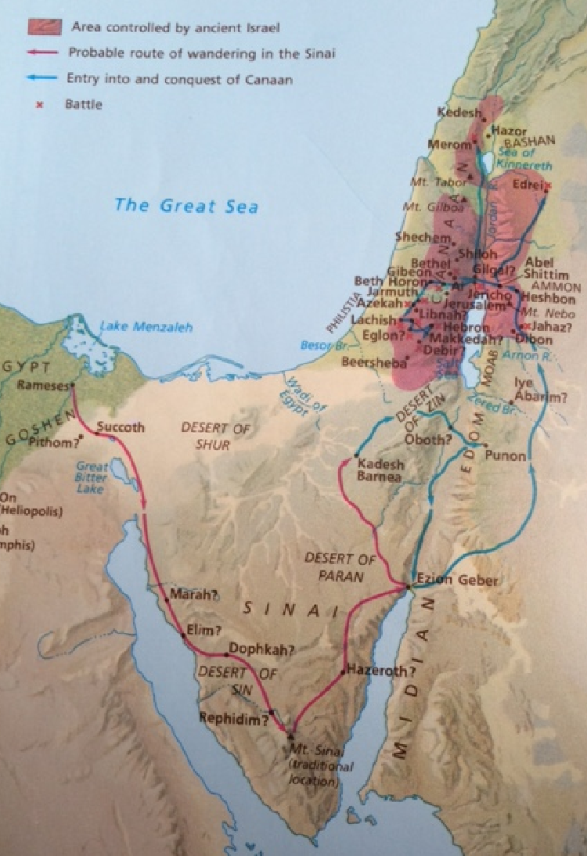
The Camp is approaching Jericho
It’s time for new leadership as the new generation approaches the day they will see Canaan.

Slide 12
A succession from Moses to Joshua: The new generation of leadership
27:12-23: Why is this section on succession placed after the case of Zelophehad’s daughters?
  Medieval Jewish commentator Rashi: Moses may have begun to believe that God would relent and allow him to enter Canaan since God commanded Moses to give them their portion of the land.
Joshua is not a carbon copy of Moses. He will not speak directly to God.
At this point, Joshua only receives a portion of Moses’ authority (v. 20).
Laying on of hands to transfer power and commission leaders is a tradition thousands of years old:
  Jacob laid on hands to bless grandsons (Gen. 48:14)
  Ritual transfer of guilt or sin (Lev. 1:4, 24:14)
  Levites commissioned as substitutes for firstborn of Israel (Num. 8:10-12)

Slide 13
Numbers 28-30
Appointed Offerings and Voluntary Vows:
Preserving Order and Holiness in the Promised Land for a New Generation

Slide 14
God replaces structure in space with a structure in time
In Numbers 2-4, God told Moses to structure the camp in space as a way of protecting the Israelites from God’s overwhelming power at the center.
Order also helps protect the people from sin, chaos and disintegration.
Now that settlement in Canaan is at hand, a new structure based in time is needed to help protect the community.
These notions of time actually follow the creation story in Genesis 1.

Slide 15
Creation story (Gen 1) vs. Offering times (Num. 28-29)
Genesis 1 | Numbers 28 Parallel
God separated the light and the darkness into the day and the night (Gen. 1:4-5) | Daily sacrifices – one in the morning and one in the evening to mark Day/Night transition (Num. 28:3-8)
God blessed the seventh day for rest after the work of creation was completed (Gen. 2:3) | Special offerings mark each Sabbath day as set apart and holy (Num. 28:9-10)
God made the sun, moon, and stars to mark the seasons and years (Gen. 1:14-16) | Festivals were timed by either the lunar phases or by the seasons of the year.

Slide 16
Festivals for the first and seventh months of the year divide the year in halves
First Half of Year (1st Month) | Second Half of the Year (7th Month)
1st Day: monthly offerings (28:11-15) 14th Day: Passover offerings (28:16) 15th-21st Days: Offerings for Festival of Unleavened Bread (28:17-25) which is a seven day festival | 1st Day: Offerings for Festival of Trumpets (29:1-6) 10th Day: Offerings for Day of Atonement 15-21st Days: Offerings for Festival of Booths (29:12-34) 22nd Day – Offerings for “solemn assembly (29:35-38)

Slide 17
Meaning of offerings and festivals
In Numbers, the offerings anticipate a settled society in a land of fertility and agricultural seasons.
Provide continual recommitment to God in accordance with time as created in Genesis.
Sets the community apart as a holy people.
Even when the Jerusalem Temple was destroyed by Babylonians in 587 B.C. and again by the Romans in 70 A.D., the Jewish community continued to observe these rhythms of time through offerings, thanksgiving, prayer, worship, and festivals.
Christians adopted a similar structure in time for morning and evening prayers, day of worship, structure of the liturgical year (Advent, Lent, etc.), and special festivals such as Christmas and Easter.

Slide 18
Numbers 30: Laws Concerning Vows
Vows are voluntary commitments to God:
  Abstention from certain activities Nazirite vows (Num. 6)
  Dedication of booty from military victory over Canaanites (21:2)
  Many other examples throughout the Bible
The bulk of the chapter deals with the power of fathers and husbands to nullify vows of daughters and wives, but also to confirm and share responsibility for them.

Slide 19
The meaning of Num. 30
At first reading, it may appear that man’s primacy over women is a major directive.
Actually, the major point is that promises (vows) made to God must be kept.
Ancient Israel was a patriarchal society in which women were economically dependent on men.
For women to keep their vows, fathers and husbands had to support their promises. If they failed to do so, they shared in the guilt of the broken promises.
Therefore, these laws could be seen as giving a measure of protection to women making vows to God.
Jesus liberated people from excessively complicated rules (Matt. 5:33-7), but reaffirmed the necessity of keeping promises made to God.

Slide 20
Numbers 31
War against the Midianites: Judgment for Past Sin, Foretaste of a Future Conquest

Slide 21
31: Holy war to punish Midianites
God orders the Israelites to defeat the Midianites as punishment for leading the older generation into sin in worship of Baal Peor.
Also, a Midianite woman named Cozbi was involved in the seduction. The three consonants of Cozbi’s name in Hebrew, kzb, form the verb “to lie, deceive.”
The prophet Balaam is also killed for his part in leading the old generation astray.
This is a holy war, as indicated by the participation of Phineas, son of the high priest, and by the sounding of the trumpets (31:6).
The fighting force consists of each numbers of soldiers from each tribe.
The battle results in total victory, and an enormous amount of plunder.

Slide 22
Moses gets angry at the leaders who returned with the guilty Midianite women.
As part of the plunder, all the Midianite women and children return to the Israeli camp.
Moses gets angry at the presence of the Midianites and orders all of them except the young girls to be killed.
Moses therefore assures that the new generation will not be tempted into sin as was the older generation.
The purity ritual is given for the army since they had been in the presence of dead bodies.
Tremendous spoils of war are gained and divided among the Israelites, signifying God’s faithfulness.
No Israelite soldier dies in the battle! 31:49

Slide 23
Comments on Holy War
We find the slaughter of so many people in the name of God to be very disturbing.
While foreigners are welcomed into Israel, they only do so while accepting God’s commands faithfully. All others are enemies.
The only Holy Wars fought in the Bible are connected with the conquest of Canaan. There is no paradigm for using Holy War in the future, and they do not happen again after the conquest.
Therefore, we interpret these wars as unique to the time of the initial establishment of Israel, and not an excuse or imperative for other times.
Note that the spoils are divided equally, including a share to God.
Also, the soldiers must undergo purification (31:19) and they make a special offering of atonement to the Lord for killing. (31:50).
God’s commands and rules change over time and Jesus later establishes an era of grace for the whole world.

Slide 24
32: A crisis is averted by compromise with Reuben and Gad
Because Reuben and Gad tribes had lots of cattle, they found the pastoral Transjordan region (east of the Jordan, not in Canaan) to be attractive.
When Reuben and Gad requested to settle there, Moses became angry because he remembered the consequences of not entering Canaan in Ch. 13-14: The Old Generation was then doomed to die in the desert.
Surprise! God accepts a compromise! Gad and Reuben (and half the Manasseh tribe) will be allowed to settle east of the Jordan if they fully participate in the war for Canaan.

Slide 25
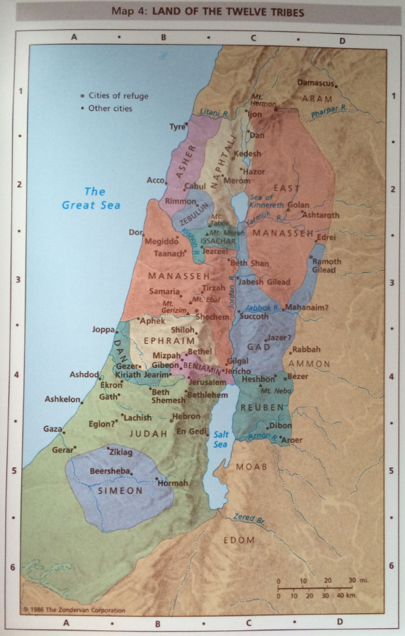
Where the tribes are headed
The story of the compromise in Ch. 32 explains how the Reuben and Gad tribes came to settle east of the Jordan River.
32:33 mentions that half the Manasseh tribe settled in the Transjordan also. This appears to scholars to be a later addition to square the story with the tradition of the Manasseh.

Slide 26
Observations from Chapter 32
Once again, God adapts His commands to the needs of the people in allowing the compromise for Reuben, Gad, and half the Manasseh tribes to settle in the Transjordan (ultimately) instead of Canaan.
The new generation has good intentions and is not afraid. While they have learned from the mistakes of the old generation, they are obedient, but resourceful.
The conquest of the Transjordan by Gad and Reuben over King Sihon and King Og (21:21-35) and by Manasseh over the Amorites in Gilead (32:34-42) serves as a dress rehearsal for the successful conquest of Canaan itself.

Slide 27
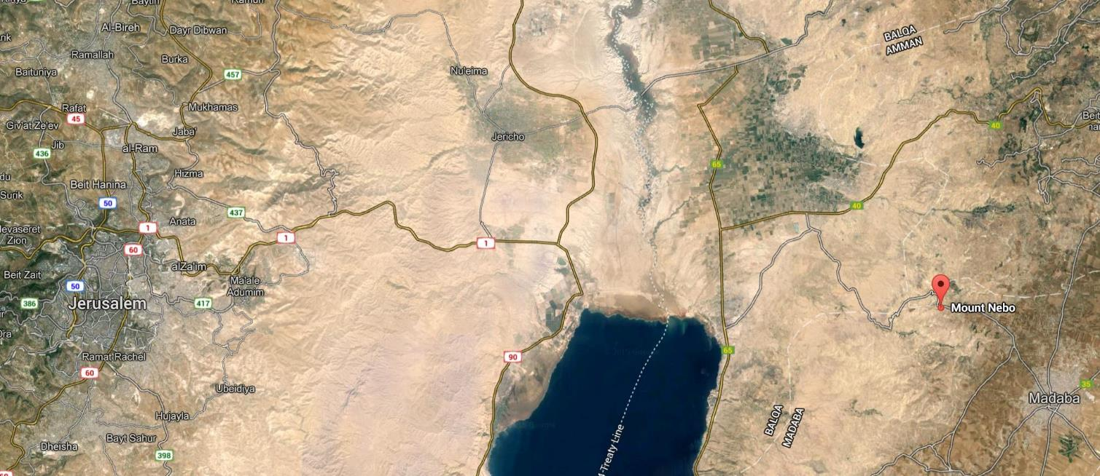
Area of Numbers 26-36 Today
Jordan River
Plains of
Moab
5 miles

Slide 28
Ch. 33: The Travel Itinerary of the Old Generation
The list is written by Moses himself according to God’s instruction.
Many of the places are not mentioned anywhere else in the Bible: 33:13, 19-29.
Most of the actual locations are unknown today.
Several of the place names have appeared earlier in Exodus and Numbers
  33:6-15 correspond to travels in Exodus 13:17-19:1
  33:16-49 from Sinai to Moab is recap of Num 10:11-22:1

Slide 29
Meanings in Numbers 33
Reminders of God’s power in victories over Egypt (33:3-4) and over Canaanite king Arad (33:40) to inspire confidence.
Remember the mistakes of the old generation: God’s judgment of foreign gods (33:4) and the death of Aaron for his sin (33:38-39).
A final instruction: 33:50-53: The Israelites should drive out all the inhabitants of Canaan and destroy all their images and holy places to prevent future trouble and temptation.

Slide 30
Israel never achieved the removal of all Canaanites from the promised land.
Joshua 2; 6:22-25, 9 – Israel is compelled to allow Canaanite prostitute Rahab and the Gibeonites to remain in Canaan.
The tribes of Israelites did not conquer all the land of Canaan, and so some of the original peoples continued to live among the Israelites (Judge 1:1-2:5; 2:11-3:6).
The situation at the end of the conquest of Canaan is summarized in Judges 3:5-6:
“So the Israelites lived among the Canaanites, the Hittites, the Amorites, the Perizzites, Hivites, and Juebusites; and they took their daughters as wives for themselves, and their own daughters they gave to their sons; and they worshiped their gods.”

Slide 31
Assignment of the Land: Num. 34:13-29
The 9 ½ tribes not settling in the Transjordan are to be assigned land in Canaan by lot.
Eleazar and Joshua head a committee composed of representatives from each of the ten tribes to inhabit Canaan.

Slide 32
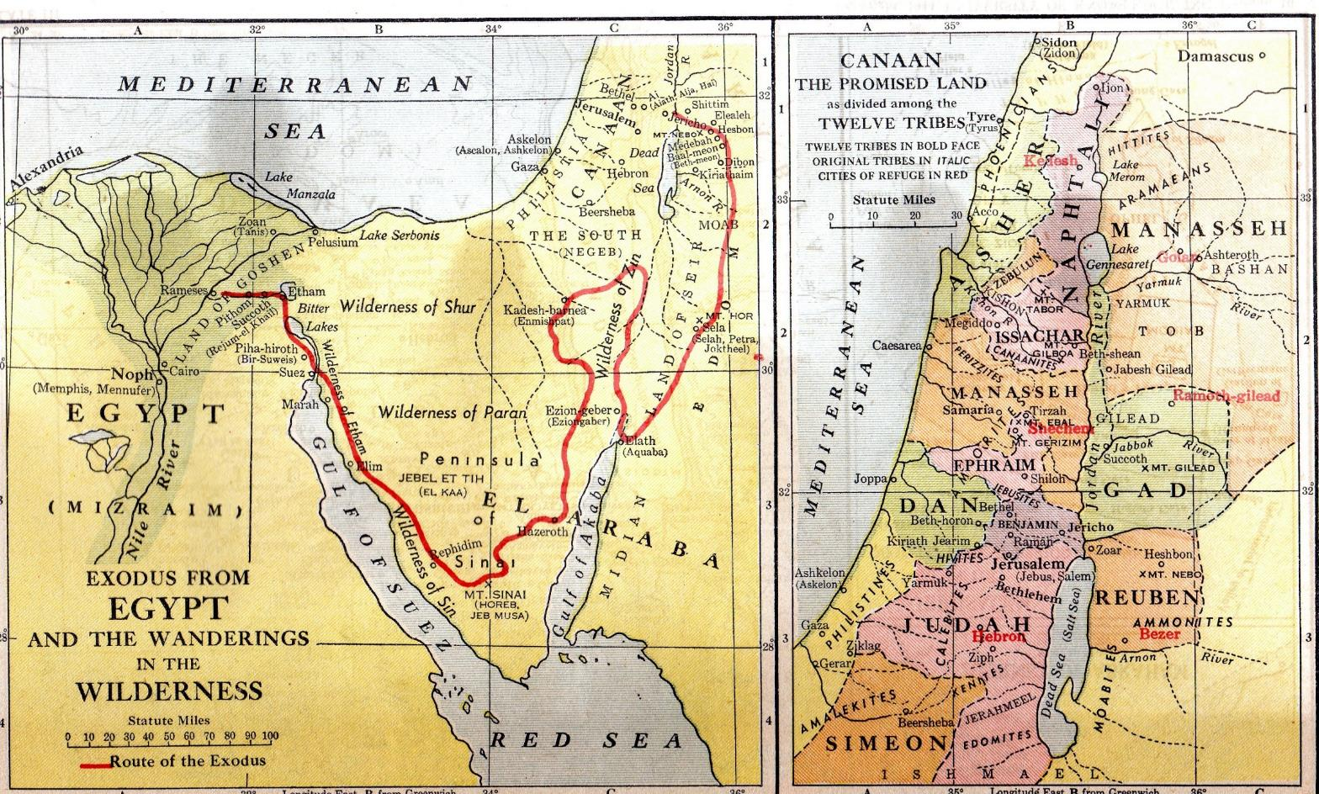

Slide 33
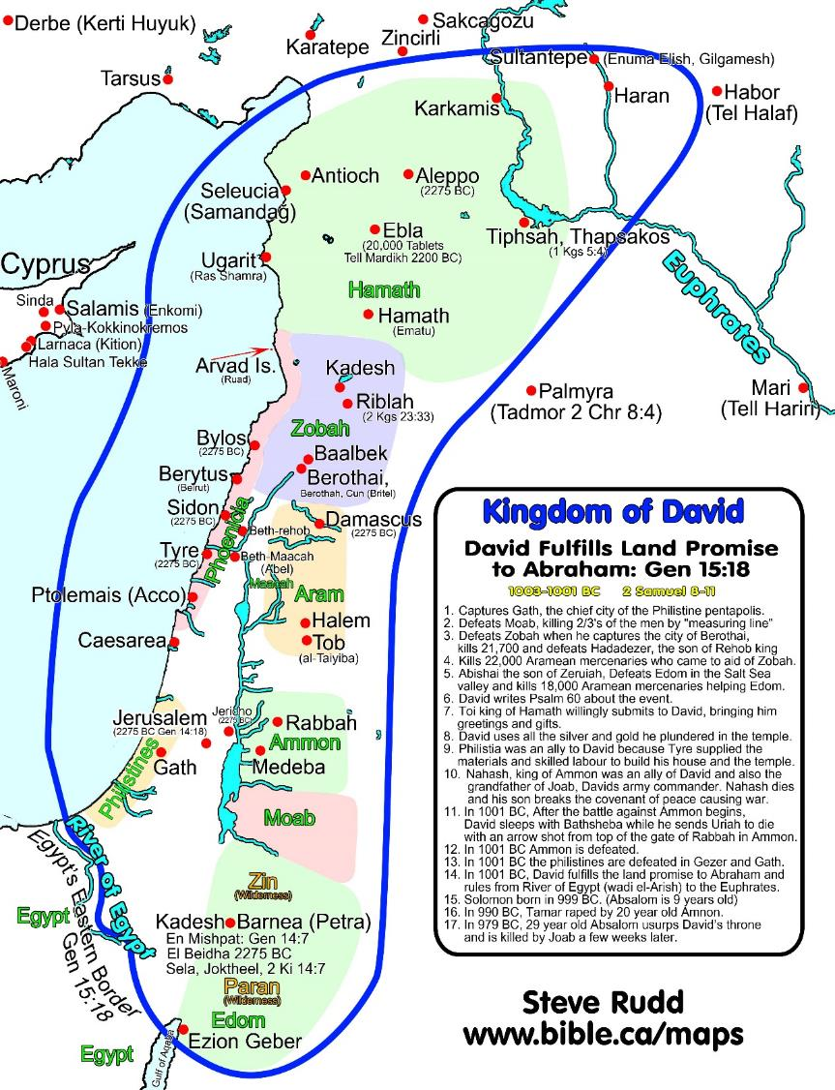

Slide 34
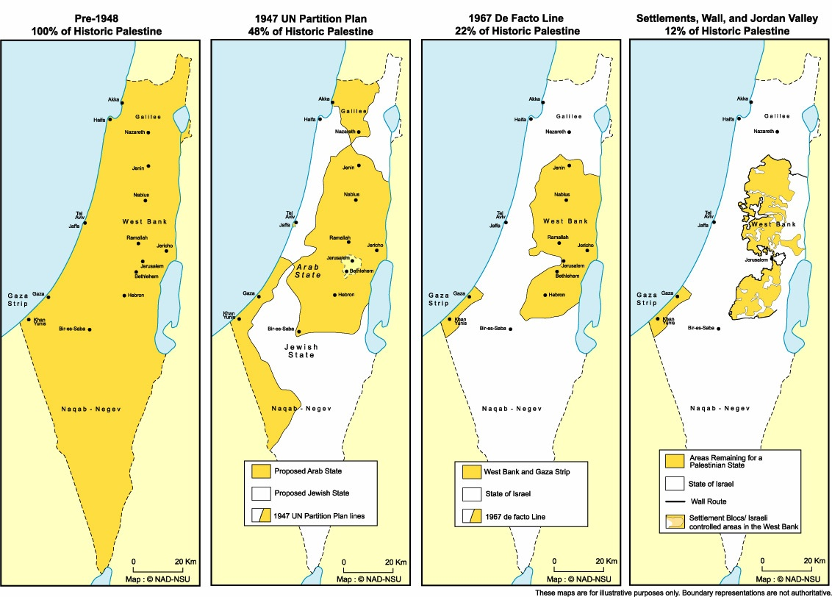

Slide 35
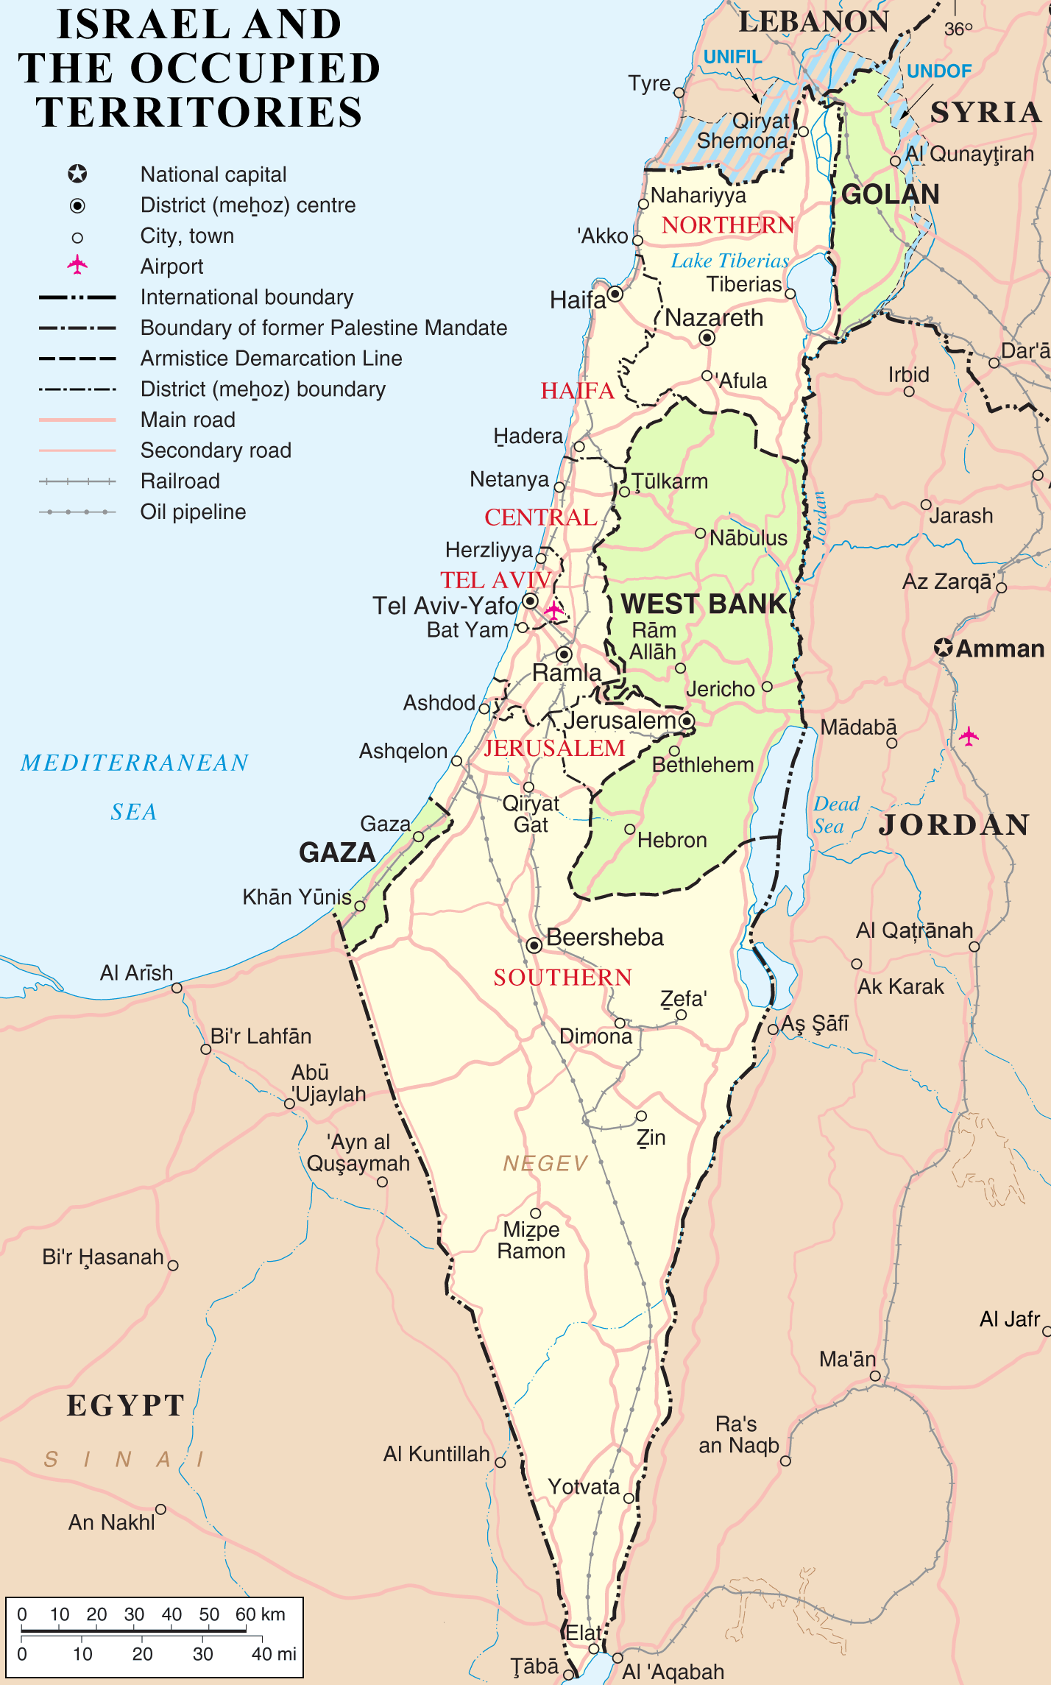

Slide 36
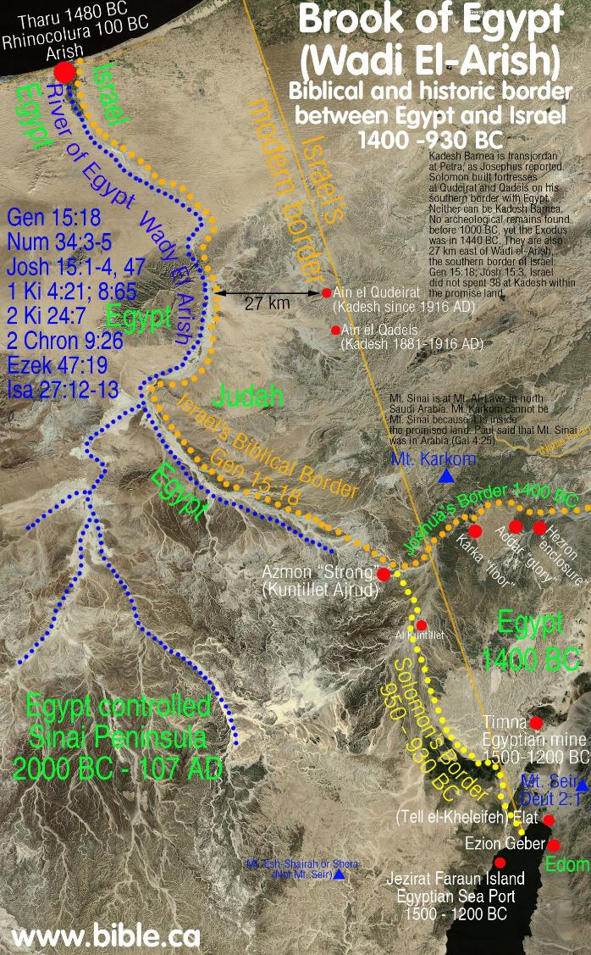

Slide 37
Towns for the Levites: Num 35
The Levites are set apart as clergy, and are not one of the twelve tribes given land.
Therefore, God commands the Israelites to provide 48 cities for the Levites including pasture land, each 3000 feet square.
The actual history of the Levites in the ancient social and religious life is debate by scholars. Example: Ezek. 48:13 provides them with a single plot of land rather than cities distributed through Israel.

Slide 38
The Levites are special.
They cross boundaries, and are unique among the tribes
They are a tribe, but not one of the twelve.
The live in designated cities with surrounding pasture, but they have no allotted tribal land.
They are a boundary between God at the center and the twelve tribes outside.
They protect and cross the boundary between the divine and the human.
Levitical cities are scattered throughout Israel just as the presence of God is.

Slide 39
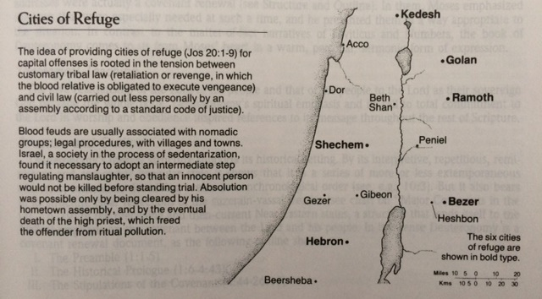

Slide 40
35: Drawing a line between murder and involuntary manslaughter
An unintentional killer could be safe as long as he stayed within a city of refuge.
This was a compromise—he would be in exile, but safe, until the high priest died.
The death of the high priest serves as a substitute expiation for the blood shed unintentionally.
The imposition of the death penalty requires two witnesses for a conviction.
No monetary ransom is allowed to make an exception from the laws.

Slide 41
Why discuss killings in Num. 35?
Sin and death make God’s holy land impure.
The Levites have a function to keep the purity of the land of Israel.
Num. 35:33-4: Do not pollute the land where you are. Bloodshed pollutes the land, and atonement cannot be made for the land on which blood has been shed, except by the blood of the one who shed it. Do not defile the land where you live and where I dwell, for I, the LORD, dwell among the Israelites.

