Slide 1

“A Study Combining Historical, Literary and Spiritual Interpretation of the Book of Numbers”
(Published 1996)

Slide 2
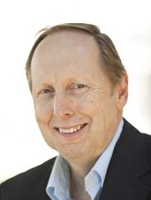
Who is Dennis Olsen?
Dennis T. Olson is the Charles T. Haley Professor of Old Testament Theology and Chair of the Biblical Studies Department at Princeton Theological Seminary. He earned his M.Div. from Luther Theological Seminary and his M.A., M.Phil., and Ph.D. from Yale University. His academic interests are in literary approaches to Old Testament interpretation and Old Testament and biblical theology. He specializes in the Pentateuch and other narrative literature of the Old Testament. An ordained Lutheran minister, he has chaired the Convocation of Teaching Theologians for the Evangelical Lutheran Church in America

Slide 3
Introduction and overview

Slide 4
The Book of Numbers – Neglected and Underappreciated
Church father Origen, writing in the early 3rd century:
“When the Gospels or the Apostle or the Psalms are read, another person joyfully receives them, gladly embraces them. … But if the book of Numbers is read to him, and especially those passages we have now in hand, he will judge that there is nothing helpful, nothing as a remedy for his weakness or a benefit for the salvation of his soul. He will constantly spit them out as heavy and burdensome food. (Origen, p. 246)”
In a long series of sermons on Numbers, Origen sought to show that this popular impression of Numbers was misguided and untrue. For Origen, the book of Numbers was filled with insight, wisdom, and spiritual sustenance for anyone with a hunger for God’s guidance through the wilderness journey of life.
Olson, Dennis T. (2012-07-31). Numbers: Interpretation: A Bible Commentary for Teaching and Preaching (Interpretation: A Bible Commentary for Teaching & Preaching) (p. 1). Westminster John Knox Press. Kindle Edition.

Slide 5
Numbers Basics
Fourth Book of the OT
Named for the census lists of ch. 1 and 26
Hebrew name is “In the Wilderness” from first verse of Num.
Numbers is the story of the Israelites in the wilderness traveling from slavery in Egypt to freedom in Canaan.

Slide 6
What do you know about Numbers?

Slide 7
“The Wilderness:” A Powerful Metaphor for Many
Isa 2: Used for the promise of return of Israel from Babylonian exile
Isa. 43:19: God will do a new thing.
John the Baptist (Luke 3:1-2)
A place for the temptation of Jesus (Luke 4).
A place for Monks to live
A modern metaphor for many disenfranchised or alienated groups.
Gary Eberle: Post-modern people live without a “spiritual geography” and lost connection to identity, personal history.

Slide 8
Numbers was probably written by many people over centuries of time
A variety of literary forms appear:
Stories
Laws
travel itineraries
census lists
lists of personal names
lists of instructions for worship
reports of military battles
accounts of legal disputes

Slide 9
Literary Traditions in Numbers
 | Tradition | Written | Where Found
J | Yawist | 700-900 B.C. | Ch. 11-25
E | Elohist | 700-900 B.C. | Ch. 11-25
P | Priestly | 400-600 B.C. | Ch. 1-10, 26-36
Also, later supplementary material added to these traditions.

Slide 10
Scholars identify oral traditions that preceded literary traditions
Twelve tribe system
Ordering of camp of Israel (Ch. 2)
Levite traditions (3—4)
Wilderness murmuring (11, 12, 13, 14, 16, 17, 21, 25)
Balaam cycle (22—24)
Allocation of land (26, 34)

Slide 11
Numbers records historical issues in Ancient Israel
Conquest (13, 21, 32)
Levitical cities (35)
Development of Israelite priesthood (16-17)
Census lists (1, 26)
Old Testament law, particularly ritual, festival, and purity (5—9, 19, 27, 36)

Slide 12
A Summary of Numbers in One Sentence
“The book of Numbers was the product of the Jewish community’s struggle to understand the pain and punishment of exile and its implications for Israel’s relationship to God, Israel’s definition as a people, and Israel’s posture toward the promised land, which had been lost but was now about to be regained.”
Olson, Dennis T. (2012-07-31). Numbers: Interpretation: A Bible Commentary for Teaching and Preaching (Interpretation: A Bible Commentary for Teaching & Preaching) (p. 3). Westminster John Knox Press. Kindle Edition.

Slide 13
The Parallel Structure of Numbers
Chapters 1-25
  Story of the generation who were freed from slavery in Egypt, but are wandering in the wilderness toward the promised land.
  The old generation never sees the promised land because of their rebellion.
Chapters 26-36
  Story of the next generation who will obey and see the promised land in their lifetime.
  They will emerge as the generation of hope.

Slide 14
Parallelism in Numbers
Numbers 1-25 – Gen. of Rebellion | Numbers 26-36 – Gen. of Hope1
1: Census of 12 tribes | 26: Census of 12 tribes
3: Census of Levites | 26: Census of Levites
5: Legal discourse about women | 27: Legal discourse about women
6: Laws concerning vows | 30: Laws concerning vows
7, 15: Laws concerning celebrations 9: Celebration of Passover | 29:16, 25: Instructions for future Passover celebrations
10:8-9 Law for priests to blow trumpets to start holy war | 31:6 Priest blow the trumpets to start holy way against Midian
12, 13: Spies chosen to spy Prom. Land | 34: Leaders chosen to divide Prom. Land
13, 14: Spy story, rebellion of old gen. | 32:6-15: Spy story recalled as a lesson
10-25: Scattered geographical notations about placed journeyed in the wildern. | 33: Summary of places Israel journeyed through the wilderness
18:21-32: Provisions for the Levites | 35: Provisions for Levitical Cities
21-35: Victory over Sihon and Og | 32: Assignment of land captured East of Jordan from Sihon and Og
25: Midianites cause Israel to Sin and God’s command to punish them | 31: Holy war against Midianites to punish them for Ch. 25.

Slide 15
Part one: death of the old generation
Num 1-25
I. Obedient beginnings: Preparation to march in the wilderness
Num 1-10

Slide 16
Chapter 1: The Census
Purposes:
To organize the former slave society
To prepare for war (includes men of fighting age only)
To mark remarkable increase in numbers of the 12 tribes since Genesis 46.
To stress unity of all the 12 tribes. (This may have been very important centuries later after return from Babylonian exile as well.)

Slide 17
Census Results: Num 1 vs. 26
Totals of adult men imply that total population of 12 tribes of ~2 million!
600,000 fighting men would be a huge army in the 21st century. Washington had 11,000 troops vs. Cornwallis in decisive battle of Revolutionary War.
Early church father Jerome held these totals as a mystery. John Calvin saw them as evidence of God’s ability to increase Israel’s population from one family to 2 million in about 250 years.
Others have postulated that the totals were misinterpreted, but they are self-consistent in the book (may have been misinterpreted by later scribes though).
Tribe | Num. 1 | Num. 26
Reuben | 46,500 | 43,730
Simeon | 59,300 | 22,200
Gad | 45,650 | 40,500
Judah | 74,600 | 76,500
Issachar | 54,400 | 64,300
Zebulun | 57,400 | 60,500
Ephraim | 40,500 | 32,500
Manasseh | 32,200 | 52,700
Benjamin | 35,400 | 45,600
Dan | 62,700 | 64,400
Asher | 41,500 | 53,400
Naphtali | 53,400 | 45,400
Total | 603,550 | 601,730

Slide 18
The tabernacle of the covenant was in the center of the encampment
Tent was 145 ft. long, 72 ft. wide, and 7 ft. high (Exod. 27:18).
The Holy of Holies containing the ark was inside another curtained enclosure inside the tent.
The Levites were to surround the tabernacle to protect it.
The tabernacle and Levites around it are visible signs of God’s presence and love, with dangerous power but with forgiving compassion.

Slide 19
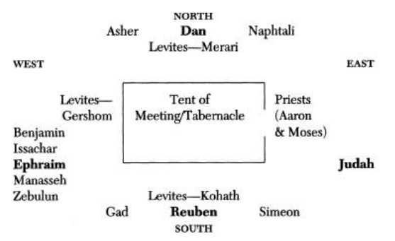
Num. 2: Organization and Leadership
The tribes were arranged in camp around the Tabernacle. The arrangement indicates the relative level of holiness, prominence, but ultimate inclusion of all.
Levites: Service to Tabernacle
Reuben, Simeon, Judah, Ephraim arrangements reflect birth stories of the twelve sons of Jacob to Leah and Rachel.
Shifts in relative status over time are evident in the scriptures.
Placement of the tribes is another indication of the development of a society as compared to the previously disordered state as slaves in Egypt.

Slide 20
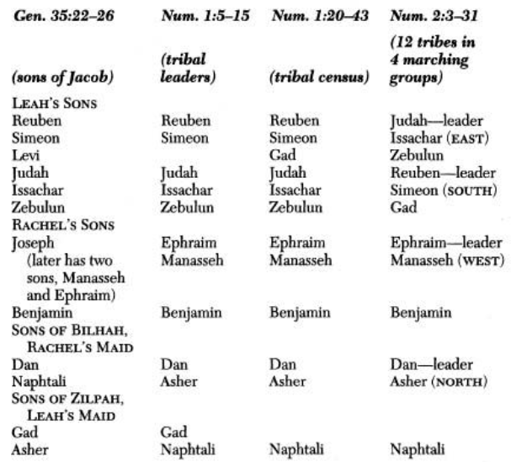
Changing status of the tribes
Notes:
Levi drops out to take priestly status.
Joseph tribe is replaced by his two sons, Manasseh and Ephraim.
Birth order originally places Reuben in top position.
Tribes born of the maids are of lower social status.
However, by Num. 2, Judah is placed in top position. Judah is reflected in the Gen. 49:8-12 blessing of Jacob. Judah becomes the most powerful tribe for centuries beyond the returned to the land of Canaan.

Slide 21
Lessons of Num. 2
Order, structure, and clear lines of accountability needed to move a large community through the Wilderness.
Those with authority and prominence bear special responsibilities (Levites protect tabernacle, but give up rights to land of their own.
God periodically reshuffles the deck of authority based on faithfulness.
Organization, with God’s Tabernacle at the center, invokes a sense of discipline to the goal and orientation toward God.

Slide 22
Num. 3: Priests and Levites
3:1 repeats a “generational formula” used 11 times in the book of Genesis, reinforcing the relationship to the earlier book.
Generational formulas do two things:
  Exclusion: Narrow the focus to highlight certain peoples: In this case, the sons of Aaron and Moses, i.e. Levites and Priests.
  Inclusion: Show relationship to the rest of world or tribes
Cautionary reference to Nadab and Abihu foreshadows the consequences of disobedience. Original story is Lev. 10:1-3

Slide 23
Num 3: The first Levite census lists
The purpose of the first list is to determine if there are enough Levites to substitute for the first born of each of the other tribes. (3:11)
The tradition comes from the last plague during the exodus out of Egypt. Levites are substitutes for the first born. In a sense, they experience death as not having a right to land.
Results are problematic: Total of the three groups of Levites is 22,300, but is reported as 22,000. Israelite first-born total is 22,273, but a shortfall of 273 is instead reported.
Extra Israelites may be redeemed instead by payment of money (3:44-51).
Giving the first born or first fruits is a tradition to recognize that we owe our existence and all that we have to God.

Slide 24
Num 4: The second Levite census
Identifies those 30-50 years old who will be serving / maintaining the tent of meeting.
The Levites serve the sons of Aaron, who are the high priests in the tabernacle.
Three households of Levites are headed by the three sons of Levi:
  Kohathites care for the most holy things, but must not see them!
  Gershonites carry curtains and outer coverings of the tent
  Merarites carry frames and bases of the tent of meeting.
Hierarchy does not indicate divine favor, but instead that being close to holiness is dangerous! God’s chosen people must never the merely human to encroach onto God’s holy space.

Slide 25
Num 5:1-6:21: Preserving Holiness in the Camp
Preparation for invading the Promised Land continues as the focus switches from safeguarding holiness among the clergy to safeguarding holiness among the laity
Impurity (5:1-4) threatens the camp, but so does injustice between people, which is another form of unfaithfulness (5:5).
However, impurity and injury to others need not be fatal – procedures are provided to deal with them.

Slide 26
What is the meaning of purity in the OT?
Purity highlights the difference between the holy and the worldly.
In the OT, impurity is not a matter of class or nationality, but is a state caused by what comes out of a person or contact with the unclean and everyone will be unclean at times and need purification.
Functions of purity in ancient Israel suggested by scholars :
  Rules of hygiene
  Make distinction from Canaanite religious practices
  Reflect sacredness of life or other deep ethics
  Boundaries to protect society from destructive powers

Slide 27
What did Jesus teach about Purity Laws?
Jesus had sympathy for the downtrodden sinner, and healed those unclean.
He did not overturn purity laws, but extended them to include impure thoughts and intentions
Jesus tells a leper he heals to show himself to the priest and make an offering as “Moses commanded.” (Luke 5:14)
As Christianity grew among Gentiles, purity laws became less relevant and meaningful. (Acts 10, Gal. 2)

Slide 28
Num. 5: Focus on the unfaithful wife
Modern difficulties:
  Unjust emphasis on woman’s guilt
  Unfair that husband accuse without evidence
  No penalty to husband if accusation is unfounded
  Degrading ritual of drinking the bitter water
However, it could be that ritual protects woman from a lynch mob and provides for innocence
Women in ancient Israel were treated as property, but laws attempted to regulate this behavior.
Placement at this point may serve to warn Israel to be faithful to a jealous God (common OT metaphor)
Compare to John 8:1-11, adulterous woman was given 'living water’ by Jesus
Practice of this law was officially abolished after destruction of 2nd temple in Jerusalem (no priesthood, no dust from tabernacle floor).

Slide 29
Statements of Gender Equality in the Bible
Num 5:3, 5 – Men and women equally subject to the law
Gen. 1:27 – Male/female both created in the image of God
Gal. 3:28 – In Christ there is no longer male and female…all are one in Christ
“ But within the ancient culture of Israel, the ordeal ritual for the unfaithful wife was another means of safeguarding the holiness of the camp through the wilderness to the promised land.”

Slide 30
Law of the Nazirites 6:1-22
Becoming a Nazirite was a voluntary holy separation from others, available to men and women.
It could be temporary.
Joseph is named as a nazir (set apart) Gen. 49:26
Samuel was dedicated by his mother Hannah with a vow suggesting he was a Nazarite (I Sam 1:11)
Most well-known Nazarite was Samson (Judg. 13:5).
Jesus is called a Nazarene in Matt 2:23 which may allude to his consecration by God or to being from Nazareth.
Elaborate rituals associated with Nazarites show how seriously the holiness of the people was taken to safeguard Israel’s relationship to God.

Slide 31
6:22 The Priestly Blessing of Peace
A proclamation of God’s blessing used as a benediction
The Mishnah (compilation of Jewish Law) prescribes it to be spoken at the end of every synagogue service.
Commonly used today at the end of Christian worship.
Often used at the end of baptismal services
Is a natural “summing up” of being in the assurance of God’s presence, bearing God’s name who’s ultimate will is mercy, blessing, and finally peace.

Slide 32
Blessing’s importance confirmed by recent archaeological finds
The Aaronic blessing from Num 6 was discovered in a burial cave on two silver scrolls dating from 600 B.C.!
These earliest known fragments of the Bible pre-date the Dead Sea Scrolls by 400 years!
Similar ideas are repeated in other Bible verses (e.g. Ps. 121, Ps. 67, Job 42:8, Ps. 29)

Slide 33
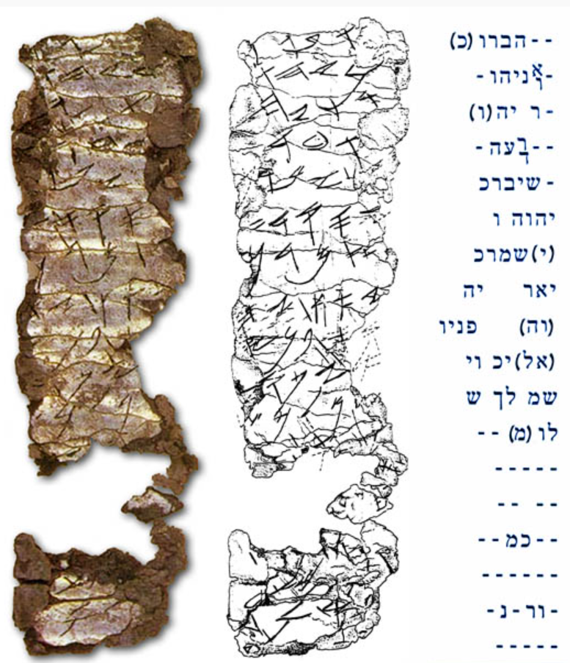
1979 find in burial chamber in Old Jerusalem – Dated to 600 B.C.
-h/hu. May be blessed h/sh-
-[e] by YHW[H,]
the warrior/helper and
the rebuker of
[E]vil: May bless you,
YHWH,
keep you.
Make shine, YH-
-[W]H, His face
[upon] you and g-
-rant you p-
-[ea]ce.
[Bottom line(s) broken.]
Compare lines 7-13 to:
Numbers 6:24—Yahweh bless you and keep you;
Numbers 6:25—Yahweh make his face shine upon you, and be gracious to you;
Numbers 6:26--Yahweh lift up his countenance upon you, and give you peace.

Slide 34
The priestly blessing of the community
Expressed in Hebrew poetic style, a high form of speech with parallelism, terseness, and metaphors.
First line: three words in Hebrew, second line has five, and third line has seven, invoking God’s expansive blessing moving outward.
Each of the three lines has two clauses: God’s movement toward the people, and then naming the results.
God (Yahweh) is the subject of each of the three lines—not the priest who speaks the words.

Slide 35
The source and power of the blessing is God
6:22 The Blessing was given directly by God to Moses
6:23 Aaron and his sons (Priests) use the blessing to invoke God’s favor on the Israelites
6:27 So they (priests) will put my name (Yahweh) on the Israelites, and I (God) will bless them.

Slide 36
6:24: Blessing→Keeping
Blessing includes the giving of God’s gifts of posterity, land, health, presence, and all things that make human life possible.
God’s “keeping” guards and protects from evil.
See the last few verses of Psalm 121.

Slide 37
6:25: Light on all nations
Light connotes clarity, revelation, the warmth of sunshine, rescue from cold darkness, renewal of life, and the brightness of joy.
This metaphor celebrates the saving power of God.
The sun, source of life giving light, shines on all nations.
See Psalm 67:1-2, Ps. 67:6-7

Slide 38
6:26 Granting peace to His chosen people
Turning his face implies giving special blessings to the Israelites, beyond those given the rest of the nations.
The ultimate goal of God’s blessing is shalom, or peace.
In other OT passages, peace is associated with prosperity (Ps. 37:11), longevity, happiness (Ps 128:6), safety, security (Ps. 4:8), good health, friendship and general well-being.
God’s Final Word is Peace.

Slide 39
Num. 7 – Flashback to offerings from the 12 tribes to set up the tabernacle
Numbers 7 occurs in the 13th month after the Exodus, so it is a flashback to before Num. 1 which begins in the 14th month.
The offerings to the Levites and to the tabernacle come from the 12 tribes of Israel so as to establish the tabernacle.
Most scholars see this section as a later editorial addition to Numbers – a rebuttal to the divisions between tribes suffered later after return from exile in Babylon (Ezra / Nehmiah).
Each tribe was given a day to give, and all gave EXACTLY the same things, even though the gifts are enumerated in exhaustive detail. This stresses the unity and equality of the tribes in Israel.

Slide 40
Num. 7 Flashback makes a point at this stage of the story
An analogy: A church planning meeting.
Tendency is to:
  Focus on efficiency, results, business tactics, programs.
  Bottom line defined by dollars, numbers of new members, etc.
A more important focus is God:
  Matters of worship, prayer, fellowship, service, and presence of God.
  Most importantly, the unity of the 12 tribes are reinforced.

Slide 41
7:89 – How God talks to Moses
God’s voice comes from between the two Cherubim on the cover of the Ark.
The cherubim are hybrid animals with wings often associated in the Near East with the presence of God.
See Exodus 25:17-22.
God’s voice will continue to be heard by Moses in the tabernacle as God guides Moses on the journey.

Slide 42
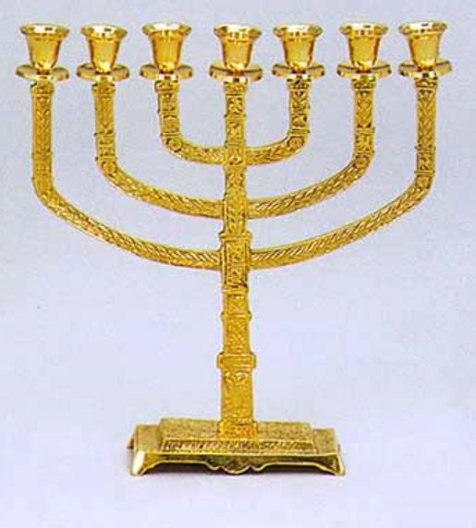
8: Evidence of obedience of Aaron and the Levites
8:1-4. The Israelites are obeying God’s instructions from Exodus, and God is fulfilling his promises. All seems well!
Exodus 25:31-40.

Slide 43
8:5-26 Purification and Dedication of the Levites
After all the preparation, the Levites are now ready to be purified and dedicated for their service.
Step 1, 8:5-7 Purification – shaving hair, washing the body, laundering clothes, and being sprinkled with the “water of purification”.
Step 2, 8:8-19 Presentation of the Levites before the tabernacle by Aaron.
The ritual of laying hands on the Levites who then lay hands on bulls to be sacrificed: It means that the Levites are dedicated to God as a living sacrifice in service to Aaron and the priests.
This model is echoed by Paul: Romans 12:1-2, 12:4-5.

Slide 44
9: Second Passover inaugurates the march of Holy Camp of Israel
The first Passover occurred as the firstborn in Egypt were killed by God except for those who marked their doorposts with the blood of the Passover lamb.
This convinced Pharaoh to set Israel free.
God commands the Israelites to always observed the Passover in Ex. 12:24.
The second Passover in Numbers also shows obedience and marks a new beginning as the march across the desert is about to begin.

Slide 45
Passover connection to Jesus
The Last Supper (continually celebrated by Christians) occurred at a Passover meal and marked a new act of salvation through Jesus.
Jesus is “the Lamb of God, who takes away the sin of the world,” John 1:29, 35.
None of Jesus bones are broken on the cross, as in the Passover lamb. (John 19:31-36)

Slide 46
God’s presence in the cloud
Ex 13: 21-22 – God’s cloud is shaped like a pillar and moves in front to guide them out of Egypt after the first Passover.
Num 9:15-23, the cloud is now over the Tabernacle to guide the Israelites from within the center of the camp.
The camp has been purified and the Israelites are obedient, therefore God is in their midst.

Slide 47
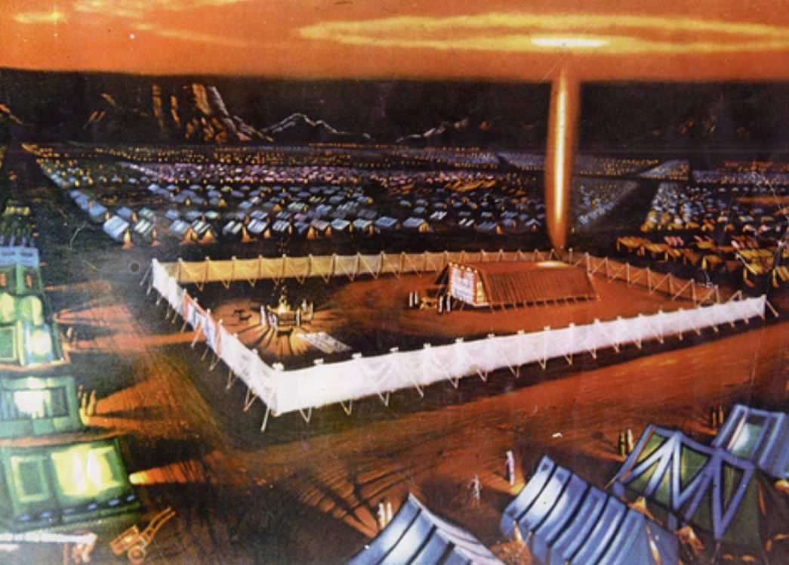
God’s presence in the cloud

Slide 48
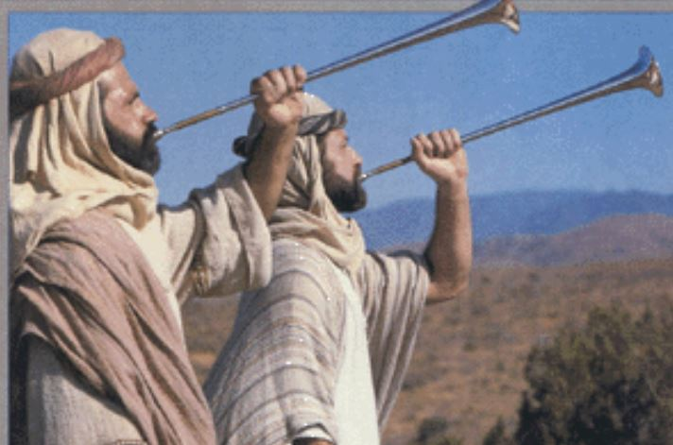
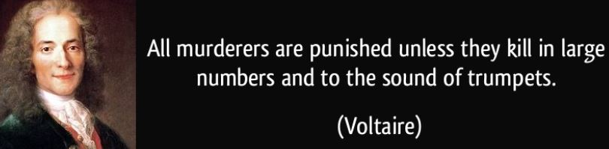
10: Trumpets for Holy Orders
Silver trumpets were used to mobilize the march, for meetings, festivals, and for war.

Slide 49
Tradition of the Trumpets – Blown by the holy men, not warriors
Num 31:6: Sound to start holy war against the Midianites.
I Chron. 15-16, II Chron. 13, 15, 29): processions of the ark, dedication of Solomon’s temple, call to war, restoration of worship after reforms of Hezekiah
Matt. 24:31: Gathering of the elect at the Apocalypse.
Paul describes the raising of the dead with a final trumpet call: I Cor. 15:51-52.
Rev. 8-9: Seven angels blow seven trumpets for assault on the enemies of God.

Slide 50
10:11-36 Just leave, already!
The flashback of Num 7-10:10 has ended. We now jump back to the 14 month after leaving Egypt, 11 months after arriving at Mt. Sinai, and 19 days after the census.
The tribes start out in the order of Num 2, and Levites take the tabernacle as instructed in Num 3.

Slide 51
10:29-32 The Ancient Tradition of Hobab
This narrative is thought to be much older than previous chapters.
Who’s the father-in-law of Moses?
  Exodus 2:18: It’s Reuel
  Judg. 4:11: It’s Hobab
  Exod. 3:1, 18:1: It’s Jethro
Why does Moses ask the foreigner Hobab for guidance when they have the cloud of God?
  Israelites are the chosen people, but God cares about all.
  This is an early endorsement of inclusion.
  We all can learn from strangers (Luke 24, stranger on Road to Emmaus turned out to be Jesus).

Slide 52
The end of obedience and preparation.
Num 1-10 is monotonous in its stories of obedience and preparation, but danger has been constantly lurking under the surface:
  3:10 death for those who come near tabernacle
  4:15 Kohathites must not touch holy things or they will die.
  Levites protect against Israelites coming to close to the sanctuary 8:19
  References to dead bodies: 5:2, 6:6, 9:6. What are all these dead bodies?
The Presence of God at the center of the camp is both a life-giving light and a powder keg about to explode!

Slide 53
Part one: death of the old generation
Num 1-25
II. ABRUPT SLIDE INTO REBELLION: THE DEATH OF THE FIRST WILDERNESS GENERATION BEGINS
Num 11-20

Slide 54
Num. 11-20 Abrupt Turn Toward Rebellion
The Israelites quickly turn from obedience to rebellion, a contrast that is similar to:
  Genesis 2 to 3: Garden of Eden is disrupted by original sin.
  Exodus 19-31 to 32. Giving of the laws of God is followed by fall into idolatry in the golden calf story.
Throughout Numbers 11-20, the Israelites continually rebel and are punished with plagues and military defeats.

Slide 55
Overview of Numbers 11-20
11: General rebellion
12: Rebellion by two leaders, Aaron and Miriam
13-14: Spy mission into the promised land defines death of the old wilderness generation and the birth of the new generation.
15: A word of hope.
16-20: Rebellion even of Aaron and Moses

Slide 56
Similarity to the Rebellion in Exodus
EXODUS – Before Sinai
NUMBERS—After Sinai
Miriam’s song of praise (15:20-21) complaint about water, bitter water made sweet, the LORD heals (15:22-26) manna/ quail—16
Water from the rock—17:1-7 leaders appointed to ease Moses’ burdens—18
Israel attacks Amalek and is victorious – 17:8-16
Miriam and Aaron rebel—12 unspecified complaint—angry fire of the LORD kills—11:1-3 manna/ quail—11:4-15, 31-35
Water from the rock—20:1-13 leaders appointed to ease Moses’ burdens 11:16-30
Israel attacks Amalek and is defeated—14:39-45

Slide 57
Fire at the Fringes: The First Rebellion (11:1-3)
Unlike in Exodus, God does not judge complaints to be legitimate, but instead treats them as unfaithful acts.
In Numbers, God punishes the Israelites unfaithfulness. By this time, God expects obedience without excuse.
Numbers 11:1-3 has the same pattern as the other complaint stories that follow:
  The people complain
  God’s anger is kindled
  Moses intercedes
  The punishment is stopped

Slide 58
Complaints about Manna 11:4
Complaints start with the Non-Israelite “rabble” on the edge of the camp (Hebrew ‘asafsuf), but the Israelites join the rebellion.
Parallels the complaints in Exodus as discussed in Dan’s sermon last week.
Manna was a basic, temporary food that required daily trust in God—provided one day at a time.
  Is the basis for the Lord’s prayer “daily bread.”
  Is a teaching of Jesus in Matt. 6:31-34.
The burden on Moses is great, so God instructs him to appoint 70 elders to help him. This also occurs in Ex. 24:1. Did these earlier elders die, or is this an alternate tradition? Also, Jesus sends out 70 evangelists in Luke 10:1-20.
God sends mountains of quail, but kills those who eat it as a lesson for their disobedience (Graves of Craving, 11:34)!

Slide 59
The Question of God’s Authority: Rebellion of Aaron and Miriam
Aaron is Moses’ brother and the high priest
Miriam is Moses’ sister, and a leader (Ex 15:20-1, Micah 6:4)
Moses is questioned because of his marriage to a “Cushite.” It could be Zipporah, the Midian woman Moses had married earlier. It could also signify a woman from the Ethiopian region with black skin.
This conflict in Numbers 12 is probably related to the tension between leaders and prophets in the tradition of the OT. It suggests that Moses has a special relationship to God that no other person has.
Nevertheless, Moses never sees God’s face, but Jesus is the only one who has seen the Father (John 6:46).

Slide 60
Miriam is punished, but Moses Intervenes
Miriam is punished with a skin disease that turns her skin white (vs. the blackness of the Cushite woman?)
In fear, Aaron confesses his sin and asks Moses to petition God.
Only Miriam is punished—not Aaron:
  Because Aaron is the high priest?
  Because Aaron confessed his sin?
  Because this is another example of unfairness to women in ancient culture?
In the end, God’s judgment on the rebellious will be all-inclusive to the entire wilderness generation who will all die before reaching the promised land.

Slide 61
Num 13-14: The Spy Mission and the Decisive Rebellon leads to Death
This spy narrative is foundational to the structure and theme of Numbers:
Theme of Numbers: Death of the old rebellious generation of the wilderness wanderers and the birth of a new generation of hope standing on the threshold of the land of Canaan.
Structure of Numbers: Census of the old generation (Ch. 1), census of the new generation (Ch. 26)
The spy story is elaborate with suspense, irony, and dramatic dialogue confirming story’s importance.

Slide 62
A Poetic Justice
The concluding lines of Anne Killigrew’s poem “On Death” provide a summary:
“Thus childish fear did Israel of old
From plenty and the Promised Land withhold;
They fancied giants, and refused to go,
When Canaan did with milk and honey flow.”

Slide 63
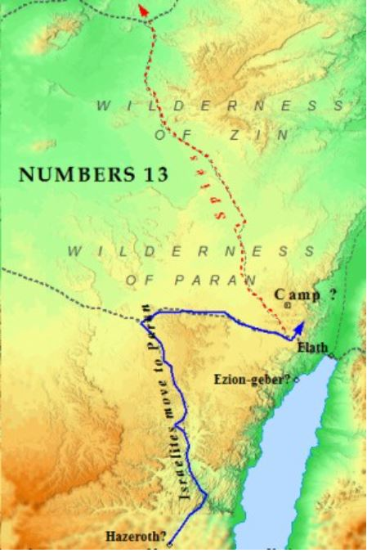
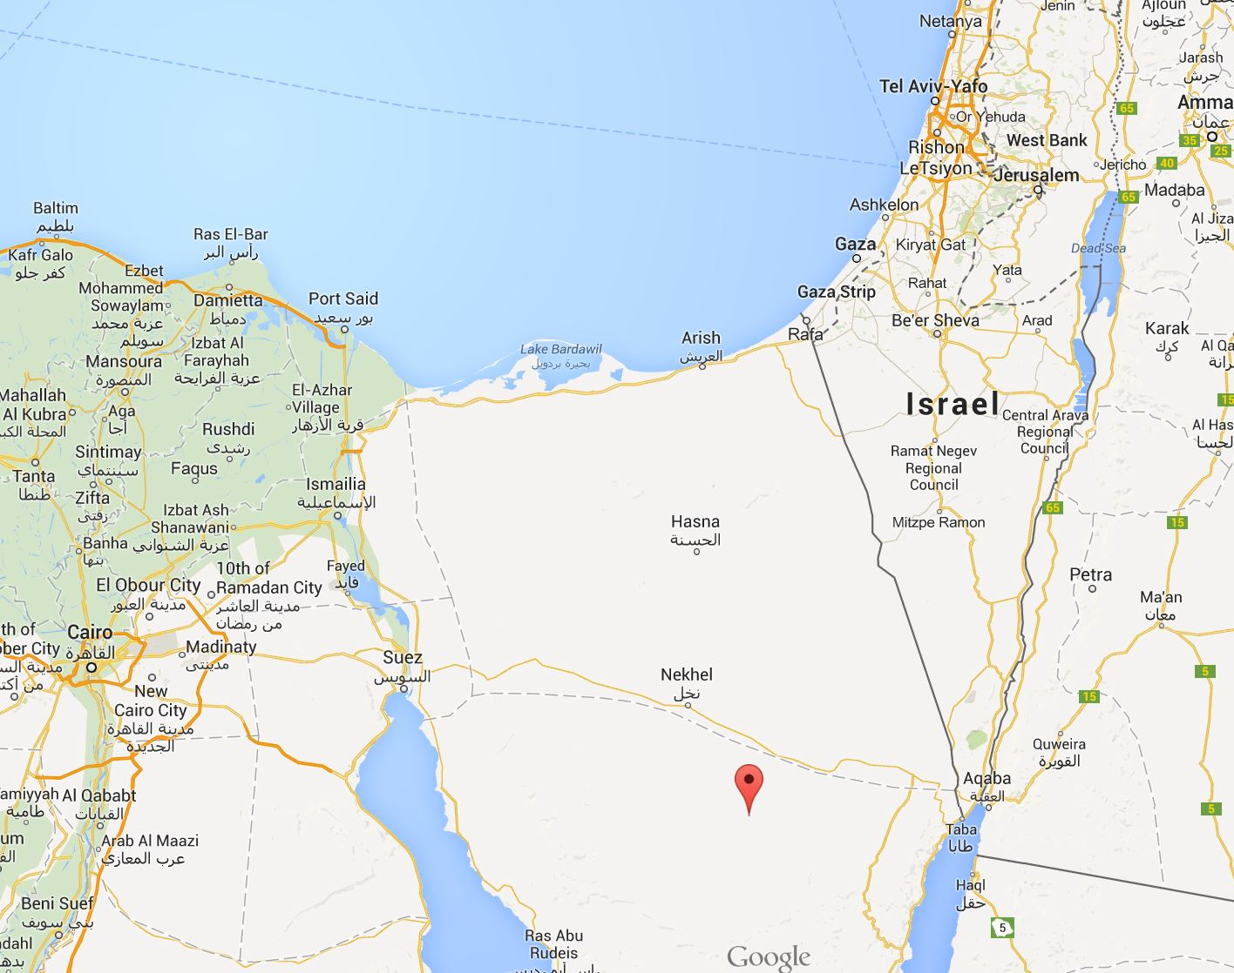
Geography of Numbers 13
The “Land of Giants”

Slide 64
13-14: Spy Story Outline
Instruction to the spies to survey the land (13:1-20)
The spies complete their mission (13:21-4)
The reports by the spies (13:25-9)
  Spies’ majority report #1—land is good “yet” the inhabitants and cities are strong (13:25-9)
  Spies’ minority report #1—Caleb alone—we are able to conquer the land (13:30)
  Spies’ majority report #2—land devours its inhabitants, people are mythological giants (13:31-3)
Response of the people—return to Egypt! (14:1-5)
Spies’ minority report#2—Caleb and Joshua—have no fear, God is with us (14:6-10)
God’s response and dialogue with Moses (14:10-35)
  A. “I will disinherit them” (14:10-2)
  Moses’ plea for forgiveness for the people (14:13-9)
  God forgives (14:20-5)
  Forgiveness yet also punishment—the death of the old generation but the promise of a new generation (14:26-35)
Proleptic fulfillment: the death of the spies, except for Joshua and Caleb (14:36-8)
The people’s failed attempt to take the promised land through their own efforts; God is not with them (14:39-45)

Slide 65
Theology of the Spy Story
The nature of sin:
Numbers 14:
  Spurning and despising God’s free gift of the promised land.
  Refusing to trust God to make good on His promise.
New Testament
  Similarly, Jesus was crucified and the cross is a sign of the world’s despising God’s gift of salvation.
  God’s fulfillment of the promise of a Messiah was rejected by the Jews.

Slide 66
Theology of the Spy Story
The nature of forgiveness:
Numbers 14
  God forgives through the intercession of Moses
  Moses denied himself the glory of becoming a great nation to appeal to God for forgiveness
New Testament
  Rom 8: Paul writes that nothing in all creation “will be able to separate us from the love of God.”
  Like Moses, Jesus denied himself and his own glory for the sake of others through his suffering and death (Phil. 2:1-11)

Slide 67
Theology of the Spy Story
3. Tension between forgiveness and judgment through the paradigm of death of the old and birth of the new:
Numbers 14
  Death in the desert is God’s judgment on the old generation
  Out of death came new life for the new generation to reach the promised land
  The rebels tried to save their lives by refusing to enter Canaan, but instead faced death in the desert.
New Testament
  Jesus’ death gives us new life
  Luke 9:24 “For those who want to save their life will lose it and those who lose their life for my sake will find it”

Slide 68
Theology of the Spy Story
4. The nature of faith as fear and trust in God’s power above all else.
  Rebellious spies feared Canaanites more than they feared God.
  In the end, they went into Canaan by their own power and resolve and were defeated.
Martin Luther: “You shall fear, love, and trust God above anything else.”

Slide 69
Theology of the Spy Story
5. God has mighty power to conquer “giants” and loving power to save “the little ones”
Numbers 14
  14:9 “The LORD is with us; do not fear them
  14:31 “your little ones, who you said would become booty, shall know the land you despised”
New Testament
  Luke 14: parable of the great banquet
  Master extends an invitation to a feast
  Invited guests make excuses and refuse
  Master invites the poor, crippled, blind and lame (i.e. the little ones).

Slide 70
Chapter 15: Regulations and Reassurances for Life in the Promised Land
Chapter 15 is an interruption in narrative of disobedience.
Some commentators do not see any reason for the placement of these ordinances here other than Numbers is the “junk room of the Bible.”
However, we will learn much from having these regulations and rituals discussed at this point.
Like a football coach teaching fundamentals after a crushing defeat: Time to remember God’s promises and commands, and receive encouragement in the face of despair.

Slide 71
Some intertwining repeated refrains show cohesion of themes in 15
“the alien who resides with you” (15:14, 15, 16, 26, 29, 30)
“throughout your generations” (15:15, 21, 23, 37)
“when you come into the land you are to inhabit that I am giving you” (15:2, 18)
“everything the LORD has commanded you” (15:22, 23, 39, 40)
“an offering by fire to the LORD (15:3, 13, 14, 25)
“a pleasing odor to the LORD” (15:3, 7, 10, 13, 14, 24)
“the whole congregation” (15:24, 25, 26, 33, 35, 36)

Slide 72
15:1-16—Offerings that can be made to God
Note that these are for the future when the Israelites are in the promised land—They only have manna in the desert.
Nature of offerings confirm that the land is “flowing with milk and honey”
There is a theme of expansion: Earlier offerings applying to specific festivals are generalized to every time sacrifices are made.
Inclusiveness: “you and the alien shall be alike before the LORD” 15:15-16 foreshadows Paul in Gal. 3:28 and is similar to Isa. 56:7

Slide 73
15:22-26 – Atonement for the Israelite community for an unintentional sin
God will forgive the Israelites if the community breaks the law inadvertently
The required offering of meat, grain, and wine is consistent with earlier guidance, and would apply to a future in the promised land.
Several phrases from earlier in 15 re-occur here in vs. 22-26:
  “throughout your generations”
  “a pleasing odor to the LORD”
  “an offering by fire to the LORD”
  “Israelites…as well as aliens”

Slide 74
15:27-31 – Consequences of sin depend on intentions
15:27-29 – Unintentional sins of an individual can be forgiven, both for Israelites and aliens among them.
15:30-31 – “Highhanded” or “blatant” sins with full knowledge of the law require “cut off from the people,” i.e. death or banishment

Slide 75
15:32-36 – Making an example of an intentional sinner
The man breaks both the prohibition against working on the Sabbath and against lighting a fire on the Sabbath (Exodus 35:2-3).
It’s not clear why Moses needs to consult God, but God’s response make certain the interpretation of the law for a “highhanded” sinner.

Slide 76
15:37-40 – Wear a blue cord as reminders of God’s commandments
This section was included in the Jewish liturgy of the postexilic period in a prayer known as the “Shema” Deut. 6:4.
Modern Jews continue to wear the blue cord and fringes on the prayer shawl worn in Jewish worship.
The chapter ends with an affirmation that God is the LORD of the Israelites who will deliver the people (the next generation) to the promised land.

Slide 77
Connections and parallels: Ch. 15 is intentionally placed in Numbers
Numbers 15 | Numbers 11-14
Non-Israelite “alien” | The non-Israelite rabble (11:4), the Cushite wife of Moses (12:1)
“throughout your generations” | Old generation will die in the desert, but the new generation will live in the land (14:30-31)
“an offering by fire to the LORD” | Reversal of “the fire of the LORD burned against” rebels in the camp (11:2-3)
Offerings as “a pleasing odor to the LORD” | The anger of the LORD—in Hebrew literally—”the nose of the LORD flares up in anger” (11:1, 10, 33; 12:9)
Will the reminders of the law in Chapter 15 prevent further rebellions? We will find out in Chapter 16…

Slide 78
16: Rebellions from Levites to Lay Leaders to All the People
It wasn’t specified in 14 whether the Levites were a guilty tribe in the spy story and were doomed to die in the desert
Here in 16, it is clear they are guilty, and this chapter continues the slow death of the old unfaithful generation to die in the desert, even as God will deliver the promised land to the next generation.
The sin in 16 is ENVY which causes Levite Korah to incite a rebellion against the exclusive position of Moses and Aaron to meet directly with God.

Slide 79
16 is a synthesis of multiple traditions of uprisings
Earliest form of story may have been about Dathan and Abiram from Reuben tribe. A third Reuben member, On, is mentioned in vs. 1 but not again.
The narrative was likely enlarged to include 250 lay leaders in the rebellion.
Korah is a subordinate Levite and is the main actor in the final version of Numbers 16 but may have been added last.
The second census list in Ch. 26 reflects a demotion of the Reuben tribe in list order as well as population.

Slide 80
The Six Response of Moses to the Rebellion in Num. 16
(v. 4) Falls on his face in intercession to God
(5-8) Korah and company invited to a showdown with censers (fire pans) at tent of meeting.
(8-11) Reminds Korah of his Levites’ duty.
(12-14) Demands to see Dathan and Abiram, but they refuse to come.
(15) Defends himself and his actions to God
(16-17) Reiterates to Korah instructions for the next day’s showdown with the censers.

Slide 81
16:18 The Showdown at the Tent
God’s threat to the disobedient is similar to Numbers 14, but this time it is about immediate death vs. eventual death of the old generation in the desert.
Entire assembly is rebellious (vs. 19) but perhaps the leaders are more guilty of “highhanded sin” and so are asked to separate.
First Korah (and Dathan and Abiram, presumably) are swallowed up by the Earth. Later, the entire 250 rebellious lay leader are also.
This was similar to Numb 3:4 when Aaron’s sons Nadab and Abihu were consumed by fire when they offered illicit fire to the LORD.
Ironically, they receive what was feared about entering Canaan—they were devoured by the Land.
Thus God affirms the leadership of Moses.

Slide 82
Sheol: Where all the dead go in the ancient Jewish Tradition
Sheol is the abode of the dead for both the wicked and the righteous.
Sheol is below ground, dark, silent, and the dead can no longer remember or praise God.
Only later did apocalyptic OT traditions emerge (Dan. 12:2-3) that include resurrection from Sheol.
Later Christian notions of heaven and hell for believers vs. non-believers are much different than the ancient Jewish traditions.

Slide 83
16:41-50 The whole nation rebels
When the whole nation rebels, there is no argument Moses can make to God but to ask Aaron to make atonement and to plead for mercy.
In the end, 14,700 died because of the rebellion, although none of the others of the old generation will survive the desert in the end.

Slide 84
Theological Implications for the Priesthood in Chapter 16
Protestant tradition of “the priesthood of all believers” sounds a lot like Korah’s heretical words “All the congregation are holy, every one of them, and the LORD is among them.
Martin Luther’s notion of all Christians as priests is supported by I Peter 2:5,9.
Exodus 19:6 supports this as well.
In Numbers, God explicitly was endorsing the leadership structure and role of the Levites as important to the community’s survival in the desert.
Heb 7:27 indicates the role of Jesus as replacement for the Earthly priesthood.
“Priesthood of all believers” doesn’t necessarily eliminate the need and role of clergy, even in protestant tradition.

Slide 85
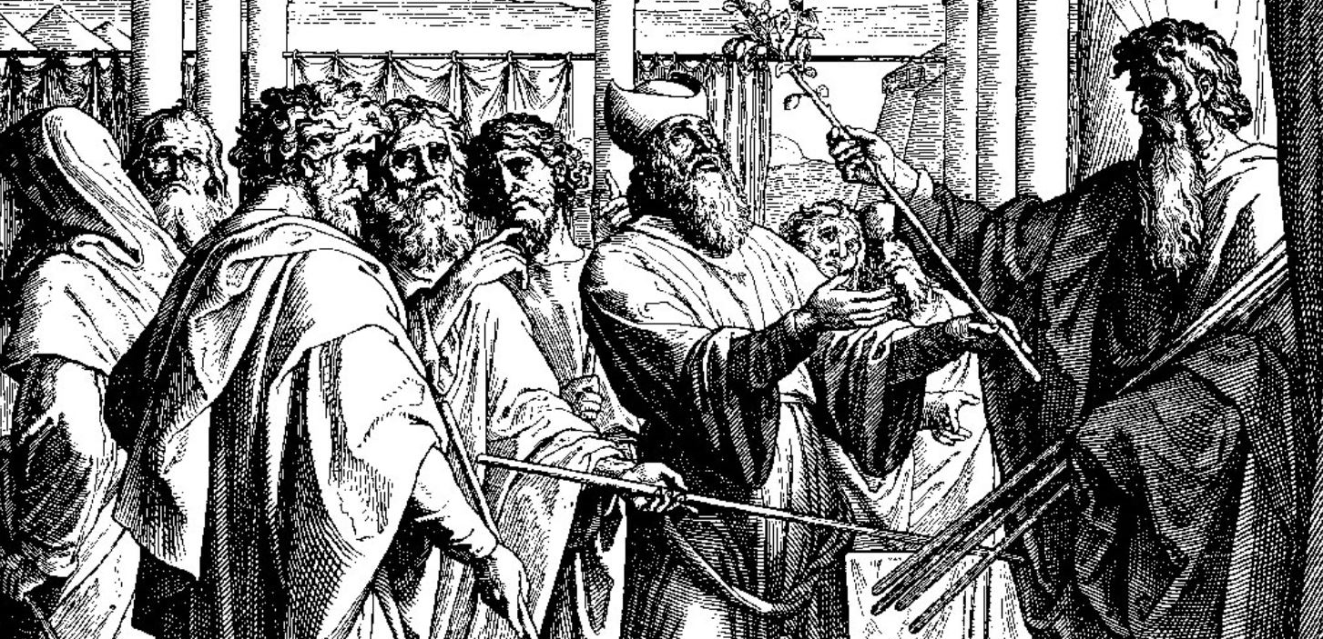
Ch. 17: God gives an enduring sign of support for the priesthood
Hebrew word for staff is matteh which also means “tribe”
The dead wood is brought to life as a sign of God‘s power anointing of the Levites
Staff is a positive reminder in the Tent of Meeting in contrast to covering made from the censers of the dead rebels of Ch. 16.

Slide 86
Wood is powerful image through the Bible
Matt. 7:15-20 – Judging a tree by its fruit.
“A holy man said to me, “Split the stick and there is Jesus.” When I split the stick to the dark marrow and the splintery grain, I saw nothing that was not wood, nothing that was not God, and I began to dream How from the tree that stood between the rivers Came Aaron’s rod that crawled in front of Pharaoh, and came the rod of Jesse flowering in all the generations of the Kings, and came the timbers of the second tree, the sticks and yardarms of the holy three-masted vessel whereon the Son of Man hung between thieves, and came the crown of thorns, the lance and the ladder, when was shed that blood streamed in the grain of Adam’s tainted seed.
--Howard Nemerov, “Runes”

Slide 87
Ch. 18 – Review of the God-given Responsibility of Priests, Levites, and Community
The previous two tests reinforced God’s commands for the role of Priests and Levites
Unlike elsewhere, God talks directly to Aaron.
The Priests and Levites receive tithes to sustain them in exchange for their service.
Once again, these laws apply to future generations of Israelites in the promised land, not in the desert in “a covenant of salt forever.”

Slide 88
Summary
18:1-20—God speaks directly to Aaron about the role of the high priests
18:21-29—God reassures the Levites of their role: support the priests with labor and tithes in turn.
18:32—Don’t forget, this role is so important that failure to obey leads to death!

Slide 89
Tithes—an OT law
The Levites require tithes to survive and to carry out their duties—they have no allotment of land like the other tribes (18:20)
A tithe is 10% of the fruits of a person’s labor.
The principle of “first fruits” is that the tithe should be from the best that you have, not the leftovers.
The OT tithe is not a law for Christians, but the principles remain for us. I Cor 9:13-14, 1 Tim 5:17-18

Slide 90
Ch. 16-18 and the Priesthood of ancient Israel
Did later priests place these stories to justify their control and position in the Temple?
Did the surviving priesthood want to suppress rival groups in Israel?
There is evidence that these accounts were developed over many generations
Cynical interpretation does not hold up however:
  The sins of the priesthood are dealt with here
  These traditions have been accepted to this day by Jews
  Christian communities adopted these themes as well and aspects of the priesthood continue to this day

Slide 91
16-18 Teach us about the Christian Church today
Sin and misconduct by church leaders and the community occurred even against direct commands of God and in his direct presence.
These sins threaten the whole community.
They are serious and have serious consequences.
God will not let the sins of people prevent His ultimate purposes from coming to fruition.
The church will endure through inevitable human sin and misconduct.

Slide 92
Ch. 19: Purification for the People
Chapters 11-18 are filled with rebellions, punishments, and death:
  Death by fire in 11:1 on fringes of camp
  Death by quail/plague in 11:33
  10 rebellious spies died of plague in 14:37
  Failed military venture in 14:45
  Earthquake and fire killed Korah, Dathan, Abiram, their families, and 250 other insurrectionists
Ch. 17-18 focused primarily on the clergy
So now, Chapter 19 tells how God provides the lay people a way forward to purify themselves in the midst of all this death through the Ashes of the red heifer or red cow.

Slide 93
Water and blood as purification have ancient roots in Numbers 19
This is the only ritual with such strict requirements for burning the animal in total, including its blood.
Eleazar, the son of Aaron, is assigned to oversee the making of the ashes. His role anticipates Aaron’s death and Eleazar becoming the new high priest.
This ritual is needed because of all the deaths that will occur of the old wilderness generation.
It is available to non-priests and foreigners alike.
For us, Christ replaces the need for this ritual as discussed in Hebrews 9:13-14.

Slide 94
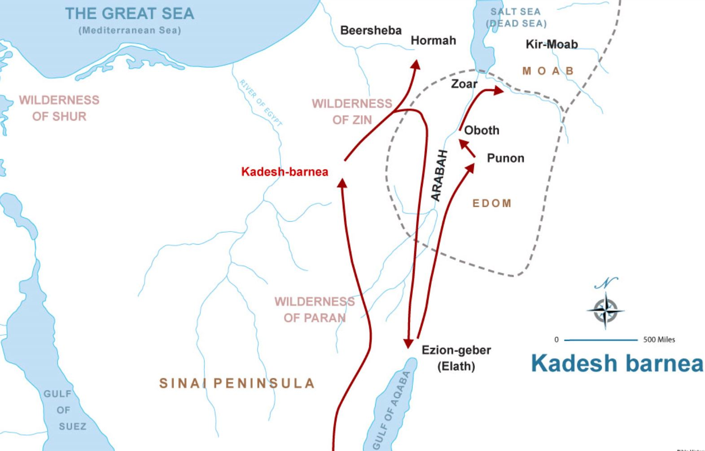
Ch. 20: Movement toward promised land is interrupted by more death and defeat
Once again, the camp is moving toward the promised land, but God will not allow the dying old wilderness generation to reach it.
Miriam dies in Kadesh

Slide 95
Moses fails to follow God’s Command
Nu. 20:2-13:
Lack of water sends the people to complaining and lamenting their life in the desert
Moses and Aaron approach God, who does not punish, but provides instructions for a miracle to bring water.
However, in vs. 10, Moses disobeys:
  Strikes the rock instead of speaking to it
  Disdained God’s miracle in his statement (shows contempt, arrogance, lack of faith, taking credit?)
As a result, Moses is condemned to never enter the promised land. An alternate tradition in Deu. 34 indicates Moses was doomed because of the sin of the people, not his own sin.

Slide 96
Edom rebuffs Israel
Jacob and Esau were twin brothers. Jacob’s descendants were Israel, and Esau’s descendants were Edom.
In Gen. 32-33, Jacob steals Esau’s birthright, and refuses to join Esau in their last meeting.
The route through Edom appears to be done without God’s support, and thus the mission fails.
There is an alternate tradition in Deu. 2:1-8 that indicates the Israelites were allowed to pass through Edom.

Slide 97
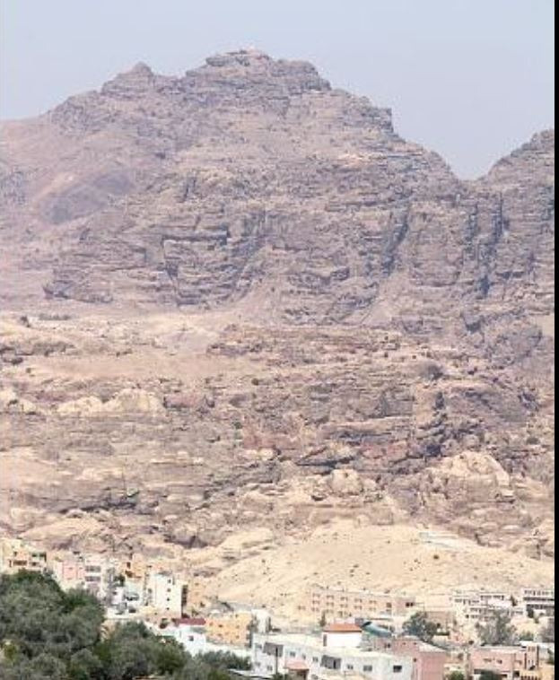
Aaron dies on Mount Hor
Before he dies, Aaron gives his garments to his son Eleazar who will then be the new high priest.
The mountain known as Mt. Hor today is in Jordan, which would have been in the middle of Edom. An alternative location would be more to the west.
Aaron’s death marks his punishment for rebellion, and a fulfillment of God’s promise to the new generation.
Today’s Mt. Hor: 4800 ft ASL, 6000 ft. above the Red Sea

Slide 98
Part one: death of the old generation
Num 1-25
III. Hitting bottom: the end of the First Generation—Signs of Hope in the midst of death
Num 21-25

Slide 99
21:1-3: Victory over Arad at Hormah
Hormah was the site of the failed invasion of the spy story of 13-14.
Just as 11:1-3 provides a template for the rebellions, 21:1-3 provides a template for Israelite holy war military victories:
  Encounter with (usually aggressive) enemy
  Israel’s vow to dedicate booty to God in exchange for victory
  God’s acceptance of the vow.
  God’s handing over of the enemy
  Israel’s dedication of the captured to God (via destroying it or handing it over to the Priests)

Slide 100
21-25: The Wilderness Generation Comes to an End
21:1-3 Victory over Arad (Canannite King)
21:4-9 Rebellion
21:10-13 Victory over Sihon and Og
22:1-24:25 King Balak of Moab and the foreign prophet Balaam—”The Balaam Cycle”
25—The final rebellion and death of the old generation

Slide 101
21:4-22: The Journey to Moab
After victory at Hormah, the camp must detour toward the Red Sea to go around Edom in order to reach Moab. This makes the people impatient and leads to more rebellion.

Slide 102
21:4-9: Serpent Represents both Life and Death
As in the spy story, the rebellion is followed by repentance. This time, God asks Moses to build a symbol to remind them of God’s power to save.
Just as the snake represents both death and life, so does the cross of Jesus. John 3:14-17
Tradition holds that this serpent was kept as a sacred object in the Temple until King Hezekiah had it destroyed as part of iconoclastic reform to prevent the people from worshipping it as a graven image (II Kings 18:4)

Slide 103
21:10-35: Two more victories on the way to Moab
The Israelites are now moving quickly toward the TransJordan from which the new generation will eventually enter the promised land.
21:27-30 is actually an Amorite victory song over Moab from the past. It is put here to emphasize why the Moab people should fear the Israelites.
This section anticipates the coming conflict with the Moabites, whose King Balak fears the Israelites and enlists a prophet named Balaam to curse them, but this will eventually backfire as God wills victory to the nation of Israel.

Slide 104
22-24: Balak, Balaam, and the Blessing of Israel
Just before the old generation dies, God confirms His commitment to Israel with some of the most lavish words of blessing in the Pentateuch.
Characters in this story:
  Balaam, a hired prophet of renown.
  Balak, King of Moab fearful of conquest by Israelites
  God
  People of Israel—camped out and waiting
  The talking donkey who makes a fool of Balaam

Slide 105
Who is Balaam?
A foreigner known in history for his power to curse or bless.
Conflicting views of Balaam may reflect the various different oral traditions that contributed to Numbers.
Positive views of Balaam: Nu 22-24 (faithfully conveys God’s blessings), Micah 6:5
Negative views of Balaam: Deu. 23:3-6 uses his association with Moab to prohibit Moabites and Ammonites from ever entering the assembly. Nu 22:22-35-the donkey episode, and Nu 25, Balaam is killed for counseling Midianite women to lead Israel astray.
Different traditions also may be the reason God has so many different names in the Balaam cycle: God (Elohim), the LORD (Yahweh), Most High (Elyon), Almighty (Shaddai)

Slide 106
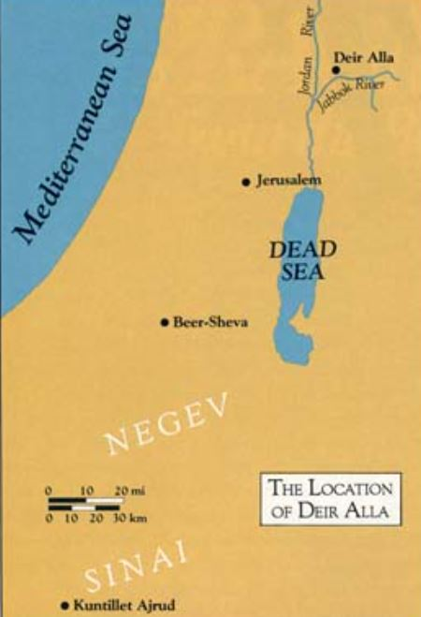
Balaam story discovered in Deir ‘Allah
Plaster panels were discovered by archeologists at a non-Israelite temple in Deir ‘Allah in the TransJordan area.
The panels date to eighth century B.C. and tell a story about Balaam, a professional prophet.
In the story, Balaam has a vision from the council of gods called Shad-dayin. Balaam intercedes to prevent a drought.
The date was March 17, 1967, a Friday. A Dutch expedition led by Professor Henk J. Franken of the University of Leiden was excavating a mound named Tell Deir Alla in the middle Jordan Valley, east of the river, in Jordan. The site lay halfway between the Sea of Galilee and the Dead Sea, barely a mile north of what was known in Biblical times as the Jabbok River and now is called the Zerqa, a tributary of the Jordan.

Slide 107
Three Sections of the Balaam Cycle
22:1-40 – Balaam’s 3 encounters with God as King Balak calls on him to curse Israel.
22:41-23:12 – Balak’s 3 attempts to curse Israel foiled by the 3 blessings of Balaam
24:14-25 – Balaam’s 4th and climactic oracle of blessing for a distant future beyond the present generation of Israelites.
The repetition in threes and the themes of “seeing” and “not seeing” give structure to the story.

Slide 108
22:1-40 King Balak tries to use unconventional means to protect Moab
Surprisingly, Balaam, a foreigner, fears the God of the Israelites more than he desires money.
God’s methods are also surprising:
  First, God says “don’t go.”
  Second, God says “go but do only what I tell you.”
  Third, God sends an Angel to stop Balaam
The donkey story emphasizes the primacy of God and makes Balaam look foolish. His donkey saw the angel but he did not!

Slide 109
22:41-24:13 King Balak refuted three times by Balaam’s blessings of Israel
Each of King Balak’s three attempts to curse Israel through Balaam has the same six elements:
Balak takes Balaam to a mountain overlooking the people of Israel.
Balak builds 7 altars and sacrifices a bull or ram.
Balaam leaves Balak at the altars to consult with God.
Balaam pronounces an oracle of blessing on Israel.
Balak responds negatively to Balaam.
Balaam responds to Balak that he has no other choice but to pronounce the truth of God.
The third oracle is different in that Balaam seems more personally invested in it, and some scholars think it is from the time of King Saul or later from David, but is put here in the mouth of Balaam.

Slide 110
The Climactic Fourth Oracle of Balaam
24:14-25 – A Star out of Jacob, a curse on Moab
Balak tries to “fire” Balaam without pay because he sees where the curse is backfiring on Moab.
However, Balaam moves without Balak to proclaim his 4th oracle which comes from the heart without altars or sacrifices.
The 4th oracle becomes more specific and positive in tone toward a bright future for Israel with powerful leaders, anticipating even King David and the Messiah.

Slide 111
25: The Final Apostasy and Death of the Old Generation
Israelites are poised on the threshold of Canaan, in large numbers, powerful, and with many recent victories.
While Balaam is proclaiming God’s commitment to them, Israel falls to the temptations of victory and power.
This story is parallel to the apostasy in Exodus 32, and it proves that the old generation did not learn its lesson.

Slide 112
Parallels between Ex. 32 and Num. 25
Exodus 32 | Numbers 25
People worship and make sacrifices to another God (6) | People worship and make sacrifices to another God (2)
Foreign involvement: gold from the Egyptians for the calf idol (2-4) | Foreign involvement: Women of Moab and Midian (1-2, 6)
God prohibits sex with unbelieving foreigners and worship of foreign gods. (15-16). | Israelites do exactly what God has forbidden in Exodus 32.
3000 guilty Israelites are killed by Levites as punishment for worship of golden calf. (28). | The “judges” kill those who yoked themselves to the Baal of Peor. (5).
Levites’ obedience in carrying out punishment results in ordination by God as priests. (25, 29) | Phinehas is ordained with a special covenant of perpetual priesthood. (6-13)
Moses “makes atonement” for Israel. (30) | Phinehas “makes atonement” for Israel (13).
A plague is sent as punishment (35). | A plague is sent as punishment (9).

Slide 113
Structure / Development of Num. 25
Scholars believe that the earlier form of the story is 1-5 that involves the women of Maob, punishment of Israelite chiefs, and the role of judges in executing the punishment.
A later addition was 6-18 which includes the women of Midian, thus justifying the assault against Midian in Num 31.
The role of the priest Phinehas in killing Zimri (from the tribe of Simeon) and Cozbi (Midianite) leads to the covenant establishing the priestly line of Phinehas’ descendants. Inclusion of the later tradition could have been used to defray later criticism of the Phinehas priesthood.

Slide 114
Num. 25 is the end of the Old Generation
Moses takes a passive role. His commands do not seem to be obeyed and Phinehas is executing God’s commands. This represents the final disintegration of the order of the camp.
Special shame is reserved for the three tribes representing the curse of Jacob on his deathbed in Genesis 49: Simeon (Zimri), Levi (Korah), and Reuben (Dathan and Abiram). Jacob had cursed these, his first three sons for violence and disobedience, and this is affirmed by their descendants in Numbers.
The death of the 24,000 from the plague in 25:9 are the last remnants of the old wilderness generation.
This brings us to the end of the first half of Numbers.

