Slide 1
Colossians, Philemon, and Ephesians
The New Testament in Its World, Chapter 20

Slide 2
Prayers
Ann Garber
Deb Germroth
Judi Easley
Gary Easley
Dave Petke’s shopping list
Qualls family
Linda’s upcoming surgery April 20
Linda’s boys
Foxes
Snooks
Pete Lodal

Slide 3


Slide 4


Slide 5
Paul Wrote from Ephesus between A.D. 52 and 55.
These three books were (probably) written by Paul from Ephesus during his second visit there (AD 52-55).
Paul ministered to some followers of John the Baptist.
He preached in a Jewish synagogue.
Paul was forced to leave and gave daily discussions in the lecture hall of Tyrannus.
Paul’s co-workers established churches in Pergamum, Sardis, Philadelphia, and Thyatira, and in the Lycus valley towns of Laodicea, Hierapolis, and Colossae.

Slide 6
Some of Paul’s Co-Workers in Ephesus
Philemon and his wife Apphia, gentiles from Colossae who were led to faith by Paul.
Epaphras evangelized Colossae, Laodica, and Hierapolis before joining Paul in Ephesus and possibly being imprisoned with him.
Archippus, who led the Colossian church in Epaphras’s absence.
Nympha, who hosted the church in Laodicea in her house.

Slide 7
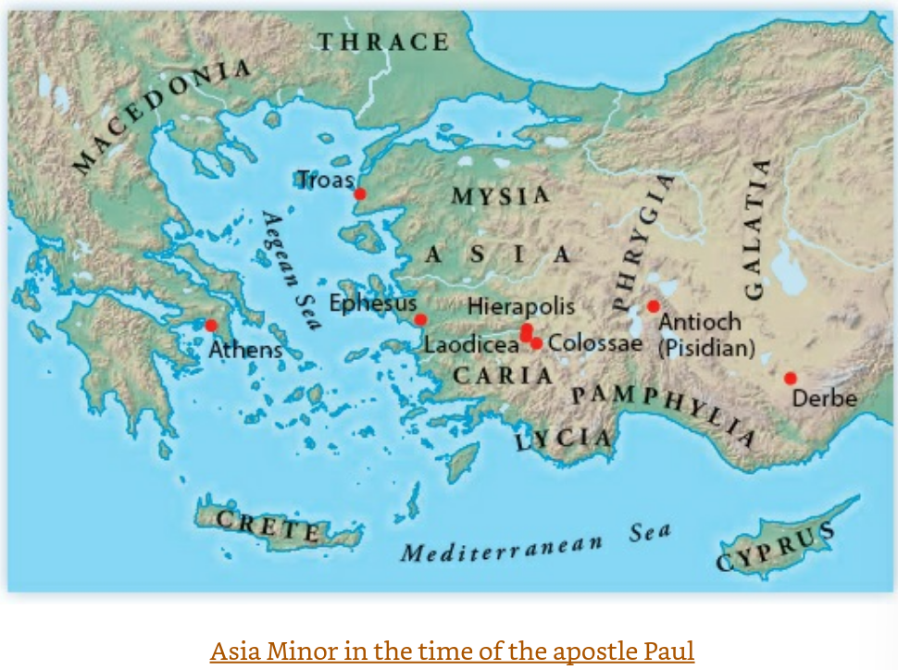

Slide 8
Paul was in prisoned in Ephesus
Malnourished, sleepless, ill, beaten by guards, wretched with the smell of rot, excrement, and death.
Yet, Paul managed to write Philippians, Philemon, Colosians, and Ephesians (which might have been written shortly after he left prison), probably with the aid of church members.
The message is: Jesus is sovereign. The churches should model the cosmic reconciliation achieved by God through him.

Slide 9
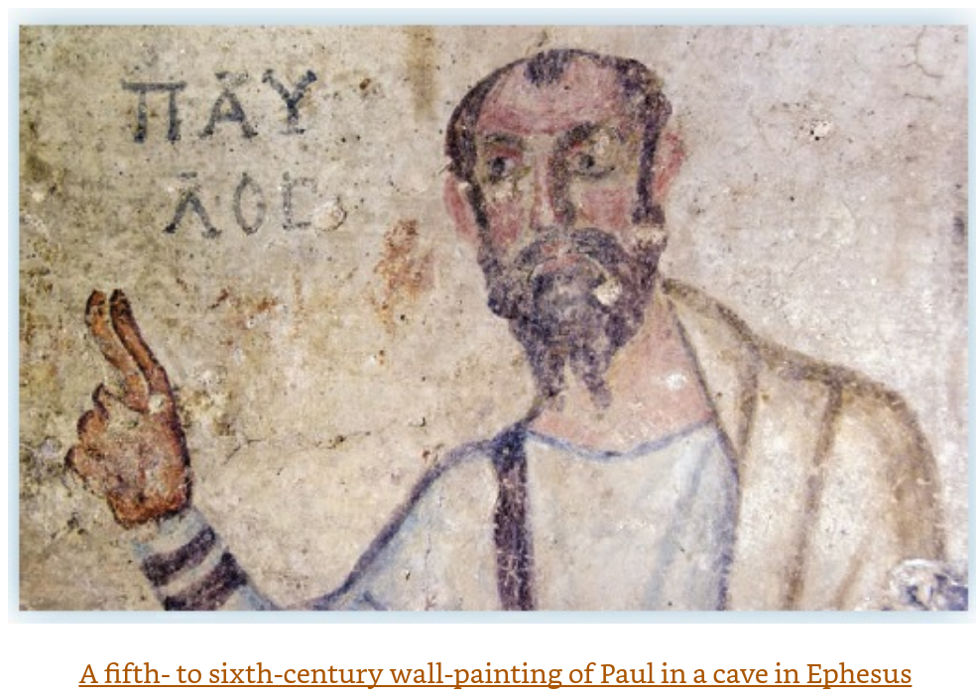
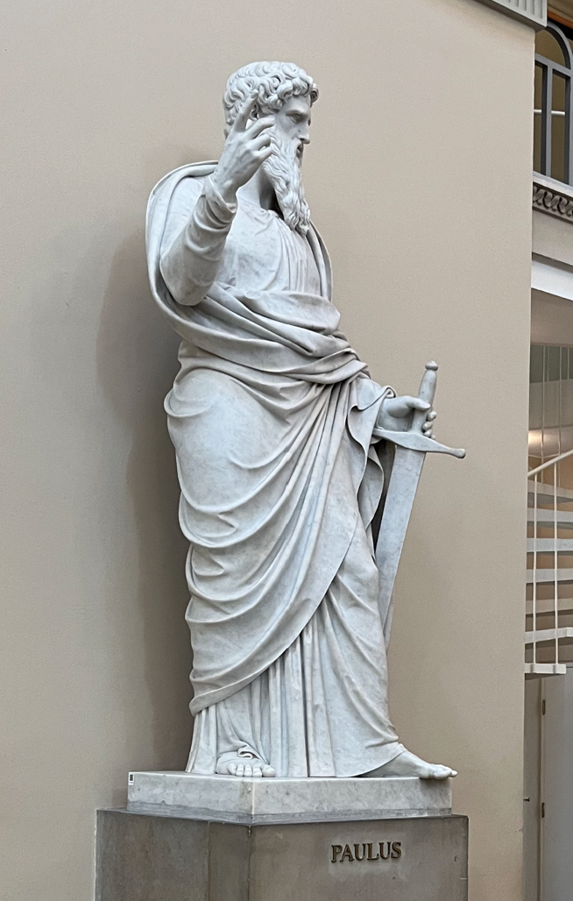
Images of Paul (Imagined by later artists)
Statue of Paul
Von Frue Kirke
Copenhagen
(i.e. Church of
Our Lady, 1829,
Original building
1209.
[Lutheran]

Slide 10
Paul’s ministry contributed to unrest in Ephesus
Opposition intensified due to a split in the synagogue community.
“Magical” scrolls were burned by many who practiced various kinds of sorcery.
The worship of the goddess Artemis declined causing opposition from local silversmiths who made and sold idols.
Eventually, less stability was experienced due to the murder of the proconsul Marcus Junius Silanus in A.D. 54 by Agrippina (mother of Nero).
Pricilla and Aquila were praised for “risking their necks” for Paul while he was in prison.

Slide 11
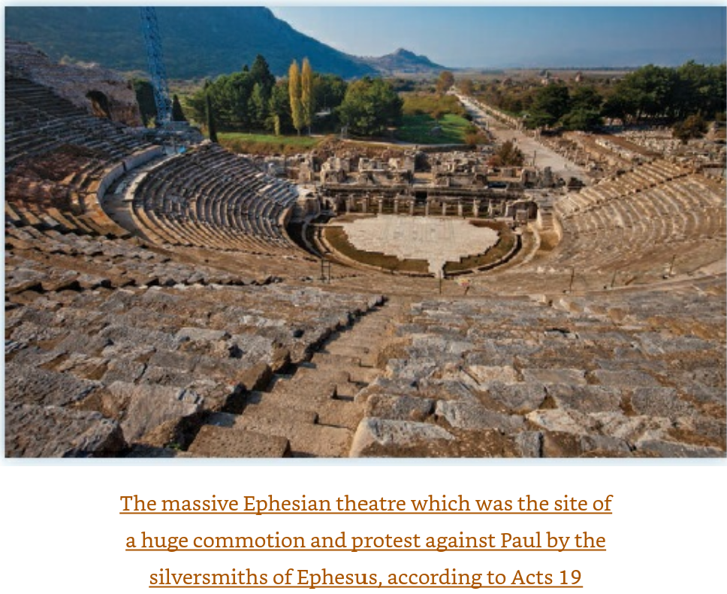
About Ephesus
Largest city in empire except for Rome and Alexandria with a population of 200,000 in A.D. 50.
Key location on trade routes on sea and land
Ampitheatre, aqueducts, gymnasium, stadium, two agoras (Greek central meeting places), impressive gates, and basilica.
Known and identified with massive shrine to Artemis, Queen of Heaven and protector as well as a source of commerce.

Slide 12
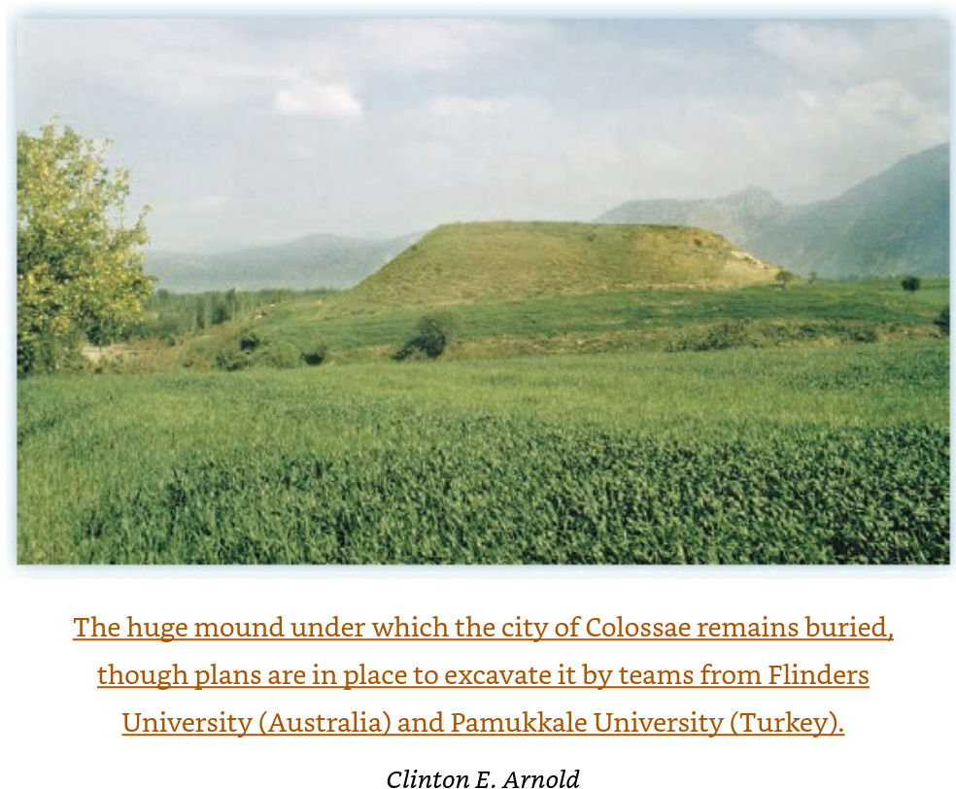
About Colossae and the Lycus Valley
Colossae was a small city in Paul’s day of about 10,000 people which was later destroyed by an earthquake in the A.D. 60s. It never recovered and faded away. It was probably similar in culture and form to other cities in the Lycus valley.
Pagan God’s were worshiped for the provision of physical human needs.
The Roman Emperor was honored in public and private.
There was a significant Jewish population.
In Roman times, Laodicea was a collection point for payment of the Temple tax.
Philo wrote that Jews dwelt in every city of Asia Minor.

Slide 13
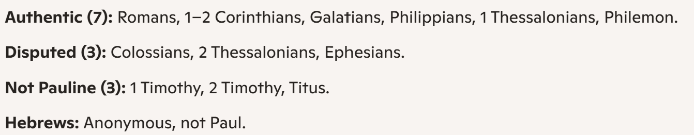
Paul’s Authorship of Colossians is Doubted
Recent scholars are doubtful due to language styles, and modern political and sociological frameworks.
N.T. Wright dismisses these concerns and maintains that Colossians is within the views of Paul’s other writings, and that style is influenced by Paul’s purpose, audience, and possibly those who helped write down his thoughts while in prison.
Modern Consensus on Paul’s authorship:

Slide 14
Colossians

Slide 15
Purpose(s) for Writing Colossians?
Colossians
There are warnings (direct and implied) against false teachings.
Many passages, especially in chapters 3 and 4, give instructions for Christian living.
The Lycus valley was a “melting pot of many pagan and Jewish beliefs, philosophies, and systems of magic” so that explicit instructions were needed in general.
Or, it could be that there was a specific, unnamed heresy or syncretic belief that was becoming prevalent.

Slide 16
Purpose(s) for Writing Colossians? Was there heresy?
Colossians
Col 2:2-4: My goal is that they may be encouraged in heart and united in love, so that they may have the full riches of complete understanding, in order that they may know the mystery of God, namely, Christ, ³ in whom are hidden all the treasures of wisdom and knowledge. ⁴ I tell you this so that no one may deceive you by fine-sounding arguments.
Col 1:23b: …if you continue in your faith, established and firm, not moved from the hope held out I the gospel.
Col 3:2: Set your minds on things above, not on earthly things.

Slide 17
Colossians 1:15-20—The Supremacy of Christ
Colossians
Col 1:15-6: He is the image of the invisible God, the firstborn over all creation. For by him all things were created: things in heaven and on earth, visible and invisible, whether thrones or powers or rulers or authorities.
Jehovah Witnesses base their Christology on the phrase “firstborn of all creation” meaning that Jesus is the first creation of God, and therefore not himself equal to God. (No trinity). The JWs say ”all other things were created” in verse 6.
However, it is more consistent with Paul’s overall writings to see “firstborn” as meaning not about birth order, but about rank, authority, and inheritance. (Jesus is part of what we now call the Trinity.)

Slide 18
Colossians 1:15-23—The Messiah poem and the gospel.
Colossians
Paul might be quoting a hymn here that was written by someone else, or perhaps he wrote it himself.
It celebrates the absolute lordship of Jesus
It is the foundation of the whole letter
Col. 1:17-20: ¹⁷ He is before all things, and in him all things hold together. ¹⁸ And he is the head of the body, the church; he is the beginning and the firstborn from among the dead, so that in everything he might have the supremacy. ¹⁹ For God was pleased to have all his fullness dwell in him, ²⁰ and through him to reconcile to himself all things, whether things on earth or things in heaven, by making peace through his blood, shed on the cross.

Slide 19
Col. 1:21-3 You have heard, and been reconciled, and so has the whole world heard.
Colossians
²¹ Once you were alienated from God and were enemies in your minds because of^{[a]} your evil behavior. ²² But now he has reconciled you by Christ’s physical body through death to present you holy in his sight, without blemish and free from accusation— ²³ if you continue in your faith, established and firm, and do not move from the hope held out in the gospel. This is the gospel that you heard and that has been proclaimed to every creature under heaven, and of which I, Paul, have become a servant.
You are already saved. Don’t be diverted!

Slide 20
Col. 1:24-2:5 – Celebration in Suffering for the Sake of Christ (and others)
Colossians
Paul is showing his love for Christ by sacrificing for others.
Paul’s commitment is total including enduring extreme hardships.
N.T. Wright points out that suffering for salvation is a concept aligned with Jewish beliefs. It is an indication of faithfulness.

Slide 21
Col. 2:6-23 – The Empty Deceit of Jewish Mysticism
Colossians
Christ alone is sufficient: “2:9 For in Christ and the fullness of the Deity lives in bodily form, 2:10 and you have been given fulness in Christ over every power and authority.”
“2:16 Therefore do not let anyone judge you by what you eat or drink, or with regard to a religious festival, a New Moon celebration or a Sabbath day.”
2:20 “Since you died with Christ to the basic principles of this world, why, as though you still belonged to it, do you submit to its rules: 2:21 ‘Do not handle! Do not taste! Do not touch!’? 2:22 These are all destined to perish with use, because they are based on human commands and teachings. 2:23 Such regulations indeed have an appearance of wisdom, with their self-imposed worship, their false humility and their harsh treatment of the body, but they lack any value in restraining sensual indulgence.”

Slide 22
Col. 3:1-17 Christians as Transformed and Renewed
Colossians
3:3 “Set your minds on things above, not on earthly things.”
This means to “put to death” the vices of sex and speech.
The believer’s “new self” involves no identity or division such as “Greek or Jew, circumcised or not, barbarian, Scythian, slave or free, but Christ is all and is in all.”
Bad things to discard: “earthly nature, sexual immorality, impurity, lust, evil desires, greed, idolatry, anger, rage, malice, slander, and filthy language”
Things to “clothe yourself with: compassion, kindness, humility, gentleness, patience,” forebearance, forgiveness, Love, unity.

Slide 23
Col. 3:18-4:1 Christians Homes in Pagan Cities and the Modern Culture War
Colossians
Instructions for Christian Households
¹⁸ Wives, submit yourselves to your husbands, as is fitting in the Lord.
¹⁹ Husbands, love your wives and do not be harsh with them.
²⁰ Children, obey your parents in everything, for this pleases the Lord.
²¹ Fathers,^{[a]} do not embitter your children, or they will become discouraged.
²² Slaves, obey your earthly masters in everything; and do it, not only when their eye is on you and to curry their favor, but with sincerity of heart and reverence for the Lord. ²³ Whatever you do, work at it with all your heart, as working for the Lord, not for human masters, ²⁴ since you know that you will receive an inheritance from the Lord as a reward. It is the Lord Christ you are serving. ²⁵ Anyone who does wrong will be repaid for their wrongs, and there is no favoritism.
4 Masters, provide your slaves with what is right and fair, because you know that you also have a Master in heaven.

Slide 24
Col. 3:18-4:1 Christians Homes in Pagan Cities and the Modern Culture War
Colossians
Modern conservative readings emphasize the supremacy of males (patriarchy), but the Roman patriarchy was one of the aspects of pagan culture that Paul was against.
Christ-like submission was being advocated, and slavery and patriarchy were not being endorsed.
The actual text is balanced with requirements for husbands and wives, slaves and masters.
Almost identical instructions are given in 1 Peter 3:1-7 showing a continuing view of Christan family life in the early church beyond Paul’s personal views.

Slide 25
The Case of Nymphia and the House Church
Colossians
Col. 4:15-6 ¹⁵ Give my greetings to the brothers and sisters at Laodicea, and to Nympha and the church in her house.¹⁶ After this letter has been read to you, see that it is also read in the church of the Laodiceans and that you in turn read the letter from Laodicea.
Clearly, Nympha was important in receiving direct greetings from Paul, as well as hosting the church in Laodicea in her own house. That this letter was meant to have been read in her house would have suggested that women were fully recognized and respected in the church.

Slide 26
Philemon
“The New Testament in its World”, Ch. 20

Slide 27
Lamentations on Limitations
“Free will is a detriment to the man who doesn’t realize he’s confused.”
“Everything I believe is based only on what I think I know, the only system available and the worst system possible.”
--Chuck Klosterman, “Football”
“I am so clever that I sometimes don’t understand a single word of what I am saying.”
--Oscar Wilde

Slide 28
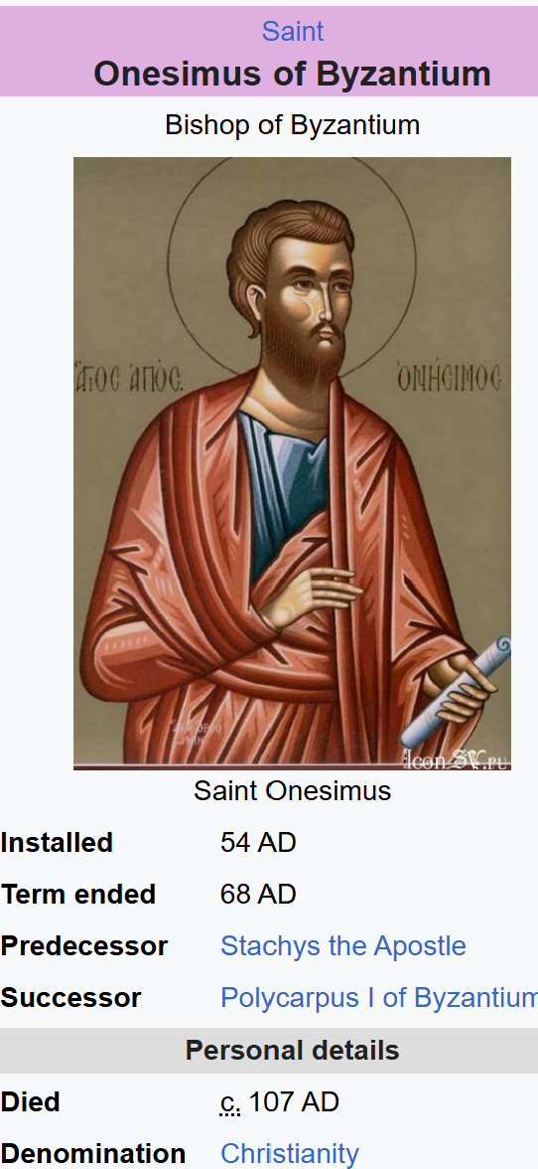
Paul’s letter to Philemon concerning his runaway slave, Onesimus
Philemon
The Central Question: To fight slavery and help Onesimus flee, or to work within the system and reconcile Onesimus to Philemon while imploring them to treat each other as brothers.
In Onesimus’ case, reconciliation led to a better result for all, even for Onesimus since he:
  Might have otherwise been captured and killed as a fugitive.
  Was treated kindly after returning to Philemon (presumably)
  Later tradition holds that Onesimus was later freed and became Bishop of Ephesus (following Timothy in this role).
On the other hand, the institution of slavery was unchallenged which provided justification (rationalization?) for later Christians to accept slavery.
Notes:
He may^{[11]} also be the same Onesimus named by Ignatius of Antioch (died c. 107) as bishop in Ephesus^{[3][12]} In his Epistle written to the Ephesians while on his way to be executed in Rome, Ignatius wrote:
I received, therefore, your whole multitude in the name of God, through Onesimus, whose love surpasses words, in the flesh as your bishop. I pray that you may love him with a love according to Jesus Christ and that you may all be like him. For blessed is He Who granted unto you, worthy as you are, to possess such a bishop.
Painting depicting death of Onesimus, from the Menologion of Basil II (c. 1000 AD)
Onesimus must have accepted episcopal see of Ephesus following Saint Timothy.^{[2]} If so, Onesimus went from slave to brother to bishop. According to Tradition, Onesimus was imprisoned and may have been martyred by stoning (some sources claim he was beheaded).^{[13]} Given that Ignatius of Antioch died under Emperor Trajan (97-117), Onesimus's death more likely fell under that Emperor as well.

Slide 29
N.T. Wright on the ‘main thrust’ of Philemon
Paul’s concern for the runaway slave Onesimus reflects his larger concern for messianic unity across traditional boundaries in the churches, whether it be the unity of Jew and gentile in the Messiah (the main point of Galatians), the unity of the church under the lordship of the Messiah in a pagan and imperial context (part of the point of Philippians), or, as here in Philemon, the unity of master and slave, expressing again what it means to be en Christō. ‘So,’ Paul asks, ‘if you reckon me a partner [koinōnos], welcome him [proslabou auton] as you would welcome me.’59 That is the main thrust of the letter.

Slide 30
How People Became Slaves in the Roman Empire
1. War Captives — the largest source, from mass enslavement of conquered peoples who were then employed in agriculture, mines, and large estates.
2. Birth into Slavery (vernae)—children of slaves were automatically slaves regardless of father’s status, were often better treated and employed in households.
3. Exposure or Sale of Infants—Abandoned children found by anyone could be raised as slaves, or poor families sometimes sold children.
4. Debt and Economic Hardship – Debt bondage (nexum) was a legal way to become a slave to satisfy a debt or provide sustenance, but this later became illegal.
5. Criminal Conviction—Punishment for the harshest crimes, these slaves had the lowest status and almost no chance of manumission. The harshest form ‘damnatio ad metalla’ was condemnation to the mines.
6. Piracy and Kidnapping – Common before Pompey’s campaign (67 BC), pirates kidnapped for ransom or sale into slavery. Even wealthy Romans could be victims.

Slide 31
What did NOT make you a slave in the Roman Empire
Race or ethnicity
Religious identity
Social class alone
Slavery in Rome was not racialized; it was fundamentally about power, conquest, and economic vulnerability.

Slide 32
The Three Classical Methods for Manumission in the Roman Empire (Wikipedia)
Manumissio vindicta — the ceremonial court freeing. This was the most prestigious form.
A magistrate presided (usually a praetor).
A third party touched the slave with a rod (the vindicta) and declared them free.
The master affirmed the claim by remaining silent.
The magistrate pronounced the slave liber.
Symbolism: It reenacted a courtroom drama where the slave “won” their freedom.
Manumissio censu — enrollment in the census
During the census, a master could allow a slave’s name to be entered on the citizen rolls.
Once registered, the person was legally free.
This method faded as the census became less frequent.
Manumissio testamento — manumission by will.
A master could free slaves in his will:
Direct manumission: “I free my slave X.
Fideicommissary manumission: The heir was ordered to free the slave.
Sometimes the freed slave had to pay a sum to the heirs to complete the process.
This was extremely common—many household slaves were freed this way.

Slide 33
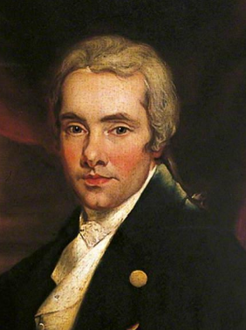
The Counterexample of William Wilberforce
(Wikipedia)
A British politician and philanthropist
Wilberforce (1759–1833) was born in Hull, Yorkshire, into a prosperous merchant family. He entered Parliament in 1780 at just 21 years old and served for more than four decades, representing constituencies including Hull and Yorkshire.
In 1787, after a deep evangelical Christian conversion, Wilberforce was persuaded by abolitionist activists—Thomas Clarkson, Granville Sharp, Hannah More, and others—to take up the cause of ending the transatlantic slave trade. He became the parliamentary spearhead of the abolition movement.
For 20 relentless years, he introduced bills, delivered speeches, and marshaled evidence documenting the brutality of the trade. His efforts culminated in the Slave Trade Act of 1807, which outlawed Britain’s participation in the trade.

Slide 34
Is Now the Time for Justice?
A Question for All Generations
Change hearts and save individuals?
Change society even to provoke conflict and division?
Just stop being reactionary and let it go and “Let God”?
All of the above?
Other choices?

Slide 35
Ephesians
Ch. 20, “The New Testament in Its World”

Slide 36
Ephesians: A circular letter to the churches in Asia
1 Paul, an apostle of Christ Jesus by the will of God,
To God’s holy people in Ephesus,^{[a]} the faithful in Christ Jesus:
Early versions do not have “in Ephesus” as the letter was probably originally written from there to churches in the broader region.
Emphasizes God’s cosmic plan in the Messiah
Central theme: unity in Christ—heaven and earth brought together
Ephesians can be read out loud in 20-25 minutes, but less if you separate out the prayers for the people and greetings. It’s a sermon waiting to be preached any Sunday.

Slide 37
God’s Plan in Christ (Eph 1)
A hymn of praise announcing God’s saving work in Jesus
Goal: “to bring unity to all things in heaven and on earth under Christ”
Believers are incorporated into this plan and empowered to live it out

Slide 38
A hint of pre-destination in Ephesians (Ch. 1)
“ ⁴ For he chose us in him before the creation of the world to be holy and blameless in his sight. In love ⁵ he^{[b]} predestined us for adoption to sonship^{[c]} through Jesus Christ, in accordance with his pleasure and will— ⁶ to the praise of his glorious grace, which he has freely given us in the One he loves. ”
^{“11} In him we were also chosen,^{[e]} having been predestined according to the plan of him who works out everything in conformity with the purpose of his will, ¹² in order that we, who were the first to put our hope in Christ, might be for the praise of his glory. ¹³ And you also were included in Christ when you heard the message of truth, the gospel of your salvation. When you believed, you were marked in him with a seal, the promised Holy Spirit, ¹⁴ who is a deposit guaranteeing our inheritance until the redemption of those who are God’s possession—to the praise of his glory.”
N.T. Wright skips right past any theological hints of pre-destination in this letter.

Slide 39
Salvation by Grace (Eph 2:1–10)
Humanity’s condition: spiritual death and captivity to evil
God’s response: grace through faith, not human achievement
The church as God’s artwork, displaying his healing purposes
“2 As for you, you were dead in your transgressions and sins, ² in which you used to live when you followed the ways of this world and of the ruler of the kingdom of the air, the spirit who is now at work in those who are disobedient. ³ All of us also lived among them at one time, gratifying the cravings of our flesh^{[a]} and following its desires and thoughts. Like the rest, we were by nature deserving of wrath. ⁴ But because of his great love for us, God, who is rich in mercy, ⁵ made us alive with Christ even when we were dead in transgressions—it is by grace you have been saved. ⁶ And God raised us up with Christ and seated us with him in the heavenly realms in Christ Jesus, ⁷ in order that in the coming ages he might show the incomparable riches of his grace, expressed in his kindness to us in Christ Jesus. ⁸ For it is by grace you have been saved, through faith—and this is not from yourselves, it is the gift of God— ⁹ not by works, so that no one can boast. ¹⁰ For we are God’s handiwork, created in Christ Jesus to do good works, which God prepared in advance for us to do.”

Slide 40
One New Humanity (Eph 2:11–3:13)
For people in Christ, there should be peace and reconciliation between them!
Jews and Gentiles united in the Messiah
The dividing wall is broken down
The church as a new Temple, indwelt by the Spirit
Unity is essential, not optional, to the gospel
^{“14} For he himself is our peace, who has made the two groups one and has destroyed the barrier, the dividing wall of hostility, ¹⁵ by setting aside in his flesh the law with its commands and regulations. His purpose was to create in himself one new humanity out of the two, thus making peace, ¹⁶ and in one body to reconcile both of them to God through the cross, by which he put to death their hostility. ¹⁷ He came and preached peace to you who were far away and peace to those who were near. ¹⁸ For through him we both have access to the Father by one Spirit.”

Slide 41
Paul’s Prayer (Eph 3:14–21)
Prayer for deep roots in God’s love
Knowing God as loving Father
Love as the foundation for Christian life and growth

Slide 42
Unity and Maturity (Eph 4:1–16)
The Spirit gives diverse ministries
Purpose: build up one body
Maturity protects the church from deception and division
4:14-6: “Then we will no longer be infants, tossed back and forth by the waves, and blown here and there by every wind of teaching and by the cunning and craftiness of people in their deceitful scheming. ¹⁵ Instead, speaking the truth in love, we will grow to become in every respect the mature body of him who is the head, that is, Christ. ¹⁶ From him the whole body, joined and held together by every supporting ligament, grows and builds itself up in love, as each part does its work.”

Slide 43
New Creation Living (Eph 4:17–5:20)
“Put off the old self, put on the new”
Pagan ways are dehumanizing
Renewed minds lead to transformed behavior
Believers move from darkness to light
Bad: sensuality, impurity, greed, deceitful desires, unwholesome talk, stealing, grieving the Holy Spirit, bitterness, rage, anger, brawling, slander, sexual immorality, foolishness, coarse joking, excessive drinking
Good: Truth in Jesus, new in attitude, truth speaking, useful work, sharing to those in need, helpful talk, thanksgiving, wise living, psalms, hymns, songs from the Spirit, music

Slide 44
Practical Advice: Ephesians 4:25-8
²⁵ Therefore each of you must put off falsehood and speak truthfully to your neighbor, for we are all members of one body. ²⁶ “In your anger do not sin”^{[l]}: Do not let the sun go down while you are still angry, ²⁷ and do not give the devil a foothold. ²⁸ Anyone who has been stealing must steal no longer, but must work, doing something useful with their own hands, that they may have something to share with those in need.

Slide 45
Christian Households (Eph 5:21–6:9)
Marriage reflects Christ’s self‑giving love
Instructions to children and slaves affirm their dignity
Radical within a pagan social world

Slide 46
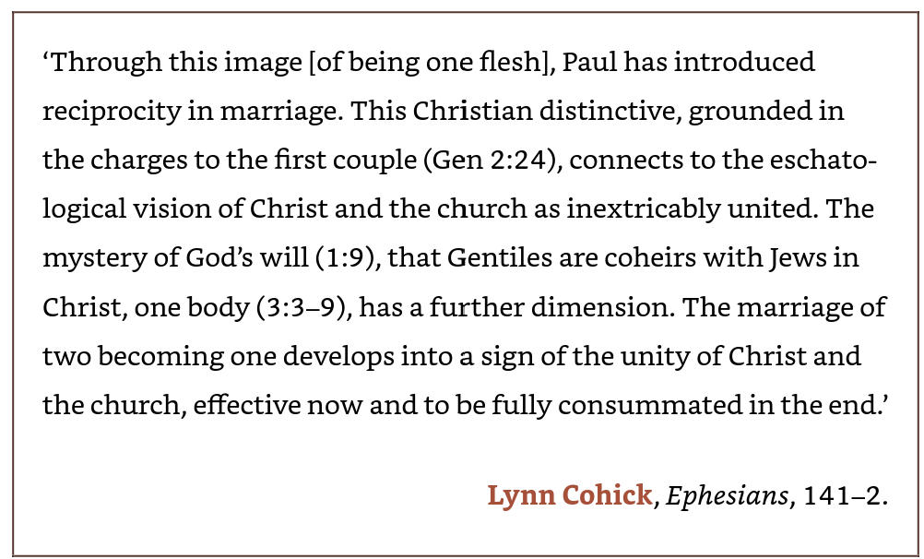
Mutual submission as the core ethic

Slide 47
Spiritual Warfare (Eph 6:10–20)
A unified, holy church provokes opposition
The struggle is against spiritual powers
Believers must use the weapons of the gospel
Paul requests prayer for his own ministry
Paul’s “sword” is of the spirit, not of steel
^{“12} For our struggle is not against flesh and blood, but against the rulers, against the authorities, against the powers of this dark world and against the spiritual forces of evil in the heavenly realms. ¹³ Therefore put on the full armor of God, so that when the day of evil comes, you may be able to stand your ground, and after you have done everything, to stand. ¹⁴ Stand firm then, with the belt of truth buckled around your waist, with the breastplate of righteousness in place, ¹⁵ and with your feet fitted with the readiness that comes from the gospel of peace. ¹⁶ In addition to all this, take up the shield of faith, with which you can extinguish all the flaming arrows of the evil one. ¹⁷ Take the helmet of salvation and the sword of the Spirit, which is the word of God.”

Slide 48
Closing and Encouragement
Tychicus delivers the letter and news of Paul
Final blessing of peace, love, and grace

Slide 49
Ephesians in the Larger Story
Complements Colossians (cosmic lordship of Christ)
Complements Philemon (gospel lived in relationships)
Ephesians sums up Paul’s vision of new creation
Church stands at the center of God’s plan to unify all within Him.
Ephesians is a good sermon for any Sunday, but use in our culture today demands proper interpretation in the context of the fledgling church set in its pagan culture. “Don’t be pagan” is one of the messages that can translate today to be “don’t be selfish, self-serving, insensitive, or hurtful, but work for, love, give to, and encourage others instead.”

