Slide 1
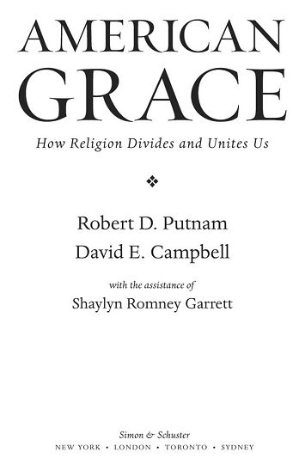

Slide 2
The “Faith Matters” Surveys
The bulk of the data in American Grace comes from the Faith Matters surveys, original sources of data we designed, implemented, and analyzed. These are among the most thorough surveys of Americans’ religious and civic lives ever conducted. Faith Matters is a two-wave panel study, meaning that we recontacted our original respondents roughly nine months after they were initially interviewed. This second wave has turned out to be critical for our analysis, as a two-wave study offers numerous analytical advantages over a single cross-sectional survey. Furthermore, panel studies on religion are rare. Other than a few technical papers presented to small audiences, primarily of academics, American Grace is the debut of findings from the Faith Matters data.
Putnam, Robert D.; Campbell, David E (2010-10-05). American Grace (Kindle Locations 8495-8501). Simon & Schuster, Inc.. Kindle Edition.

Slide 3
Major Points of the Book
Public displays and endorsement of religion were common and accepted in the 1950s:
  “under God” added to pledge of allegiance and “In God We Trust” added to the currency
  The movie “Ten Commandments” was promoted by placing public monuments, which stood non-controversially for decades.
  Catholic status of JFK caused large gap in votes of protestants and Catholics, but in 2004, John Kerry lost half of the Catholic vote.

Slide 4
Big changes occurred in religion in America the last 50 years:
Americans have become polarized toward opposite ends of religious spectrum: Highly religious vs. avowedly secular.
Religious middle dominated in the 1950s, but is shrinking today.
Catholic vs. Protestant divide in the 50s has been replaced by religious vs. secular divide
Since 1990, secularism is growing dramatically.

Slide 5
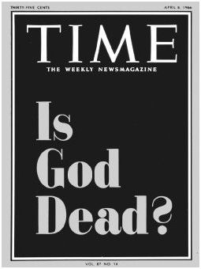
Religious polarization has resulted from three seismic societal shocks
Sexually libertine 1960s weakened conservative institutions
1970s-80s: Conservative reaction, especially evangelicalism, including political activism, especially adoption of social conservatism by the Republican Party
1990s: Reaction against social conservatism by young people, especially against association between religion and conservative politics
April 8, 1966

Slide 6
How does religious pluralism coexist with polarization in America?
Religion is fluid in America.
Separation of church and state allow for vigorous competing religions (and secularism)
Americans are increasingly intermarrying with those of other beliefs.
Americans are changing churches and religions more readily and often.
All these trends help protect religious tolerance and benign pluralism

Slide 7
Americans are high in “Religiosity”
Belonging: 83% belong to a religion
Behaving:
  40% attend religious services nearly every week or more
  59% pray at least weekly
  33% read scripture at least weekly
Believing:
  80% absolutely sure there is a God
  60% absolutely sure there is a heaven

Slide 8
Growing secularism is also a trend in America
17% do not belong to a religion
15% never attend religious services
Gallup Poll:
2005: 73% of Americans called themselves religious
2011: 60% of Americans called themselves religious

Slide 9
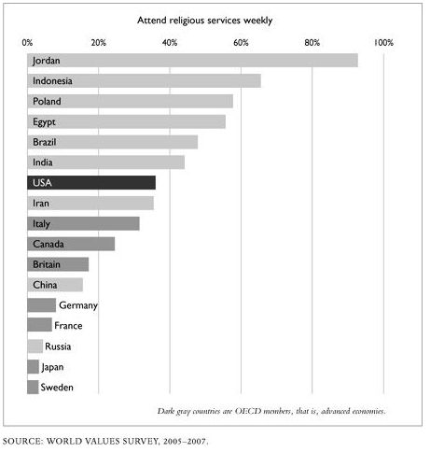
Americans have high weekly attendance at religious services compared to other Industrialized Nations

Slide 10
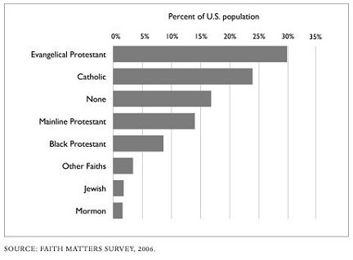
Religious “Nones” now outnumber mainline Protestants like us

Slide 11
Religious intensity is called “religiosity”
Determined by asking questions about:
Attendance at religious services
Prayer outside of religious services
Importance of religion to daily life
Important of religion to identity
Strength of belief in religion
Strength of belief in God

Slide 12
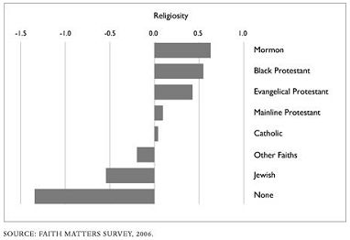
MORMONS, BLACK PROTESTANTS, AND EVANGELICALS ARE THE MOST RELIGIOUSLY OBSERVANT GROUPS IN AMERICA
Religiosity is standardized with a mean of 0 and a standard deviation of 1

Slide 13
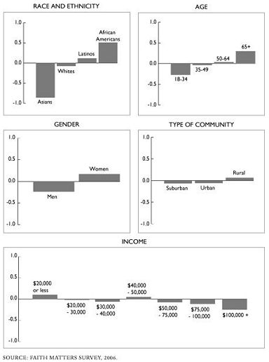
RELIGIOSITY VARIES A LOT BY RACE AND AGE, AND A LITTLE BY GENDER, TYPE OF COMMUNITY, AND INCOME
Vertical axis is religiosity, standardized with a mean of 0 and a standard deviation of 1

Slide 14
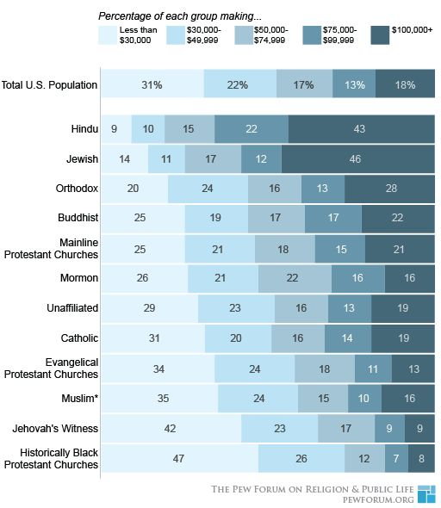

Slide 15
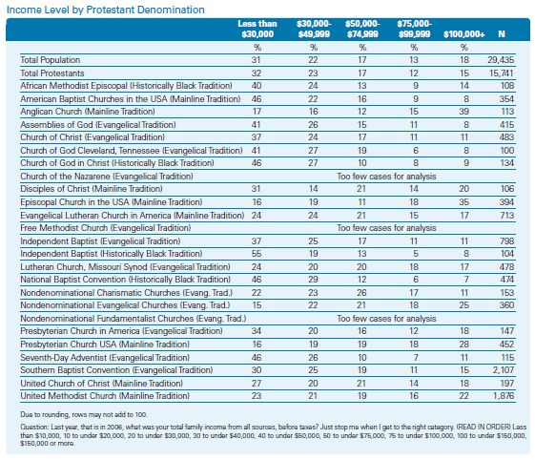

Slide 16
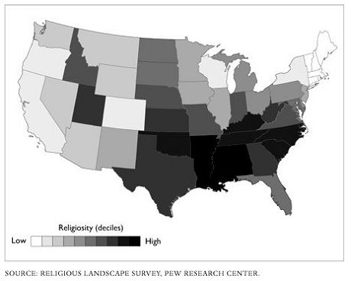
Deep South, Utah, and Mississippi Valley are the most religious

Slide 17
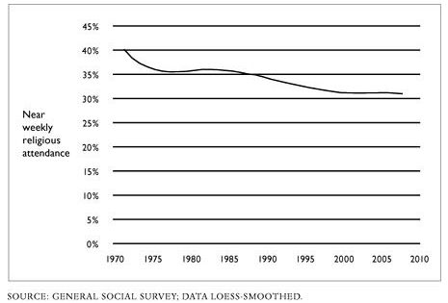
Church attendance is slowly declining in America

Slide 18
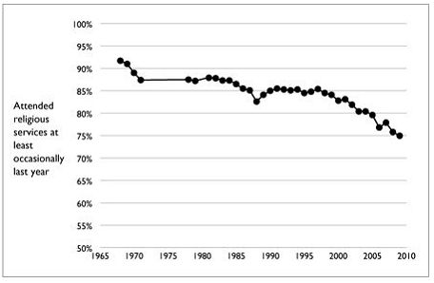
But Adolescent religious observance is declining much faster –we’re losing our young people
Adolescents only
60’s revolution
Recent rebellion
against conservative politics

Slide 19
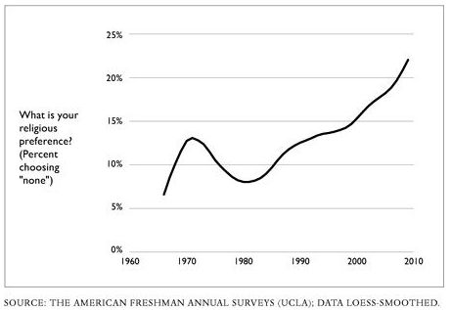
More college freshman are “nones”

Slide 20
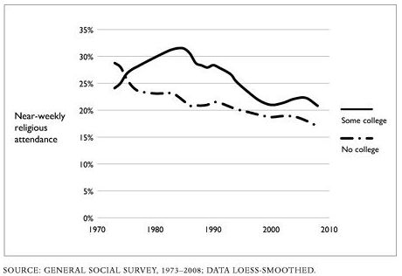
Religious attendance among 18-29 year olds is declining

Slide 21
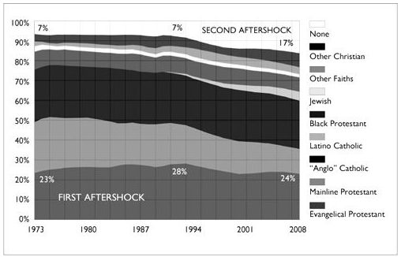
Mainline Protestants are declining and “Nones” are increasing in America
Mainline Protestants

Slide 22
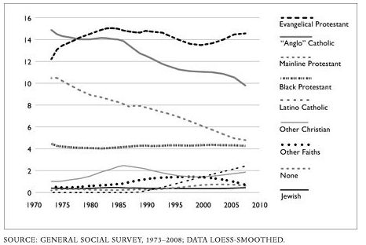
Attendance at mainline Protestant and Anglo Catholic services are on a straight line down.
% of US Population attending on average Sunday
Anglo Catholic
Mainline Protestant

Slide 23
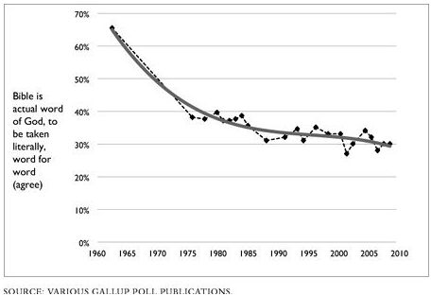
Rise of conservative Christianity has not stopped decline of Biblical Literalism

Slide 24
Why are Evangelicals winning more hearts than mainline Protestants?
Gallup says the survey evidence supports that:
Views on pre-marital sex are the biggest difference.
Therefore, personal moral concerns are the most important motivator for evangelicalism rather than theology or response to “hot button issues.”
“Save the Children!” is an effective message.

Slide 25
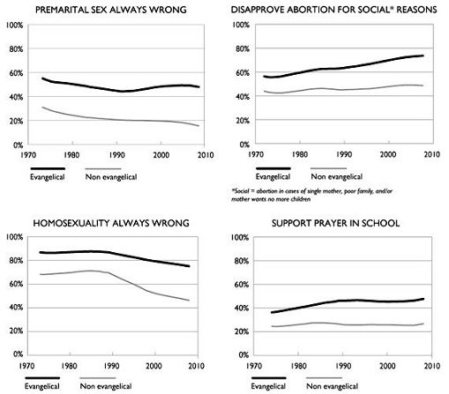
Different views between Evangelicals and other Christians

Slide 26
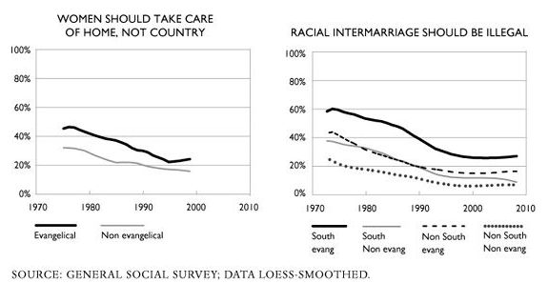
Different views between Evangelicals and other Christians

Slide 27
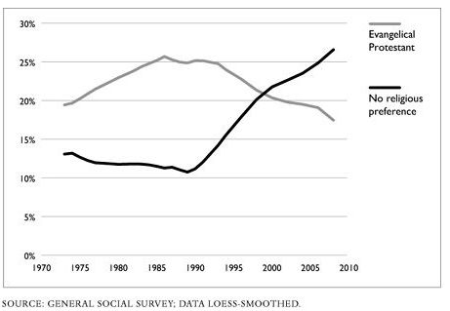
But even Evangelicals are losing hearts to the “Nones” among young people
Data are for 18-29 year-olds in U.S.

Slide 28
Is the rise of the “Nones” due to Asian Immigration?
Demographic Group | 1990 | 2010
White | 80.3 | 78.1
Black | 12.1 | 13.1
Native Amer. | 0.8 | 1.2
Asian | 2.7 | 5.0
Pacific Is. | 0.2 | 0.2
Multiple Races | 3.9 | 2.3
Hispanic | 9.0 | 16.7
White not Hispanic |  | 63.4
Big increase in Hispanics, who are more religious than general pop.
No, the increase in the “nones” is much greater than increase in Asian population.

Slide 29
Tim’s Question
If God doesn’t change, but opinions of Christians on social issues do change, then are Christians mistaken in giving social issues and politics so much attention? Isn’t the great commission about spreading the good news?
Should the church support:
Slavery?
Capital punishment?
Persecution of scientists?
Prohibition of women as clergy?
Censorship of books and music?

Slide 30
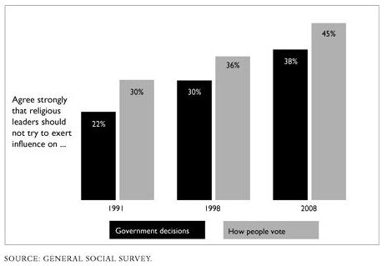
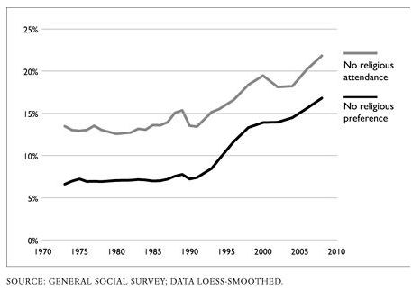
Rise of the “Nones” coincides with increasing concern about religion’s role in politics

Slide 31
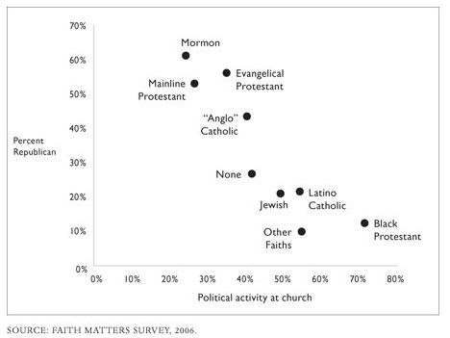
But it’s the more liberal churches that mix politic and religion – Surprize!

Slide 32
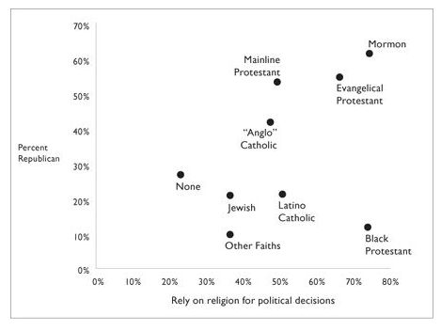
But, individuals who rely on their religion for political views are more Republican (except for Blacks)

Slide 33
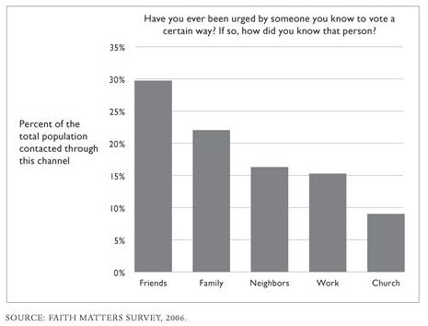
Political mobilization is least common through church

Slide 34
In summary:
Identification of conservative politics with religion is leading to increasing secular segment, especially among young people.
Increased religious polarization is primarily hurting mainline traditions.
Conservative Evangelical growth appears to be powered by a desire for personal morality more than about politics.

Slide 35
Religion and Politics in America

Slide 36
Main Points about Religion and Politics
Since 1970, religion has become more associated with conservative politics (Republicans)
Abortion and same sex marriage have driven a wedge between religion and political liberals
However, these wedge issues might be breaking down:
  Religious people starting to accept same-sex marriage
  Non-religious starting to oppose abortion

Slide 37
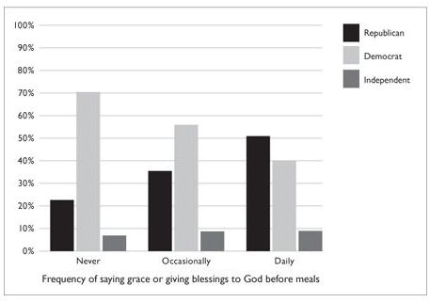
The Grace Gap: Frequency of saying grace predicts party affiliation

Slide 38
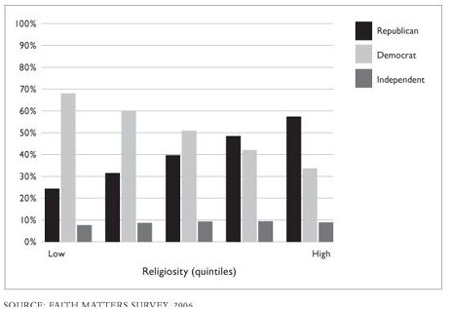
The God Gap: Religiosity predicts party affiliation

Slide 39
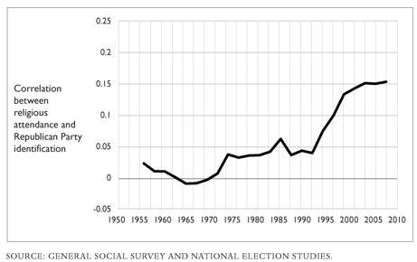
For whites, religious worship attendance has become correlated with Republican Party
White Americans only

Slide 40
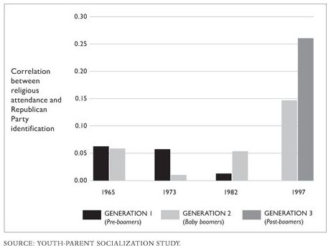
Religion association with Republican Party shows in baby boomers, but even more so in their children

Slide 41
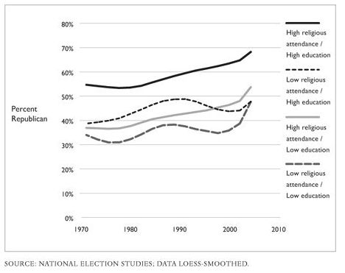
Highly educated religious whites have moved most strongly toward GOP
“Country Club Republicans”

Slide 42
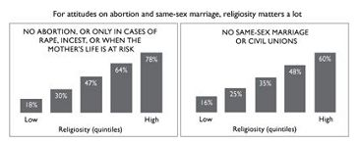
Political stances on Abortion and Same Sex Marriage show the highest correlation to Religiosity

Slide 43
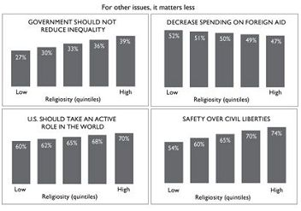
For many issues, religiosity has only a slight correlation

Slide 44
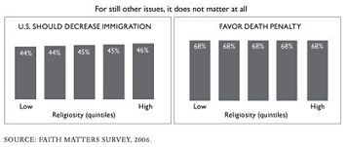
For two important societal questions, religiosity doesn’t correlate at all.

Slide 45
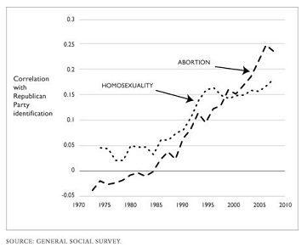
Among whites, the Republicans have attracted pro-life, anti-gay marriage voters

Slide 46
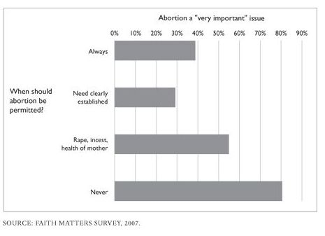
Those who oppose abortion rights think the issue is more important than those who favor them.

Slide 47
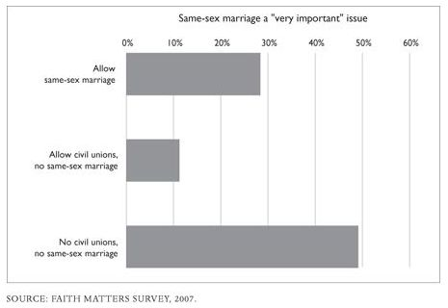
Those opposing gay marriage think it’s a more important issue than those in favor of it.

Slide 48
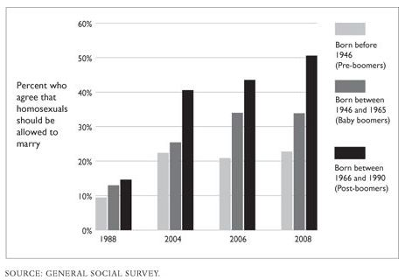
Support is increasing for same sex marriage, especially among young

Slide 49
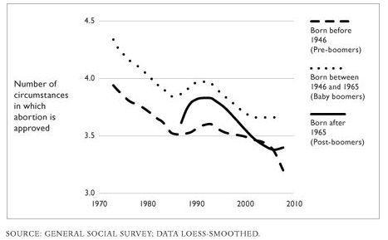
Opposition to abortion limits is fading, especially among young Americans

Slide 50
Tim’s Question
If God doesn’t change, but opinions of Christians on social issues do change, then are Christians mistaken in giving social issues and politics so much attention? Isn’t the great commission about spreading the good news?
Should the church support:
Slavery?
Capital punishment?
Persecution of scientists?
Prohibition of women as clergy?
Censorship of books and music?

Slide 51
In Summary: Religion and Politics in America
Since 1970, religion has become more associated with conservative politics (Republicans)
Abortion and same sex marriage have driven a wedge between religion and political liberals
However, these wedge issues might be breaking down:
  Religious people starting to accept same-sex marriage
  Non-religious starting to oppose abortion

