Slide 1
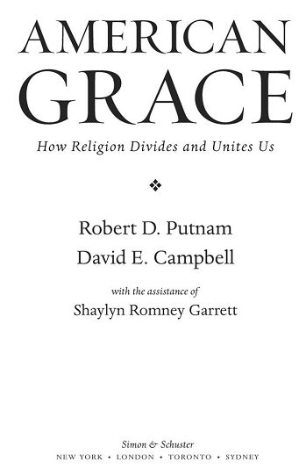

Slide 2
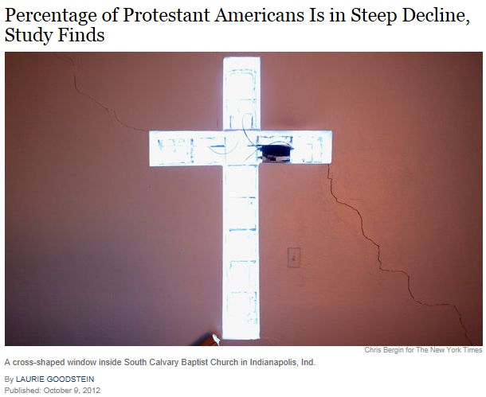
Pew Research Update – October 2012

Slide 3
Major Points
2012: Fewer than half of Americans are Protestant, down from two-thirds 40 years ago.
2012: 19% of Americans are “nones” which means they say they are atheist, agnostic, or nothing in particular, up from 15% in 2007 and 7% 40 years ago.
Catholics are single biggest religion, holding steady at 22% because of influx of Latinos.
One-third of 18 to 22 year olds are “nones.”
Two-thirds of “nones” say they believe in God, nonetheless.
Most “nones” are liberal Democrats, support gay marriage and environmental causes.

Slide 4
Theories on the Increase of Religious Nones (according to Pew report)
Liberal Christians disillusioned with conservative Christian involvement in politics.
Shift reflects a broader trend away from social and community involvement (bowling alone).
U.S. is becoming more secular like Canada, most of Europe, and Australia (globalization of secularism).

Slide 5
Examine three questions about American Women and Religion
Has religiosity affected pace of women moving into paid work?
Has religiosity affected changing norms about gender roles in family and in public?
How have roles for women in religious institutions changed?

Slide 6
Women in the Workforce
Women from every religious tradition have increased participation in workforce since the 1970s.
Religious beliefs and institutions have had NO measureable effect on movement of women in the workforce.

Slide 7
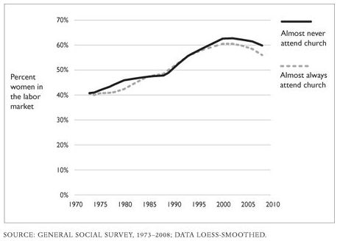
Worship attendance had no effect on women’s workforce participation

Slide 8
How has religion affected the adoption of feminist views by American women?
Religious women have only slightly more traditional views than secular women.
Adoption of feminist views has occurred at the same pace for both religious and secular women.
Most of the adoption of feminist views occurred between 1970 and 1990, in spite of this being the period of reaction against the 1960s.
Men’s views about gender roles are even less influenced by religion than are those of women.

Slide 9
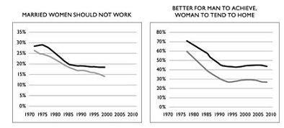

Slide 10
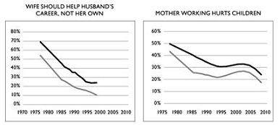

Slide 11
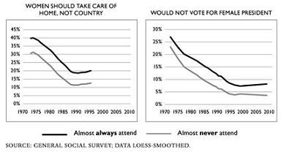

Slide 12
Women’s roles in the churches have expanded greatly
50% of Christian denominations allow women clergy, up from 25% a century ago.
37% of clergy in liberal congregations are women vs. 5% in conservative congregations
A majority of adherents in every major religious tradition favor allowing women as clergy (Exception: Only 30% of Mormons do).
Women are LESS likely to favor female clergy than men are.

Slide 13
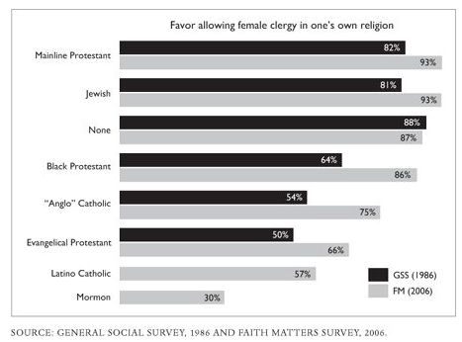
Increasing majorities in most religious traditions favor allowing female clergy

Slide 14
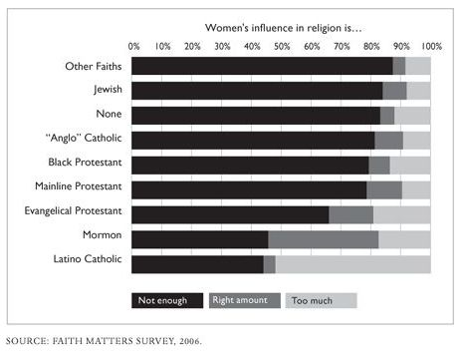
Most members of most religious traditions favor increasing women’s role in church

Slide 15
Conclusions
Religious people have adopted feminist views as fast as secular people.
Even a majority of American Catholics today favor female priests
Apparently, American Christians and others are increasingly in agreement that the role of women is not a matter of theology, but is one of cultural choice.

Slide 16
Religion and “Good Neighborliness”
Do religious Americans make better neighbors?

Slide 17
“of all the dispositions and habits which lead to political prosperity, religion and morality are indispensable supports.”
-- George Washington, farewell address
“Religion poisons everything.”
– Christopher Hitchens

Slide 18
Conclusions from “American Grace”
Evidence shows religious Americans to be more generous and conscientious than secular Americans.
Evidence suggests that theology is not the reason for the “religious edge” in good citizenship.
Instead, “communities of faith” appear to be more important than theology in fostering good neighborliness.

Slide 19
Religious people volunteer more than secular people
45% of weekly churchgoers volunteer for non-religious causes in addition to volunteering for their religion.
Only 26% of non-churchgoers volunteer for non-religious causes.
Average weekly churchgoer volunteers an extra 10.5 hours/month for religious causes and an extra 6.4 hours/month for secular causes compared to a once/yr churchgoer.
(All figures above were corrected for demographic factors!!)

Slide 20
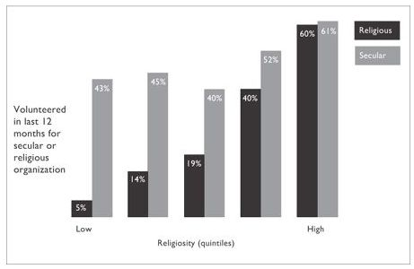
Religiosity predicts both secular and religious volunteering in America

Slide 21
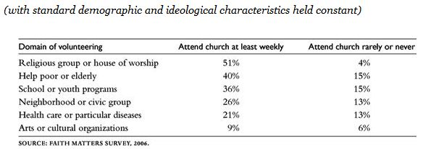
Religious Americans are more likely to volunteer for any type of community service

Slide 22
Religious Americans donate more money than secular Americans
32% of secular made no charitable donations in 2006 vs. only 6% of religious.
Religious fifth donated average of $3000 vs. $1000 for most secular fifth.
Religious Americans donate more money to every type of cause than do secular Americans.

Slide 23
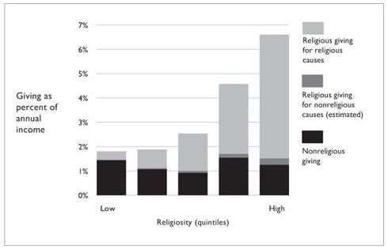
Religiosity encourages giving as a percentage of income

Slide 24
Religiosity matters for some “good deed” behaviors, but not others
Religious are more likely to:
Religious and secular are equally likely to:
Donate blooc
Help other household with housework
Spend time with someone who is “down”
Allow a stranger to cut in front of them
Offer a seat to a stranger
Help someone find a job
Look after a plant or pet
Carry a stranger’s belongings
Give directions to a stranger
Let someone borrow an item of some value
Lend money to another person.
But not a single one of these good deed behaviors is more likely for secular vs. religious

Slide 25
“Every significant generalization in this chapter remains accurate when we control simultaneously for gender, education, income, race, region, home-ownership, length of residence, marital and parental status, ideology, and age.”
Putnam, Robert D.; Campbell, David E (2010-10-05). American Grace (Kindle Locations 6940-6942). Simon & Schuster, Inc.. Kindle Edition.

Slide 26
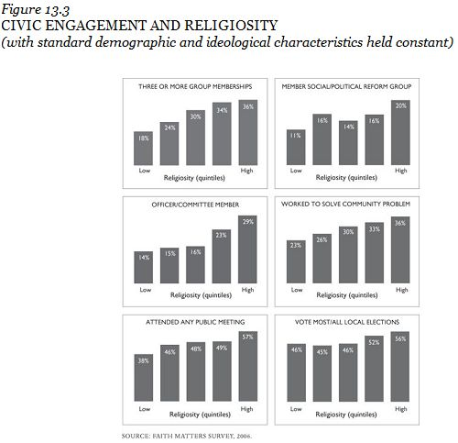

Slide 27
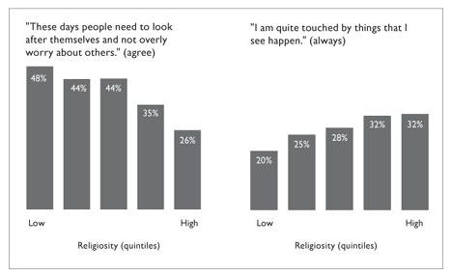
Religious Americans express more altruistic values

Slide 28
Next Lesson – Why?
We will examine the reasons religious people are better neighbors:
Evidence that “Communities of faith” relationships are the determining factor for “good neighborliness”
Evidence against theology as causing differences in behavior
Focus on “God’s love” vs. “God’s Judgement” makes a difference in trusting others.

