Slide 1
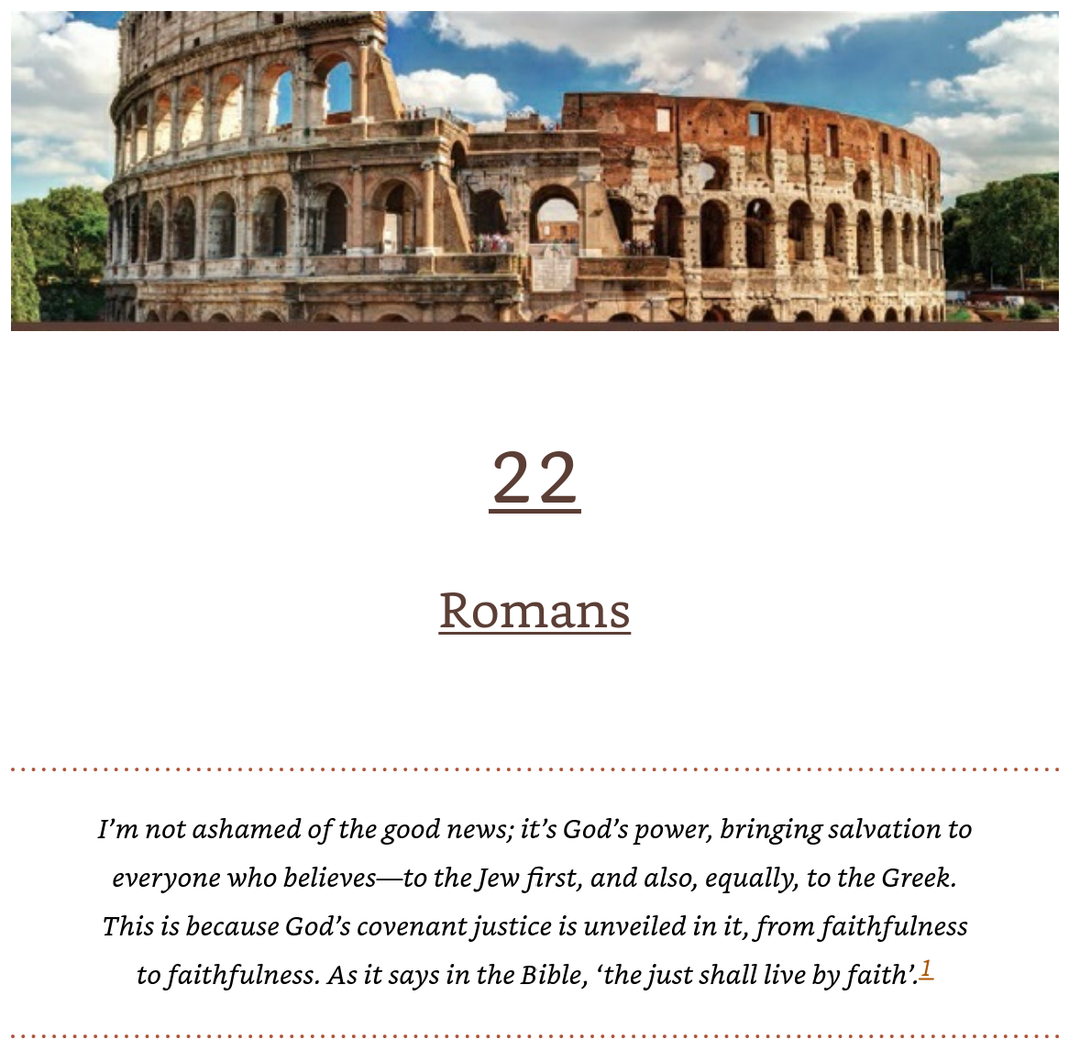
Ch. 22: Romans
Wright, N. T.; Bird, Michael F.. The New Testament in Its World: An Introduction to the History, Literature, and Theology of the First Christians (pp. 502-527).
Romans 1:16-7

Slide 2
“The reasonable man adapts himself to the world. The unreasonable one persists in trying to adapt the world to himself. Therefore all progress depends on the unreasonable man.” --George Bernard Shaw
^{“14} I have given them your word and the world has hated them, for they are not of the world any more than I am of the world. ¹⁵ My prayer is not that you take them out of the world but that you protect them from the evil one. ¹⁶ They are not of the world, even as I am not of it. ¹⁷ Sanctify them by^{[d]} the truth; your word is truth. “ –Jesus, John 17:14-17.
1 Corinthians 12 and 13
Now eagerly desire the greater gifts.
Love Is Indispensable
And yet I will show you the most excellent way.
13 If I speak in the tongues^{[a]} of men or of angels, but do not have love, I am only a resounding gong or a clanging cymbal.

Slide 3
Prayer Concerns
Blessings
Karen and John
Dave Petke
David Knight
Lynda Snook
Bree Fox
David Fox (surgery)
Ann Garber’s granddaughter McKenzie has breast cancer
Deb Ingram (Wes)
Sarah Gilmer’s good prognosis
John Gilmer’s service to Karen

Slide 4
Introduction: What is Romans?
It is a letter, not a treatise, but it provide the most wide-ranging theological views of Paul, written to the Roman church, mostly gentiles but also Jews, living in the grace of Christ within a multi-ethnic world capital of paganism.
It is an apostolic testament rather than a systematic theology, but it has the depth to provide a foundation for the great theologians in church history to expound upon. “One can almost write the history of Christian theology by surveying the ways in which Romans has been interpreted.” (Joseph Fitzmyer)
Paul intended to make Rome his base for his evangelism as he planned to travel to Spain.
Justification (salvation) by faith, a practical holiness, and the unity of God’s people are key foundations of God at work through Jesus.

Slide 5
Side Note!
Unlike other letters of Paul, Romans is longer than a sermon and most advanced theologically.
Chapter 22 in the textbook is 10700 words.
Romans in the NIV is 7500 words, or about one hour to read out loud.

Slide 6
Romans: A Syllabus of Topics to Expound:
God’s righteousness
God’s love for sinners
God’s super-abounding grace
The hope of glory
Adoption to sonship
The indwelling spirit
Victory through suffering
A foreign people made God’s people
Love over law
Torah affirmed and Israel saved
Fulfillment of God’s promise to the patriarchs by calling gentile into the family of Abraham.
Romans “Big Banner:” God demonstrates his own love for us: The Messiah died for us while we were still sinners.

Slide 7
The Jewish People and Rome
63 BCE
Roman general Pompey captures Jerusalem, marking the beginning of Roman influence over Judea.
70 CE
The Romans, under Titus, destroy the Second Temple in Jerusalem, a pivotal event in Jewish history.
132-135 CE
Bar Kokhba revolt; the Romans suppress the uprising, and many Jews are killed or displaced.
4th Century CE
Christianity becomes the official religion of the Roman Empire, affecting Jewish communities.
7th Century CE
The decline of Roman authority in the region as new powers emerge, changing the dynamics for the Jewish people.

Slide 8
In Paul’s Time, Judaism was already established in Rome
In mid-second century B.C., many Jews moved to Rome following an alliance between Maccabean rulers of Judea and the Romans.
Further Jews arrived as slaves (many later freed) after Pompey’s conquest of Palestine in 63 B.C.
Several synagogues have been discovered by archeology from the time.
Jews were tolerated well under Julius Caesar and Augustus, but were sometimes persecuted under Tiberius and Caligula.
Under Claudius, many Jews were expelled because of disputes involving ‘Chistos.’

Slide 9
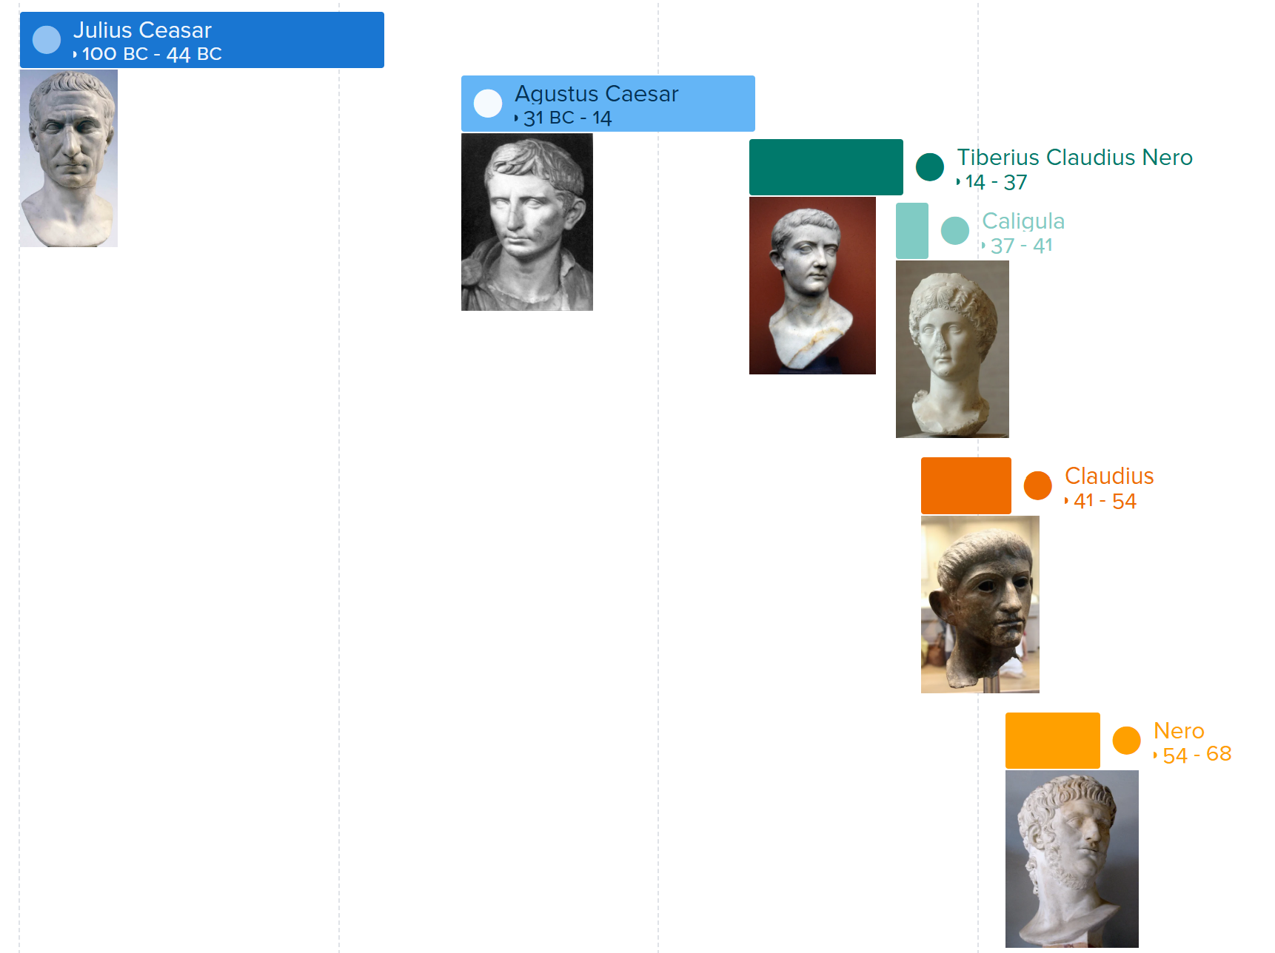
Timeline of Roman Leaders(Dictators/ Emperors)

Slide 10
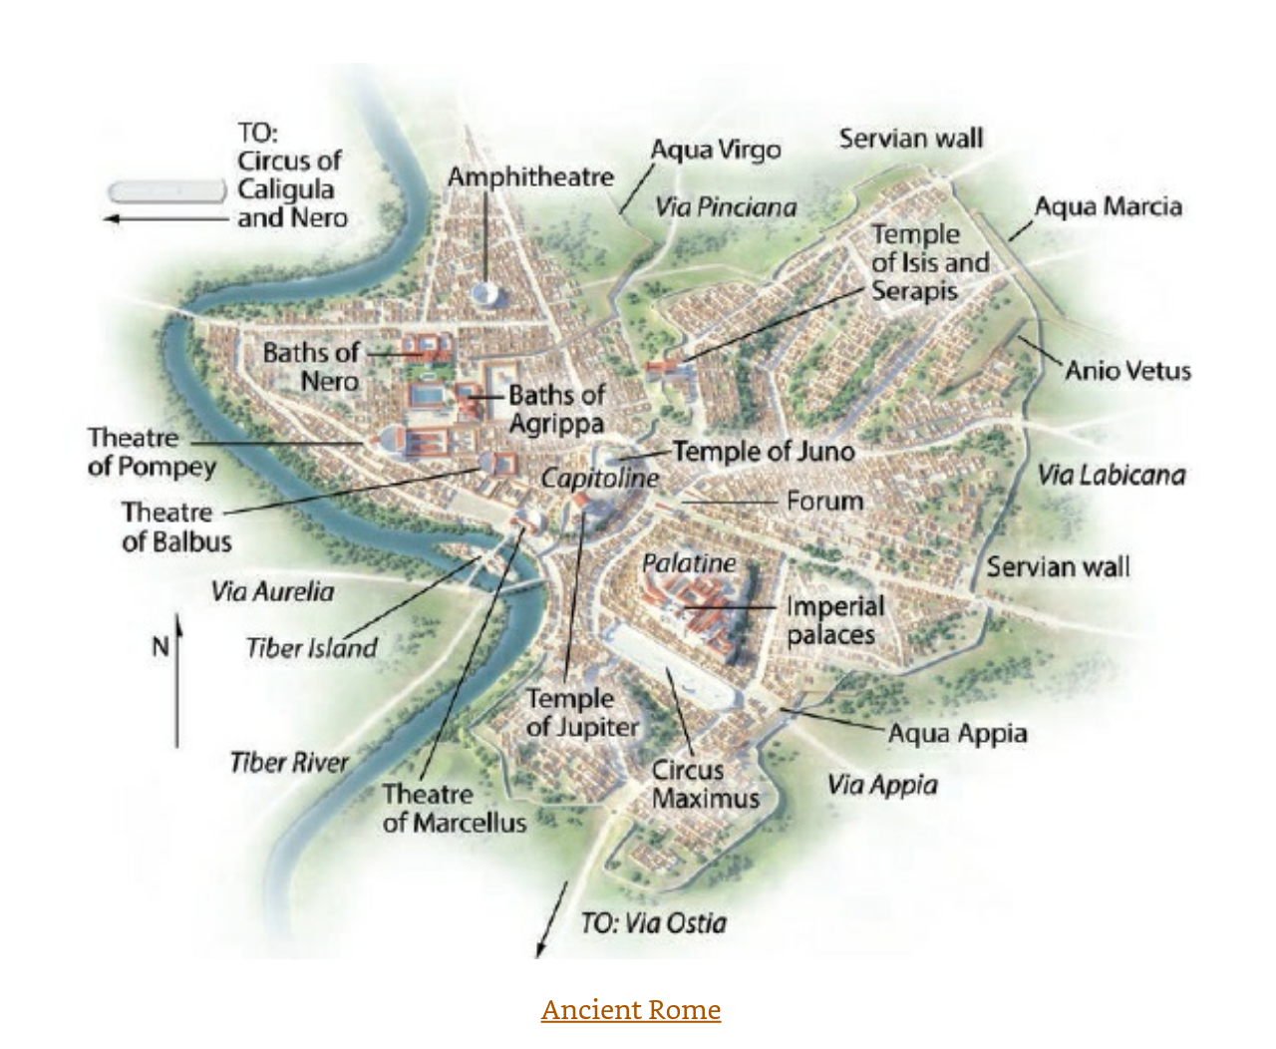
Ancient Rome
A.D. 50
Population ~1 million
World’s largest city, and only million population city in Europe until the 19th century
Today: 2.7 million in Rome.
2021: There are 113 cities in China > 1 million.

Slide 11
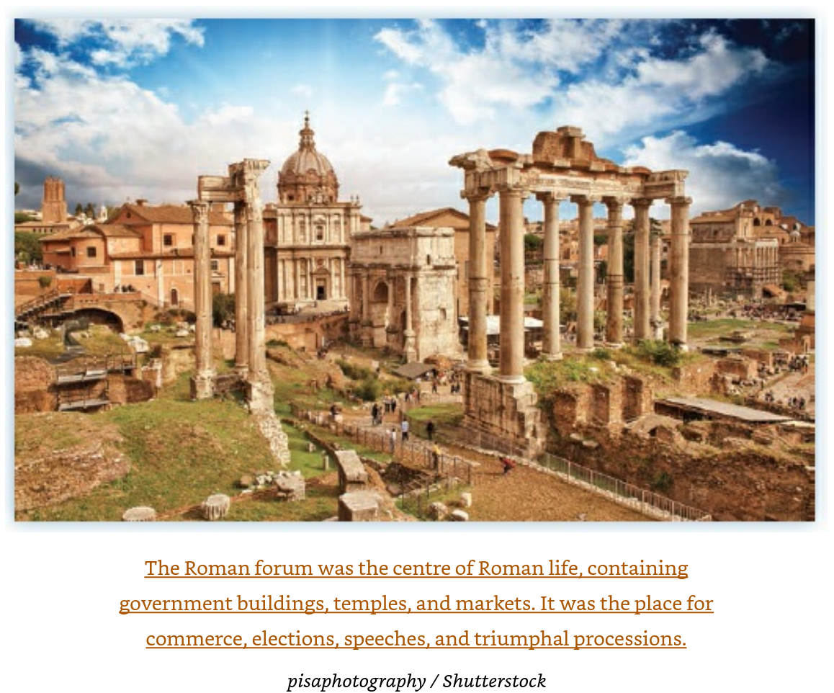

Slide 12
Did Paul Establish the Church in Rome?
Christian churches pre-existed Paul’s arrival, probably due to Jews visiting Jerusalem and hearing about Jesus. Traveling tradespeople such as Priscilla and Aquila probably had an important role.
Peter’s role was probably exaggerated in the retellings by the established church over time, including the idea that he was the first leader of the church there.

Slide 13
Where and How Romans was Written
Paul wrote Romans in Cenchreae (near Corinth) about 56/7.
He planned to return to Jerusalem with the collections taken for them from gentile churches and then to travel to Spain.
The letter was dictated to Tertius (16:22) and entrusted to Phoebe to be delivered to Roman congregations.

Slide 14
What is the Purpose of Romans?
Muratorian canon (late 2nd century): “concerning the plan of the Scriptures, showing that their foundation is Christ.”
Luther: Paul’s summary of Christian and evangelical teaching.
Melanchthon (Luther’s friend): “a compendium of Christian doctrine.
N.T. Wright: It is not a ‘theological treatise’ because
  Key topics are not addressed (holy spirit, church, second coming)
  Romans is situational and includes specific plans, warnings, etc.
N.T. Wright: Romans written for Paul’s specific circumstances and ministry, [OR] Romans written to address an internal problem in the Roman house-churches.

Slide 15
Possible Purposes of Romans
Win the church over to his account of the gospel:
  Freedom from the law through grace for
  Both gentiles and Jews included
Perform “preventative pastoral care”:
  Need to address Claudius’s expulsion of many Jews from Rome, leaving the Roman churches mostly gentile. Claudius’s edicts were canceled when Nero became emperor in 54.
  Perhaps Jews returning to Rome found conflicts with the mostly gentile churches.

Slide 16
In Summary, Roman’s is:
“In sum, Romans is a gospel-based exposition and exhortation; a masterpiece of missionary theology, christological exegesis, pastoral care, and artful rhetoric—all designed to win over the many strands of early Roman Christianity to Paul’s gospel, to lend practical support to his mission in Spain and moral support for his immediate visit to Jerusalem, to draw Jewish and gentile Christians in Rome closer together, to strengthen them in their faith despite the perils of Roman culture. “

Slide 17
Outline of Romans
1. Unveiling God’s righteousness (1—4) a. Introductions, greetings, and defence of Paul’s travel plans (1.1–15) b. Thesis statement (1.16–17) c. Gentiles and Jews condemned, God’s purposes remaining (1.18—3.20) d. Covenant fulfilled through faith for faith (3.21—4.25)
2. From new covenant to new creation (5—8) a. Assurance based on cross and spirit (5.1–11) b. Launching the new humanity (5.12–21) c. The new exodus: baptism and freedom (6.1–23) d. The law and the spirit (7.1—8.11) e. Spirit and new creation (8.12–30) f. Nothing shall separate us from God’s love (8.31–39)
3. God’s faithfulness and Israel’s unbelief (9—11) a. Paul’s grief (9.1–5) b. God’s plan in Israel’s history (9.6–29) c. God’s covenant-faithfulness in the gospel (9.30—10.21) d. God’s abiding faithfulness (11.1–36)
4. Faithfulness and fellowship in the wider world (12—16) a. The transformed mind and its effects (12.1–21) b. Living between the times (13.1–14) c. Growing towards unity (14.1—15.12) d. Missionary plans and closing greetings (15.13—16.27)

Slide 18
“The Romans Road”—Selection of Verses
Evangelical device in the SBC—Compare to overall Romans Outline
Different churches use slightly different sets, but the most common “Roman Road” includes:
Romans 3:23 — The universal problem
“For all have sinned and fall short of the glory of God.”
Key point: Everyone is a sinner.
Romans 6:23 — The consequence and the gift
“For the wages of sin is death, but the gift of God is eternal life in Christ Jesus our Lord.”
Key point: Sin earns death; God offers life.
Romans 5:8 — God’s loving solution
“But God demonstrates his own love for us in this: While we were still sinners, Christ died for us.”
Key point: Christ’s death is God’s answer to sin.
Romans 10:9–10 — The response of faith
“If you confess with your mouth ‘Jesus is Lord’ and believe in your heart that God raised him from the dead, you will be saved.”
Key point: Salvation comes through confessing and believing.
Romans 10:13 — The promise
“Everyone who calls on the name of the Lord will be saved.”
Key point: The offer is open to all.
Some churches add Romans 5:1, 8:1, or 12:1–2 as “next steps” in discipleship.

Slide 19
Romans Coheres through themes and strands which extend through its four parts
One old formula says:
  Part 1 (1-4) is about Justification
  Part 2 (5-8) is about sanctification and/or salvation
  Part 3 (9-11) is a treatise on the Jews
  Part 4 (12-16) is about practice of the faith
This and other paradigms are “too shallow by half” because strands such as Abraham, faith, and others run through each section.
‘If we think that God’s power is restricted to the sphere of the “spiritual,” then we have a fairly small notion of God. What we also need to hear is Paul’s understanding that the gospel encompasses the cosmos, the whole of creation—all the way out and all the way down in human life.’ – Beverly Gaventa, “When in Romans, 46.”

Slide 20
1. Unveiling God’s Righteousness a. Introductions, greetings, and defence of Paul’s travel plans (1.1–15)
1 Paul, a servant of Christ Jesus, called to be an apostle and set apart for the gospel of God [which was predicted in the scriptures and has arrived through Christ]
7 To all in Rome who are loved by God and called to be his holy people:
8 First, thanks…because your faith is being reported all over the world
¹¹ I long to see you so that I may impart to you some spiritual gift to make you strong
¹⁴ I am obligated both to Greeks and non-Greeks, both to the wise and the foolish.
¹⁶ For I am not ashamed of the gospel, because it is the power of God that brings salvation to everyone who believes: first to the Jew, then to the Gentile.

Slide 21
1. Unveiling God’s Righteousness b. Thesis Statement (1:16-7)
¹⁶ For I am not ashamed of the gospel, because it is the power of God that brings salvation to everyone who believes: first to the Jew, then to the Gentile.
It is Jesus who has divine power, revealing the righteousness of God.
People are not righteous, but God is, and it is through faith in God that all are saved, not through national identity, actions to follow the law, or other worshipful activities.

Slide 22
1. Unveiling God’s Righteousness c. Gentiles and Jews condemned, God’s purposes remaining (1:18-3:20)
All humans are ungodly and unjust.
Those Jews who try to do good will fail to avoid all sin.
Israel has failed in its calling to put the world right and has suffered many consequences.
The Messiah has appointed himself judge and righteous judgment is coming.

Slide 23
1. Unveiling God’s Righteousness c. Gentiles and Jews condemned, God’s purposes remaining (1:18-3:20)
¹⁸ The wrath of God is being revealed from heaven against all the godlessness and wickedness of people,
For since the creation of the world God’s invisible qualities—his eternal power and divine nature—have been clearly seen, being understood from what has been made, so that people are without excuse.
²¹ For although they knew God, they neither glorified him as God nor gave thanks to him, (failure of worship!)
²⁴ Therefore God gave them over in the sinful desires of their hearts to sexual impurity for the degrading of their bodies with one another. ²⁵ They exchanged the truth about God for a lie, and worshiped and served created things rather than the Creator—who is forever praised. Amen.

Slide 24
1. Unveiling God’s Righteousness c. Gentiles and Jews condemned, God’s purposes remaining (1:18-3:20)
¹² All who sin apart from the law will also perish apart from the law, and all who sin under the law will be judged by the law. ¹³ For it is not those who hear the law who are righteous in God’s sight, but it is those who obey the law who will be declared righteous. ¹⁴ (Indeed, when Gentiles, who do not have the law, do by nature things required by the law, they are a law for themselves, even though they do not have the law. ¹⁵ They show that the requirements of the law are written on their hearts, their consciences also bearing witness, and their thoughts sometimes accusing them and at other times even defending them.) ¹⁶ This will take place on the day when God judges people’s secrets through Jesus Christ, as my gospel declares.

Slide 25
1. Unveiling God’s Righteousness c. Gentiles and Jews condemned, God’s purposes remaining (1:18-3:20)
According to Paul, the people were unfaithful even though they knew about God. So God “gave them over” to “sinful desires” (1:24), “shame lusts” (1:26), a “depraved mind” (1:28).
Results of unfaithfulness and being “given over” to their desires: unnatural sexual relations, wickedness, evil, greed, depravity, envy, murder, strife, deceit, malice, gossip, slander, God-hating, insolence, arrogance, infidelity, unloving, unmerciful.
“They know God’s righteous decree that those who do such things deserve death”, but “continue to do these things” and “approve of those who practice them.” (1:32)

Slide 26
1. Unveiling God’s Righteousness c. Gentiles and Jews condemned, God’s purposes remaining (1:18-3:20)
But what of the Jews?
The Jews have failed, but they have been entrusted with the word of God.
Practices required by the Law should be of the heart, not just in action.
Jews are not superior to gentiles, because no one is righteous in fact.
¹⁹ Now we know that whatever the law says, it says to those who are under the law, so that every mouth may be silenced and the whole world held accountable to God. ²⁰ Therefore no one will be declared righteous in God’s sight by the works of the law; rather, through the law we become conscious of our sin. Romans 3:19

Slide 27
Theodicy Questions, Examples of the Mysteries
If no one can save himself in the law, why did God let him try?
Are the Old Testaments beliefs incomplete or wrong? No! Jesus and Paul affirmed them as true.
Why did God start with the Jews as his chosen people? If Jewish failures were to be punished by God, why not the greater spiritual failures of other societies?

Slide 28
1. Unveiling God’s Righteousness d. Covenant fulfilled through faith for faith(3:21-4:25)
God has done what he promised.
3:21-31—The cross fulfills the covenant promise to Abraham (Gen 15): A single, sin-forgiven family has formed based only on faith.
Jesus, Israel’s Messiah, achieved by himself the vocation of Israel.

Slide 29
1. Unveiling God’s Righteousness d. Covenant fulfilled through faith for faith(3:21-4:25)
3:21
²¹ But now apart from the law the righteousness of God has been made known, to which the Law and the Prophets testify. ²² This righteousness is given through faith in^{[q]} Jesus Christ to all who believe. There is no difference between Jew and Gentile, ²³ for all have sinned and fall short of the glory of God, ²⁴ and all are justified freely by his grace through the redemption that came by Christ Jesus. ²⁵ God presented Christ as a sacrifice of atonement,^{[r]} through the shedding of his blood—to be received by faith. He did this to demonstrate his righteousness, because in his forbearance he had left the sins committed beforehand unpunished— ²⁶ he did it to demonstrate his righteousness at the present time, so as to be just and the one who justifies those who have faith in Jesus.
Incarnation atonement

Slide 30
Paul’s Point about Abraham
Abraham’s faith was credited to him as righteousness (not his works, and before the law was given to Moses).
Circumcision was sign Abraham received after he was credited with righteousness. Abraham believed God in spite of his circumstances.
^{“16} Therefore, the promise comes by faith, so that it may be by grace and may be guaranteed to all Abraham’s offspring—not only to those who are of the law but also to those who have the faith of Abraham. He is the father of us all. ¹⁷ As it is written: “I have made you a father of many nations.”^{[u]} He is our father in the sight of God, in whom he believed—the God who gives life to the dead and calls into being things that were not.” 4:16-7
^{“23} The words “it was credited to him” were written not for him alone, ²⁴ but also for us, to whom God will credit righteousness—for us who believe in him who raised Jesus our Lord from the dead. ” 4:23

Slide 31
2. From new covenant to new creation (5-8)
Romans Chapters 5-8 summarize neatly the way God’s action in the Messiah and the spirit provide redemption for the world.
Redemption to ancient Israel often meant the exodus (freed from slavery, progress to gain the land of milk and honey).
Chapter 6: echoes the rescue of slaves through baptism
Chapter 7: Paradox of the Torah, given by God yet increasing the grip of sin.
Chapter 8: the Messiah’s death and resurrection is the saving work of God, along with the gift of the spirit. God’s people are redeemed like the Israelites in the Exodus, but, unlke the Exodus, on a personal level and through Jesus.

Slide 32
2. From new covenant to new creation (5-8) a. Assurance based on cross and spirit (5.1–11)
“We have been justified through faith” 5:1
“suffering produces perseverance; perseverance, character; and character, hope.” 5:3-4
“hope does not shame because God’s love has been poured out into our hearst through the Holy Spirit, who has been given to us.” 5:5 (the Trinity again)
“At just the right time…Christ died for the ungodly” 5:6
God’s love: While we were still sinners, Christ died for us.” 5:6

Slide 33
2. From new covenant to new creation (5-8) b. Launching the new humanity (5.12–21)
Sin entered the world through Adam
The giving of the Torah and the law did not overcome sin, but instead accentuated and focused it.
But just as Abraham’s obedience was credited to him as righteousness, Jesus’ obedience superseded Adam’s trespass.
Romans 5:19-21
“. ¹⁹ For just as through the disobedience of the one man the many were made sinners, so also through the obedience of the one man the many will be made righteous. ²⁰ The law was brought in so that the trespass might increase. But where sin increased, grace increased all the more, ²¹ so that, just as sin reigned in death, so also grace might reign through righteousness to bring eternal life through Jesus Christ our Lord.”

Slide 34
2. From new covenant to new creation (5-8) c. The new exodus: baptism and freedom (6.1–23)
So what is the plight of the new believer now?
“Paul insists that baptism, like the crossing of the Red Sea brings them out of the ‘old humanity’ and into the new, messianic humanity.”
The new believers are like freed slaves who now have to learn the difficult lessons of living freed from their old selves.
1 Cor 10:1-4 …our ancestors were all under the cloud and that they all passed through the sea. ² They were all baptized into Moses in the cloud and in the sea. ³ They all ate the same spiritual food ⁴ and drank the same spiritual drink; for they drank from the spiritual rock that accompanied them, and that rock was Christ.
Romans 6:22-3 ²² But now that you have been set free from sin and have become slaves of God, the benefit you reap leads to holiness, and the result is eternal life. ²³ For the wages of sin is death, but the gift of God is eternal life in Christ Jesus our Lord.

Slide 35
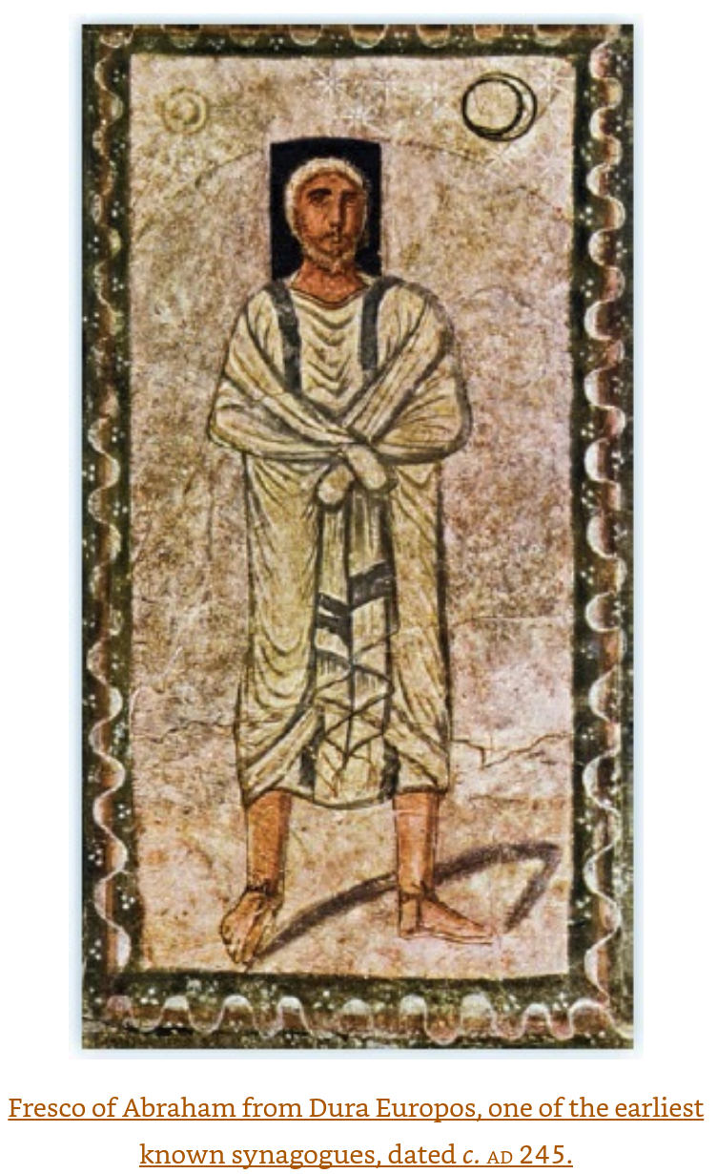
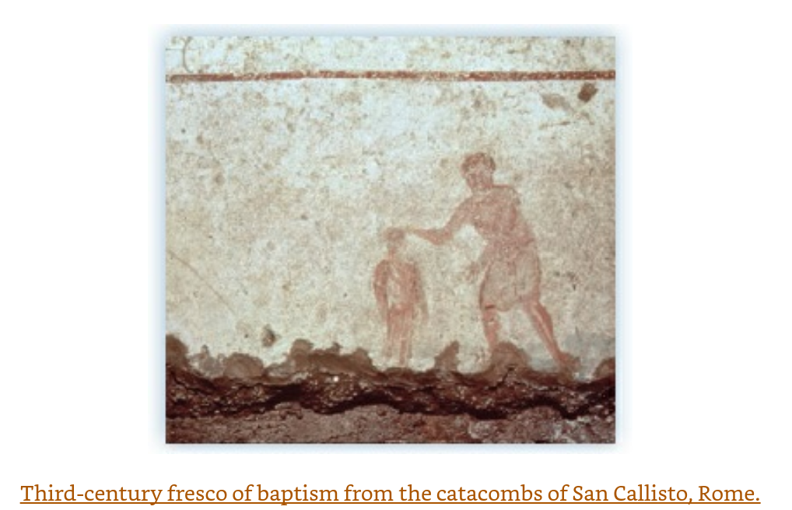

Slide 36
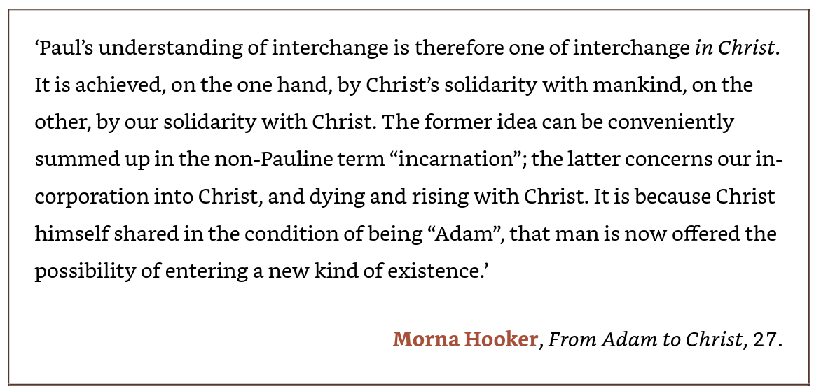
2. From new covenant to new creation (5-8) d. The law and the spirit (7.1—8.11)
Paul makes the case that the Torah actually reveals our sin, but our sinful nature does not allow us to overcome sin on our own. The Torah is judgment on behaviors. The Torah reveals we are in Adam, until we become one with Christ.
Christ
Human-kind
Adam

Slide 37
2. From new covenant to new creation (5-8) d. The law and the spirit (7.1—8.11)
Paul’s humanity is the same as our own humanity in all its sincere truth, expressed in Romans 7:15-25
. ¹⁵ I do not understand what I do. For what I want to do I do not do, but what I hate I do. ¹⁶ And if I do what I do not want to do, I agree that the law is good. ¹⁷ As it is, it is no longer I myself who do it, but it is sin living in me. ¹⁸ For I know that good itself does not dwell in me, that is, in my sinful nature. For I have the desire to do what is good, but I cannot carry it out. ¹⁹ For I do not do the good I want to do, but the evil I do not want to do—this I keep on doing. ²⁰ Now if I do what I do not want to do, it is no longer I who do it, but it is sin living in me that does it.
²¹ So I find this law at work: Although I want to do good, evil is right there with me. ²² For in my inner being I delight in God’s law; ²³ but I see another law at work in me, waging war against the law of my mind and making me a prisoner of the law of sin at work within me. ²⁴ What a wretched man I am! Who will rescue me from this body that is subject to death? ²⁵ Thanks be to God, who delivers me through Jesus Christ our Lord!

Slide 38
2. From new covenant to new creation (5-8) e. Spirit and new creation (8.12–30)
“This is where Paul states most clearly how it is that the Messiah, representing Israel and hence the world, has borne in himself the condemnation of sin: ‘there is no condemnation’ for his people (8.1), because God has condemned sin in the Messiah’s flesh (8.3). But this is no abstract transaction. Because ‘sin’ has been condemned, the new life of the resurrection, put into operation through the spirit, is now at work to set the Messiah’s people free from sin in the present (8.5–8) and free from death itself when they are raised from the dead (8.9–11).”
Wright, N. T.; Bird, Michael F.. The New Testament in Its World: An Introduction to the History, Literature, and Theology of the First Christians (p. 519). Zondervan Academic. Kindle Edition.

Slide 39
2. From new covenant to new creation (5-8) f. Nothing shall separate us from God’s love (8.31–39)
Beautiful words to the Romans, but also for all and forever
³¹ What, then, shall we say in response to these things? If God is for us, who can be against us? ³² He who did not spare his own Son, but gave him up for us all—how will he not also, along with him, graciously give us all things? ³³ Who will bring any charge against those whom God has chosen? It is God who justifies. ³⁴ Who then is the one who condemns? No one. Christ Jesus who died—more than that, who was raised to life—is at the right hand of God and is also interceding for us. ³⁵ Who shall separate us from the love of Christ? Shall trouble or hardship or persecution or famine or nakedness or danger or sword? ³⁶ As it is written:
“For your sake we face death all day long;
we are considered as sheep to be slaughtered.”^{[ao]}
³⁷ No, in all these things we are more than conquerors through him who loved us. ³⁸ For I am convinced that neither death nor life, neither angels nor demons,^{[ap]} neither the present nor the future, nor any powers, ³⁹ neither height nor depth, nor anything else in all creation, will be able to separate us from the love of God that is in Christ Jesus our Lord.

Slide 40
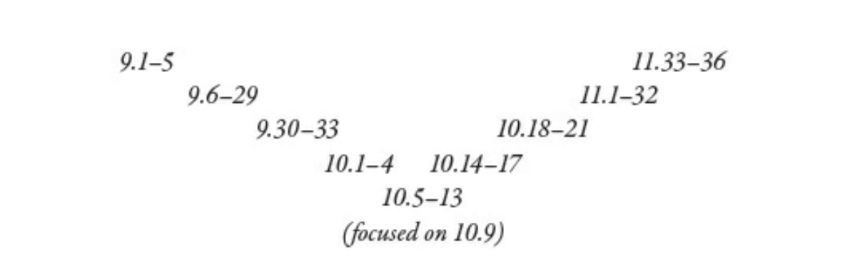
3. God’s faithfulness and Israel’s unbelief (9—11)
Structured as a chiasm
Lament Meditation / Petition Praise
⁹ If you declare with your mouth, “Jesus is Lord,” and believe in your heart that God raised him from the dead, you will be saved.

Slide 41
3. God’s faithfulness and Israel’s unbelief (9—11)
N.T.Wright Many Others
Paul has two purposes here:
Theological: Can God be trusted is he seems to have gone back on his word to Israel?
Practical: Gentile Christians must not suppose that God abandoned the Jews.
Many have misunderstood Paul’s purposes here:
Is NOT claiming the story of Israel as abstract salvation and ethical code.
Is NOT addressing abstract theological questions like “predestination.”

Slide 42
3. God’s faithfulness and Israel’s unbelief (9—11) a. Paul’s grief (9.1–5)
Paul, as a Jew, laments Israel’s rebellious history
Israel’s historic privileges have now by inherited by Jesus and His people.

Slide 43
3. God’s faithfulness and Israel’s unbelief (9—11) b. God’s plan in Israel’s history (9.6–29)
The Story of Israel from Abraham to the exile shows that God’s word has not failed even though many hearts were hardened against him.
From Romans 9:
¹⁴ What then shall we say? Is God unjust? Not at all! ¹⁵ For he says to Moses,
“I will have mercy on whom I have mercy,
and I will have compassion on whom I have compassion.”^{[av]}
¹⁶ It does not, therefore, depend on human desire or effort, but on God’s mercy. ¹⁷
²³ What if he did this to make the riches of his glory known to the objects of his mercy, whom he prepared in advance for glory— ²⁴ even us, whom he also called, not only from the Jews but also from the Gentiles?

Slide 44
3. God’s faithfulness and Israel’s unbelief (9—11) b. God’s plan in Israel’s history (9.6–29)
The points of Romans Chapter 9:
Paul is anguished for Israels failings.
God’s promise has not failed because true Israel is defined by God’s calling, not ancestry (9:6-13)
  Isaac, not Ishmael
  Jacob not Esau
God’s sovereign freedom in showing mercy (9:14-29)
  God is not unjust because mercy is never owed.
  Mercy is a gift, not a wage.
  God’s plan always included a remnant within Israel and the eventual inclusion of the Gentiles.

Slide 45
3. God’s faithfulness and Israel’s unbelief (9—11) b. God’s plan in Israel’s history (9.6–29)
The theological reflections of Romans 9:
Divine sovereignty
Election and calling
The mystery of God’s mercy
The continuity of God’s promises from Abraham to Christ.
Romans 9 challenges human assumptions about fairness and reminds the recipients of the letter and us today that salvation is ultimately a work of God’s grace, not human striving.
Scriptureinsight.org

Slide 46
Romans 9:30-3
³⁰ What then shall we say? That the Gentiles, who did not pursue righteousness, have obtained it, a righteousness that is by faith^{; 31} but the people of Israel, who pursued the law as the way of righteousness, have not attained their goal. ³² Why not? Because they pursued it not by faith but as if it were by works. They stumbled over the stumbling stone. ³³ As it is written:
“See, I lay in Zion a stone that causes people to stumble
and a rock that makes them fall,
and the one who believes in him will never be put to shame.”
Isaiah 8:14; 28:16

Slide 47
3. God’s faithfulness and Israel’s unbelief (9—11) c. God’s covenant-faithfulness in the gospel (9.30—10.21)
Paul’s points in Romans Chapter 10:
The law’s purpose is fulfilled and completed in Christ and righteousness is granted through faith in Christ. Israel is zealous, but lacks this understanding as they try to “establish their own righteousness” through the law.
Salvation is simple and universally available, near, “on your lips and in your heart” for Jew and Greek alike.
Preaching is necessary so others can hear and believe, and God’s calls people for this task.
Israel has heard the gospel through scripture, creation, and the prophets and will be held accountable for its stubborn resistance.
Israel’s covenant-story has come through the predictions of Deuteronomy 27—29 (rebellion and exile) but has now reached Deuteronomy 30 (renewal and restoration), through the Messiah.
Wright, N. T.; Bird, Michael F.. The New Testament in Its World: An Introduction to the History, Literature, and Theology of the First Christians (p. 522). Zondervan Academic. Kindle Edition.

Slide 48
3. God’s faithfulness and Israel’s unbelief (9—11) c. God’s covenant-faithfulness in the gospel (9.30—10.21)
The main point is in 10:8-13
⁸ But what does it say? “The word is near you; it is in your mouth and in your heart,”^{[d]} that is, the message concerning faith that we proclaim: ⁹ If you declare with your mouth, “Jesus is Lord,” and believe in your heart that God raised him from the dead, you will be saved. ¹⁰ For it is with your heart that you believe and are justified, and it is with your mouth that you profess your faith and are saved. ¹¹ As Scripture says, “Anyone who believes in him will never be put to shame.”^{[e]} ¹² For there is no difference between Jew and Gentile—the same Lord is Lord of all and richly blesses all who call on him, ¹³ for, “Everyone who calls on the name of the Lord will be saved.”

Slide 49
3. God’s faithfulness and Israel’s unbelief (9—11) d. God’s abiding faithfulness (11.1–36)
Romans 11 explains how Israel’s unbelief, the Gentiles’ inclusion, and God’s ultimate plan for mercy all fit together. Paul argues that:
God has not rejected Israel—a faithful remnant remains.
Israel’s temporary hardening has allowed Gentiles to be brought in.
Gentiles must remain humble, because they stand by grace, not superiority. (Olive tree metaphor)
God will ultimately restore Israel, showing His covenant faithfulness.
The whole plan leads to worship, because God’s wisdom is beyond human comprehension.
A key purpose for Paul is to address the irony that most Jews rejected Jesus, but remnant who remain can grow. Also, gentiles are not superior or inferior but also receive the same grace. The desired result is an open invitation to all and unity among believers.

Slide 50

The Olive Tree (Rom 11)
¹⁷ If some of the branches have been broken off, and you, though a wild olive shoot, have been grafted in among the others and now share in the nourishing sap from the olive root, ¹⁸ do not consider yourself to be superior to those other branches. If you do, consider this: You do not support the root, but the root supports you.
²² Consider therefore the kindness and sternness of God: sternness to those who fell, but kindness to you, provided that you continue in his kindness. Otherwise, you also will be cut off. ²³ And if they do not persist in unbelief, they will be grafted in, for God is able to graft them in again.
³² For God has bound everyone over to disobedience so that he may have mercy on them all.

Slide 51
3. God’s faithfulness and Israel’s unbelief (9—11) d. God’s abiding faithfulness (11.1–36)
A.I. summary of Romans 11 in one sentence:
Romans 11 exists to show that God’s salvation plan is merciful, unified, and still unfolding—preserving a remnant of Israel, welcoming the Gentiles, and promising a future restoration that reveals the depth of God’s wisdom.

Slide 52
4. Faithfulness and fellowship in the wider world (12—16) a. The transformed mind and its effects (12.1–21)
Romans 1-11
God’s Mercy Explained
Romans 12-16
How believers should practice life under grace.
THEREFORE
Darkened Mind
Idolatry
Wrong Behaviors
Renewed Mind
Genuinely Human Behaviors
Will of God
TRUE
WORSHIP

Slide 53
Romans 12 -- The lifestyle, character, and community ethic of people who have been transformed by God’s mercy
Believers are called to present their bodies as living sacrifices in total, whole-life worship. 12:1-2
  Worship is daily life (not just ritual)
  Transformation by renewal of the mind
  Believers must resist the influence of the world’s patterns.
Believers should have humility and self-understanding (12:3-5)
  The church is one body.
  Everyone is one of many, not self-sufficient or superior
Spiritual gifts should be used well, humbly, and for others in ministries that build up the church.
The Christian ethic of love is defined in 12:9-21 (next slide)

Slide 54
Romans 12 -- The lifestyle, character, and community ethic of people who have been transformed by God’s mercy
Paul defines the Jesus believer’s ethic of love (12:9-21) as active, sacrificial, and countercultural.
Sincere
Honoring others above yourself
Patience in suffering (indeed, “patience” means suffering)
Hospitality
Blessing persecutors
Overcoming evil with good
This is practical advice in the early churches in Rome surrounded by opposition under Nero.

Slide 55
4. Faithfulness and fellowship in the wider world (12—16) ) b. Living between the times (13.1–14)
Paul seems to endorse obeying Roman laws and the rule of the Roman government.
Unlike in the nation of Israel, the Roman government presided over many belief systems and cultures. The Messiah movement was small and vulnerable, lacking in political power, and needed the Roman government systems and rule.
Paul wanted to avoid repeating the expulsion of Jewish Christians under Claudius caused by conflict between Jews and Messiah-believers.
Throughout history, religious authorities have partnered with government to obtain power, leading to corruption and then resistance / reformation within religion.

Slide 56
4. Faithfulness and fellowship in the wider world (12—16) ) b. Living between the times (13.1–14)
Did Paul and Jesus recognize government as a tool of God? Or did they advocate a sort of separation of church and state?
Romans 13 Let everyone be subject to the governing authorities, for there is no authority except that which God has established. The authorities that exist have been established by God. ² Consequently, whoever rebels against the authority is rebelling against what God has instituted, and those who do so will bring judgment on themselves. 3 For rulers hold no terror for those who do right, but for those who do wrong.
Mark 12:17 Then Jesus said to them, “Give back to Caesar what is Caesar’s and to God what is God’s.”
John 19:10-1: Pilate said. “Don’t you realize I have power either to free you or to crucify you?”
¹¹ Jesus answered, “You would have no power over me if it were not given to you from above. Therefore the one who handed me over to you is guilty of a greater sin.”

Slide 57
4. Faithfulness and fellowship in the wider world (12—16) ) b. Living between the times (13.1–14)
Pay taxes…give to everyone what you owe them… (Rom 13:6)
Let no debt remain outstanding (Rom 13:8)
“Love your neighbor as yourself.” Love does no harm to a neighbor. Therefore love is the fulfillment of the law. (Romans 13:9-10)
Wake up because our salvation is nearer now than when we first believed. (Rom 13:13)
Clothe yourselves with the Lord Jesus Christ, and do not think about how to gratify the desires of the flesh (Rom 13:14)

Slide 58
4. Faithfulness and fellowship in the wider world (12—16) ) b. Living between the times (13.1–14)
Within the “inaugurated eschatology of the gospel: though the world still seems dark, the day has in fact broken and Jesus’ followers must live accordingly” –N.T. Wright
The Lord is coming again soon → No need for structural reforms in society?
¹¹ And do this, understanding the present time: The hour has already come for you to wake up from your slumber, because our salvation is nearer now than when we first believed. ¹² The night is nearly over; the day is almost here. So let us put aside the deeds of darkness and put on the armor of light. (Rom 13:11-2)
¹Thess 5.3-6. ³ While people are saying, “Peace and safety,” destruction will come on them suddenly, as labor pains on a pregnant woman, and they will not escape. ⁴ But you, brothers and sisters, are not in darkness so that this day should surprise you like a thief. ⁵ You are all children of the light and children of the day. We do not belong to the night or to the darkness. ⁶ So then, let us not be like others, who are asleep, but let us be awake and sober.

Slide 59
4. Faithfulness and fellowship in the wider world (12—16) ) c. Growing towards Unity (14:1-15:12)
Here Paul addresses the specific problems of A.D. 56 facing the Roman house churches, and does so without naming groups or factions, but instead focusing on personal behaviors, which apply to all.
Christians today mostly view Romans as theology for Christianity for all time, but Paul never envisioned the “between times” as extending very far into the future.
Romans 14:1 ”Accept the one whose faith is weak, without quarreling over disputable matters. ”
The rule that matters is the messianic principle of not pleasing oneself but allowing the needs of others to be paramount (15.1–6), always with the aim of a united fellowship that can worship with one heart and voice (15.6).
-- Wright, N. T.; Bird, Michael F.. The New Testament in Its World (pp. 523-524). Kindle Edition.

Slide 60
4. Faithfulness and fellowship in the wider world (12—16) d. Missionary plans and closing greetings (15:13-16:27)
Paul shares his plan to deliver the [special] Collection to Jerusalem and then proceed to Spain via Rome. He makes a subtle bid for support for the collection to the Roman house-churches in 15:24-7.
Paul extends greetings to individuals, possibly preparing to visit each of them in their own house-churches.

Slide 61
4. Faithfulness and fellowship in the wider world (12—16) d. Missionary plans and closing greetings (15:13-16:27)
Many of those Paul sends greetings to are women, including Phoebe, Priscilla (who delivered his message of Romans in person), Mary, Junia, Tryphena, Tryphosa, Persis.
Some interpret the prominence of women as endorsing the elevation of the status of women in the church. Even some early church fathers wrote on this.
“John Chrysostom wrote about Junia: ‘O how great is the devotion of this woman that she should be counted worthy of the appellation of apostle!’* Origen could infer: ‘This passage teaches that there were women ordained in the church’s ministry by the apostles’ authority . . . Not only that—they ought to be ordained into the ministry, because they helped in many ways and by their good services deserved the praise even of the apostle.’†”.
* Chrys. Hom. Rom. 31. † Cited in Bray 2005, 355.
John Chrysostom, 347-407 A.D.
Origin, 185-254 A.D.

Slide 62
Paul’s Summary: Romans 16:25-27
Paul ends with a blessing which summarizes the point of the entire letter in one sentence which threatens to “collapse grammatically under its own weight”
²⁵ Now to him who is able to establish you in accordance with my gospel, the message I proclaim about Jesus Christ, in keeping with the revelation of the mystery hidden for long ages past, ²⁶ but now revealed and made known through the prophetic writings by the command of the eternal God, so that all the Gentiles might come to the obedience that comes from^{[au]} faith— ²⁷ to the only wise God be glory forever through Jesus Christ! Amen.

Slide 63
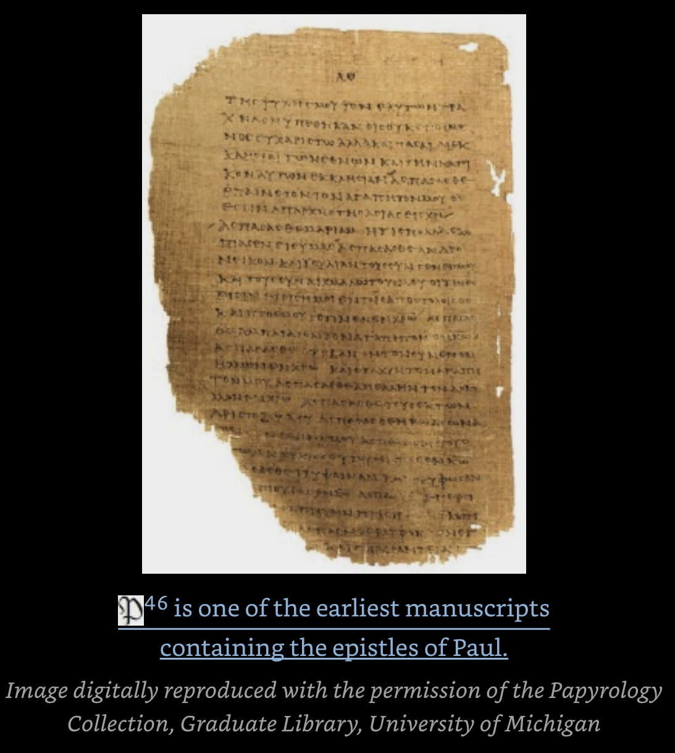
Papyrus 46
The earliest substantial manuscript of Paul’s letters is Papyrus 46, commonly written 𝔓46. It is one of the oldest surviving New Testament manuscripts and the earliest major witness to the Pauline epistles.
📜 What 𝔓46 Is: 𝔓46 is a Greek papyrus codex containing a large collection of Paul’s letters. It is part of the Chester Beatty Papyri, with some leaves in Dublin and others at the University of Michigan. Wikipedia
🕰️ Date: Paleographers date it to c. 175–225 AD, placing it in the late 2nd or early 3rd century. Wikipedia
📖 What It Contains: 𝔓46 preserves portions of the following Pauline letters:• Romans• 1 Corinthians• 2 Corinthians• Galatians• Ephesians• Philippians• Colossians• 1 Thessalonians• Hebrews (included in the Pauline corpus at the time)Wikipedia
🗺️ Where It Was Found: The most likely provenance is Faiyum, Egypt, based on manuscript comparisons.

Slide 64
The Two “Big Picture” themes of Romans are Gospel and Community
“First, the letter is gospel-centred. The noun euangelion and the verb euange lizō together occur a dozen times in the letter. Paul knows that the Romans have received a true gospel tradition; he wants to fill this out with his own rich gospel insight, emphasizing that gentiles are justified by faith without adopting the Jewish way of life. “
“Second, Paul urges an ethnically mixed and potentially fractious network of churches to welcome one another… To walk the ‘Roman road’ (as some have called the gospel presentation in this letter) is not only to discover one’s sins forgiven by the God of utter love and mercy, but also to learn that this lavish forgiveness was always intended to draw people of all sorts into a single family. Multi-ethnic churches should be the norm, not the exception. “
euangelion (εὐαγγέλιον) means “good news” or “glad tidings.”
euangelizō (εὐαγγελίζω) means “to announce good news,” “to proclaim glad tidings,” or “to preach the gospel.” This is the core meaning across classical Greek, the Septuagint, and the New Testament.

Slide 65
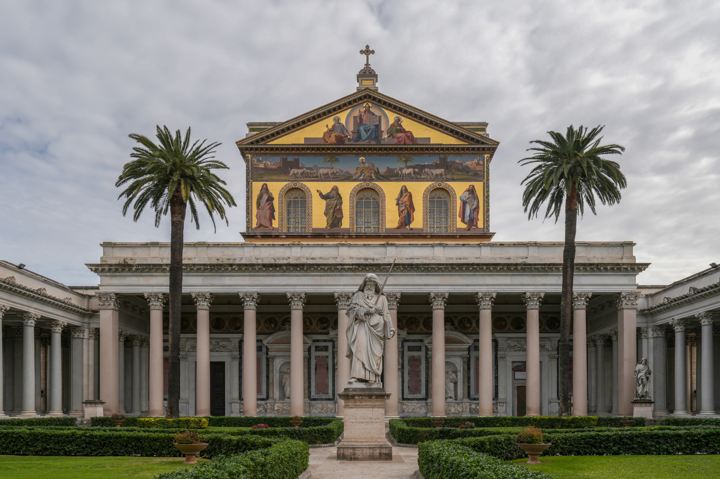
Basilica of Saint Paul Outside the Walls – Rome
Although the modern building is from 1823, the basilica was founded by the Roman emperor Constantine the Great over the burial place of Paul of Tarsus, where it was said that, after the apostle's execution, his followers erected a memorial, called a cella memoriae. This first basilica was consecrated by Pope Sylvester in 324.^{[1]}
^{Wikipedia}

