Slide 1

Christmas Morning 2025

Slide 2
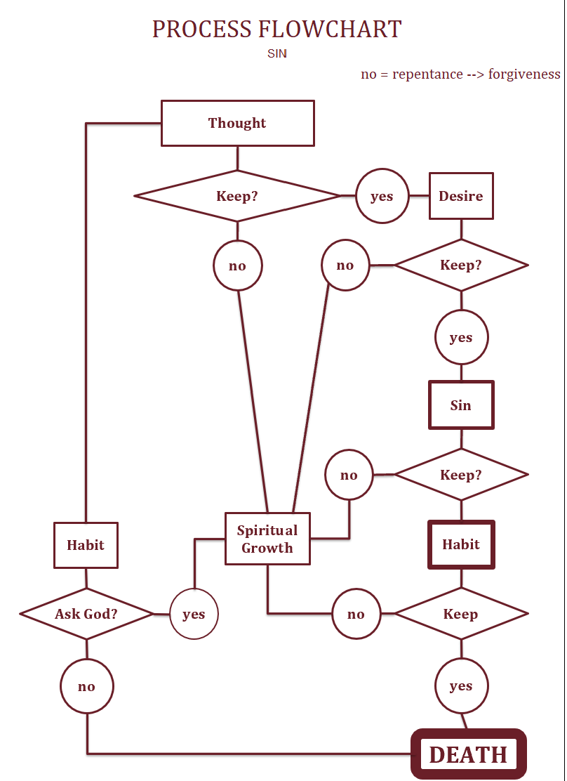
Sharon Petke’s 2018 Flowchart From James 1
The Path From Thought to Death

Slide 3
Prayer Concerns
Supplications
The Petkes
The Choir
Howard Sr.
Praises
Lynda Snook

Slide 4
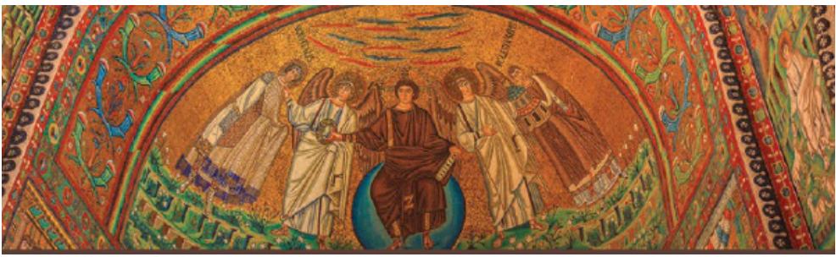
Chapter 18
1st and 2nd Thessalonians
Apprentice Sunday School Class
December 2025
Wright, N. T.; Bird, Michael F.. The New Testament in Its World: An Introduction to the History, Literature, and Theology of the First Christians (p. 416). Zondervan Academic. Kindle Edition.
Notes:
This mosaic is from the Basilica of San Vitale in Ravenna, Italy. It depicts Christ enthroned on a blue globe, flanked by four angels, a masterpiece of 6th‑century Byzantine art.
Specific Location
Church: Basilica of San Vitale
City: Ravenna, Emilia-Romagna, Italy
Date: Built between 526–547 CE under Ostrogoth and Byzantine rule
Placement: Apse mosaic (the semicircular recess behind the altar)
The Basilica of San Vitale is one of the UNESCO World Heritage Sites in Ravenna, famous for its mosaics.
These mosaics blend Roman naturalism with Byzantine symbolism, marking the transition from classical art to medieval Christian iconography.
The apse mosaics, including this one, were commissioned by Archbishop Maximian and reflect Ravenna’s role as a cultural capital after the fall of Rome.
So, the image you uploaded is not just decorative—it’s one of the most iconic mosaics of early Christian art, located in Ravenna’s Basilica of San Vitale, a jewel of Byzantine heritage.

Slide 5
CoPilot AI Summary of Chapter 18
Background and Context
  The Thessalonian letters are among the earliest New Testament writings, reflecting confusion in the early church about Jesus’ return and its implications for believers.
  Thessalonica was a significant city in Macedonia, with a diverse population and a large Jewish community, making it a strategic location for Paul’s ministry.
Paul’s Ministry and Challenges
  Paul, Silas, and Timothy faced opposition and persecution in Thessalonica, leading to their departure and ongoing concern for the young church.
  Paul wrote 1 Thessalonians to encourage perseverance, assure believers about the fate of the deceased, and exhort them to holiness and godliness.
Themes in 1 Thessalonians
  Addresses anxiety about believers who died before Jesus’ return and the temptation to abandon work in anticipation of the end.
  Emphasizes perseverance, purity, and preparedness until the Parousia (Jesus’ coming).
  Outlines the importance of living a holy life, maintaining sexual morality, and supporting one another as a family.
  Clarifies that Jesus’ return will be sudden and transformative, not something to be predicted or obsessed over.
Themes in 2 Thessalonians
  Written shortly after the first letter to address intensified persecution, confusion about the “day of the Lord,” and issues of idleness.
  Stresses steadfastness, correction of false reports about the end times, and the need to remain engaged in work.
  Discusses the “man of lawlessness” (antichrist figure) and the “restrainer,” with historical and theological interpretations provided.
Authorship and Authenticity
  Debates exist about whether Paul wrote 2 Thessalonians, with arguments both for and against its authenticity.
Major Theological Themes
  The letters call the church to a kingdom perspective: living in the present with hope for the future, shaped by Jesus’ death and resurrection.
  Christians are urged to resist cultural pressures, live holy lives, and act as a supportive family.
  Paul warns against speculation about the timing of Jesus’ return and encourages preparation through faith, love, and hope.
Practical Exhortations
  Maintain sexual purity and avoid the prevalent Greco-Roman attitudes toward sex.
  Support one another practically and financially, remain engaged in work, and avoid idleness.
  Discipline within the church family is necessary for maintaining integrity and mission.

Slide 6
Introduction
First and Second Thessalonians are among the earliest of writings of Paul and of the New Testament.
The church in Thessalonica was confused about the presence or coming of Jesus
  Problem 1: Anxiety—What will happen to believer’s who died before the Lord’s return.
  Problem 2: Anticipation—Should believers abandon ordinary life to rely on Christian generosity in the short time before Jesus’ return?
Pithy descriptions penned by authors Longenecker and Still:
1 Thess: Perseverance, Purity, and Preparedness until the Parousia
2 Thess: Consolation and Correction for an Afflicted and Confused Church
Notes:
Quick Answer:
In Christian theology, Longenecker usually refers to Richard N. Longenecker or his son Bruce W. Longenecker, both prominent New Testament scholars. Still refers to Todd D. Still, a Pauline scholar and dean at Baylor University’s Truett Seminary. Together, Bruce Longenecker and Todd Still have co-authored works on Paul’s theology.
📖 Richard N. Longenecker (1930–2021)
Role: Distinguished Professor of New Testament at McMaster Divinity College; previously taught at Wheaton, Trinity Evangelical Divinity School, and Wycliffe College.
Focus: Pauline theology, covenantal themes, and New Testament exegesis.
Notable Works:
Paul, Apostle of Liberty (1964)
Galatians (Word Biblical Commentary, 1990)
Biblical Exegesis in the Apostolic Period (1999)
Romans (New International Greek Testament Commentary, 2016)
Contribution: He emphasized the faithfulness of Christ in Paul’s theology and helped shape modern evangelical scholarship Wikipedia Theopedia.
📖 Bruce W. Longenecker
Role: W. W. Melton Professor of Christian Origins at Baylor University.
Focus: Early Christianity in its Greco-Roman context, Pauline chronology, and Christian social identity.
Notable Works:
The Lost Letters of Pergamum (2003, 2nd ed. 2016)
Remember the Poor: Paul, Poverty, and the Greco-Roman World (2010)
In Stone and Story: Early Christianity in the Roman World (2020)
Co-editor of The Cambridge History of Ancient Christianity (2023)
Contribution: Known for blending historical reconstruction with theological insight, especially regarding Paul and early Christian communities religion.artsandsciences.baylor.edu.
📖 Todd D. Still
Role: Dean and Professor of Christian Scriptures at Baylor University’s Truett Seminary.
Focus: Pauline letters, New Testament theology, and Christian ethics.
Notable Works (often co-authored with Bruce Longenecker):
Thinking Through Paul: A Survey of His Life, Letters, and Theology (2014)
Contributions to Pauline commentaries and edited volumes.
Contribution: Still is recognized for his accessible scholarship on Paul, making complex theological ideas approachable for students and pastors.
🔑 Why They Matter
Richard Longenecker: A foundational voice in evangelical New Testament scholarship.
Bruce Longenecker: A bridge between historical-critical methods and theological reflection.
Todd Still: A contemporary interpreter of Paul, often collaborating with Bruce Longenecker to produce works that combine historical depth with theological clarity.
Together, these scholars represent three generations of Pauline and New Testament study, shaping how pastors, students, and academics understand Paul’s theology and the early church.
Would you like me to map out how their works interconnect—for example, how Bruce Longenecker and Todd Still’s co-authored Thinking Through Paul builds on Richard Longenecker’s earlier scholarship? That could show the continuity of thought across generations.

Slide 7
Thessalonica (modern day Thessaloniki)
Contextual and Critical Matters
Founded 316 BC by Macedonian general Cassander who named it for his wife Thessalonekeia.
Annexed by Rome in 168 BC
Became a regional capital in 146 BC
In Paul’s day, it was a free city with tax exemptions, predominately Greek but with numerous other groups including Jews who had a synagogue building there.
It was on an important Roman road, the Via Egnatia.

Slide 8
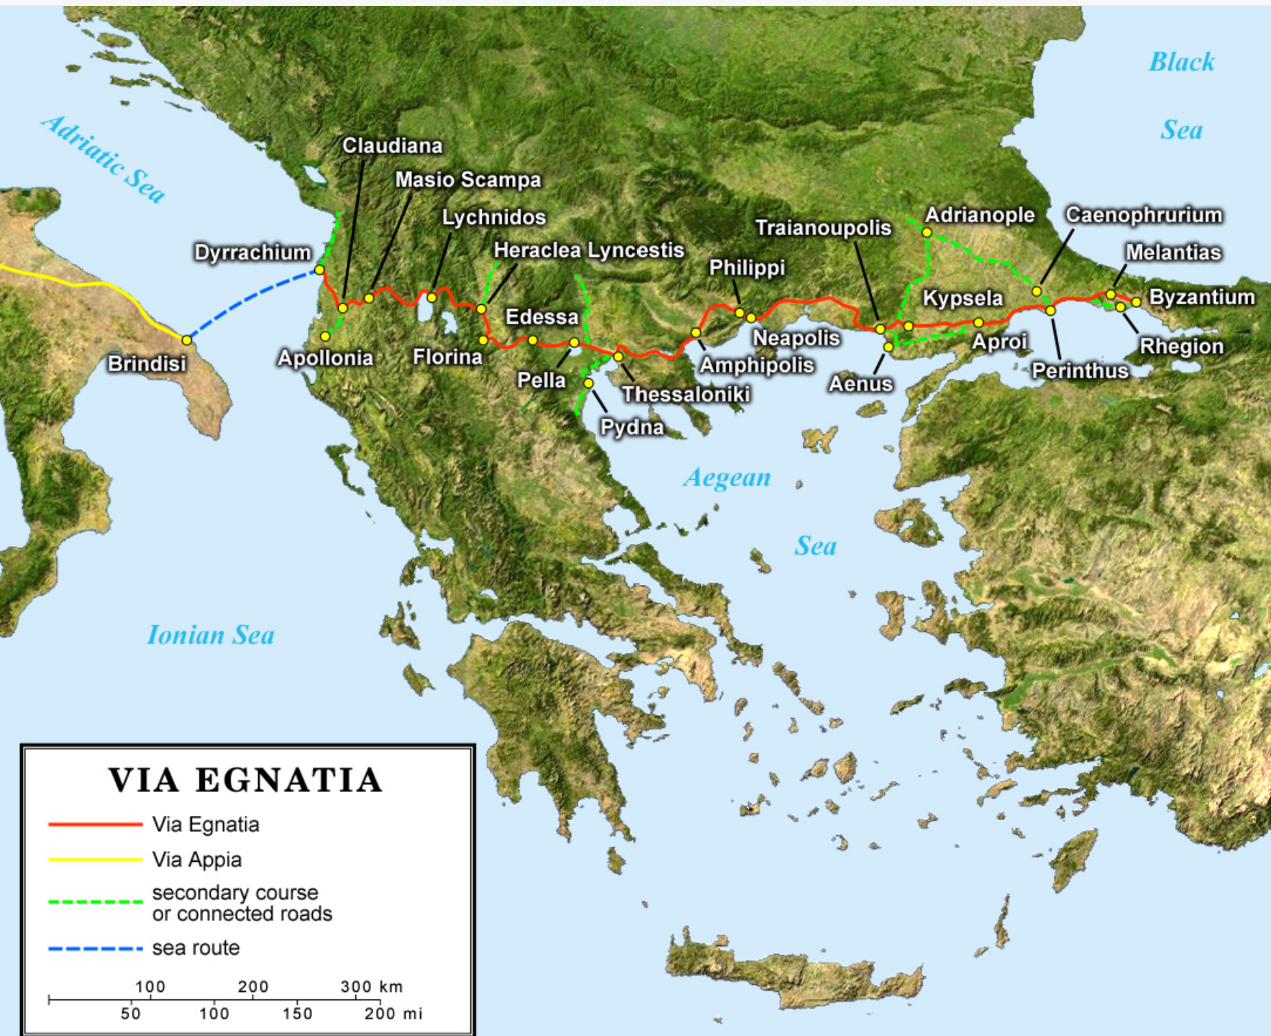
Thessalonia lies on a crossroads location for the region

Slide 9
Paul in Thessalonica, A.D. 50 (Acts 17-18)
Contextual and Critical Matters
Paul arrived in Thessalonica from Philippi under threat from authorities there in A.D. 50.
For three weeks, Paul preached in the Jewish synagogue and worked in his tent-making.
Some Jews, gentile God-fearers, and prominent woman came to believe while Paul was there.
Paul’s host in Thessalonica was Jason, who with others were accused of harboring troublemakers and made to face civic authorities .
Paul, Silas, and Timothy fled together under cover of night to Berea and continued to flee from Thessalonian opposition then to Athens.
Paul dispatched Timothy to Thessalonica to check on the church while Paul left for Corinth.
Paul received Timothy in Corinth who reported that the Thessalonians were doing all right.
It was then in AD 50 that Paul probably wrote 1 Thessalonians while in Corinth.

Slide 10
Why Did the Jews Chase Paul Away?
Contextual and Critical Matters
Paul, Silas, and Timothy had to flee Philippi, Thessalonica, and Berea because of opposition by many in the Jewish community.
Acts 17:4-9
⁴ Some of the Jews were persuaded and joined Paul and Silas, as did a large number of God-fearing Greeks and quite a few prominent women.
⁵ But other Jews were jealous; so they rounded up some bad characters from the marketplace, formed a mob and started a riot in the city. They rushed to Jason’s house in search of Paul and Silas in order to bring them out to the crowd.^{[a]} ⁶ But when they did not find them, they dragged Jason and some other believers before the city officials, shouting: “These men who have caused trouble all over the world have now come here, ⁷ and Jason has welcomed them into his house. They are all defying Caesar’s decrees, saying that there is another king, one called Jesus.” ⁸ When they heard this, the crowd and the city officials were thrown into turmoil. ⁹ Then they made Jason and the others post bond and let them go.

Slide 11
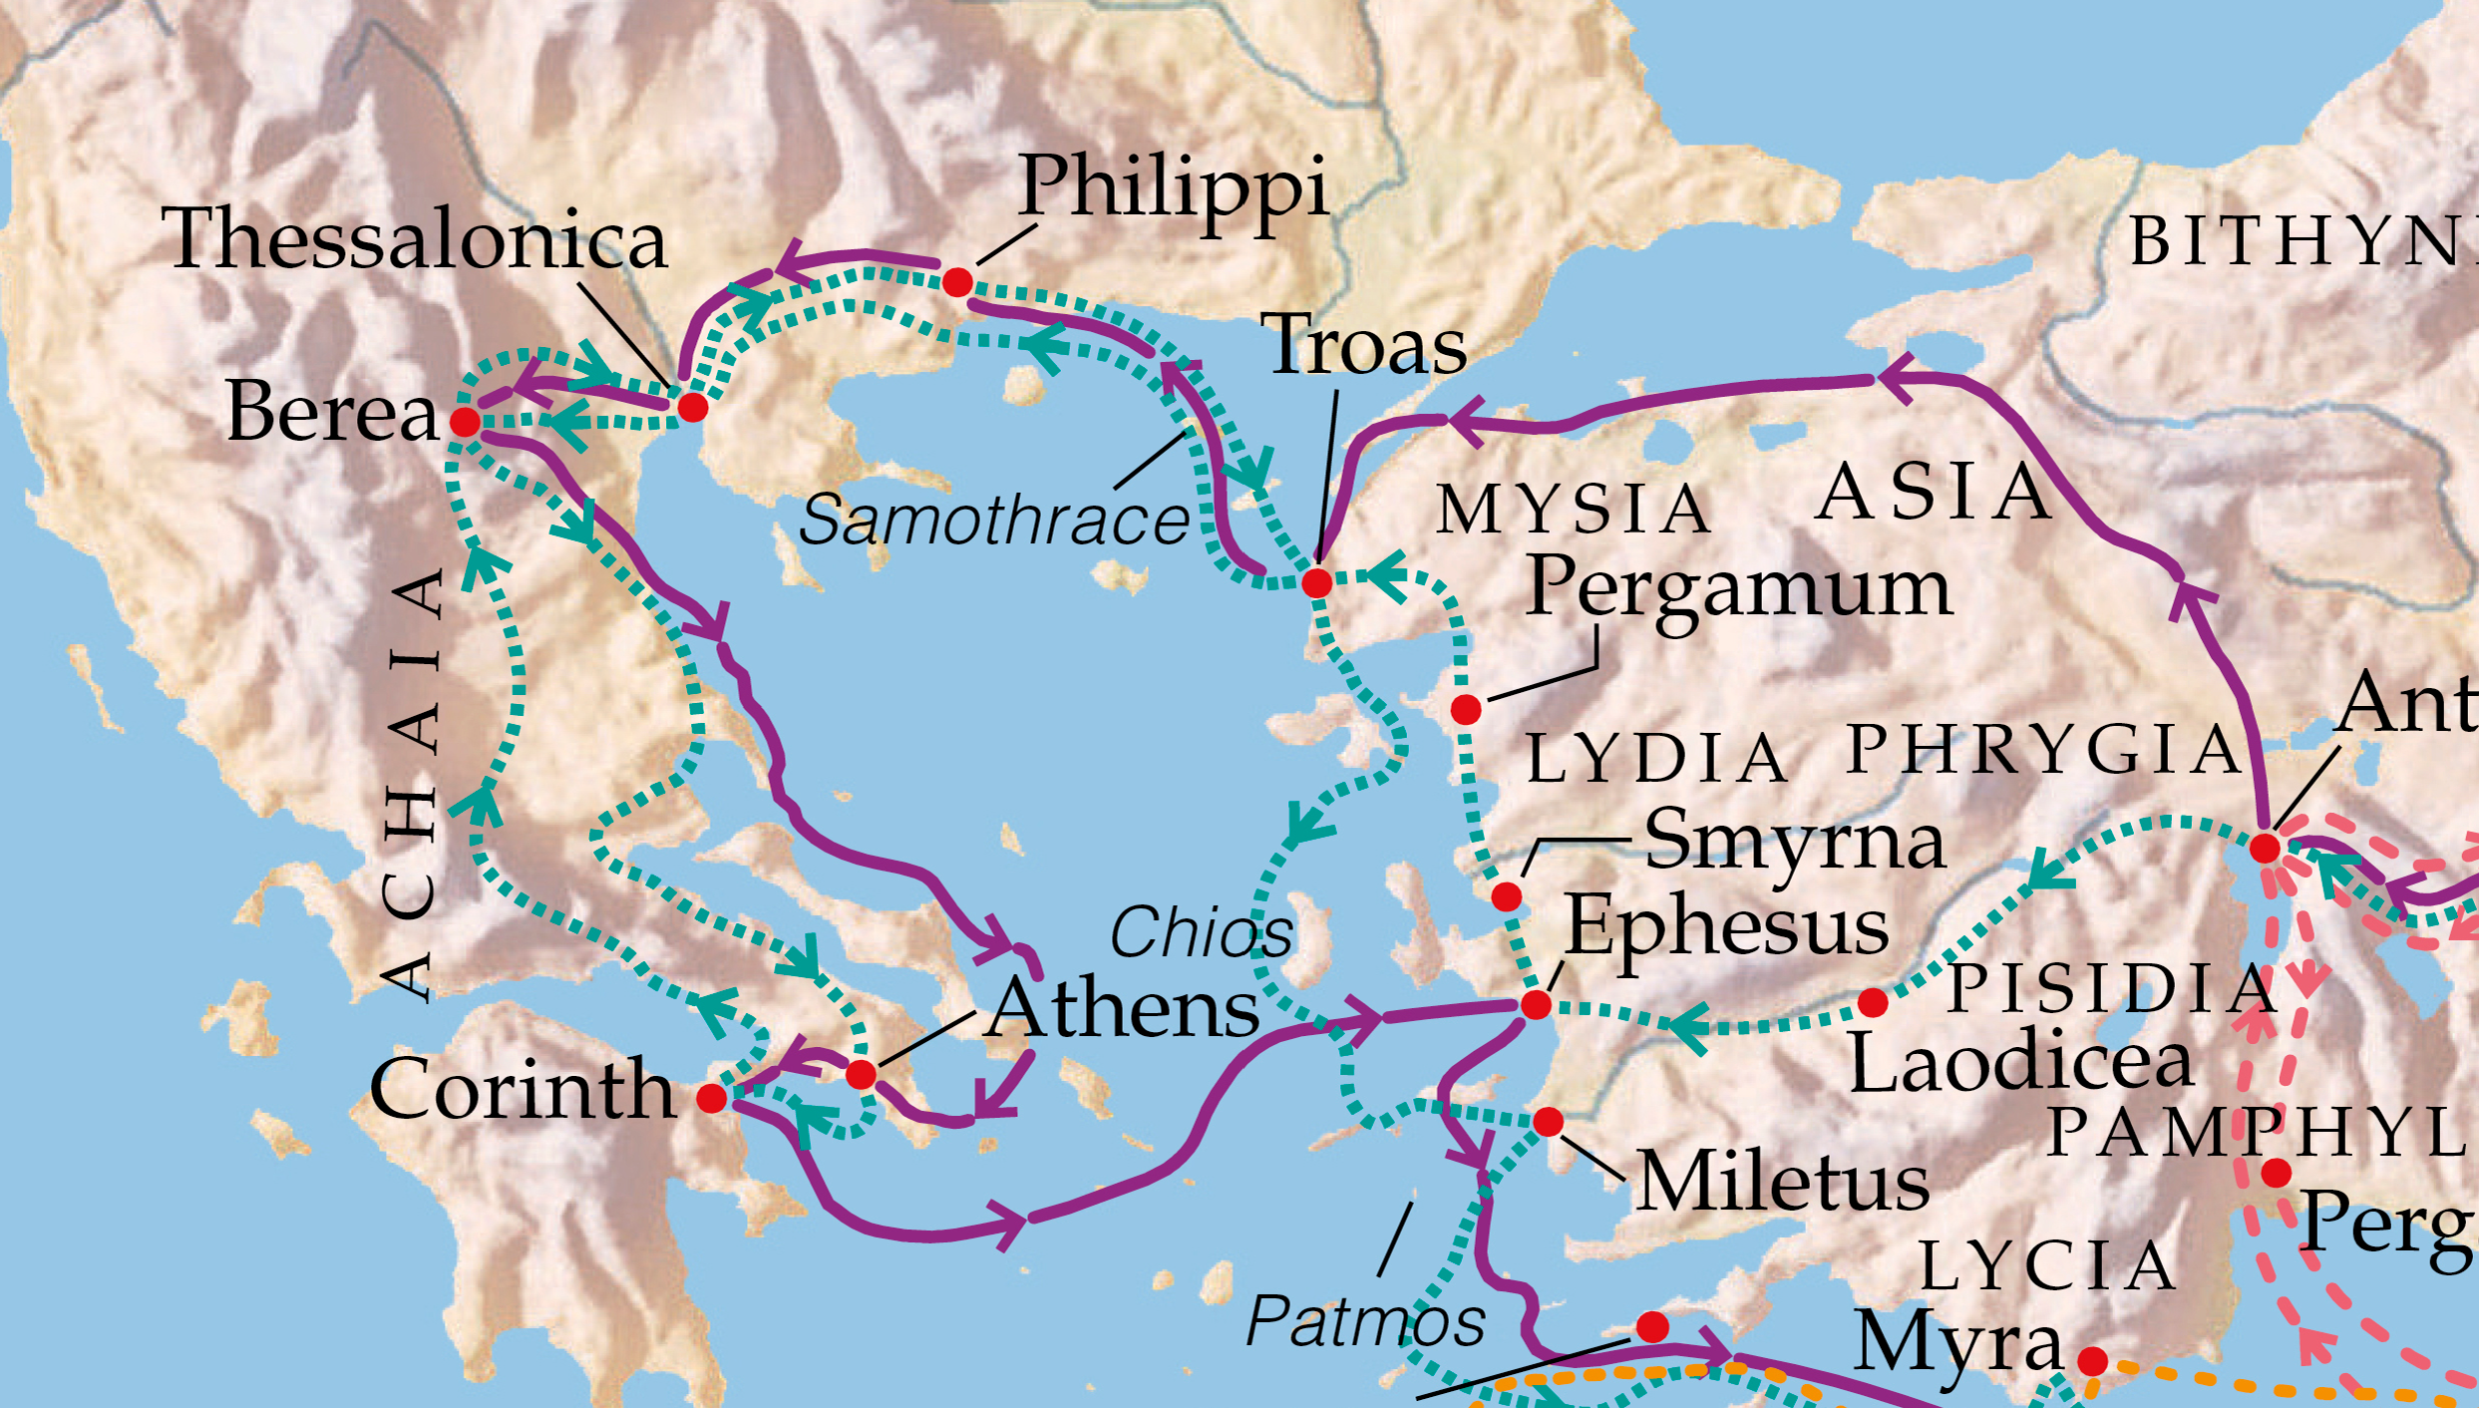
Contextual and Critical Matters

Slide 12
Purposes for Writing 1 Thessalonians
Contextual and Critical Matters
Encourage the fledgling church
Praise for perseverance in the face of opposition.
Assure believer’s who die in faith will be raised by Christ first of all.
Exhort them to continue in holiness and godliness with their world of darkness
Paul’s affection for the Thessalonians is undimmed and motivated only by love.

Slide 13
Purposes for Writing 2 Thessalonians
Contextual and Critical Matters
The book was written very soon after 1 Thessalonians while Paul remained in Corinth.
Addresses concerns about whether the day of the Lord had already come.
A problem arose with people giving up daily life to wait for the Lord’s imminent return.
Exhortation to remain in the faith they were taught, living by God’s call, and rejoicing in God’s glory.

Slide 14
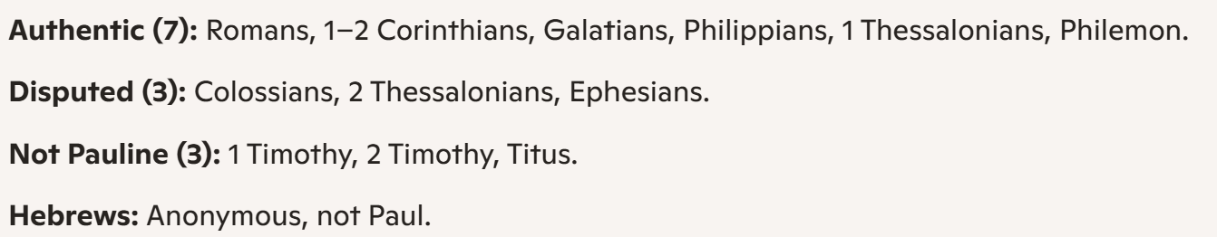
Paul’s Authorship of 2 Thessalonians is Doubtful
Authorship of 2 Thessalonians
1 Thessalonians is generally considered authentic to Paul
2 Thessalonians is considered not Pauline most scholars, but is disputable. N.T. Wright argues in favor of Paul as the author as being “probable.”
Consensus:

Slide 15

Issues related to authorship of 2 Thessalonians
Issue | Argument Against | Argument For
Eschatology | Change in timing for parousia | Paul suggests uncertainty of return of Jesus in other books
Literary Features | Some parts appear too similar to 1 Thess. as if copied. | 1 and 2 Thess. were written close together, so similarity expected
Authorial Tone | Less warmth and more authoritarian than 1 Thess. | Paul’s tone can vary sharply even within a book, and he has experienced persecution in between.
Marks of Authenticity | Excessive emphasis on proving authenticity is suspicious | There were few previous extant letters before Thess and outsiders were misleading believers.

Slide 16
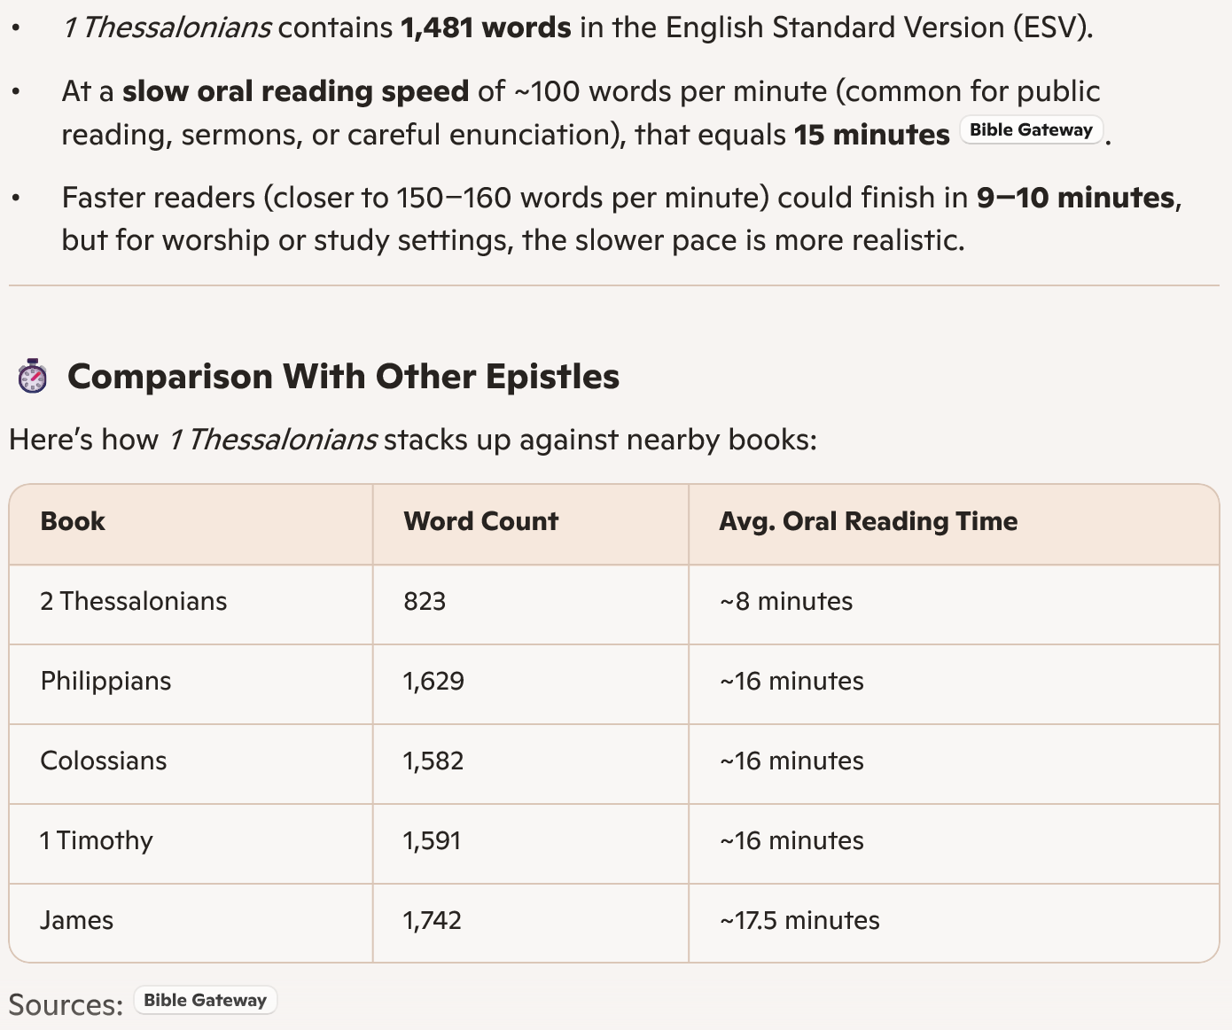
1 Thess. is a short book!

Slide 17
1 Thess. 1 – Greetings and Thanksgiving
The Argument of 1 Thessalonians
1 Paul, Silas^{[a]} and Timothy,
To the church of the Thessalonians in God the Father and the Lord Jesus Christ:
Grace and peace to you.
Thanksgiving for the Thessalonians’ Faith
² We always thank God for all of you and continually mention you in our prayers. ³ We remember before our God and Father your work produced by faith, your labor prompted by love, and your endurance inspired by hope in our Lord Jesus Christ.
⁴ For we know, brothers and sisters^{[b]} loved by God, that he has chosen you, ⁵ because our gospel came to you not simply with words but also with power, with the Holy Spirit and deep conviction. You know how we lived among you for your sake. ⁶ You became imitators of us and of the Lord, for you welcomed the message in the midst of severe suffering with the joy given by the Holy Spirit. ⁷ And so you became a model to all the believers in Macedonia and Achaia. ⁸ The Lord’s message rang out from you not only in Macedonia and Achaia—your faith in God has become known everywhere. Therefore we do not need to say anything about it, ⁹ for they themselves report what kind of reception you gave us. They tell how you turned to God from idols to serve the living and true God, ¹⁰ and to wait for his Son from heaven, whom he raised from the dead—Jesus, who rescues us from the coming wrath.

Slide 18
1 Thess. 2:1-9 Paul’s ministry in Thessalonica was authentic
The Argument of 1 Thessalonians
2 You know, brothers and sisters, that our visit to you was not without results. ² We had previously suffered and been treated outrageously in Philippi, as you know, but with the help of our God we dared to tell you his gospel in the face of strong opposition. ³ For the appeal we make does not spring from error or impure motives, nor are we trying to trick you. ⁴ On the contrary, we speak as those approved by God to be entrusted with the gospel. We are not trying to please people but God, who tests our hearts. ⁵ You know we never used flattery, nor did we put on a mask to cover up greed—God is our witness. ⁶ We were not looking for praise from people, not from you or anyone else, even though as apostles of Christ we could have asserted our authority. ⁷ Instead, we were like young children^{[a]} among you.
Just as a nursing mother cares for her children, ⁸ so we cared for you. Because we loved you so much, we were delighted to share with you not only the gospel of God but our lives as well. ⁹ Surely you remember, brothers and sisters, our toil and hardship; we worked night and day in order not to be a burden to anyone while we preached the gospel of God to you.

Slide 19
1 Thess. 2:10-17 Paul’s motives were loving and Godly
The Argument of 1 Thessalonians
2 You know, brothers and sisters, that our visit to you was not without results. ² We had previously suffered and been treated outrageously in Philippi, as you know, but with the help of our God we dared to tell you his gospel in the face of strong opposition. ³ For the appeal we make does not spring from error or impure motives, nor are we trying to trick you. ⁴ On the contrary, we speak as those approved by God to be entrusted with the gospel. We are not trying to please people but God, who tests our hearts. ⁵ You know we never used flattery, nor did we put on a mask to cover up greed—God is our witness. ⁶ We were not looking for praise from people, not from you or anyone else, even though as apostles of Christ we could have asserted our authority. ⁷ Instead, we were like young children^{[a]} among you.
Just as a nursing mother cares for her children, ⁸ so we cared for you. Because we loved you so much, we were delighted to share with you not only the gospel of God but our lives as well. ⁹ Surely you remember, brothers and sisters, our toil and hardship; we worked night and day in order not to be a burden to anyone while we preached the gospel of God to you.

Slide 20
1 Thess. 2:17-3:5 Paul was torn away from Thessalonica
The Argument of 1 Thessalonians
¹⁷ But, brothers and sisters, when we were orphaned by being separated from you for a short time (in person, not in thought), out of our intense longing we made every effort to see you. ¹⁸ For we wanted to come to you—certainly I, Paul, did, again and again—but Satan blocked our way. ¹⁹ For what is our hope, our joy, or the crown in which we will glory in the presence of our Lord Jesus when he comes? Is it not you? ²⁰ Indeed, you are our glory and joy.
3 So when we could stand it no longer, we thought it best to be left by ourselves in Athens. ² We sent Timothy, who is our brother and co-worker in God’s service in spreading the gospel of Christ, to strengthen and encourage you in your faith, ³ so that no one would be unsettled by these trials. For you know quite well that we are destined for them. ⁴ In fact, when we were with you, we kept telling you that we would be persecuted. And it turned out that way, as you well know. ⁵ For this reason, when I could stand it no longer, I sent to find out about your faith. I was afraid that in some way the tempter had tempted you and that our labors might have been in vain.

Slide 21
1 Thess. 3:6-13 Joy over Timothy’s report from his return visit
The Argument of 1 Thessalonians
⁶ But Timothy has just now come to us from you and has brought good news about your faith and love. He has told us that you always have pleasant memories of us and that you long to see us, just as we also long to see you. ⁷ Therefore, brothers and sisters, in all our distress and persecution we were encouraged about you because of your faith. ⁸ For now we really live, since you are standing firm in the Lord. ⁹ How can we thank God enough for you in return for all the joy we have in the presence of our God because of you? ¹⁰ Night and day we pray most earnestly that we may see you again and supply what is lacking in your faith.
¹¹ Now may our God and Father himself and our Lord Jesus clear the way for us to come to you. ¹² May the Lord make your love increase and overflow for each other and for everyone else, just as ours does for you. ¹³ May he strengthen your hearts so that you will be blameless and holy in the presence of our God and Father when our Lord Jesus comes with all his holy ones.

Slide 22
1 Thess 4:1-12 Call for Purity among Believers
The Argument of 1 Thessalonians
It is God’s will that you should be sanctified: that you should avoid sexual immorality; ⁴ that each of you should learn to control your own body^{[a]} in a way that is holy and honorable, ⁵ not in passionate lust like the pagans, who do not know God; ⁶ and that in this matter no one should wrong or take advantage of a brother or sister.^{[b]} The Lord will punish all those who commit such sins, as we told you and warned you before. ⁷ For God did not call us to be impure, but to live a holy life. ⁸ Therefore, anyone who rejects this instruction does not reject a human being but God, the very God who gives you his Holy Spirit.

Slide 23
Call for Purity was Counter to Roman Culture
The Argument of 1 Thessalonians
N.T. Wright: Ancient literature shows that “patriarchal debauchery” characterized Greco-roman sexual mores.
Example (Demosthenes, Against Neaera)
“We keep mistresses for pleasure, concubines for our day-to-day bodily needs, but we have wives to produce legitimate children and serve as trustworthy guardians of our homes.”
Example (Horace, Sermons 1.2.116-19)
“If your groin is swelling, and a housemaid or a slave boy is at hand, arousing constant desire, do you prefer to burst with tension? Not me: I enjoy love that is available and easy.”

Slide 24
1 Thess. 4:13-5:11—Clarifications about the Lord’s Return
The Argument of 1 Thessalonians
Pagans and Christians both grieve the dead, but Christians give with hope and expectation.
Jesus will return and take people back with him, but not in terms of modern rapture theology. Instead, Paul is using Daniel’s exaltation-imagery (‘caught up on the clouds).
The dead will rise first, then the believers will join them in God’s new world.
No one knows when this will happen, and there will be no sign.

Slide 25
Assurance about the Faithful Dead*
The Argument of 1 Thessalonians
1 Thessalonians 4:13-18:
¹³ Brothers and sisters, we do not want you to be uninformed about those who sleep in death, so that you do not grieve like the rest of mankind, who have no hope. ¹⁴ For we believe that Jesus died and rose again, and so we believe that God will bring with Jesus those who have fallen asleep in him. ¹⁵ According to the Lord’s word, we tell you that we who are still alive, who are left until the coming of the Lord, will certainly not precede those who have fallen asleep. ¹⁶ For the Lord himself will come down from heaven, with a loud command, with the voice of the archangel and with the trumpet call of God, and the dead in Christ will rise first. ¹⁷ After that, we who are still alive and are left will be caught up together with them in the clouds to meet the Lord in the air. And so we will be with the Lord forever. ¹⁸ Therefore encourage one another with these words.
*As contrasted with the Grateful Dead

Slide 26
1 Thess. 4:13-5:11—Clarifications about the Lord’s Return
The Argument of 1 Thessalonians
5 Now, brothers and sisters, about times and dates we do not need to write to you, ² for you know very well that the day of the Lord will come like a thief in the night. ³ While people are saying, “Peace and safety,” destruction will come on them suddenly, as labor pains on a pregnant woman, and they will not escape.
⁴ But you, brothers and sisters, are not in darkness so that this day should surprise you like a thief. ⁵ You are all children of the light and children of the day. We do not belong to the night or to the darkness. ⁶ So then, let us not be like others, who are asleep, but let us be awake and sober. ⁷ For those who sleep, sleep at night, and those who get drunk, get drunk at night. ⁸ But since we belong to the day, let us be sober, putting on faith and love as a breastplate, and the hope of salvation as a helmet. ⁹ For God did not appoint us to suffer wrath but to receive salvation through our Lord Jesus Christ. ¹⁰ He died for us so that, whether we are awake or asleep, we may live together with him. ¹¹ Therefore encourage one another and build each other up, just as in fact you are doing.

Slide 27
Prof. Dana Schuler
The Argument of 1 Thessalonians
“On what happens at the rapture, let me put it this way: if one day you look out of your window and see people rising up into the air, the natural thing to do is say to yourself, ‘Well, I’ll be damned!’”
Wright, N. T.; Bird, Michael F.. The New Testament in Its World: An Introduction to the History, Literature, and Theology of the First Christians (p. 425). Zondervan Academic. Kindle Edition.

Slide 28
2 Thessalonians
“Consolation and Correction for a Confused and Conflicted Church”
Clarification on “the Day of the Lord”

Slide 29
The Time has not come for the “Man of Lawlessness”
2 Thessalonians
2 Thess 2:1-4
The reports that the day of the Lord has already come are false!
(N.T. Wright: Obviously “the day of the Lord” does not mean the end of the world or else no one could have thought they had already missed it.)
2 Thess 2:5-12
A “man of lawlessness is coming!”
There will be “works of Satan in counterfeit miracles, signs, and wonders, and in every sort of evil that deceives those who are perishing!”

Slide 30
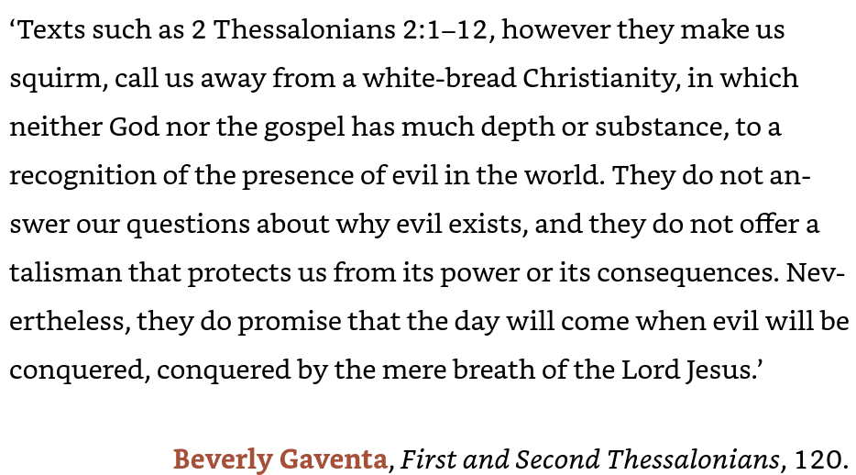
2 Thessalonians
Other Voices:
BLAST FROM THE PAST: TERTULLIAN ON THE RESTRAINER The church father Tertullian (c. AD 155–240), a north African lawyer and apologist, one of the first great Latin theologians, identified the ‘restrainer’ of the Antichrist, which Paul discusses in 2 Thessalonians 2.3–6, as none other than the Roman empire:
“There is also another, even greater, obligation for us to pray for the emperors; yes, even for the continuance of the empire in general and for the Roman interests. We realize that the tremendous force which is hanging over the whole world, and the very end of the world with its threats of dreadful afflictions, is arrested for a time by the continued existence of the Roman Empire. This event we have no desire to experience and, in praying that it may be deferred, we favour the continuance of Rome. (Tert. Apol. 32)”
Wright, N. T.; Bird, Michael F.. The New Testament in Its World: An Introduction to the History, Literature, and Theology of the First Christians (p. 428). Zondervan Academic. Kindle Edition.

Slide 31
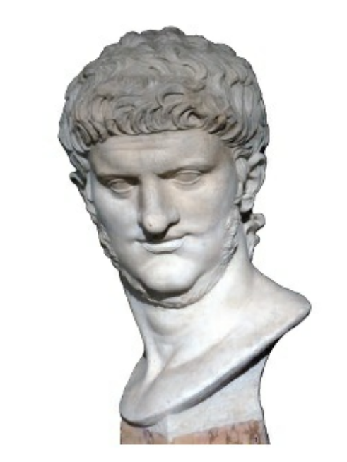
“This ‘Man of Lawlessness’ is likely an archetype
2 Thessalonians
The archetype follows other villains such as:
Antiochus Epiphanes who desecrated the Temple (and is probably the original ‘boastful horn’ in Daniels vision).
Pompey, a Roman general who entered the Holy of Holies in the Jerusalem Temple
Caligula, the emperor who wanted his statue put up in the Temple
Nero (after Thess. was written) who was a terror.
In other words, another terrible leader would come along to coincide with God’s final action against evil.
Emperor Nero fit the archetype of the ‘Man of Lawlessness” for many early Christians

Slide 32
Who is the “Restrainer” postponing the Parousia
2 Thessalonians
No one can be sure what Paul is talking about, but perhaps:
The Holy Spirit?
The Church?
The preaching of the Gospel?
An Angel?
The Jewish people?
God’s decree?
The Roman Empire?

Slide 33
Chapter 18 Big Picture Conclusions for 1 and 2 Thessalonians
1. Kingdom Perspective and Jesus’ Return
The Thessalonian letters urge believers to adopt a kingdom-focused outlook—anticipating the future return of Jesus while recognizing that God’s kingdom has already begun through Jesus’ death and resurrection. This perspective shapes Christian living, encouraging followers to resist the dominant culture and political alliances, and instead trust in God’s purposes. The hope of Jesus’ return is a recurring theme, but Paul cautions against obsessive speculation about its timing. Instead, Christians are called to demonstrate readiness through love, faith, and hope.
2. Holiness and Sexual Conduct
A significant emphasis is placed on holiness, especially regarding sexual behavior. Paul teaches that Christians are called to live lives worthy of God’s kingdom, countering the prevailing cultural idolization of sex. Bodies are seen as sacred, and sexual conduct is to be governed by discipleship and sanctification, not by unchecked desire. The church is called to care for the vulnerable and maintain high standards of conduct, with warnings against exploitation and immorality.
3. The Church as Family
The letters portray the church as a close-knit family, bound by the self-giving love of Jesus. Members are responsible for supporting, comforting, and disciplining one another, actively seeking the good of others. Paul’s frequent use of “brothers” underscores this familial bond. In a culture that values individualism, the Thessalonian church’s sense of family was essential for its survival and mission. When the church acts as a true family, it thrives both internally and in its outreach to the world.

Slide 34
