Slide 1
Prayers
Supplications
Howard Sr.’s heart
Sharon Petke — At Waters getting therapy
Gratitude
Sam starts new job tomorrow
Both Davids are here

Slide 2
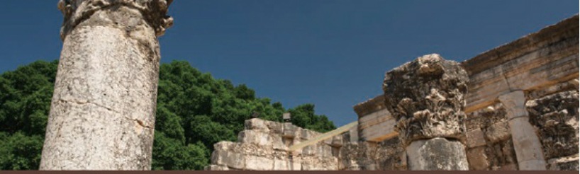
Chapter 16 – A Primer on Pauline Theology
“The New Testament in Its World” N.T. Wright

Slide 3
AI Summary of Chapter 16
Paul’s theology is fundamentally pastoral, aimed at shaping the life and unity of God’s people through a reworking of Jewish monotheism centered on Jesus the Messiah and the Spirit. His letters, including the letter to Philemon, highlight the transformative power of belonging to the Messiah’s family, which transcends traditional social boundaries and calls for mutual love and acceptance.
Theology as pastoral care: Paul’s theological work is rooted in the need to nurture and protect the community of believers, guiding them to think and live as members of the Messiah’s family, exemplified in his appeal for Onesimus to be received as a brother in Christ.
Christological monotheism: Paul redefines Jewish monotheism by placing Jesus at the center as the one in whom God has acted decisively in history, especially through his death, resurrection, and exaltation, thus maintaining strict monotheism while affirming Jesus’ divine identity.
Spirit’s role in God’s presence: The Spirit is portrayed as the active presence of God with believers, sent by the Father alongside the Son, enabling them to live in new covenant relationship and embody the promises of God’s renewed creation.
Election reinterpreted: Paul affirms Israel’s election by God but reinterprets it through Jesus as Israel’s representative Messiah, expanding the chosen people to include Gentiles who share faith in Christ, thus forming a new, inclusive covenant community.
Justification by faith: Justification is understood as being declared righteous through faith in the Messiah’s death and resurrection, which replaces reliance on Torah observance and ethnic identity as markers of covenant membership.
Incorporation into the Messiah: Believers are spiritually united with Jesus through faith and baptism, participating in his death and resurrection, which defines their identity and hope within God’s people.
Eschatological hope: Paul reworks Jewish eschatology around the Messiah’s death, resurrection, and return, emphasizing the inaugurated but not yet fully realized kingdom of God, the defeat of evil, resurrection of the dead, and cosmic renewal.
The day of the Lord and judgment: The future return of Jesus (parousia) will bring final judgment and the full establishment of God’s reign, with believers sharing in the judgment and the transformation of creation.
Paul’s legacy: Paul’s theological vision calls for a united community of Jews and Gentiles worshiping God through Jesus and empowered by the Spirit, embodying the new creation and continually engaging in theology to live out this identity.

Slide 4
Saint Paul and Christian Theology
Paul helped create a distinctive field called “theology” involving prayerful reflection on God, the world, and ourselves in a way not done before.
Theology to Paul was a practical and necessary aspect of his pastoral role and not for intellectual curiosity.
Paul’s theology in Christ was grounded in Jewish belief but was a radical reshaping of these beliefs which can thought of in three pillars:
Monothesism – One (true) God
Election – One body of God’s people
Eschatology – One Future for God’s people

Slide 5
What Theological Tenets are Associated with Paul – Your Ideas Here:

Slide 6
N.T. Wright Starts with Philemon?
This letter was written (AD 57-62) to Philemon who was the master of the slave Onesimus, who had escaped from Colossae to be with Paul. Paul was an “old man” near the end of his ministry and his full theological framework was in place.
Did Paul advise Philemon to let Onesimus go free? No!
Instead, Paul advised Philemon to allow Onesimus to return as a slave, but to be received as a brother in Christ, with forgiveness, and to be treated as such (except for the slavery part).
Onesimus was to give us his flight and live in harmony.
What kind of theological statement is this?

Slide 7
What Would We Do?
Let Onesimus continue to defy the law and protect him at the expense of Philemon (and possibly to the death of Onesimus)?
Tell Philemon to free Onesimus possibly causing division and harm and provoking other slave owners?
Organize a political movement against slavery that would probably be crushed resulting the in the deaths of many?
Persecute Onesimus for breaking the law and causing trouble?

Slide 8
What Paul Did for Onesimus and Philemon
Write to Philemon asking him, not requiring him to: Receive Onesimus (sent back by Paul) as they he were Paul himself.
Philemon is free to choose what is required by Christ, not coerced.
Onesimus would be forgiven and not punished.
Onesimus would be a full member and partner in the fellowship (koinonia).
Onesimus would still be a slave, but treated as a brother.
Philemon would still be his master, but be subject to Christ.

Slide 9
What does Philemon imply about Pauline Pastoral Theology?
Romans 14/15: Welcome [the] weak in faith…not [for] disputes..[but] because God has welcomed them.
Strive for messianic unity across traditional boundaries (Jew/gentile, church unity, free/slave, male/female)
This unity in Christ could only be attained and maintained through a freshly worked theology, rooted in Jesus the Messiah and activated through the spirit.

Slide 10
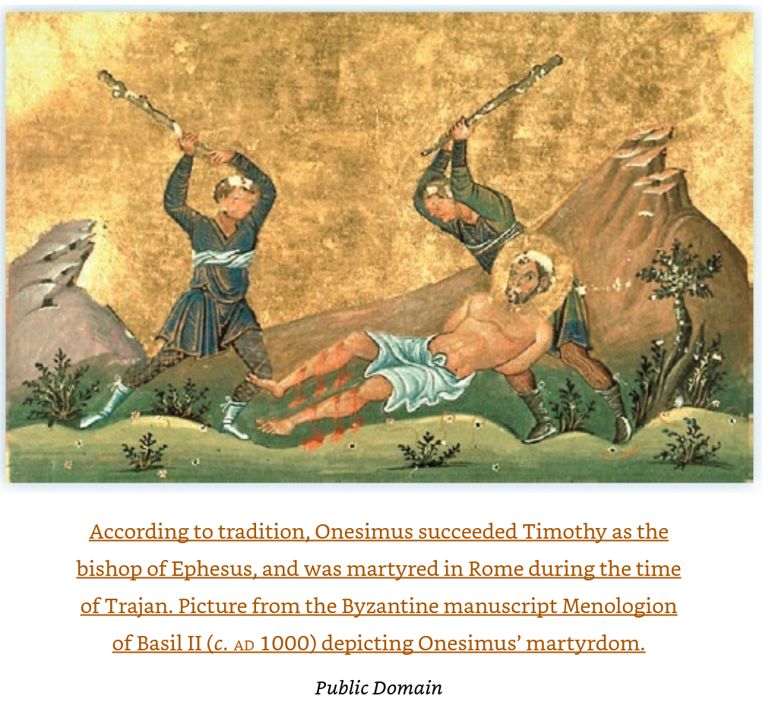
Did Onesimus Obtain Freedom and Renown and Martyrdom?

Slide 11
Saint Paul and Christian Theology, again
Paul helped create a distinctive field called “theology” involving prayerful reflection on God, the world, and ourselves in a way not done before.
Theology to Paul was a practical and necessary aspect of his pastoral role and not for intellectual curiosity.
Paul’s theology in Christ was grounded in Jewish belief but was a radical reshaping of these beliefs which can thought of in three pillars:
Monothesism – One (true) God
Election – One body of God’s people
Eschatology – One Future for God’s people

Slide 12
“The Pauline Trinity: Monotheism, Election, and Eschatology
“…if there is one God, and if Israel is God’s people, something is surely wrong: How is the one God going to fulfil his promises to His people and to the world?”
Paul’s pastoral theology arose from his rethinking of these three Jewish pillars through the Messiah, the spirit, and a dialogue with scripture.
This new theology provides wisdom and weapons for:
Calling out the idolatry of the pagan world
Implies the tasks of the church’s mission that he preached to.

Slide 13
Monothesism according to Paul
Paul’s first theological pillar

Slide 14
Monotheism: There is One God, but Who is He?
Qumran Sectarian Jews: God is enthroned in heaven, holy and pure, passing judgment against the wicked and vindicating the righteous.
Stoicism – Pantheism but everything is divine, so therefore there must be only one divinity.
Wahhabi Sect of Islam – God is absolutely singular and unique, transcendent, and described literally in the Qur’an. There are no saints, no trinity, and no mystical practices.
Moral Therapeutic Deism – Common today in the West -- See next slide
Paul: God is described in the Jewish second-Temple literature, and is 1) creational (God made the world) and 2) covenantal (God remains in dynamic relationship with it, particularly Israel).

Slide 15
What is “Moral Therapeutic Deism?”
Moral Therapeutic Deism (MTD) is a belief system that emphasizes being good, feeling happy, and viewing God as a distant helper—not as a personal, involved presence.
This term was coined by sociologist Christian Smith in his 2005 book Soul Searching: The Religious and Spiritual Lives of American Teenagers, based on interviews with thousands of U.S. teens. It’s not a formal religion, but a pattern of beliefs that many young people (and increasingly adults) hold, often unconsciously.
🧩 Core Beliefs of Moral Therapeutic Deism
Smith and Denton identified five key tenets:
God exists and watches over the world, but is not deeply involved in daily life.
God wants people to be good, nice, and fair, as taught by most religions.
The goal of life is to be happy and feel good about oneself.
God is only needed when there’s a problem, like a divine therapist or butler.
Good people go to heaven when they die, regardless of specific faith commitments.
🧠 Why It Matters
MTD reflects a shift from traditional religious doctrines to a more individualistic, feel-good spirituality.
It often lacks repentance, sacrificial living, or deep theological engagement, replacing them with moralism and emotional comfort.
Critics argue it’s a watered-down version of Christianity, more focused on self-help than divine transformation.
🕊️ In Practice
MTD can show up in churches, youth groups, and even adult faith communities. It’s often subtle—people may not realize they’ve adopted it. It’s especially relevant in discussions about faith formation, spiritual depth, and generational shifts in belief.

Slide 16
How Did Philo Describe God?
Philo of Alexandria believed God to be utterly transcendent, incorporeal, and beyond human comprehension—yet also intimately involved with the world through the divine Logos.
Philo, a Jewish philosopher living in Alexandria in the 1st century BCE–CE, sought to harmonize Hebrew Scripture with Greek philosophy, especially Platonism and Stoicism. His conception of God reflects this synthesis:
🕊️ Key Beliefs About God
Transcendence and Incomprehensibility: Philo emphasized that God is utterly beyond human understanding. God has no body, no emotions, and no likeness to anything in creation—not heaven, the world, or humanity.
Incorporeality and Simplicity: God is pure being, without parts or passions. Philo rejected any anthropomorphic descriptions of God in Scripture as metaphorical, meant to accommodate human understanding.
Unchanging and Eternal: God is unchanging, eternal, and self-sufficient. He exists outside of time and space, and His essence cannot be grasped by the senses or intellect.
🔁 God’s Relationship to the World
The Logos as Mediator: Philo introduced the concept of the Logos—a divine intermediary between God and the world. Drawing from Greek philosophy and Hebrew Scripture, he described the Logos as:
  God’s divine reason or mind
  The instrument of creation
  The first-born Son of God
  A bridge between the transcendent God and the material world
Revelation Through Nature and Prophecy: While God’s essence is unknowable, Philo believed humans could perceive God’s existence through nature and prophetic revelation—a kind of direct, spiritual insight rather than rational deduction.
🧠 Philosophical Synthesis
Philo’s theology was deeply influenced by:
Plato: especially the idea of a world of perfect Forms and a transcendent source of all being.
Stoicism: particularly the concept of the Logos as the rational principle pervading the cosmos.
Hebrew Scripture: which he interpreted allegorically to align with philosophical ideas.
Philo’s vision of God laid important groundwork for later Christian theology, especially in how early Christian thinkers like the author of the Gospel of John developed the idea of the Logos as both divine and incarnate.
Notes:
Philo of Alexandria was a Jewish philosopher who lived in Roman Egypt around 20 BCE to 50 CE. He is best known for blending Jewish theology with Greek philosophy, especially Platonism, and for developing the concept of the Logos as a divine intermediary.
Here’s a deeper look at his life and legacy:
🧠 Background and Identity
Full Name: Philo Judaeus (also known as Philo of Alexandria)
Born: Between 15–10 BCE in Alexandria, Egypt
Died: Around 45–50 CE in Alexandria
Cultural Context: He was part of the Hellenistic Jewish community in Alexandria, which used Greek as its primary language and revered the Septuagint (Greek translation of the Hebrew Bible) as sacred

Slide 17
What was Monotheism to Paul?
The one true God is the Jewish God of the Old Testament.
The problem of Evil is central to Jewish thoughts about God – Evil in humankind, society, and within the natural order.
God will one day deal with evil and its consequences to restore creation.
The identity of God is redrawn around Jesus who came to redeem the world through his life, death, resurrection, and ascension (and future return).
This is Paul’s Christological monotheism

Slide 18
Paul redefines Israel’s ‘God’
Philippians 2.6-11 (A.D. 61-62)
⁶ Who, being in very nature^{[a]} God,
did not consider equality with God something to be used to his own advantage;
⁷ rather, he made himself nothing
by taking the very nature^{[b]} of a servant,
being made in human likeness.
⁸ And being found in appearance as a man,
he humbled himself
by becoming obedient to death—
even death on a cross!
⁹ Therefore God exalted him to the highest place
and gave him the name that is above every name,
¹⁰ that at the name of Jesus every knee should bow,
in heaven and on earth and under the earth,
¹¹ and every tongue acknowledge that Jesus Christ is Lord,
to the glory of God the Father.
Quoting Isaiah 45:23 referring
to God

Slide 19
Paul avows Jewish-style monothesism, not pagan polytheism
1 Corinithians 8:4-6 (A.D. 53-55)
⁴ So then, about eating food sacrificed to idols: We know that “An idol is nothing at all in the world” and that “There is no God but one.” ⁵ For even if there are so-called gods, whether in heaven or on earth (as indeed there are many “gods” and many “lords”), ⁶ yet for us there is but one God, the Father, from whom all things came and for whom we live; and there is but one Lord, Jesus Christ, through whom all things came and through whom we live.

Slide 20
To Paul, the Faithfulness of the Convenant God is revealed by the Cross
Romans 3:21-26 (A.D. 55-57)
²¹ But now apart from the law the righteousness of God has been made known, to which the Law and the Prophets testify. ²² This righteousness is given through faith in^{[a]} Jesus Christ to all who believe. There is no difference between Jew and Gentile, ²³ for all have sinned and fall short of the glory of God, ²⁴ and all are justified freely by his grace through the redemption that came by Christ Jesus. ²⁵ God presented Christ as a sacrifice of atonement,^{[b]} through the shedding of his blood—to be received by faith. He did this to demonstrate his righteousness, because in his forbearance he had left the sins committed beforehand unpunished— ²⁶ he did it to demonstrate his righteousness at the present time, so as to be just and the one who justifies those who have faith in Jesus.

Slide 21
Paul tells of the Spirit of God, with us
Romans 8:8-13
⁸ Those who are in the realm of the flesh cannot please God.
⁹ You, however, are not in the realm of the flesh but are in the realm of the Spirit, if indeed the Spirit of God lives in you. And if anyone does not have the Spirit of Christ, they do not belong to Christ. ¹⁰ But if Christ is in you, then even though your body is subject to death because of sin, the Spirit gives life^{[d]} because of righteousness. ¹¹ And if the Spirit of him who raised Jesus from the dead is living in you, he who raised Christ from the dead will also give life to your mortal bodies because of^{[e]} his Spirit who lives in you.
¹² Therefore, brothers and sisters, we have an obligation—but it is not to the flesh, to live according to it. ¹³ For if you live according to the flesh, you will die; but if by the Spirit you put to death the misdeeds of the body, you will live.

Slide 22
One God, Three Parts – Pointing to the Trinity
The Trinity as an explicit construct does not appear in the Bible.
Galatians is possibly the earliest Christian writing we have (A.D. 48-50) and Paul wrote (Gal 4:4-6): “But when the time had fully come, God sent his Son, born of a woman, born under law, to redeem those under law, that we might receive the full rights of sons. Because you are sons, God sent the Spirit of his Son into our hearts, the Spirit who calls out, ‘Abba, Father.’ “
Consider Paul’s “apostolic benediction” 2 Cor 13:14: “The grace of the Lord Jesus Christ, and the love of God, and the fellowship of the Holy Spirit be with you all.”
…If the doctrine of the Trinity had not come into existence it would have been necessary to invent it. -- N.T. Wright

Slide 23
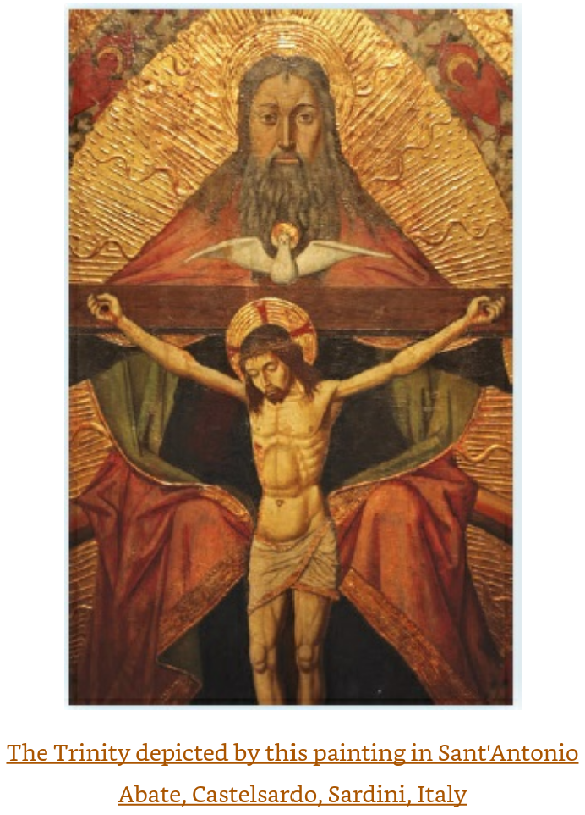

Slide 24
Election according to Paul
“Rethinking God’s People”
Paul’s second theological pillar
“Hello, Ladies and Gentiles!”

Slide 25
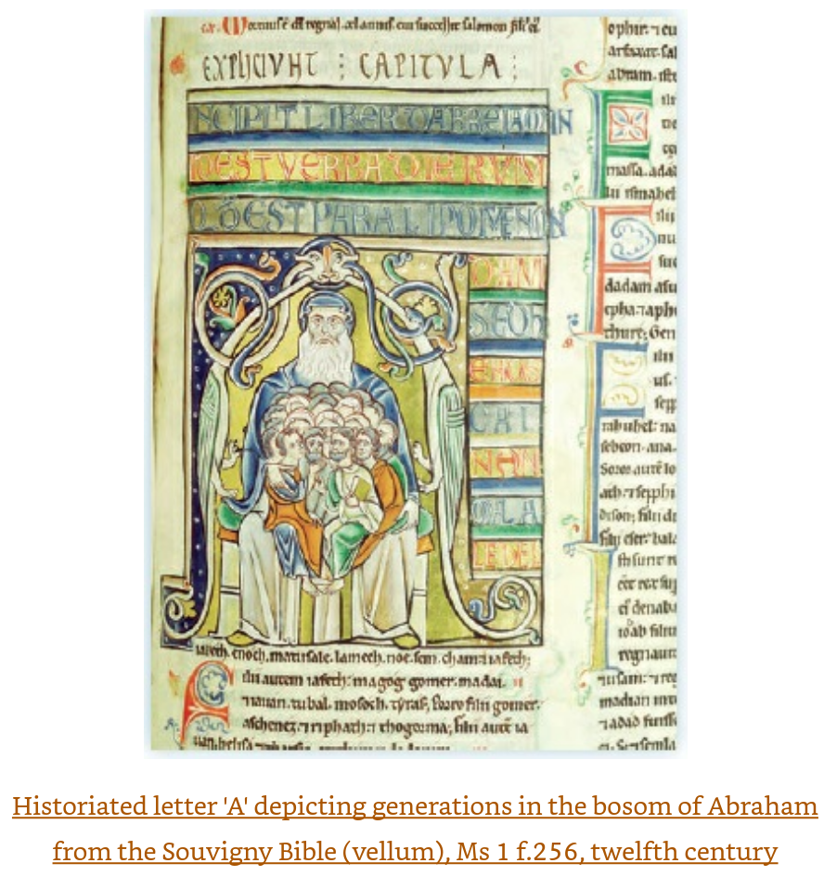

Slide 26
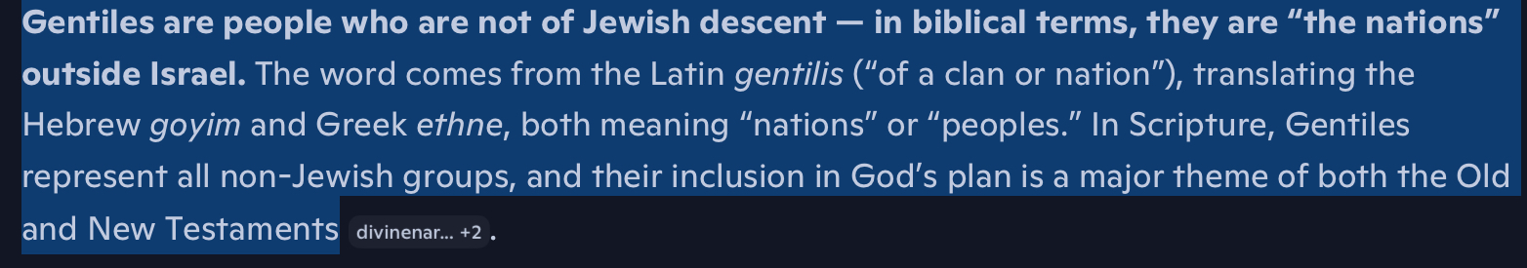

Slide 27
The Old Testament View of Election (God’s People)
The One God, the Creator:
  Called and chose Israel to be his special people
  Gave Isael the land to live in.
  Provided his Word (the Torah) to live by
God’s chosen people repeatedly failed to follow God’s commands
Because of God’s
Love
Adam’s Fall
Sodom
The Flood
Exile in Egypt
Disobedience in the Desert
Exile in Babylon
Leading To
Through all, a continued belief in God’s faithfulness and redemptive intent and power (e.g. Isaiah)

Slide 28
OT Views of the Future for God’s People
Psalm 2: Israel under its Messiah will smash the gentiles with a rod of iron.
--OR--
Others envisioned a redemption of Israel spreading to other nations. (e.g. the Hillelite tradition)
Somehow, God will redeem the whole world by either judging or blessing (or both) the gentiles.
God’s transformation of Israel would mean the transformation of the world by the rooting of evil out of the world.
Notes:
he Hillelites were followers of the Jewish sage Hillel the Elder, forming one of the two major schools of thought in early Rabbinic Judaism. They were known for their moderate, inclusive, and compassionate interpretations of Jewish law.
🕍 Origins and Identity
Hillel the Elder lived in the late 1st century BCE to early 1st century CE and was a leading Pharisaic scholar.
His followers formed the House of Hillel (Beit Hillel), which became a dominant force in shaping the Oral Torah and later Rabbinic Judaism.
They were often contrasted with the House of Shammai (Beit Shammai), led by Hillel’s contemporary, Shammai.
⚖️ Philosophical and Legal Approach
Leniency and Compassion: Hillelites generally favored more lenient and humane interpretations of Jewish law.
Inclusivity: They believed Torah should be taught to everyone, trusting that people would grow into worthiness.
Peace and Patience: Hillel himself was known for his gentle demeanor, and his school

Slide 29
Two Major Schools in Early Rabbinic Judaism
In the century before and after Christ:
Issue | Beit Hillel View | Beit Shammai View
Admission to Torah | Teach everyone | Only teach the worthy
Divorce | Allowed for trivial reasons (e.g., burnt meal) | Only for serious transgressions
Hanukkah candles | Light one candle first night, add one each night | Light eight first night, reduce each night
Bride’s appearance | Say all brides are beautiful | Do not lie about appearance
Tu Bishvat (New Year) | 15th of Shevat | 1st of Shevat

Slide 30
The OT Story: Why God Chose the People of Israel
“A matter of God’s love” (e.g. Deuteronomy)
Abraham was called to answer the problem of Adam / Babel: rebellion, arrogance, pride, fracturing (Genesis)
To become a royal nation of holy priests for the sake of the world.
A future when ‘sons of light’ would recapture ‘the glory of Adam’ (sectarians at Qumran)
The purpose of the exodus was to create a people who would deliver the human race from evil (Philo}
In short, God chose Israel to deal with the problem of evil but this did not happen and a Messiah was needed. -- Wright

Slide 31
Paul’s Reappropiation of Election
Paul strongly affirms Israel’s election and God’s faithfulness to it.
But God’s convenantal purpose in Israel had been accomplished through Jesus as Israel’s Messiah.
This is the Jewish view of election reworked to be around Jesus, his death, his resurrection, and his enthronement.
Most Jews of Paul’s day rejected Jesus, but God did not reject the Jewish people.

Slide 32
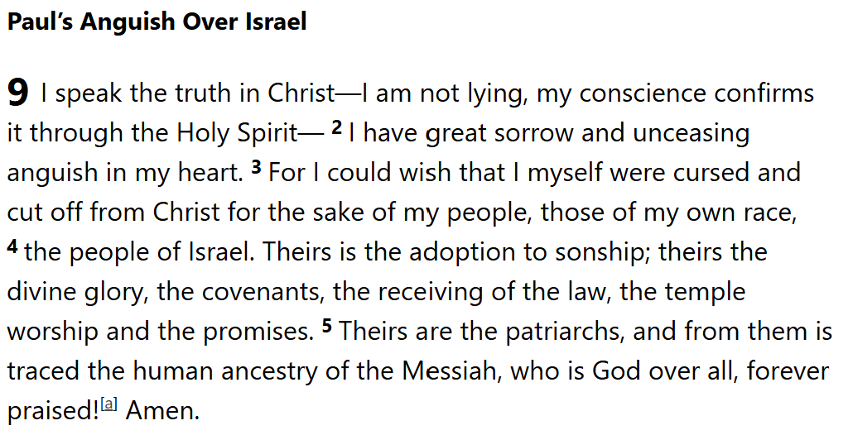
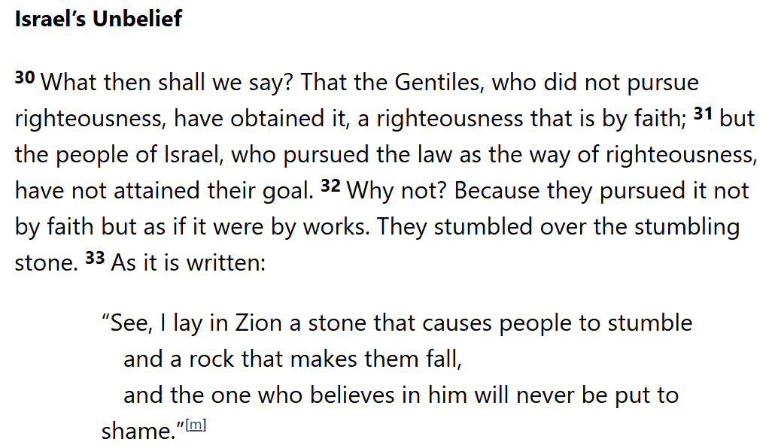
Romans Chap. 9-11 – Jews, Gentiles, Election

Slide 33
Paul Affirms that the Messiah Transformed the Boundaries of “God’s People”
Not ethnic, but eschatological
Not boundaries, but bountiful grace
Grace, not race
Promises, not paternity
Abraham’s family was chosen because of faith, and all the people of the world can inherit Abraham’s place through belief in Jesus.
Israel has been renewed, not replaced.
Israel has been expanded beyond ethnic and cultural limits, not superseded.
There is still hope for unbelieving Jews to embrace the Messiah.

Slide 34
Jesus incorporates God’s People into himself.
Jesus brought redemption, renewal, and life which was why Israel was chosen in the first place to do but could not. (Romans 3:21-6)
All those who believe, by faith and through the agency of the Spirit, are incorporated into the Messiah.
Philippians 3:4-12
If someone else thinks they have reasons to put confidence in the flesh, I have more: ⁵ circumcised on the eighth day, of the people of Israel, of the tribe of Benjamin, a Hebrew of Hebrews; in regard to the law, a Pharisee; ⁶ as for zeal, persecuting the church; as for righteousness based on the law, faultless.
⁷ But whatever were gains to me I now consider loss for the sake of Christ. ⁸ What is more, I consider everything a loss because of the surpassing worth of knowing Christ Jesus my Lord, for whose sake I have lost all things. I consider them garbage, that I may gain Christ ⁹ and be found in him, not having a righteousness of my own that comes from the law, but that which is through faith in^{[a]} Christ—the righteousness that comes from God on the basis of faith. ¹⁰ I want to know Christ—yes, to know the power of his resurrection and participation in his sufferings, becoming like him in his death, ¹¹ and so, somehow, attaining to the resurrection from the dead.
¹² Not that I have already obtained all this, or have already arrived at my goal, but I press on to take hold of that for which Christ Jesus took hold of me.

Slide 35
Election now means “Justification by Faith”
The fulfillment of the Old Testament covenant with the Jews has now taken place with the resurrection of Jesus.
God’s people now include those who are “justified by faith” by believing in Jesus rather than the observance of the Torah.
The day of redemption is now for those who believe, and they have received a righteous status (not a righteous character).
The wall separating Jews and Gentiles is torn down through the unity of justification by faith. This even makes Jewish dietary practices and circumcision unnecessary. (Galatians 2)
2 Corinthians 3: “You show that you are a letter from Christ, the result of our ministry, written not with ink but with the Spirit of the living God, not on tablets of stone but on tablets of human hearts.”

Slide 36
Eschatology – One Future for God’s People

Slide 37
OT Jewish Views of “God’s Future”
Eschatology varied among Jewish sects and over time, but included many of the ideas later reshaped by Jesus:
The “dark powers” of the pagan world will eventually be overthrown.
YHWH will come to dwell
Exile will end and/or there will be a new exodus.
Agriculture will yield abundantly
A new Davidic king will arrive
The dispersed tribes will return to Judea
Peace, the bestowal of God’s spirit, submission, conversion.
Resurrection of the dead
This future was seen as climax of the long story of God’s work

Slide 38
Paul Sees that the Messiah has already fulfilled some Jewish Hopes, but not yet others.
Prophecies fulfilled with Jesus’ Resurrection, Ascension
Revealed God’s Righteousness
Ended Israel’s exilic curse
Died as a sacrifice for sins
Delivered believers to the divine reign
Won the victory over evil
His resurrection began the general resurrection of the dead
Install a human as co-regent of the universe
The Spirit remains with us to transform us from slavery to sonship.
Prophecies not yet realized—still in the future
(The world was/is continuing in wickedness and evil, including the ignorance of God, idolatry, sin, and political oppression.)
The ‘Day of the Lord’ will come to complete the work he already started
Jesus will return with his royal presence (parousia) and appearing (epiph aneia)
Jesus will bring judgment on all of creation.
All of creation will be restored to be free of evils and imperfections.

Slide 39
Paul Sees Jesus as the Messiah who is Fulfilling God’s Promising now and later
Prophesies already fulfilled by the Messiah
For Paul, the various elements of Jewish hope for the future were accomplished through Jesus’ death and would be completed at his return.

Slide 40
Paul: The ‘End’ had already arrived in Jesus.
Prophesies already fulfilled by the Messiah
Jesus is the pre-promised messianic deliverer who had come to Israel and revealed God’s saving righteousness
Romans 1:3-4: “…concerning his Son, who was descended from David^{[b]} according to the flesh ⁴ and was declared to be the Son of God in power according to the Spirit of holiness by his resurrection from the dead, Jesus Christ our Lord, ”
Romans 15:8-9: “ For I tell you that Christ became a servant to the circumcised to show God's truthfulness, in order to confirm the promises given to the patriarchs, ⁹ and in order that the Gentiles might glorify God for his mercy. As it is written,
“Therefore I will praise you among the Gentiles,
and sing to your name.”

Slide 41
Jesus’ Death ended Israel’s Exilic Curse
Prophesies already fulfilled by the Messiah
Galatians 3:13
“Christ redeemed us from the curse of the law by becoming a curse for us, for it is written:’ Cursed is everyone who is hung on a tree.’”

Slide 42
Christ Died as a Sacrifice for Sins
Prophesies already fulfilled by the Messiah
For example, Romans 8:3-4
“For what the law was powerless to do because it was weakened by the flesh, God did by sending his own Son in the likeness of sinful flesh to be a sin offering. And so he condemned sin in the flesh, in order that the righteous requirement of the law might be fully met in us, who do not live according to the flesh but according to the Spirit.”

Slide 43
Jesus Transferred Believers from Darkness to the Devine Reign
Prophesies already fulfilled by the Messiah
For example, Colossians 1:13-14
“ For he has rescued us from the dominion of darkness and brought us into the kingdom of the Son he loves, ¹⁴ in whom we have redemption, the forgiveness of sins.”

Slide 44
Christ Won the Victory over Evil
Prophesies already fulfilled by the Messiah
Galatians 1:3-4
“Grace and peace to you from God our Father and the Lord Jesus Christ, ⁴ who gave himself for our sins to rescue us from the present evil age, according to the will of our God and Father”
1 Corinthians 15:54-6
When the perishable has been clothed with the imperishable, and the mortal with immortality, then the saying that is written will come true: “Death has been swallowed up in victory.”^{[h]}
⁵⁵ “Where, O death, is your victory?
Where, O death, is your sting?”^{[i]}
⁵⁶ The sting of death is sin, and the power of sin is the law. ⁵⁷ But thanks be to God! He gives us the victory through our Lord Jesus Christ.

Slide 45
The “Day of the Lord”
Prophesies yet to be fulfilled when Christ returns
This is a redefinition of the OT‘day of ‘YHWH.’
Paul distinguished the present day fulfillment from the future day in which the work would be completed and the creator would be ‘all in all’
²⁰ But Christ has indeed been raised from the dead, the firstfruits of those who have fallen asleep. ²¹ For since death came through a man, the resurrection of the dead comes also through a man. ²² For as in Adam all die, so in Christ all will be made alive. ²³ But each in turn: Christ, the firstfruits; then, when he comes, those who belong to him. ²⁴ Then the end will come, when he hands over the kingdom to God the Father after he has destroyed all dominion, authority and power. ²⁵ For he must reign until he has put all his enemies under his feet. ²⁶ The last enemy to be destroyed is death. ²⁷ For he “has put everything under his feet.”^{[c]} Now when it says that “everything” has been put under him, it is clear that this does not include God himself, who put everything under Christ. ²⁸ When he has done this, then the Son himself will be made subject to him who put everything under him, so that God may be all in all.
– 1 Corinthians 15:20-28

Slide 46
Parousia – Jesus’ Royal Presence on Return
Prophesies yet to be fulfilled when Christ returns
Paul used parousia to mean that Jesus will appear again and be present as opposed to absent from the world. Parousia was used to describe a royal visitation, such as a visit from a Roman emperor.
1 Thessalonians 3:13: ³ May he strengthen your hearts so that you will be blameless and holy in the presence of our God and Father when our Lord Jesus comes with all his holy ones.
“This is the focal point of the final hope for God to rescue his people, not by whisking them up to heaven as in the Platonic view of immortal souls being rescued from hopeless bodies, but by transforming the present creation, including believers still alive at the time, and by raising his people from the dead.” (Wright, N. T.; Bird, Michael F.. The New Testament in Its World: An Introduction to the History, Literature, and Theology of the First Christians (p. 391). Zondervan Academic. Kindle Edition. )

Slide 47
The Judgment of Creation
Prophesies yet to be fulfilled when Christ returns
Romans 2:1: You, therefore, have no excuse, you who pass judgment on someone else, for at whatever point you judge another, you are condemning yourself, because you who pass judgment do the same things. ² Now we know that God’s judgment against those who do such things is based on truth. ³ So when you, a mere human being, pass judgment on them and yet do the same things, do you think you will escape God’s judgment?
Romans 2:12-16: All who sin apart from the law will also perish apart from the law, and all who sin under the law will be judged by the law. 13 For it is not those who hear the law who are righteous in God’s sight, but it is those who obey the law who will be declared righteous. 14 (Indeed, when Gentiles, who do not have the law, do by nature things required by the law, they are a law for themselves, even though they do not have the law. 15 They show that the requirements of the law are written on their hearts, their consciences also bearing witness, and their thoughts sometimes accusing them and at other times even defending them.) 16 This will take place on the day when God judges people’s secrets through Jesus Christ, as my gospel declares.

Slide 48
The Renewal of All of Creation
Prophesies yet to be fulfilled when Christ returns
God created an imperfect world out of his love, that it could respond to God’s creative power and love in worship and praise.
This is what a newly restored creation entails:
It will be filled with God’s glory, knowledge, breath, life, spirit.
All obstacles (and enemies) will be overcome through the divine love poured out in the death of Jesus. God’s people will be ‘more than able’ to ‘overcome all obstacles.’
Romans 8:35-37
³⁵ Who shall separate us from the love of Christ? Shall trouble or hardship or persecution or famine or nakedness or danger or sword? ³⁶ As it is written:
“For your sake we face death all day long;
we are considered as sheep to be slaughtered.”^{[j]}
³⁷ No, in all these things we are more than conquerors through him who loved us.

Slide 49
Paul’s Enduring Legacy
Paul’s theological vision calls for a united community of Jews and Gentiles worshiping God through Jesus and empowered by the Spirit, embodying the new creation and continually engaging in theology to live out this identity.
The salvation of believers (Jews and Gentiles) is here now, already accomplished through Jesus.
The transformation of God’s people is made through the living Spirit with us.
All Creation will be restored on Jesus’ return thus giving all those in Christ a firm foundation for hope and assurance of God’s love.

