Slide 1
About Eastman:
An Engineer’s View of History
Tim Nolen, Engineering Leader and Fellow
July 2012

Slide 2
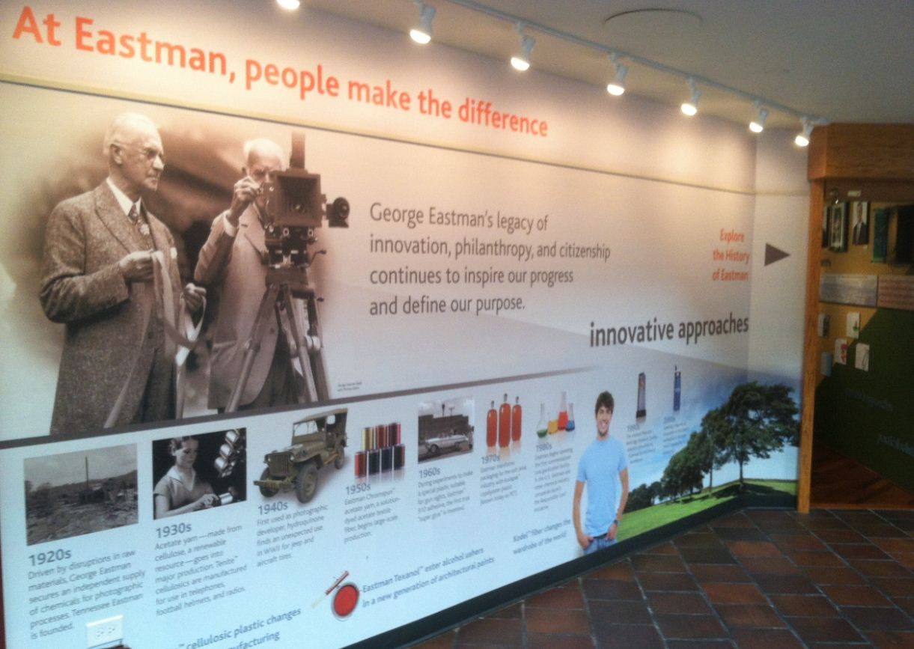
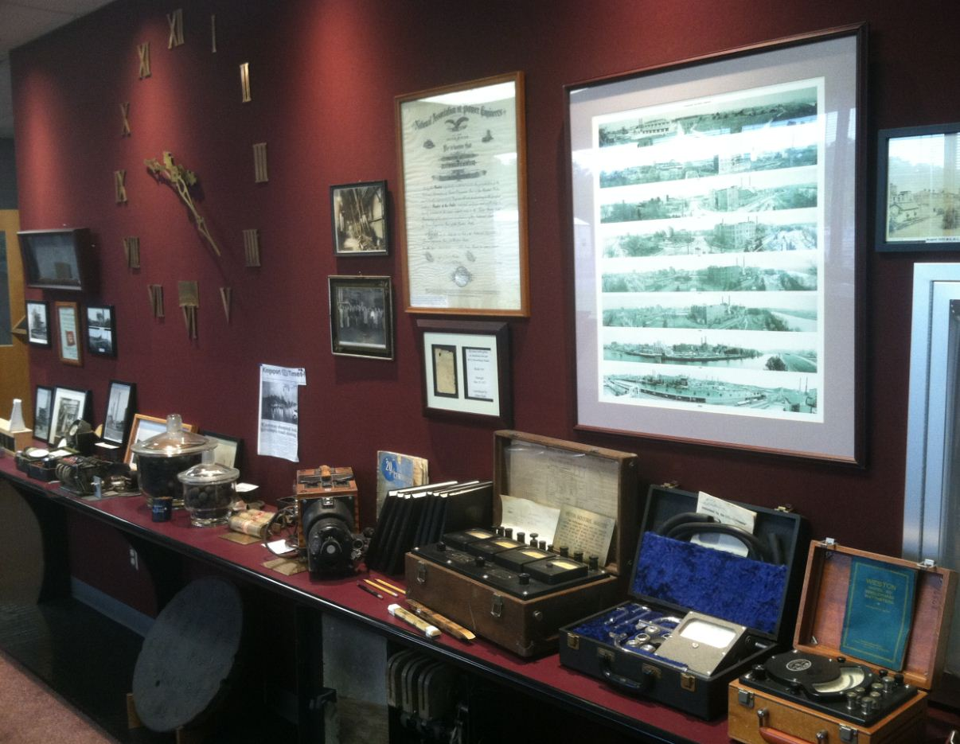
Eastman History
Resources
Eastman History Exhibit – B-310
Utilities History Exhibit – B-469
Eastman History Videos (3 on streaming media)
Eastman Timeline (online)
Eastman History Book: “Years of Glory. Times of Change” (1990s vintage)
Notes:
You can’t cover Eastman history in an hour. There are good resources available.

Slide 3
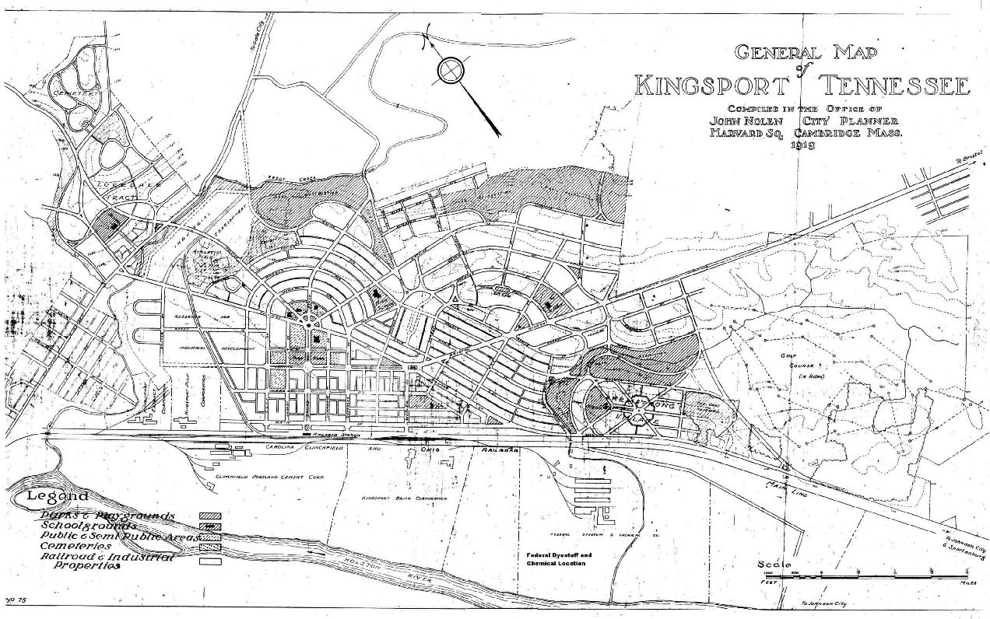
Kingsport had a vision to become an industrial town.
Notes:
Kingsport was created by the Kingsport Development Company who hired famous Boston city planner John Nolen to design the city. People like J. Fred Johnson and John B. Dennis recruited industry for the new town, including a Wood Distillation Company and the Federal Dyestuff and Chemical (on the site of the current Eastman Credit which was formed during WWI. After the war, prices fell and both failed. That led to the search for companies that might need a supply of methanol. George Eastman visited and was convinced to buy the wood distillation site.

Slide 4
Kodak Needed Materials
World War I interrupted commerce and George Eastman was determined to secure his supply.
Kingsport had a wood distillation plant, a willing spirit, and a new railroad.

Slide 5
Kodak needed and we delivered
Methanol
Cellulose acetate (safety film)
Hydroquinone
PET
Photographic chemicals
Notes:
Our technology engines were established because Kodak needed them for photographic films and chemicals.

Slide 6
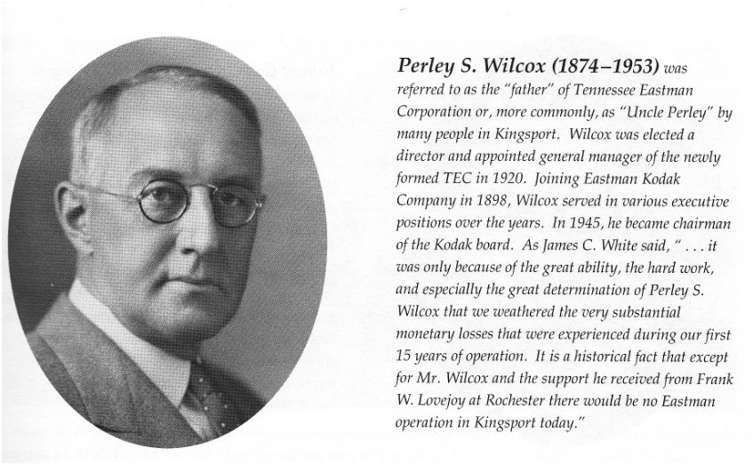
Eastman Chemical’s True Founding Father: Perley Wilcox

Slide 7
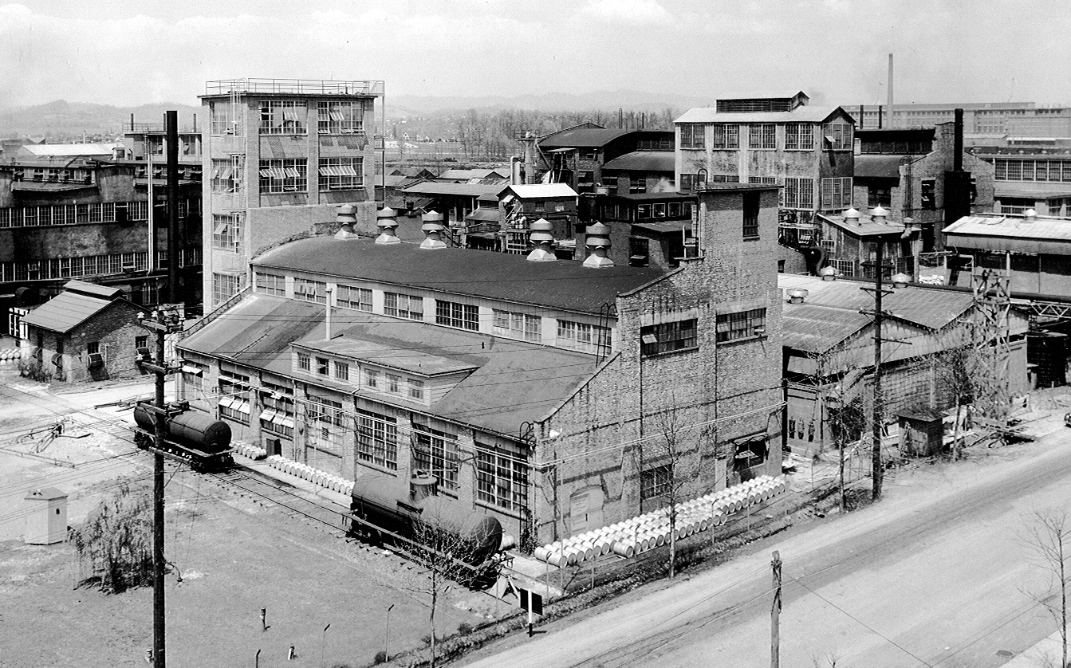
Wood Distillation provided methanol and acetic acid. Building 3 and plant in 1929.
Notes:
The early plant lost money until 1932. It was making commodities at a small scale. The remedy was to add scale and new products to provide for a profitable enterprise.

Slide 8
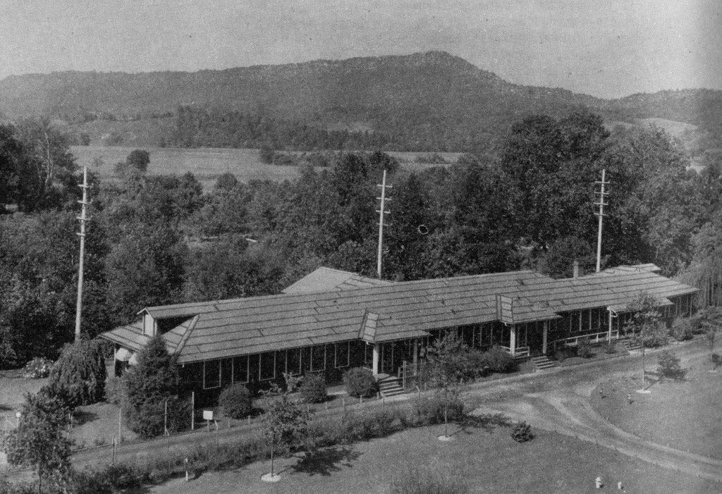
Building 1: Administration
Top of Bays Mountain: Logged for the trees
Notes:
Building 1 was near where Eastman Road (then called Horse Creek Road) crossed the Holston River.

Slide 9
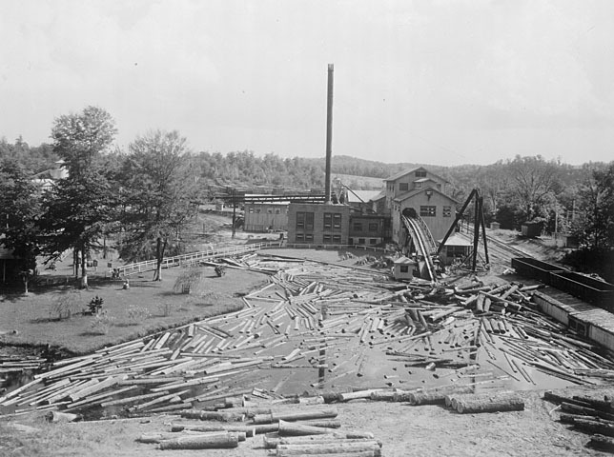
Sawmill devours ever more wood
Band sawmill operated between 1927 and 1945
Sawmill location occupied today by tow warehouse between B-150 and B-162
White farmhouse is today research pilot plant area
Log Pond fed by “Hales Branch” which today is submerged near Konnarock and Lincoln street and runs under corner of B-150C to NW corner of B-162
Notes:
Eastman built a larger sawmill in 1927 to achieve economy of scale to try to make a profit. The power plant at the mill ran 2/3 on wood and 1/3 on coal.

Slide 10
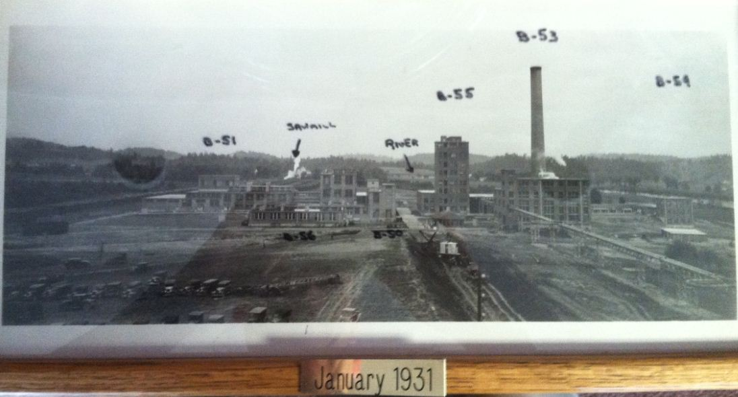
From the TNO Utilities Division Archives
Notes:
B-53 is the first coal boiler. These initial buildings show Eastman’s foray into make cellulose acetate. The old wood distillation buildings are behind and to the right of the photographer.

Slide 11
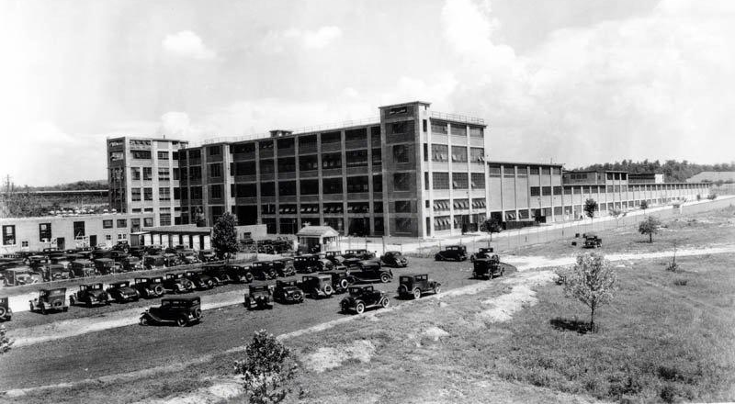
Adaptation: Cellulose acetate for textile fibers, not just safety film
Yarn plant, B-70, 1932. It’s still in operation today!
Today, you can get a Chik-fil-a.
Henry Ford: Any color you want, as long as it’s black.
Notes:
Expanding further into cellulose acetate fibers, we built our first yard plant, which is still in use today to make filter tow.

Slide 12
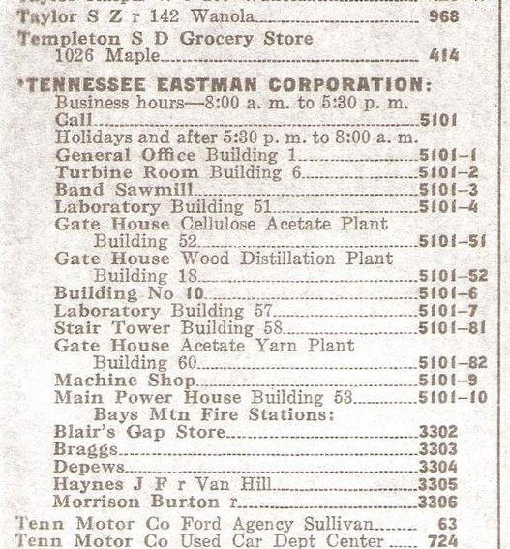
1933 Kingsport Phone Book

Slide 13
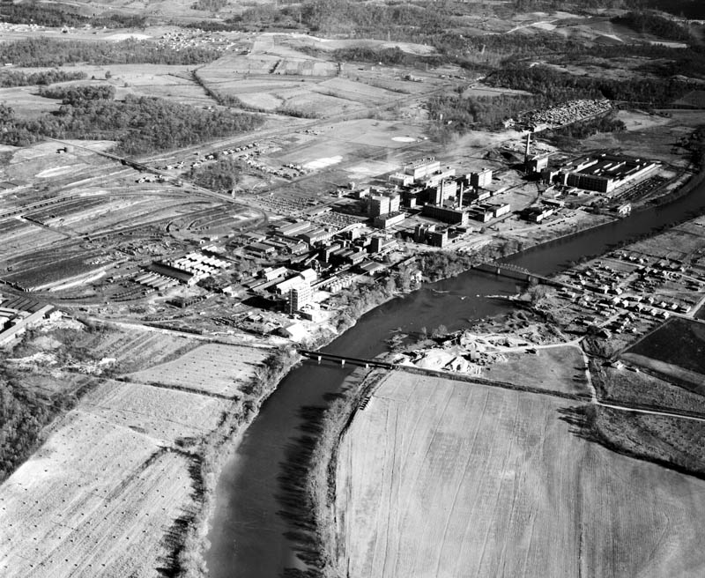
1939

Slide 14
1939 – Before the War
Hale’s Branch
saw mill and wood yard
Eastman Road
Baseball Field
B-83
Yarn plant
Edgewood Village
B-53
75
Retorts and distillation building
B-99
Notes:
B-99 is still under construction.

Slide 15
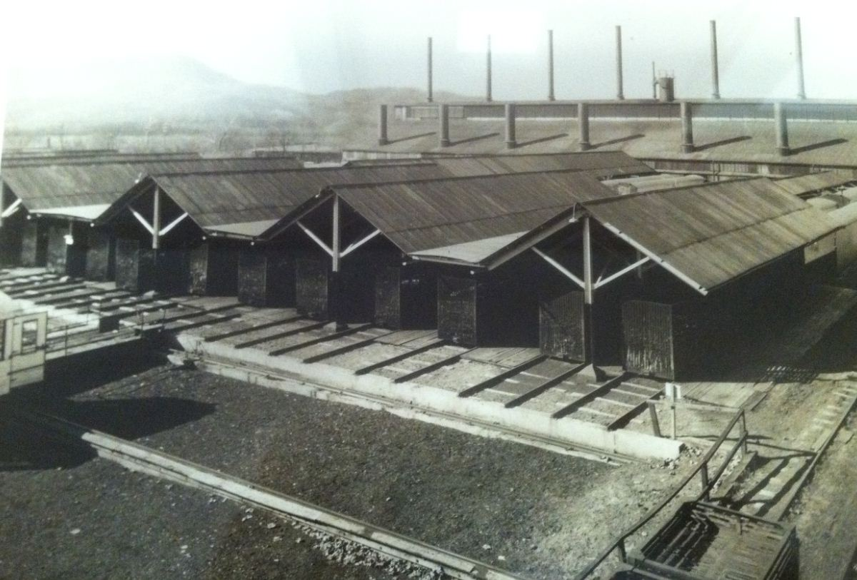
Acetic Acid and Methanol from Wood Distillation
Notes:
This is the larger wood, more efficient wood distillation unit we built to expand with the larger saw mill. Note the wood feed system, which fills carts with wood that roll into retorts to be pyrolyzed. The vapors traveled inside the building where pyroligneous acid was condensed, and non-condensable gases were burned to provide energy for the process.

Slide 16
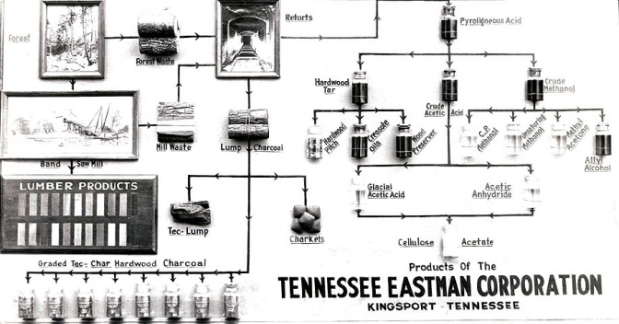
Wood distillation provided only 1 lb of methanol / acetic per 6 lb of wood.
Notes:
This shows how we had to sell lumber and charcoal, and use lots and lots of wood! Eastman logged 40,000 acres to provide 200,000 tons/yr of wood. Even so, it only provided 2% of the acetyl production that coal gas does today. We couldn’t have grown much more based on a relatively low yield wood process.

Slide 17
Eastman’s new products in the 30’s and 40’s
Acetic acid cracking
Ethanol to acetic acid
Butanol to butyric acid
Tenite plastics
Acetate Staple Fiber
Acetate dyes
Triethyl phosphate
Isopropyl Acetate
HQ and derivatives
Eastman’s first profit was not realized until 1932.

Slide 18
Donald Othmer invented acid concentration process
Ph.D. in chemical engineering from U. of Nebraska in 1925.
Worked for Kodak in Rochester from 1927 to 1931.
Was professor at Brooklyn Polytechnic starting in 1932 (150 patents / 350 publications).
Collaborated with Raymond Kirk on Kirk-Othmer Encyclopedia of Chemical Industry.
Invested with Warren Buffett (also from Omaha) in the 1950s.
Died in 1995 with an estate worth $750 million.
He and his second wife Mildred had no children, and gave estate to many charitable organizations.

Slide 19
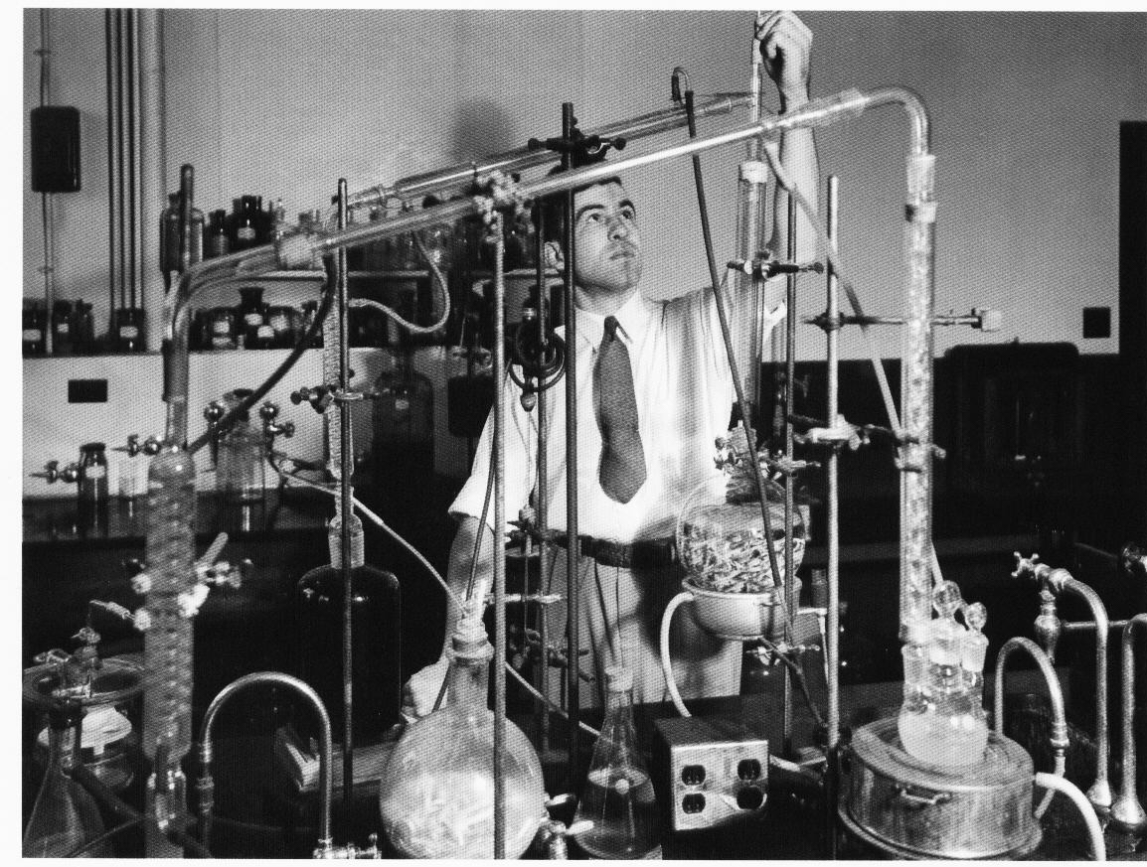
Donald Othmer in the 1940s
Worked for Kodak from 1927-1931. Invented Eastman’s Acid Concentration Process which enabled entire acetyl stream.
Notes:
Acid Con uses 20% of TNO steam load today. Othmer’s makes this feasible and enables the entire acetyl stream.

Slide 20
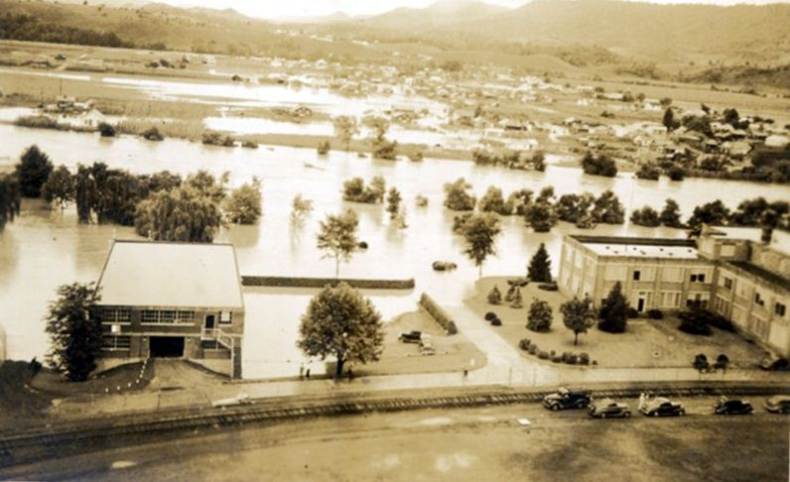
Long Island Flood of 1940
Ft. Patrick Henry Dam completed on October 27, 1953.
Notes:
Note the open windows of B-75 (no A/C) and that it only had two stories.

Slide 21
Tennessee Eastman Company Wins the War
Implemented U. Michigan process to make RDX, high explosive
Created Wexler Bend Pilot Plant to make RDX within 26 days of being asked by the government
Was contractor for atomic bomb Manhattan Project at Oak Ridge
Eastman employed 30,000 people at Oak Ridge and Holston Ordinance Works at height of effort(!)

Slide 22
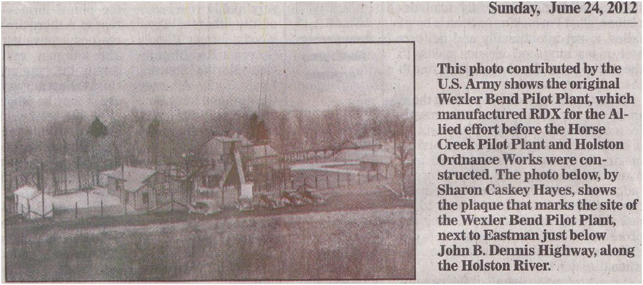
Produced first RDX in 26 days

Slide 23
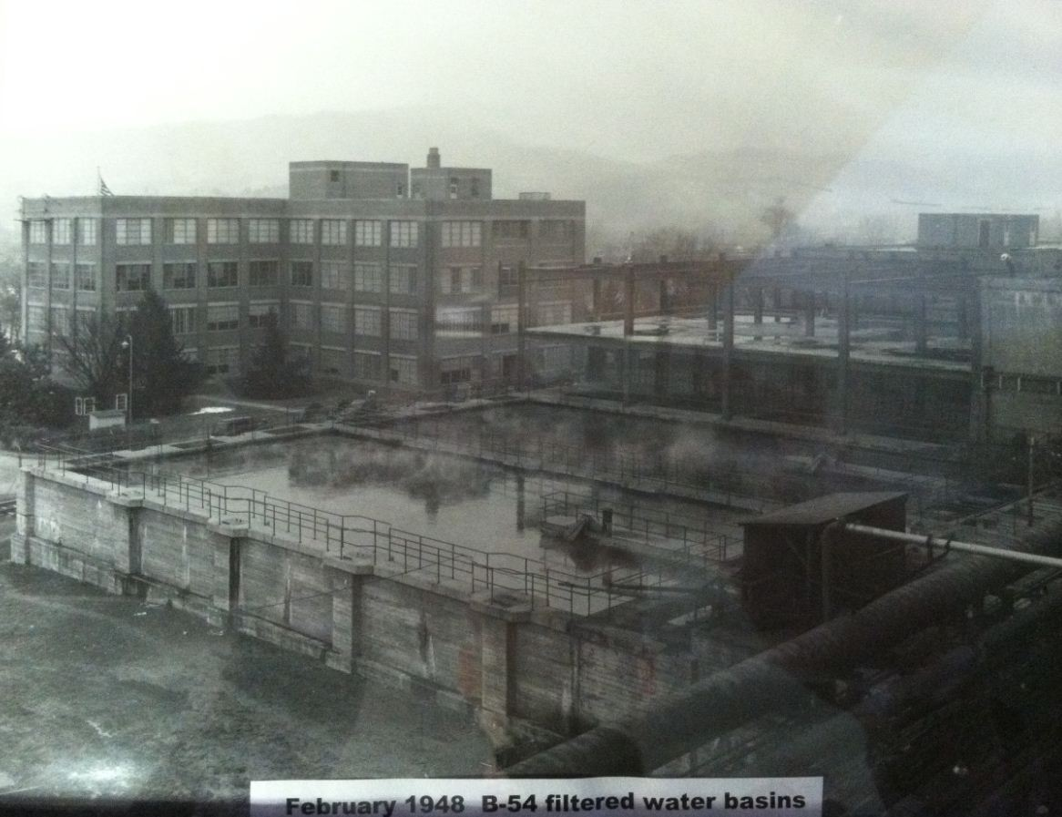
Notes:
B-75 doubled in size and we needed a big office building. B-54D was born on top of the filtered water basins.

Slide 24
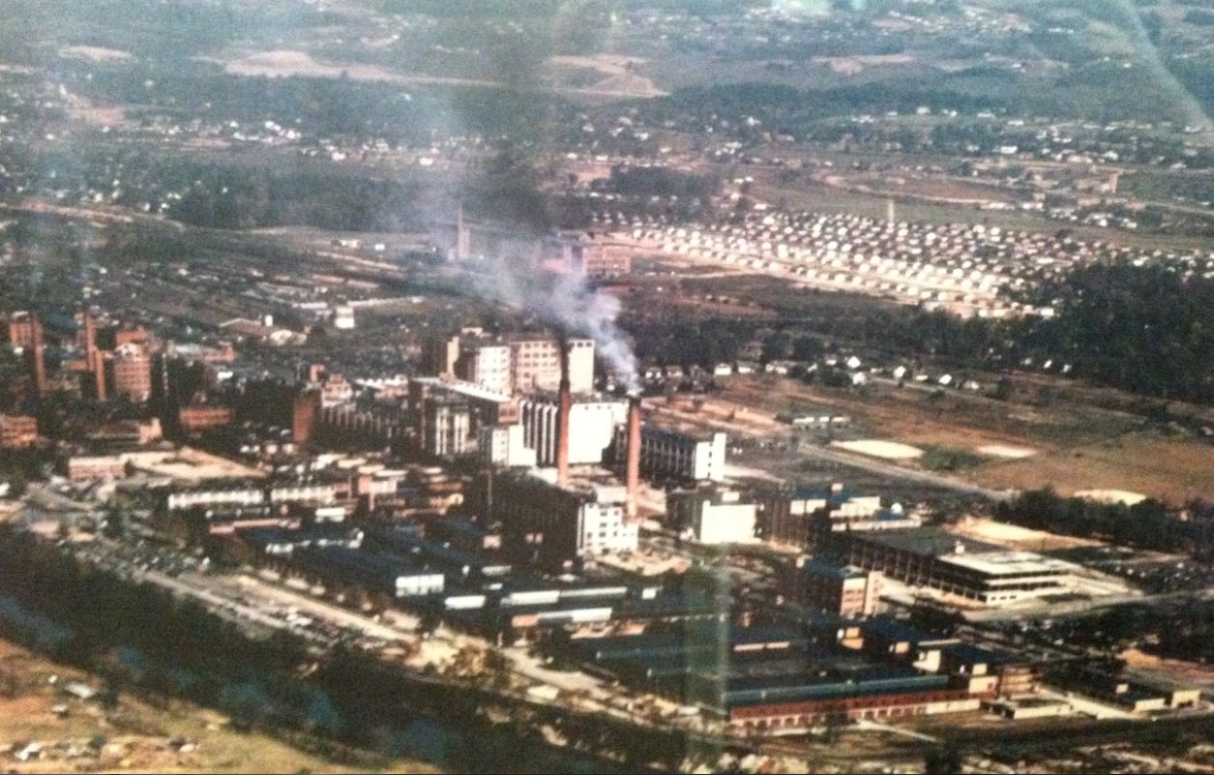
1948 – Yes, the world was in color
Notes:
B-83 has two stacks. Note the new neighborhood (no trees).

Slide 25
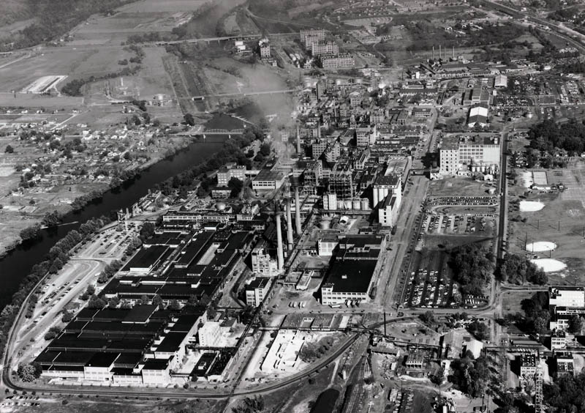
1955 – Golden Age of Manufacturing in America
Notes:
A poster-sized version of this photo hangs in B-310 lobby. Note B-102 (the second yarn plant). B-162 is under construction. The sawmill has been dismantled at lower right. Holston Defense Area A is at top. Future site of B-310 is a drive-in theater. B-83 power house now has three stacks (multiple boilers)

Slide 26
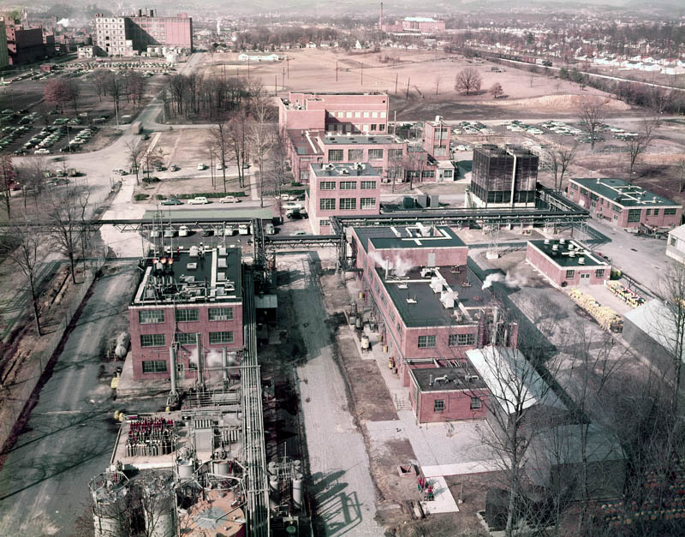
Picture: March 1955
Most elements of the Research Complex were established 1948-1952.
Notes:
Lincoln Street wasn’t built until the 1960s. The area around research was public streets. B-150A was added in 1960, and 150B in 1970.

Slide 27
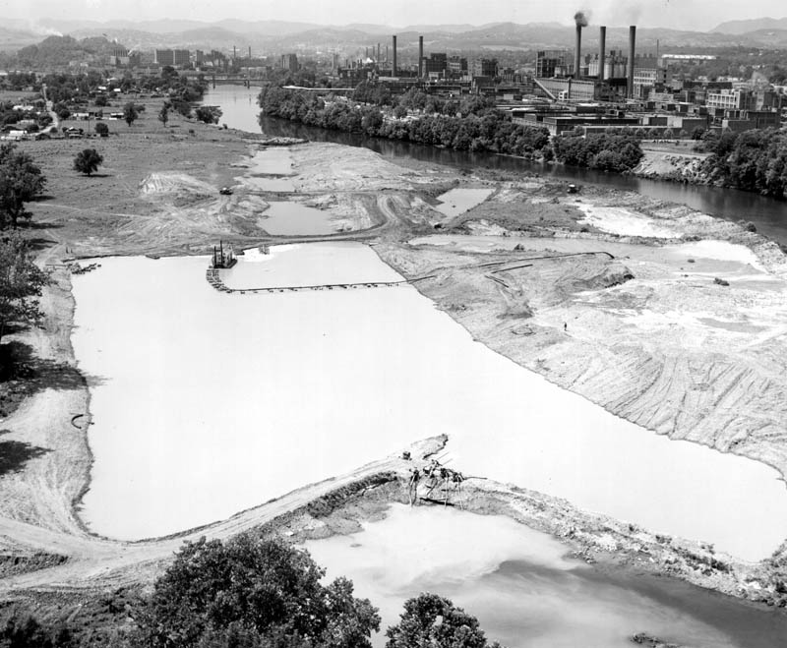
1958 We’d like the river over there, please.
Notes:
Why didn’t they just build a bridge and expand on Long Island?

Slide 28
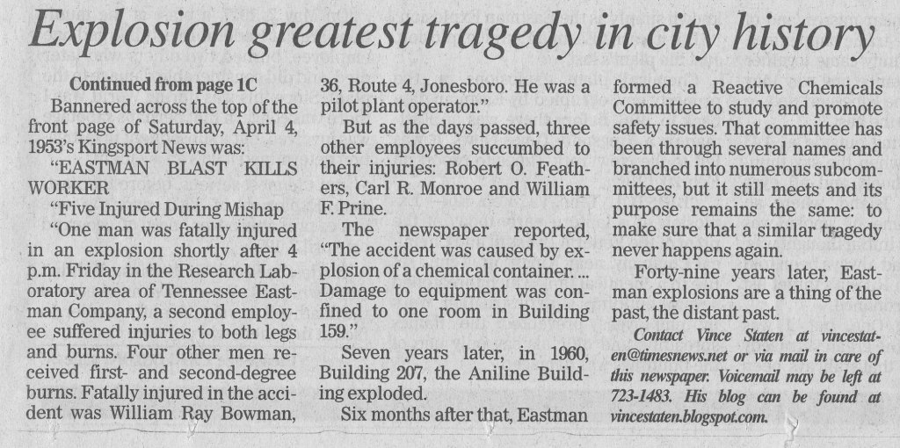
Growing Pains
April 4, 1953
  Explosion in B-159 in research – Four employees killed
Kingsport Times-News, Oct. 4, 2009

Slide 29
Growing Pains
October 4, 1960
Explosion in Aniline plant, B-207, 16 employees killed

Slide 30
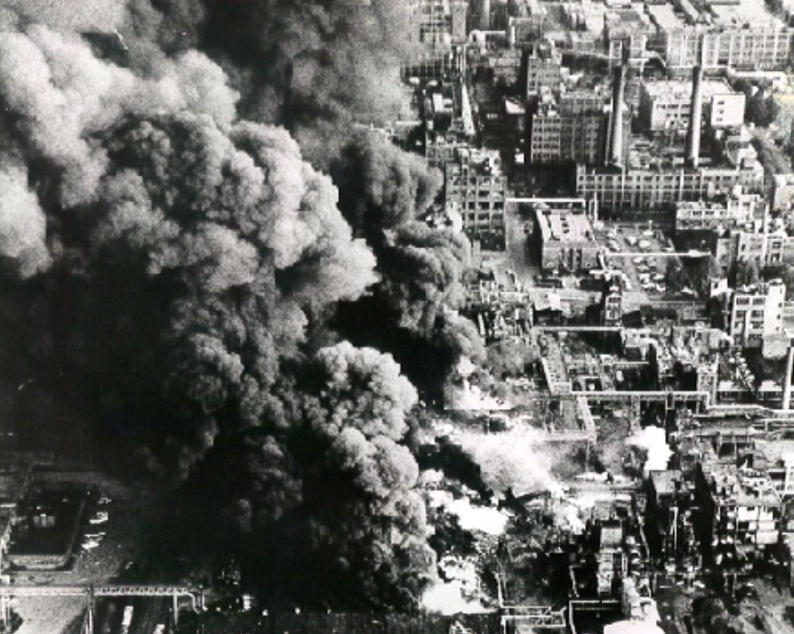
B-207 Aniline plant
exploded Oct. 4, 1960
killing 16

Slide 31
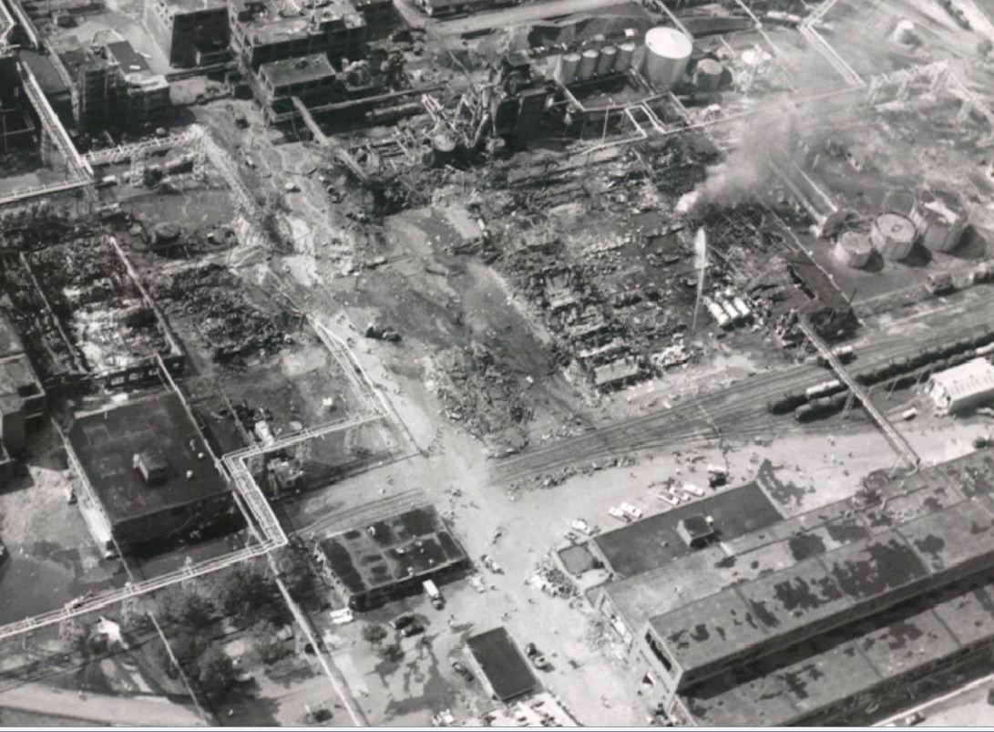
Crater
Future location
of B-231

Slide 32
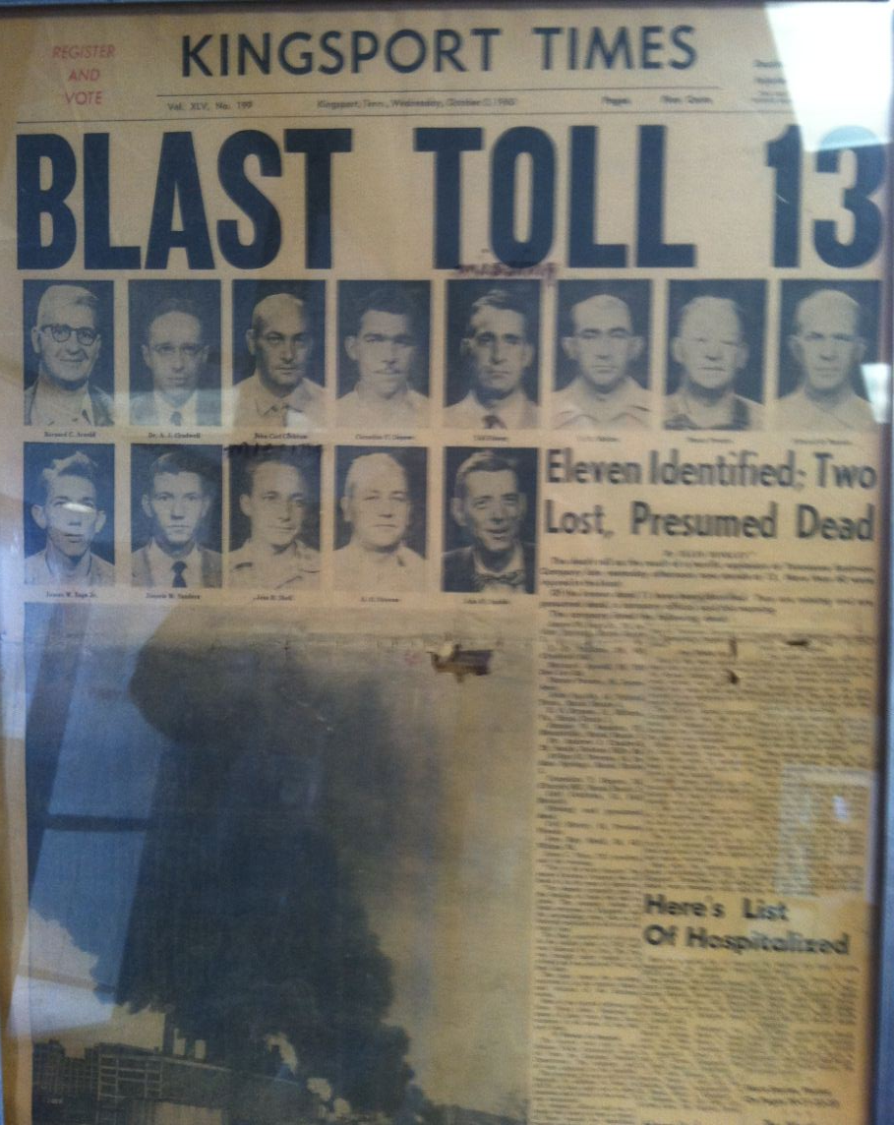
Oct. 5, 1960 – Displayed in B-469
Notes:
The good news is that this led to major changes and the institution of the Process Safety Committee, which continues today.

Slide 33
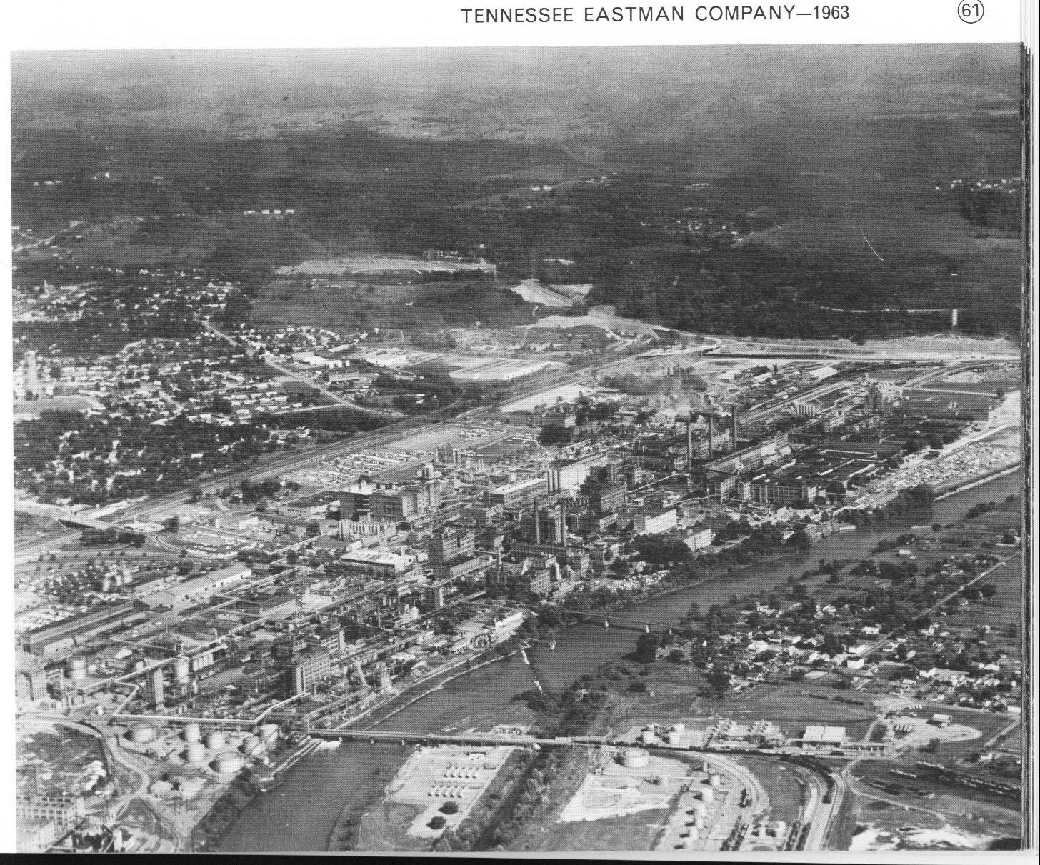
Notes:
Polymers division appears! DMT plant and B-226 PET plants. Lincoln Street and John B. Dennis Highway are under construction.

Slide 34
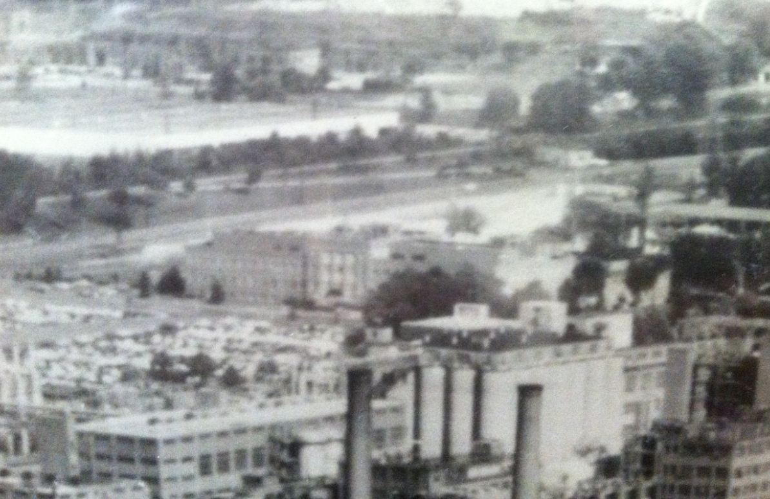
Research Building 150, 150A in 1965

Slide 35
Adaptation / Innovation in Acetyls

Slide 36
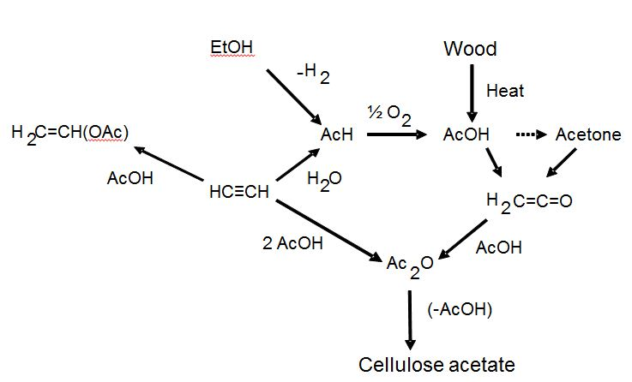
Acetyls Adaptation / Innovation
Before 1950
Eastman
1930s
Credit: Joe Zoeller

Slide 37
Acetyls Adaptation / Innovation
Before 1950
Eastman
1940s-50s
Credit: Joe Zoeller

Slide 38
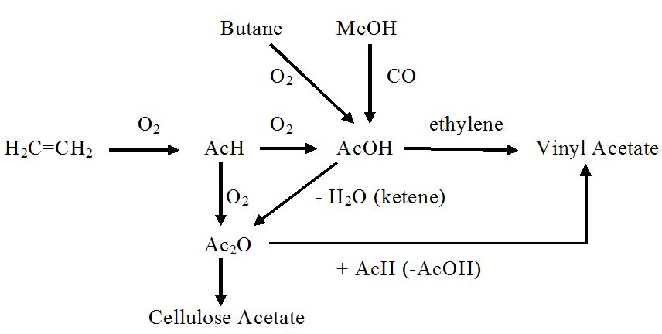
Acetyls Adaptation / Innovation
1970
Eastman
1950s-1991
Credit: Joe Zoeller

Slide 39
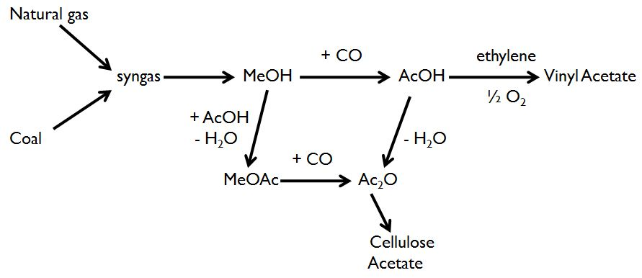
Acetyls Adaptation / Innovation
Today
Eastman Today
Coal Gas Phase II
1991 eliminated
need to use
acetaldehyde to
make acetic acid
Credit: Joe Zoeller

Slide 40
Adapting Acetyls
1930 – cellulose acetate for safety film
1931 – cellulose acetate for textiles
1932 – cellulose acetate for plastics
1938 – cellulose acetate butyrate
1952 – filter tow for cigarette filters
On and on to other applications in coatings and films

Slide 41
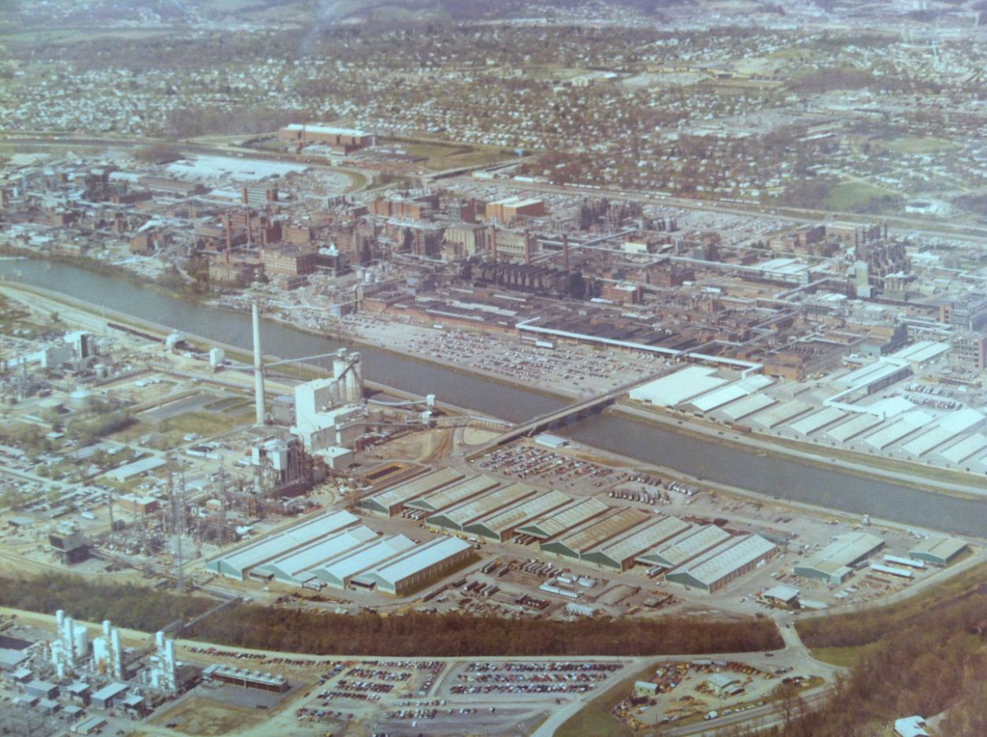
1983 – Coal Gas (Phase I) Starts Up
Notes:
Note the trees in the neighborhoods, the expanded DMT and polymers operations, B-253 powerhouse, and B-325 powerhouse, and coal gas.

Slide 42
Adaptation / Innovation in Polyester

Slide 43
The Dawn of Polyester
Polyethylene Terephthalate was developed at ICI in the 1930s.
DuPont and Eastman produced it during WWII as a nylon substitute to meet war demand.
After the war, DuPont licensed PET to Eastman for use as film base
Eastman licensed PET bottle patents from DuPont and made its first PET for bottles in 1979.
Eastman ended production of PET fibers for textiles in 1993.
Eastman sold the PET business in 2011.

Slide 44
Polyester Adaptation / Innovation
Got into fibers for war production (1940s)
Adapted PET as film base for Kodak (1950s)
Developed TPA / DMT processes (1950s)
Built two EG plants at Texas in the 1960s to integrate
Changed TPA chemistry in the early 1980s to avoid acetyladehyde-to-acetic acid co-production
Adopted direct esterification of TPA (PTA)
Created Integrex™ technology for esterification (2000s)
Built iso-phthalic acid plant in the late 1990s
Created co-polyesters to build specialty plastics business

Slide 45
Provista
Durastar
Tritan™
Embrace
Eastar
EB062
Eastar
PETG
6763
Eastar
PCTG
5445
Spectar
Cadence
Credit: Eric Moskala

Slide 46
What have we done lately at Tennessee Operations?

Slide 47
What have we built lately in Kingsport?
1983 – New hydroquinone plant with improved chemistry
1991 – Coal gas phase II for more acetic anhydride
1992 – Primester JV for cellulose acetate flake
1998 – Isophthalic acid plant
1998 – New World Headquarters B-280B,C
1998 – Research expansion, B-150C
1990s – CHDA plant (1990s)
1990s – Liquid Phase Methanol Plant
2011 – TMCD for Tritan™
2012 – Perennial Wood Demonstration Plant
2012 – New Cellulose Triacetate Plant
Plus lots of expansions and infrastructure projects

Slide 48
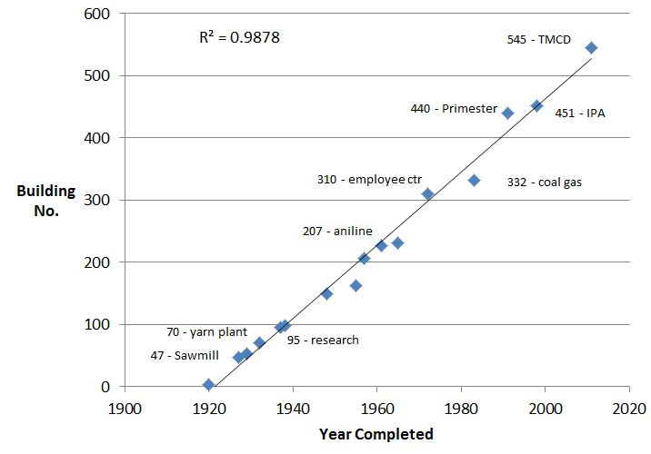
Increase in building numbers in time is a straight line
Notes:
Most expansion occurs through adding onto existing buildings (e.g. 280B, C) Amazing that we are still creating new buildings at the same rate over our entire history.

Slide 49
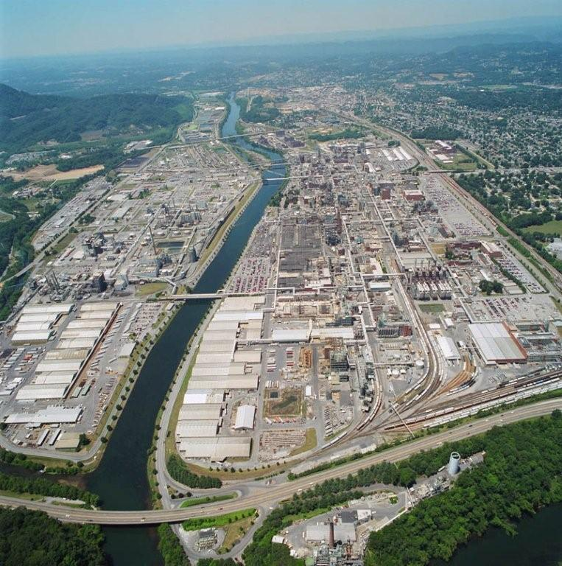

Eastman Kingsport, TN
“An integrated site”
5 Manufacturing Divisions
Hundreds of chemicals, fibers, and plastics produced
~7,000 Eastman Employees
> 1,000 Contract Employees
>500 buildings and ~4,000 acres of land (main plant occupies ~900 acres)
~90% power & 100% steam internally produced
~165MW avg. electrical use
Hundreds of Commercial Products | >650
Billions of lbs of Sales Volume | ~4,700
Energy Input
Power & Steam Production
Major Steam Distribution
Major Furnaces or Stacks
Representative OUTPUT
Chemical Production Plants
Fibers Production Plants
Plastics Production Plants
Credit: Ron Sheppard
Notes:
Replacement cost (to build entire site) is would be about $10 Billion today. This is what you get from 92 years of investing $200 million / yr.

Slide 50
A Few Words About
Texas Operations (TXO)
(a.k.a. Texas Eastman)

Slide 51
After WWII, TEC wanted to integrate back to raw materials
Longview, Texas was selected because of
  East Texas Oil Field
  Sabine River
  Two Railroads
  Strong Labor Force
Plant site is 6,000 acres!
Artificial lake with thermal dam provides cooling water

Slide 52
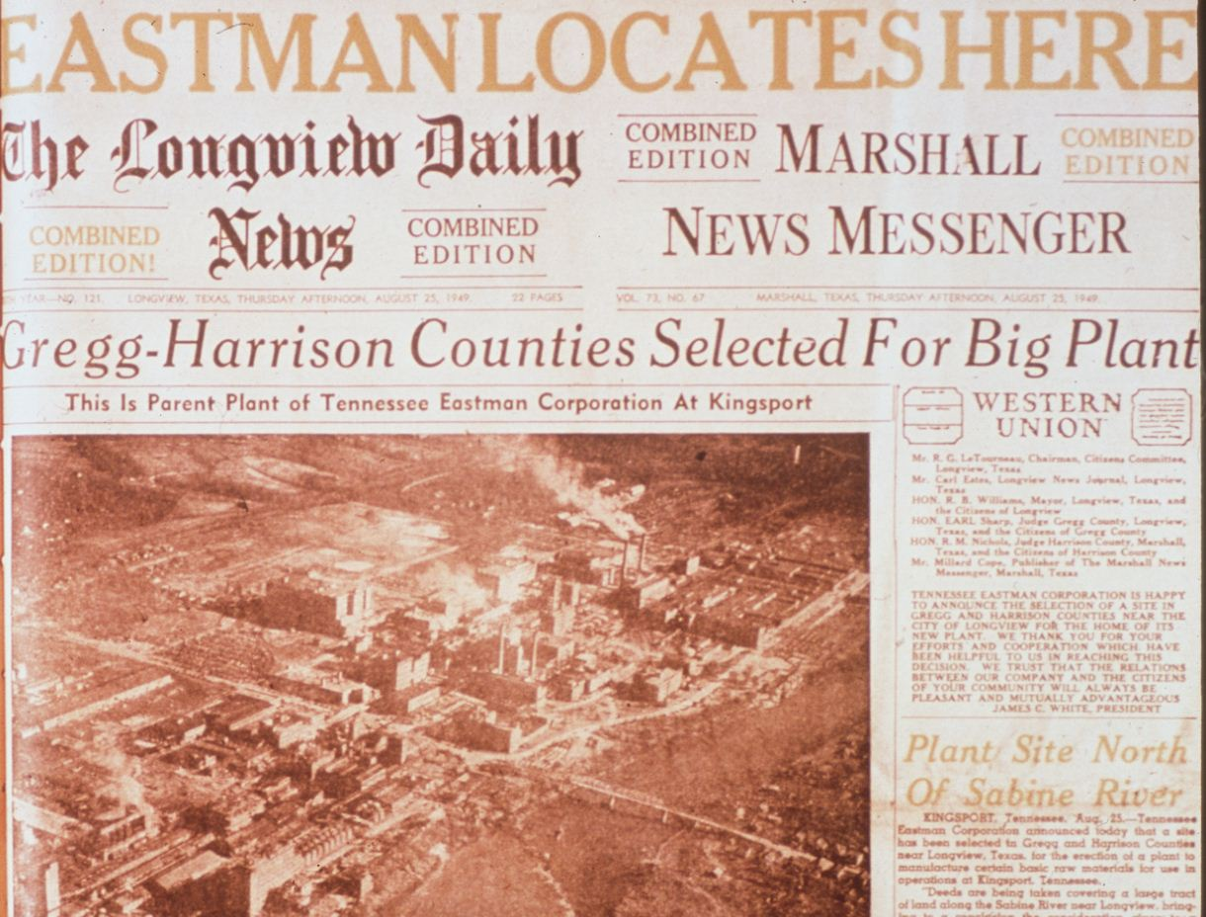

Slide 53
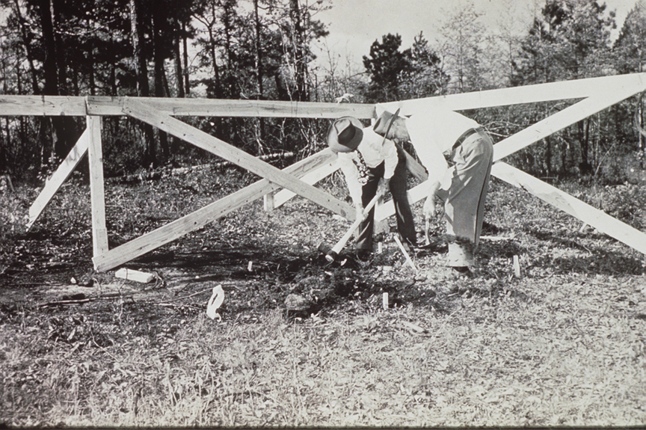
Texas Eastman Groundbreaking March 23, 1950
Notes:
Two decades after the oil was discovered, Eastman announced that it would build a chemical plant in East Texas.
Groundbreaking took place on a 6,000 acre site south of Longview in March of 1950. There was no support structure in place. Everything had to be built from scratch. This was true green field site.

Slide 54
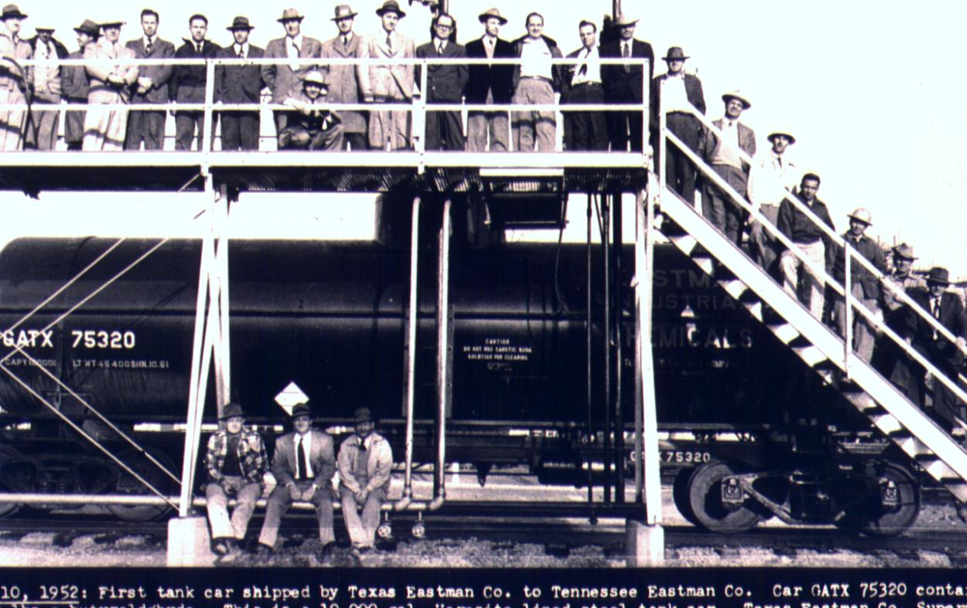
First Product Shipped
March 10, 1953
Notes:
Two years after groundbreaking, we shipped our first railcar of product.

Slide 55
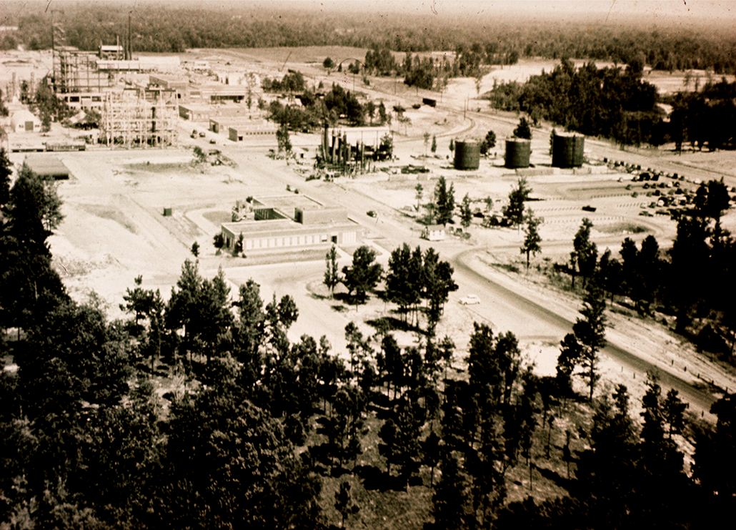
Texas Eastman 1952
250 Employees
Notes:
We began construction of our site a couple of months later. At that time employment was about 250 people. The plan was to build a hydrocarbon cracking plant to produce olefins using feedstocks from the East Texas Oil Field. In addition, a few small olefin derivative plants were built to produce aldehydes, alcohols and polyethylene.

Slide 56
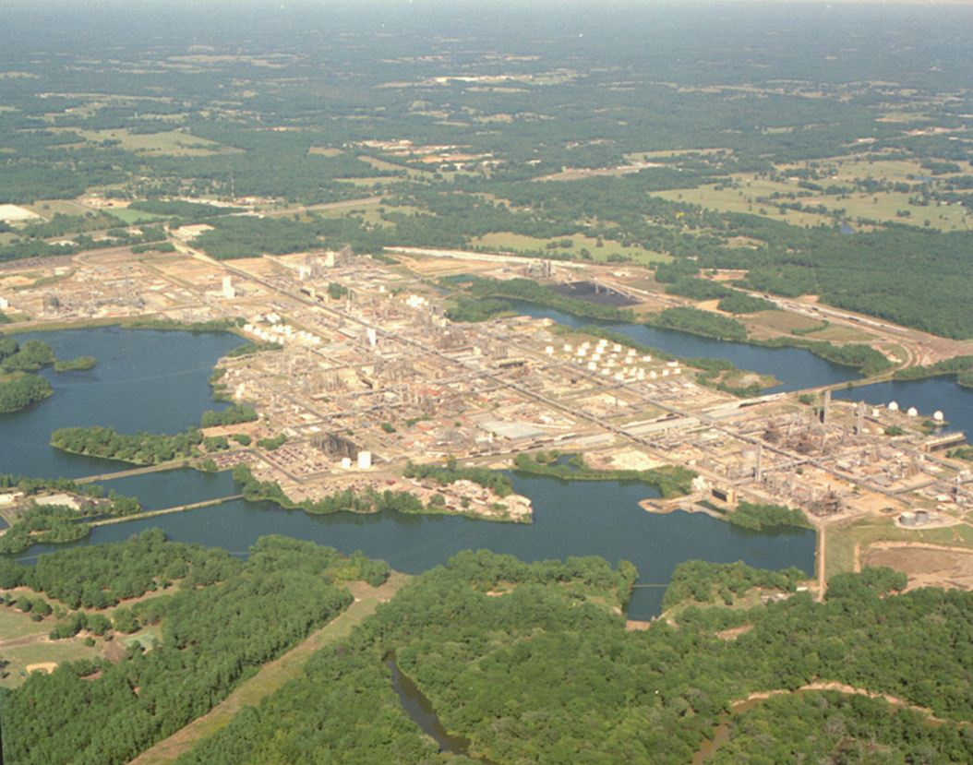
Texas Operations - Today
~1,600 Employees
> 40 Chemicals and Plastics
~ 4 Billion Pounds/year
  Olefins
  Polyolefins
  Alcohols
  Aldehydes
  Solvents
  Resins
  Other Chemicals
Notes:
We've steadily expanded and grown over the past 57 years to the facility shown here today; however, we've stayed true to our original purpose of producing olefins and olefin derivative chemicals. We currently have about 1,600 employees and we produce over 40 different organic chemicals and plastics. Last year, we shipped almost 4 billion pounds of products from this site.

Slide 57



Longview, Texas
6000 acres
First production 1953
1600 employees
40 products
4 Billion lb/yr
Olefins
Polyolefins
Alcohols
  Aldehydes
  Solvents
  Resins
  Other Chemicals
Boilers
Cooling Towers
1 mile
Cogen
Instrument Air
Once Through
Cooling Water
Pump Stations
Once Through
Cooling Water
Cracking Plants
Bldg 52
Boiler house
&
Demin. Plant

Slide 58


Beyond Kodak:
Eastman Chemical grows up and leaves home Jan. 1, 1994

Slide 59
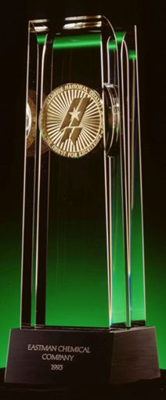
Triumph! Eastman spins free of Kodak on Jan. 1, 1994!
Kodak facing tough future—returning to core
Eastman Chemical fortunate to get independence with headquarters in Kingsport
We also got billions in debt, but profits boomed in 1995 and we survived.
We won the Malcolm Baldridge National Quality Award in 1993—but we survived anyway!

Slide 60
Life Before and After Kodak
Before the spin
US chemical industry grows faster than GDP
Focus is on organic growth – building plants
Kodak business necessity establishes core
Kodak strength helps ECD weather cycles
Kodak provides corporate identity and functions
After the spin
US chemical industry matures
Acquisitions, divestitures more prominent
Eastman must define its own core
Eastman must deal with stockholders
Eastman must establish new identity and corporate functions

Slide 61
ECD Homegrown Plant Sites Peaked in 1981
In 1981:
TEC (Kingsport), est. 1920 – 12,500 employees
TEX (Longview), est. 1950 – 2600 employees
CEC (Columbia, SC), est. 1967 – 2000 employees
ARK (Batesville, AR), est. 1977 – 600 employees

Slide 62
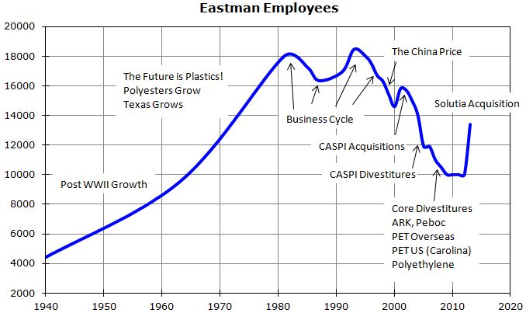
Life on our own is tough in a maturing and globally competitive industry
Notes:
To be fair, U.S. manufacturing employment overall shows the exact same trends. Since the 1970s, output has risen more slowly than productivity, so employment has declined.

Slide 63
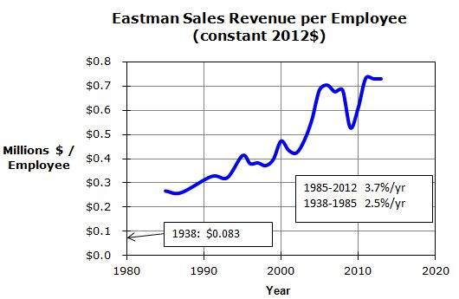
Productivity has marched ever upward
Notes:
Incredible productivity gains through our history are because of better chemistry, better processes, large scales, and information technology.

Slide 64
Why don’t we like commodities?
Legacy of Kodak – Technology and market differentiation provide higher, more stable profits
Commodities require stripped down, low cost organization
The two models don’t mix well in the same company

Slide 65

The Winning Formula – What is working
Expanding the core – Build on strengths
  Chemistry
  Chemical engineering
  Operational excellence
Acquiring More!
  Add compatible businesses
  Differentiated technology and products

Slide 66
The Winning Formula – What is working
Expanding the core
  Fibers growth in Asia (production and sales there)
  Plasticizers – World leader enhanced by acquisitions (Genovique, Sterling Chemicals, internal growth)
  Specialty Plastics – Building on co-polyesters with new monomer
  Expanding Oxo chemicals for rising demand with advantaged Longview position
  Expanding cellulose esters for new applications at high margins
  Acetylated Wood
Acquiring More!
  Solutia – major increase in industry position, complementary but expanded portfolio, high margins
  Small Technology acquisitions to aid growth projects

Slide 67
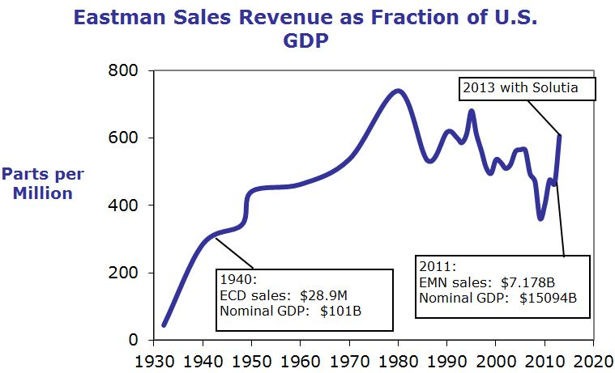
Solutia will help maintain Eastman’s Prominence in the US Economy
Notes:
Solutia is an important step to get us back to 600 ppm!

Slide 68

Eastman – 92 Years Old, Strong Profitable Core, and Financial Resources for Balanced Growth
18 years as independent Fortune 500 public company headquartered in Kingsport.
Continuing to invest in existing plant sites and in newly acquired ones
Solutia acquisition helps us to stay independent and integrated
Notes:
There is still tremendous opportunity. (Inscription from Ross Hall, Auburn University)

Slide 69
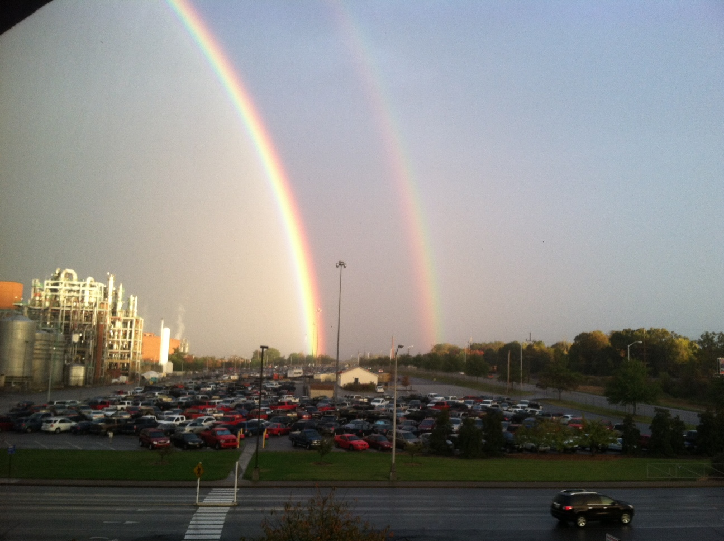
Notes:
The pot of gold is at B-280!

